Slide 1
Clustering Countries for Climate Action (SDG 13)
One-line: Cluster countries by emissions & energy indicators to inform targeted climate policy.
Notes:
Intro: Explain the goal and relevance to SDG 13.

Slide 2
Problem & Opportunity
Problem: Global emissions are heterogeneous; one-size-fits-all policies fail. Opportunity: Unsupervised ML reveals country groups for tailored interventions.
Notes:
Give concrete examples: coal-heavy countries vs renewable leaders.

Slide 3
Approach
Data: Our World in Data — CO2 & GHG metrics (open). Method: K-Means clustering on normalized indicators; PCA for visualization.
Notes:
Mention features used: CO2 per capita, renewables share, fossil subtypes.

Slide 4
Key Findings (Example)
• 4 clusters with policy implications • Cluster A: High per-capita emissions, fossil-heavy • Cluster B: Middle emissions, mixed sources • Cluster C: Low emissions, high renewables
Notes:
Add real cluster examples after running the notebook.

Slide 5
Next Steps & Ethics
Next steps: validate with GDP, NDCs; create maps/dashboards. Ethics: Avoid penalizing developing countries; focus on finance & tech transfer.
Notes:
Highlight fairness, data gaps, and stakeholder engagement.

Slide 6
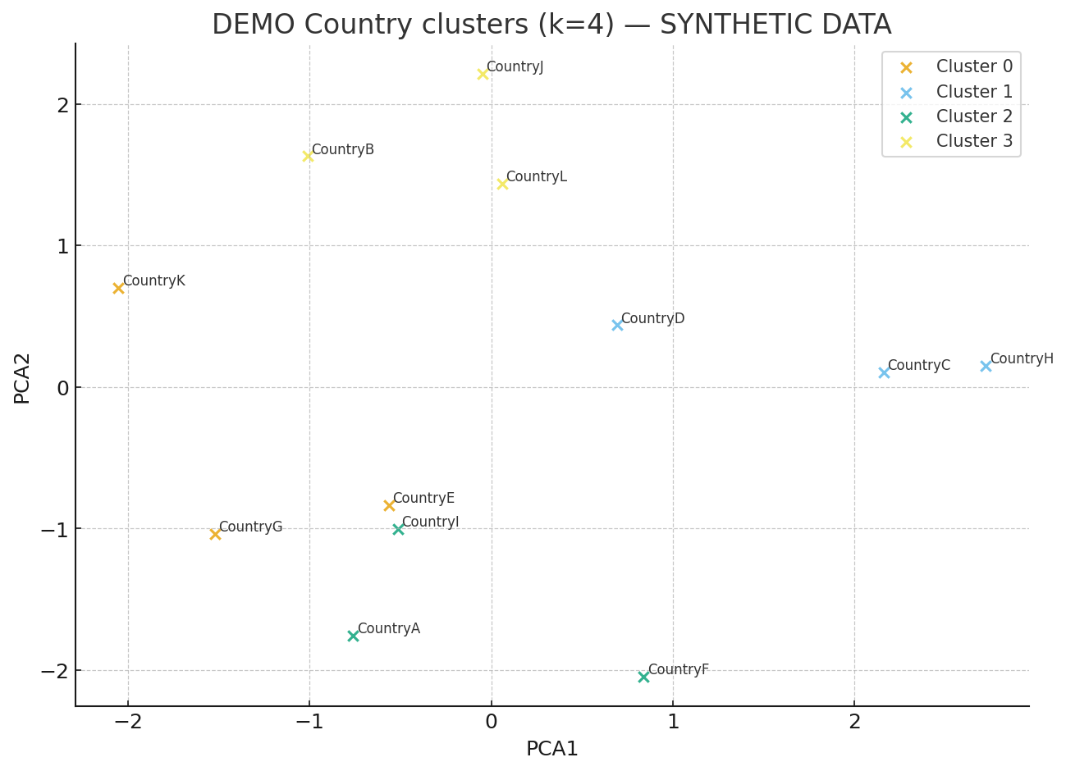
DEMO: PCA Cluster Plot (synthetic)

Slide 7
DEMO: Cluster sample countries
Cluster 0: CountryE, CountryG, CountryK
Cluster 1: CountryH, CountryC, CountryD
Cluster 2: CountryI, CountryA, CountryF
Cluster 3: CountryL, CountryB, CountryJ

