Slide 1
SAM simétrico y asimétrico
Elio Campitelli

Slide 2
—

Slide 3
title: “Title Goes Here”

Slide 4
author:

Slide 5
- Myfirstname Mylastname:

Slide 6
email: fl@oneplace.edu

Slide 7
institute: [UofO]

Slide 8
correspondence: true

Slide 9
- Yourfirstname Yourlastname:

Slide 10
email: fl@another.edu

Slide 11
institute: [UofA]

Slide 12
correspondence: false

Slide 13
institute:

Slide 14
- UofO: University of One Place

Slide 15
- UofA: University of Another Place

Slide 16
date: “25 June, 2020”

Slide 17
output:

Slide 18
bookdown::word_document2:

Slide 19
fig_caption: yes

Slide 20
reference_docx: “../templates/template.docx” # Insert path for the DOCX file

Slide 21
pandoc_args:

Slide 22
- –lua-filter=../templates/scholarly-metadata.lua

Slide 23
- –lua-filter=../templates/author-info-blocks.lua

Slide 24
- –lua-filter=../templates/pagebreak.lua

Slide 25
bibliography: references.bib

Slide 26
csl: “../templates/journal-of-archaeological-science.csl” # Insert path for the bib-style

Slide 27
abstract: |

Slide 28
Text of abstract

Slide 29
keywords: |

Slide 30
keyword 1; keyword 2; keyword 3

Slide 31
highlights: |

Slide 32
These are the highlights.

Slide 33
—

Slide 34
Keywords:
Highlights:

Slide 35
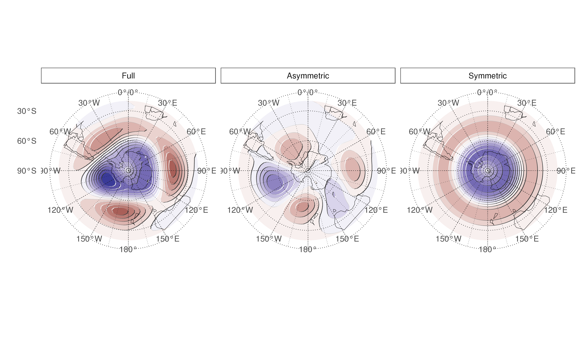
Spatial patterns of the first EOF of 700 hPa geopotential height. Full field (left), zonally asymmetric component (middle) and zonally symmetric component (right). Arbitrary units.

Slide 36
Introduction

Slide 37
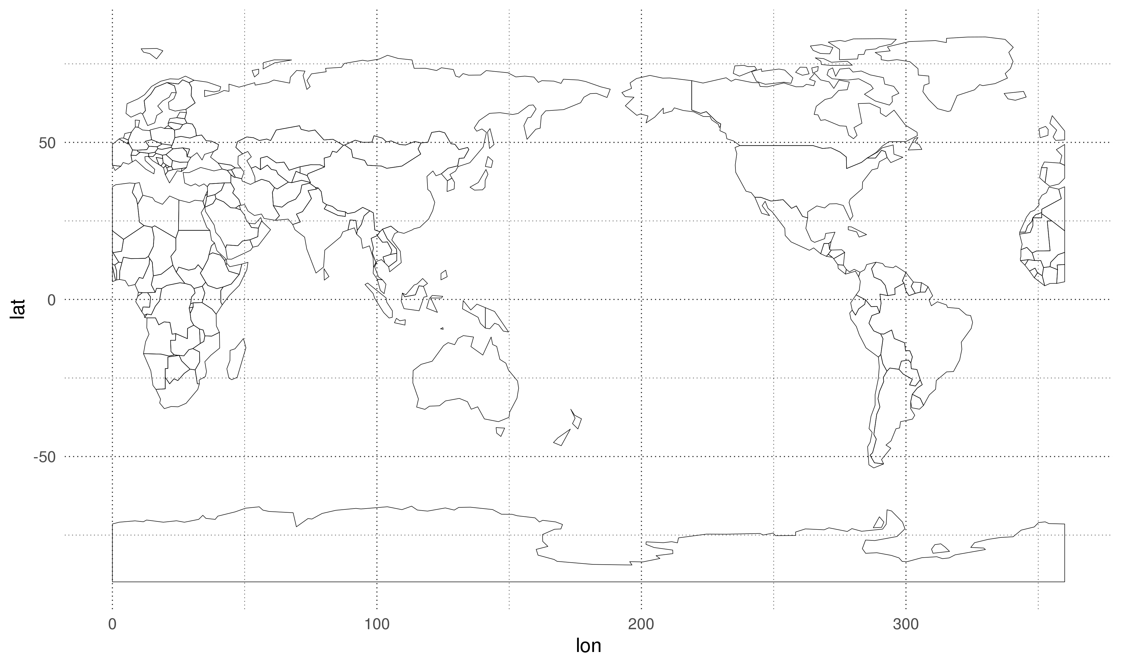

Slide 38
Here is a citation [@Marwick2017]

Slide 39
Background

Slide 40
Methods

Slide 41
Results

Slide 42
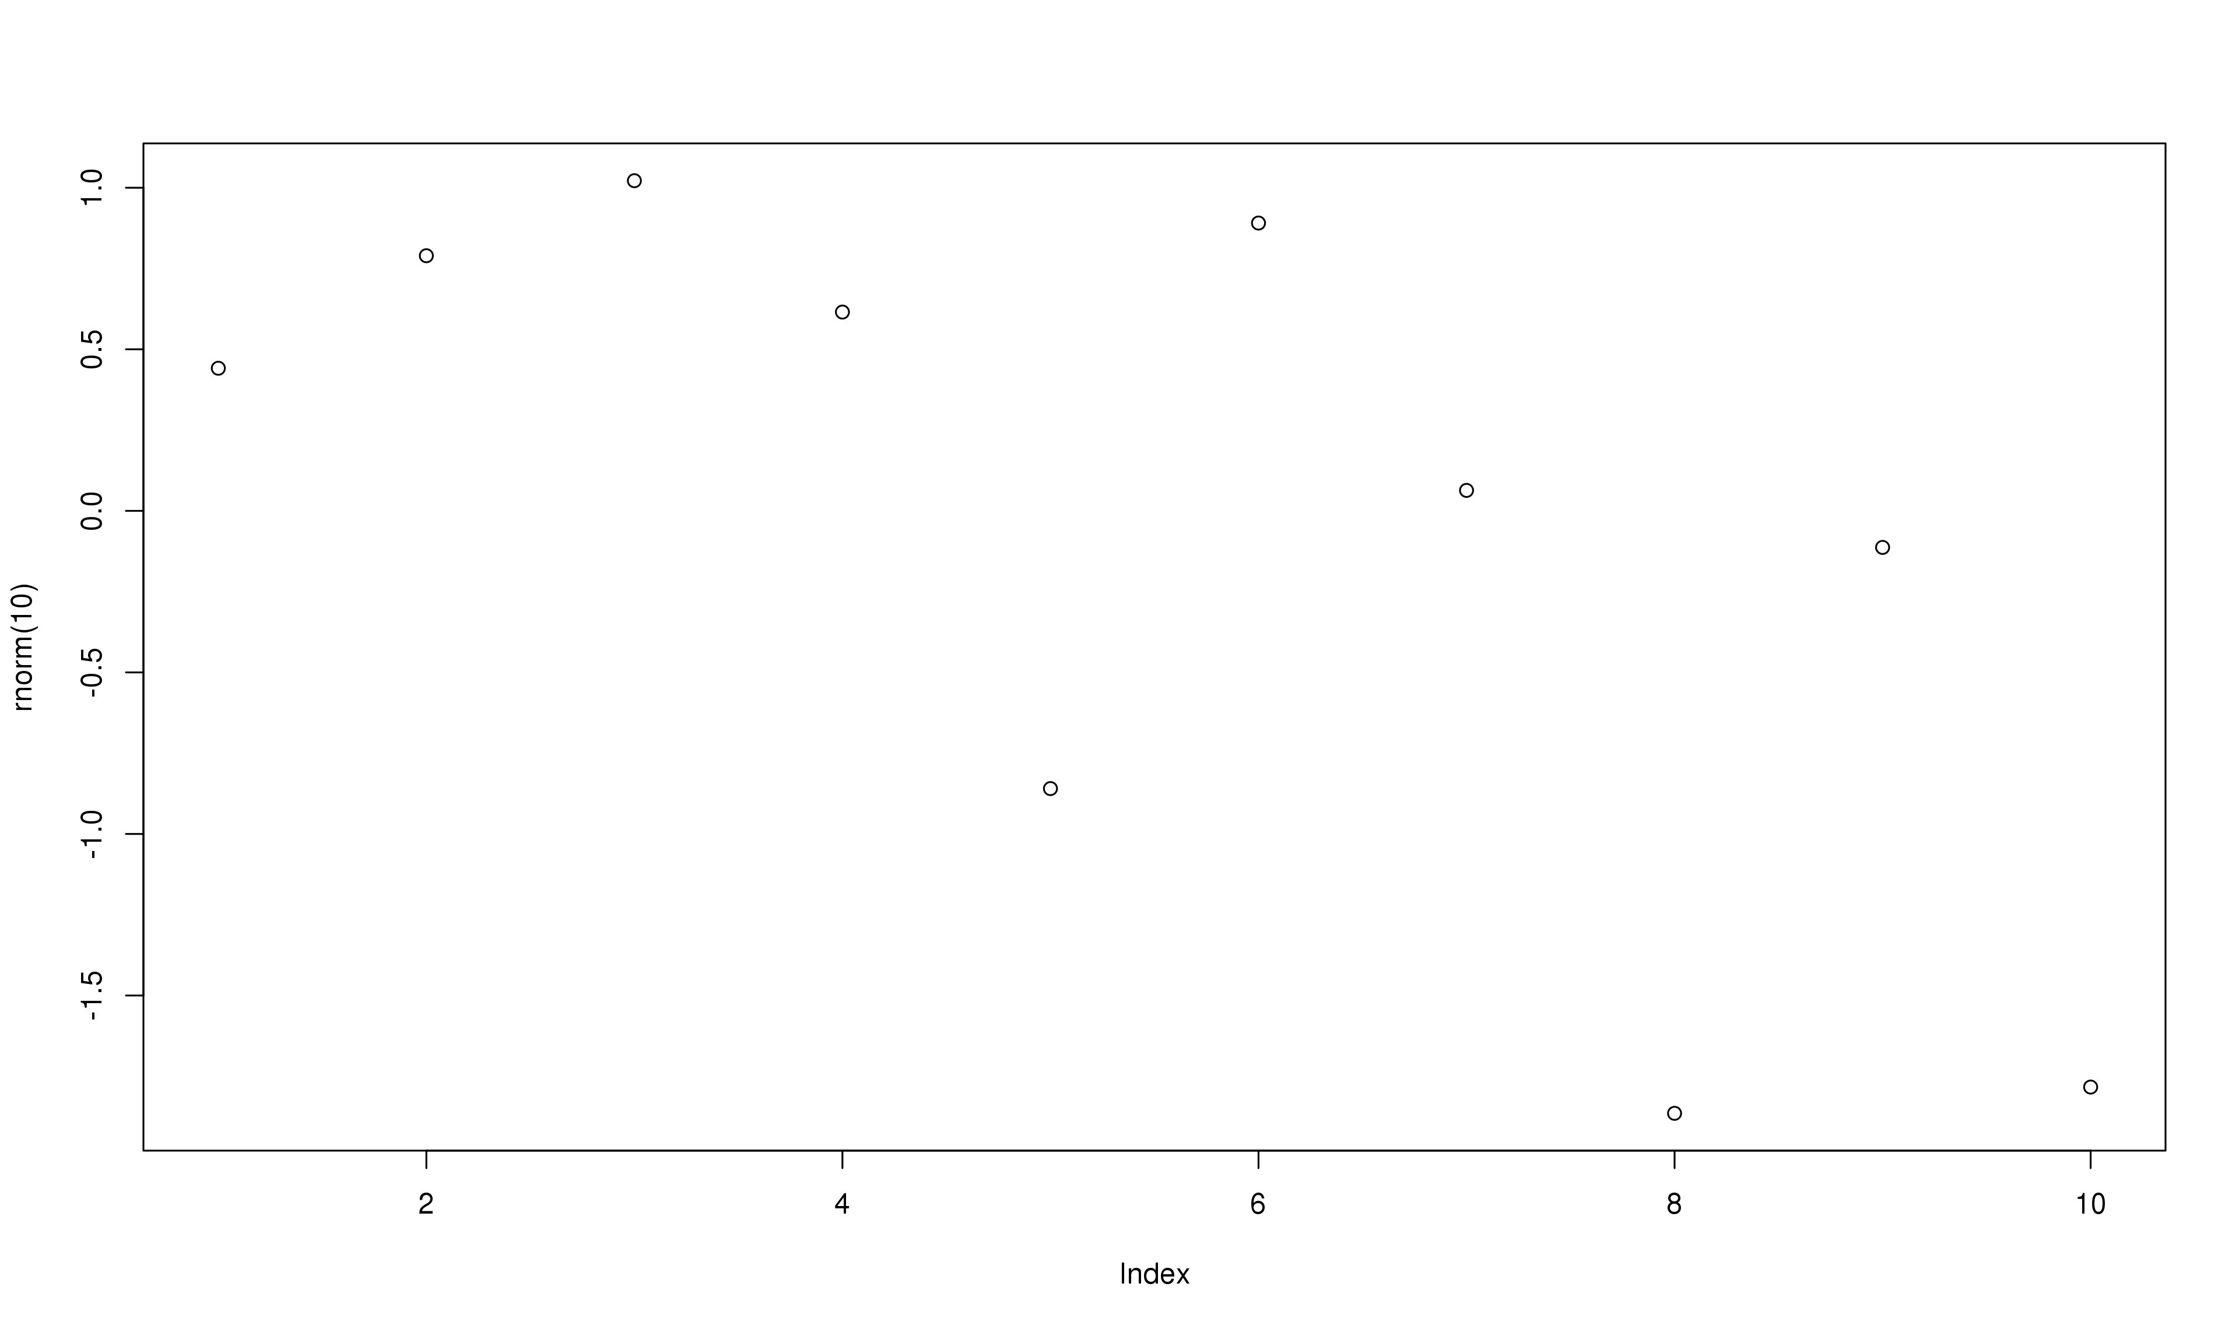
A plot of random numbers

Slide 43
Figure @ref(fig:demo-plot) shows how we can have a caption and cross-reference for a plot
Here is an example of inline code 3.14 in the middle of a sentence.

Slide 44
Discussion

Slide 45
Conclusion

Slide 46
Acknowledgements

Slide 47
References

Slide 48
Colophon
This report was generated on 2020-06-25 18:13:39 using the following computational environment and dependencies:
#> ─ Session info ─────────────────────────────────────────────────────────────── #> setting value #> version R version 3.5.3 (2019-03-11) #> os Debian GNU/Linux 9 (stretch) #> system x86_64, linux-gnu #> ui X11 #> language (EN) #> collate en_US.UTF-8 #> ctype en_US.UTF-8 #> tz America/Argentina/Buenos_Aires #> date 2020-06-25 #> #> ─ Packages ─────────────────────────────────────────────────────────────────── #> package * version date lib source #> assertthat 0.2.1 2019-03-21 [1] CRAN (R 3.5.3) #> asymsam * 0.0.0.9000 2020-06-25 [1] local #> backports 1.1.8 2020-06-17 [1] CRAN (R 3.5.3) #> bitops 1.0-6 2013-08-17 [1] CRAN (R 3.5.3) #> callr 3.4.3 2020-03-28 [1] CRAN (R 3.5.3) #> checkmate 2.0.0 2020-02-06 [1] CRAN (R 3.5.3) #> class 7.3-15 2019-01-01 [4] CRAN (R 3.5.3) #> classInt 0.4-2 2019-10-17 [1] CRAN (R 3.5.3) #> cli 2.0.2 2020-02-28 [1] CRAN (R 3.5.3) #> clisymbols 1.2.0 2017-05-21 [1] CRAN (R 3.5.3) #> colorspace 1.4-1 2019-03-18 [1] CRAN (R 3.5.3) #> crayon 1.3.4 2017-09-16 [1] CRAN (R 3.5.3) #> crul 0.9.0 2019-11-06 [1] CRAN (R 3.5.3) #> curl 4.3 2019-12-02 [1] CRAN (R 3.5.3) #> data.table * 1.12.8 2019-12-09 [1] CRAN (R 3.5.3) #> DBI 1.1.0 2019-12-15 [1] CRAN (R 3.5.3) #> desc 1.2.0 2018-05-01 [1] CRAN (R 3.5.3) #> devtools 2.3.0 2020-04-10 [1] CRAN (R 3.5.3) #> digest 0.6.25 2020-02-23 [1] CRAN (R 3.5.3) #> dplyr 1.0.0 2020-05-29 [1] CRAN (R 3.5.3) #> e1071 1.7-3 2019-11-26 [1] CRAN (R 3.5.3) #> ellipsis 0.3.1 2020-05-15 [1] CRAN (R 3.5.3) #> evaluate 0.14 2019-05-28 [1] CRAN (R 3.5.3) #> fansi 0.4.1 2020-01-08 [1] CRAN (R 3.5.3) #> farver 2.0.3 2020-01-16 [1] CRAN (R 3.5.3) #> foreign 0.8-71 2018-07-20 [4] CRAN (R 3.5.2) #> fs 1.4.1 2020-04-04 [1] CRAN (R 3.5.3) #> generics 0.0.2 2018-11-29 [1] CRAN (R 3.5.3) #> geojson 0.3.2 2019-01-31 [1] CRAN (R 3.5.3) #> geojsonio 0.9.0 2020-02-13 [1] CRAN (R 3.5.3) #> geojsonlint 0.4.0 2020-02-13 [1] CRAN (R 3.5.3) #> ggh4x * 0.1.1 2020-03-24 [1] Github (teunbrand/ggh4x@1a547cc) #> ggperiodic * 1.0.0 2019-03-12 [1] CRAN (R 3.5.3) #> ggplot2 * 3.3.2.9000 2020-06-25 [1] Github (tidyverse/ggplot2@ccd94e1) #> glue 1.4.1 2020-05-13 [1] CRAN (R 3.5.3) #> gtable 0.3.0 2019-03-25 [1] CRAN (R 3.5.3) #> here 0.1 2017-05-28 [1] CRAN (R 3.5.3) #> highr 0.8 2019-03-20 [1] CRAN (R 3.5.3) #> hms 0.5.3 2020-01-08 [1] CRAN (R 3.5.3) #> htmltools 0.5.0 2020-06-16 [1] CRAN (R 3.5.3) #> httpcode 0.3.0 2020-04-10 [1] CRAN (R 3.5.3) #> irlba 2.3.3 2019-02-05 [1] CRAN (R 3.5.3) #> jqr 1.1.0 2018-10-22 [1] CRAN (R 3.5.3) #> jsonlite 1.6.1 2020-02-02 [1] CRAN (R 3.5.3) #> jsonvalidate 1.1.0 2019-06-25 [1] CRAN (R 3.5.3) #> KernSmooth 2.23-15 2015-06-29 [4] CRAN (R 3.5.2) #> knitr 1.29 2020-06-23 [1] CRAN (R 3.5.3) #> labeling 0.3 2014-08-23 [1] CRAN (R 3.5.3) #> lattice 0.20-38 2018-11-04 [4] CRAN (R 3.5.2) #> lazyeval 0.2.2 2019-03-15 [1] CRAN (R 3.5.3) #> lifecycle 0.2.0 2020-03-06 [1] CRAN (R 3.5.3) #> lubridate 1.7.9 2020-06-08 [1] CRAN (R 3.5.3) #> magrittr * 1.5 2014-11-22 [1] CRAN (R 3.5.3) #> maps 3.3.0 2018-04-03 [1] CRAN (R 3.5.3) #> maptools 0.9-9 2019-12-01 [1] CRAN (R 3.5.3) #> Matrix 1.2-16 2019-03-08 [4] CRAN (R 3.5.3) #> memoise 1.1.0 2017-04-21 [1] CRAN (R 3.5.3) #> metR * 0.7.0 2020-04-21 [1] Github (eliocamp/metR@fa7ae32) #> munsell 0.5.0 2018-06-12 [1] CRAN (R 3.5.3) #> ncdf4 1.17 2019-10-23 [1] CRAN (R 3.5.3) #> pillar 1.4.4 2020-05-05 [1] CRAN (R 3.5.3) #> pkgbuild 1.0.8 2020-05-07 [1] CRAN (R 3.5.3) #> pkgconfig 2.0.3 2019-09-22 [1] CRAN (R 3.5.3) #> pkgload 1.1.0 2020-05-29 [1] CRAN (R 3.5.3) #> plyr 1.8.6 2020-03-03 [1] CRAN (R 3.5.3) #> prettyunits 1.1.1 2020-01-24 [1] CRAN (R 3.5.3) #> processx 3.4.2 2020-02-09 [1] CRAN (R 3.5.3) #> prompt 1.0.0 2020-01-17 [1] Github (gaborcsardi/prompt@b332c42) #> ps 1.3.3 2020-05-08 [1] CRAN (R 3.5.3) #> purrr 0.3.4 2020-04-17 [1] CRAN (R 3.5.3) #> R6 2.4.1 2019-11-12 [1] CRAN (R 3.5.3) #> Rcpp 1.0.4.6 2020-04-09 [1] CRAN (R 3.5.3) #> RCurl 1.98-1.2 2020-04-18 [1] CRAN (R 3.5.3) #> readr 1.3.1 2018-12-21 [1] CRAN (R 3.5.3) #> remotes 2.1.1 2020-02-15 [1] CRAN (R 3.5.3) #> rgdal 1.4-8 2019-11-27 [1] CRAN (R 3.5.3) #> rgeos 0.5-2 2019-10-03 [1] CRAN (R 3.5.3) #> rlang 0.4.6 2020-05-02 [1] CRAN (R 3.5.3) #> rmapshaper 0.4.3 2020-01-28 [1] CRAN (R 3.5.3) #> rmarkdown 2.3 2020-06-18 [1] CRAN (R 3.5.3) #> rprojroot 1.3-2 2018-01-03 [1] CRAN (R 3.5.3) #> rstudioapi 0.11 2020-02-07 [1] CRAN (R 3.5.3) #> scales 1.1.1 2020-05-11 [1] CRAN (R 3.5.3) #> sessioninfo 1.1.1 2018-11-05 [1] CRAN (R 3.5.3) #> sf 0.9-0 2020-03-24 [1] CRAN (R 3.5.3) #> sp 1.4-1 2020-02-28 [1] CRAN (R 3.5.3) #> sticky 0.5.6.1 2020-03-16 [1] CRAN (R 3.5.3) #> stringi 1.4.6 2020-02-17 [1] CRAN (R 3.5.3) #> stringr 1.4.0 2019-02-10 [1] CRAN (R 3.5.3) #> testthat 2.3.2 2020-03-02 [1] CRAN (R 3.5.3) #> tibble 3.0.1 2020-04-20 [1] CRAN (R 3.5.3) #> tidyselect 1.1.0 2020-05-11 [1] CRAN (R 3.5.3) #> udunits2 0.13 2016-11-17 [1] CRAN (R 3.5.3) #> units 0.6-6 2020-03-16 [1] CRAN (R 3.5.3) #> usethis 1.6.1 2020-04-29 [1] CRAN (R 3.5.3) #> V8 3.0.2 2020-03-14 [1] CRAN (R 3.5.3) #> vctrs 0.3.1 2020-06-05 [1] CRAN (R 3.5.3) #> withr 2.2.0 2020-04-20 [1] CRAN (R 3.5.3) #> xfun 0.15 2020-06-21 [1] CRAN (R 3.5.3) #> yaml 2.2.1 2020-02-01 [1] CRAN (R 3.5.3) #> #> [1] /home/elio.campitelli/R/x86_64-pc-linux-gnu-library/3.5 #> [2] /usr/local/lib/R/site-library #> [3] /usr/lib/R/site-library #> [4] /usr/lib/R/library
The current Git commit details are:
#> Local: master /home/elio.campitelli/asymsam #> Remote: master @ origin (https://github.com/eliocamp/asymsam.git) #> Head: [ec4b4f0] 2020-06-25: LFS won't work

