Slide 1
paper de la tesis
Elio Campitelli

Slide 2
Selección de figuras para paper

Slide 3
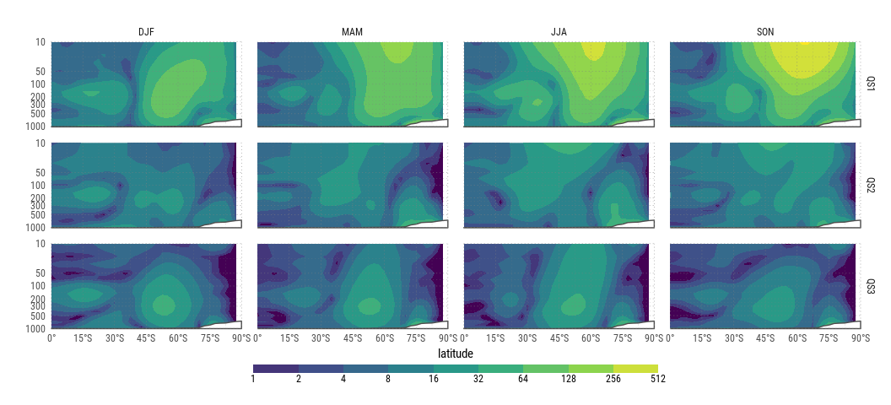
Fourier amplitude of the mean zonal wave 3 (contours).
Notes:
(En la tésis no tengo demasiado texto sobre ésta figura; principalmente la compara con el campo de r2 que no voy a mostrar.)
The amplitude of wave 3 can be computed via Fourier decomposition of the mean seasonal field (AM method) or by computing the mean amplitude of the instantaneous –monthly– fields (MA method). The ratio MA/AM can be used as a meassure of the stationarity of the zonal wave 3 since a perfectly stationary wave (withouth change in phase) would have a ratio equal to 1 and a completely unstationary wave (with completely random phase) would have a ratio close to zero…
The amplitude of QS3 achieves it’s maximum at near 200hPa and 50°S in all seasons but with important changes in it’s vertical extent. During austral winter and autum, wave 3 amplitude extends up to the higest model levels while it remains restricted to the stratosphere during spring and summer. In general, the high amplitudes are colocated with areas of high stationarity, although this metric is maximized at lower levels with the exception of spring. While the mean wave amplitude during this season is high (not shown), stationarity is low in the midlatitudes and specially in the high stratosphere. This is due primarily by the behaviour during november, when high phase variance means that wave 3 cannot be considered stationary.

Slide 4
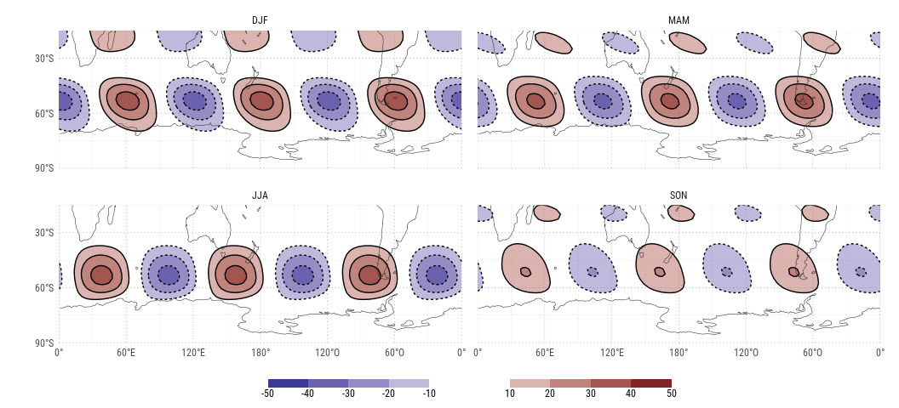
Wave 3 component of the geopotential field of each season at 200hPa.
Notes:
The reconstructed QS3 field at 200hPa show the expected maximum at 50°S and the anual cycle in its phase already observed in previous studies. It also shows an easterly inclination of the systems evident in summer but absent in winter, suggesting that the QS3 might be related to southerly transport of momentum.

Slide 5
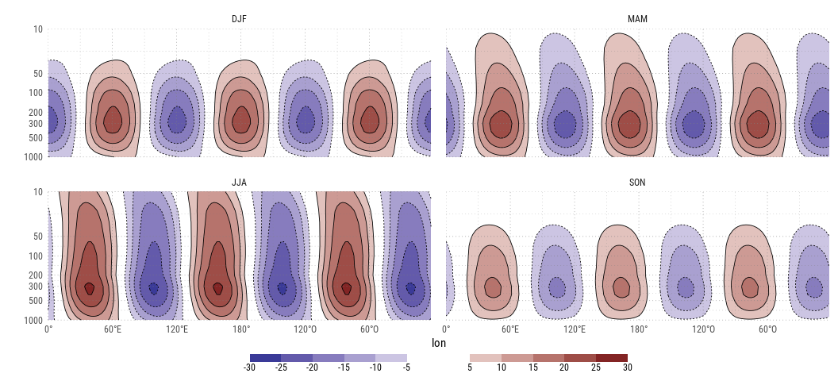
Mean wave 3 component of geopotential height between 65°S and 35°S
Notes:
The vertical strucure of the QS3 shows that the expected seasonal cycle in vertical extent is followed by a slight inclination of the disturances.
Taken together, this suggests a mix of baroclinic and barotropic processes related to the QS3. The former, more important during summer and the the latter dominating in winter. (Esto se debería ver con la energética)

Slide 6
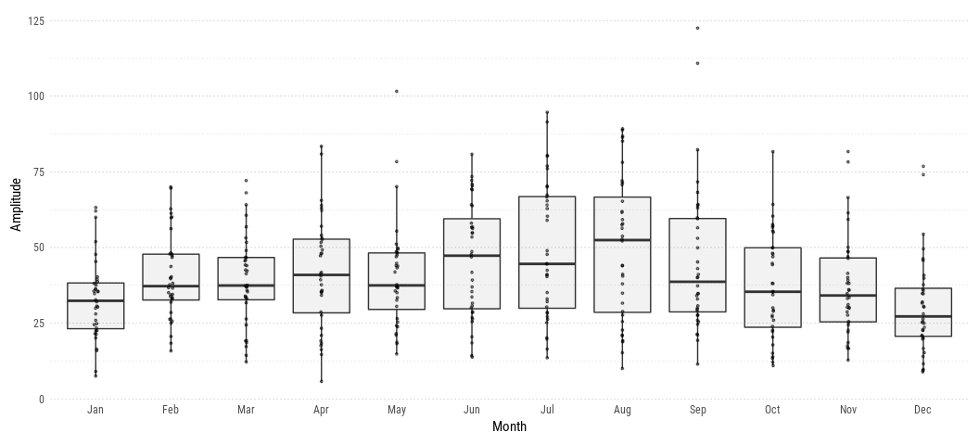
Seasonal cicle of QS3 index.
Notes:
ZW3 activiy exhibits a clear annual cycle with higher amplitude during the austral winter months and lower amplitude during the summer months. This annual cycle is consistent with previous work [@Loon1972; @Karoly1985; @Raphael2004].
As suggested previously, the low amplitude of QS3 wave in spring is not due to a reduction in the amplitude of the planetary wave 3 but to its reduced stationarity.

Slide 7
## Regions defined for each Polygons ## Regions defined for each Polygons

Slide 8
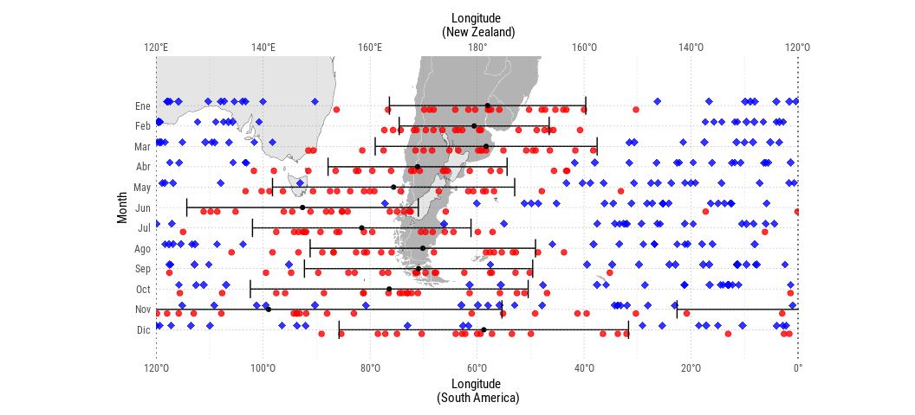
Phase of the mean wave for each month and $±$ 1 standrad deviation (black dots and error bars). In red and blue, phase of the most intense 20 events for each month, representing the location of the ridge and throuht respectively.

Slide 9
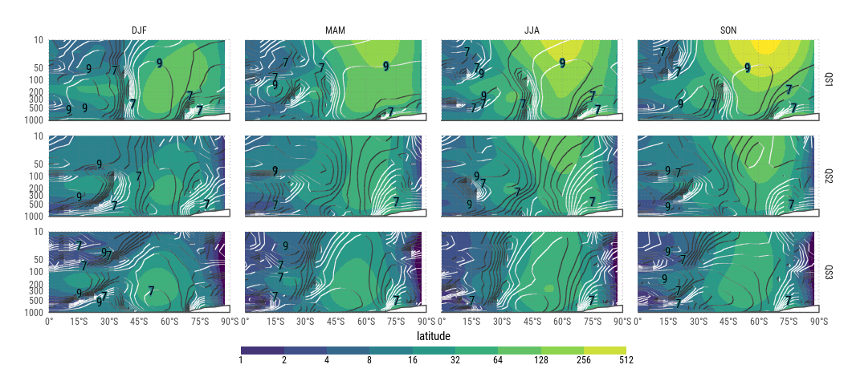
Mean wave amplitude (shaded) and stationarity (contours).

Slide 10
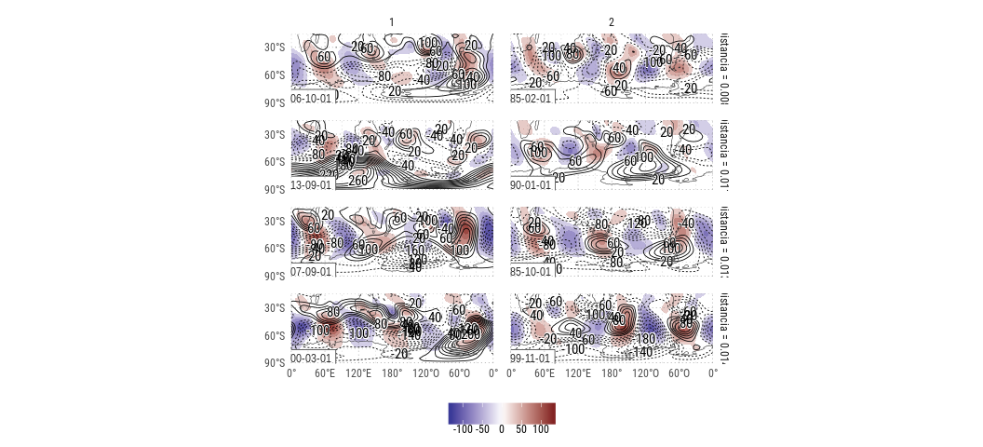
Four most similar field tuples in standarized wave 3 amplitude and phase space. Temporal anomaly of 200hPa geopotential (contours) and zonal anomaly of 200hPa geopotential with waves 1 and 2 filtered out (shaded).
Notes:
Se muestran los cuatro pares de campos más similares en cuanto a amplitud y fase. Aún en esta muestra puede verse grandes heterogeneidades. En el primer par de campos, por ejemplo, uno muestra anomalías zonales significativas principalmente sobre el Atlántico y el Índico mientrs que en el otro éstas ocupan todo el dominio. La latitud de las anomal ías también cambia mucho entre ambos casos. La correlación de campo es de 0.37 El segundo y tercer par de campos presenta mayor similaridad (correlación de campo 0.54 y 0.84 respectivamente). El cuarto par no sólo presenta poca correlación (0.47) sino que presenta una gran diferencia en el área de máximas anomalías.
Los campos de anomalías temporales, por su parte, casi no presentan similitudes entre los campos. Esto se debe principalmente a que no se está filtrando las ondas 1 y 2.

Slide 11
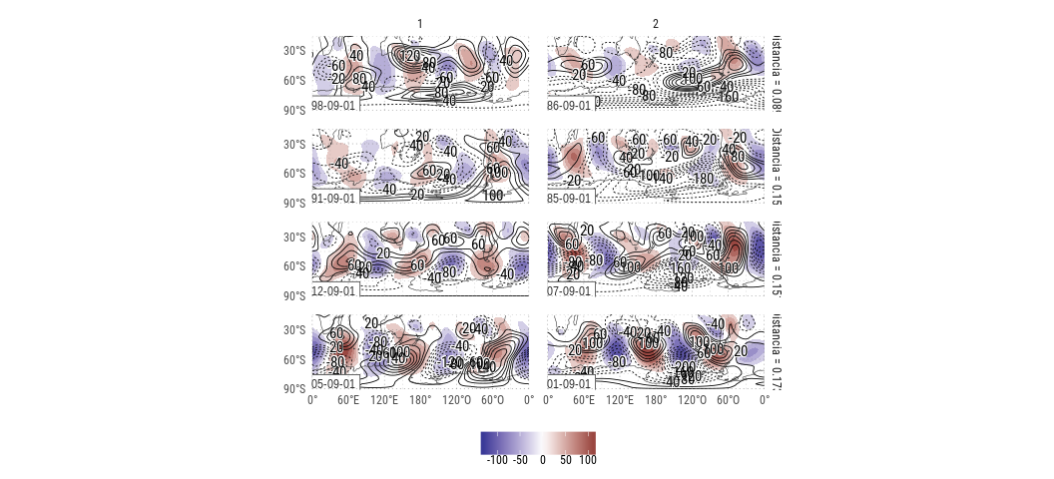
Four most similar september field tuples in standarized wave 3 amplitude and phase space. Temporal anomaly of 200hPa geopotential (contours) and zonal anomaly of 200hPa geopotential with waves 1 and 2 filtered out (shaded).
Notes:
Restringiendo el análisi a un mes, por ejemplo, septiembre,

Slide 12
## `geom_smooth()` using method = 'gam' and formula 'y ~ s(x, bs = "cs")'

Slide 13
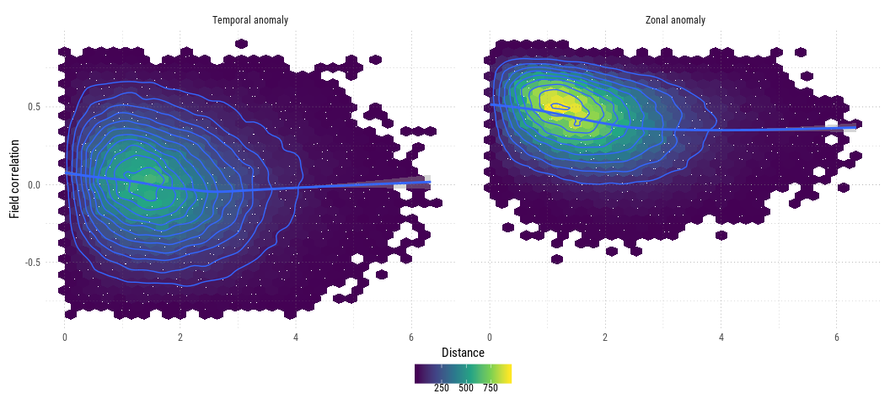
Correlation between geopotential zonal anomalies and distance in QS3 amplitude and phase.

Slide 14
Se observa que hay una ligera relación entre menor distancia en el espacio de amplitiud y fase de QS3 y la correlación de los campos de anoamlías zonales, pero que ésta es nula para las anomalías temporales.

Slide 15
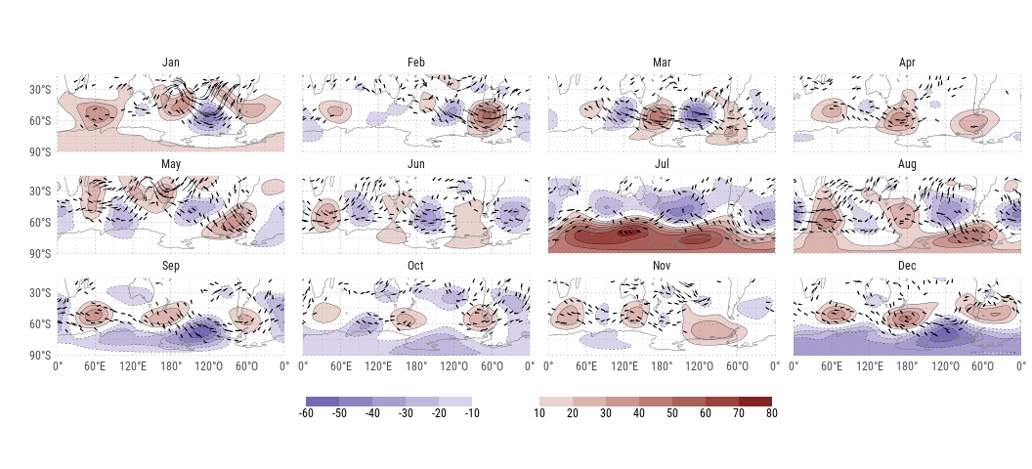
Regression of 200hPa geopotential height and QS3 standarized index, and wave acivity flux computed from regression of 0.201 sigma.
Notes:
All months show evidence of planetary wave 3 activity, but with considerable heterogeneity in its characteristics. In January, September and December, zonal wave 3 is related to a wave train emanating from the tropical western Pacific propagating to the southeast and then turning to the northeast.
En enero, se observa un patrón hemisférico de onda 3, con un centro anómalamente negativo importante en el Pacífico sudeste, embebido además en un tren de ondas extendido entre el este de Nueva Zelanda, y Sudamérica. En febrero, la estructura se mantiene similar, pero con menor evidencia de propagación meridional, y el centro anticiclónico en Sudamérica intensificado y un debilitamiento de aquel ubicado al sur del Índico. En marzo, la estructura de onda 3 exhibe mínima variación meridional y ocupa todo el círculo de latitud entre 60°S y 45°S. Abril es similar a marzo, pero sin centros ciclónicos significativos. En mayo, se distingue nuevamente un tren de ondas con propagación meridional, emanando desde Australia, pero con evidencias de reflexión en el Mar de Weddell. Junio, al igual que marzo, presenta una estructura de QS3 zonal, pero menos definida y, consistente con el corrimiento de la fase observado (), con los centros ciclónicos y anticiclónicos desplazados hacia el oeste.

