Slide 1
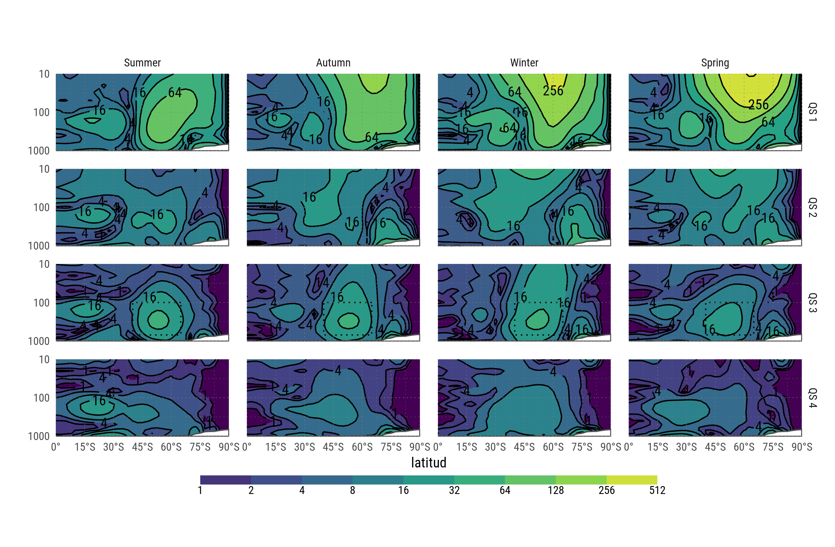
Fourier amplitude of geopotential height

Slide 2
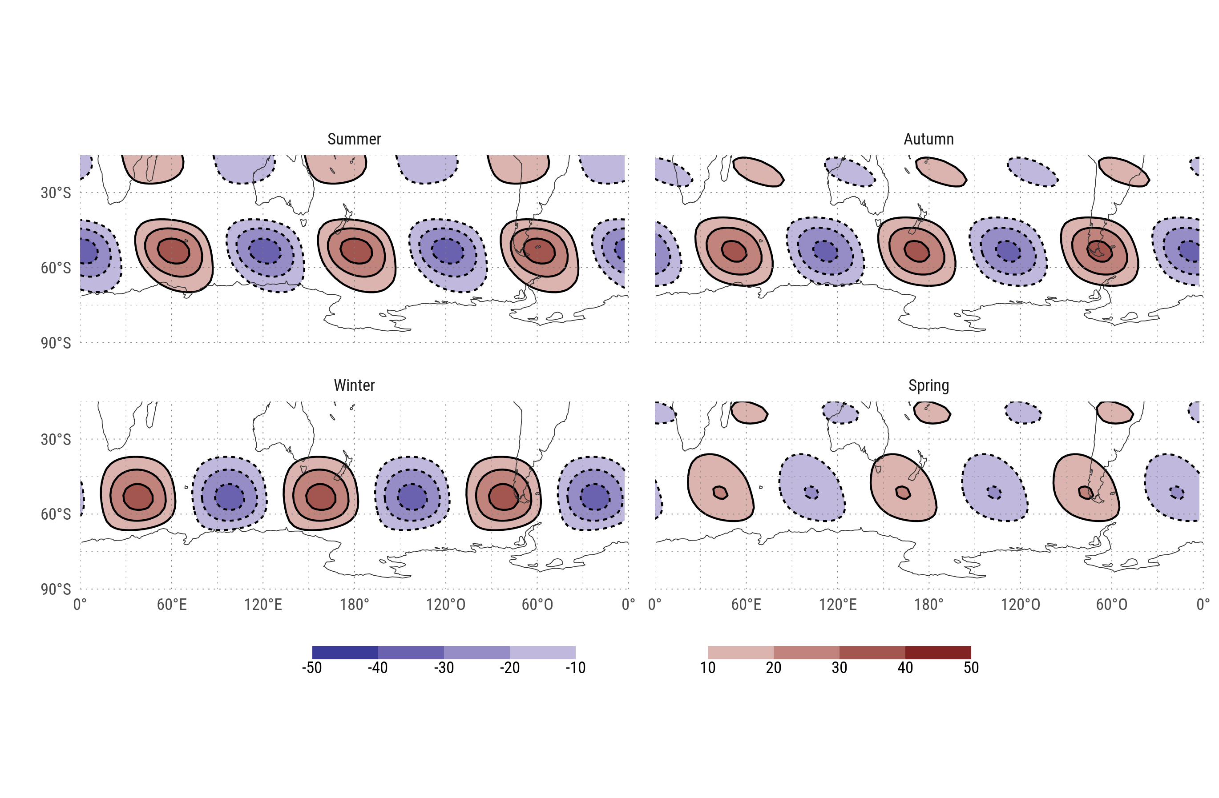
Wave 3 component of the geopotential field of each season at 200hPa.

Slide 3
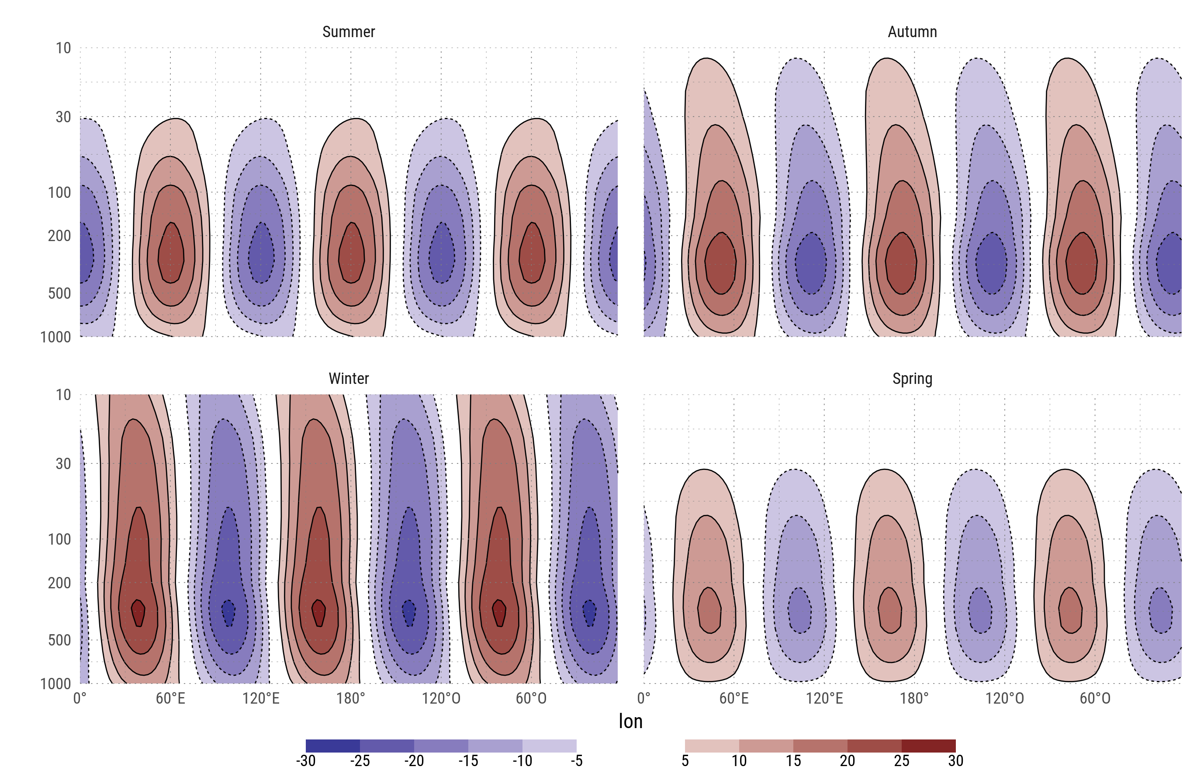
Mean wave 3 component of geopotential height between 65°S and 35°S

Slide 4
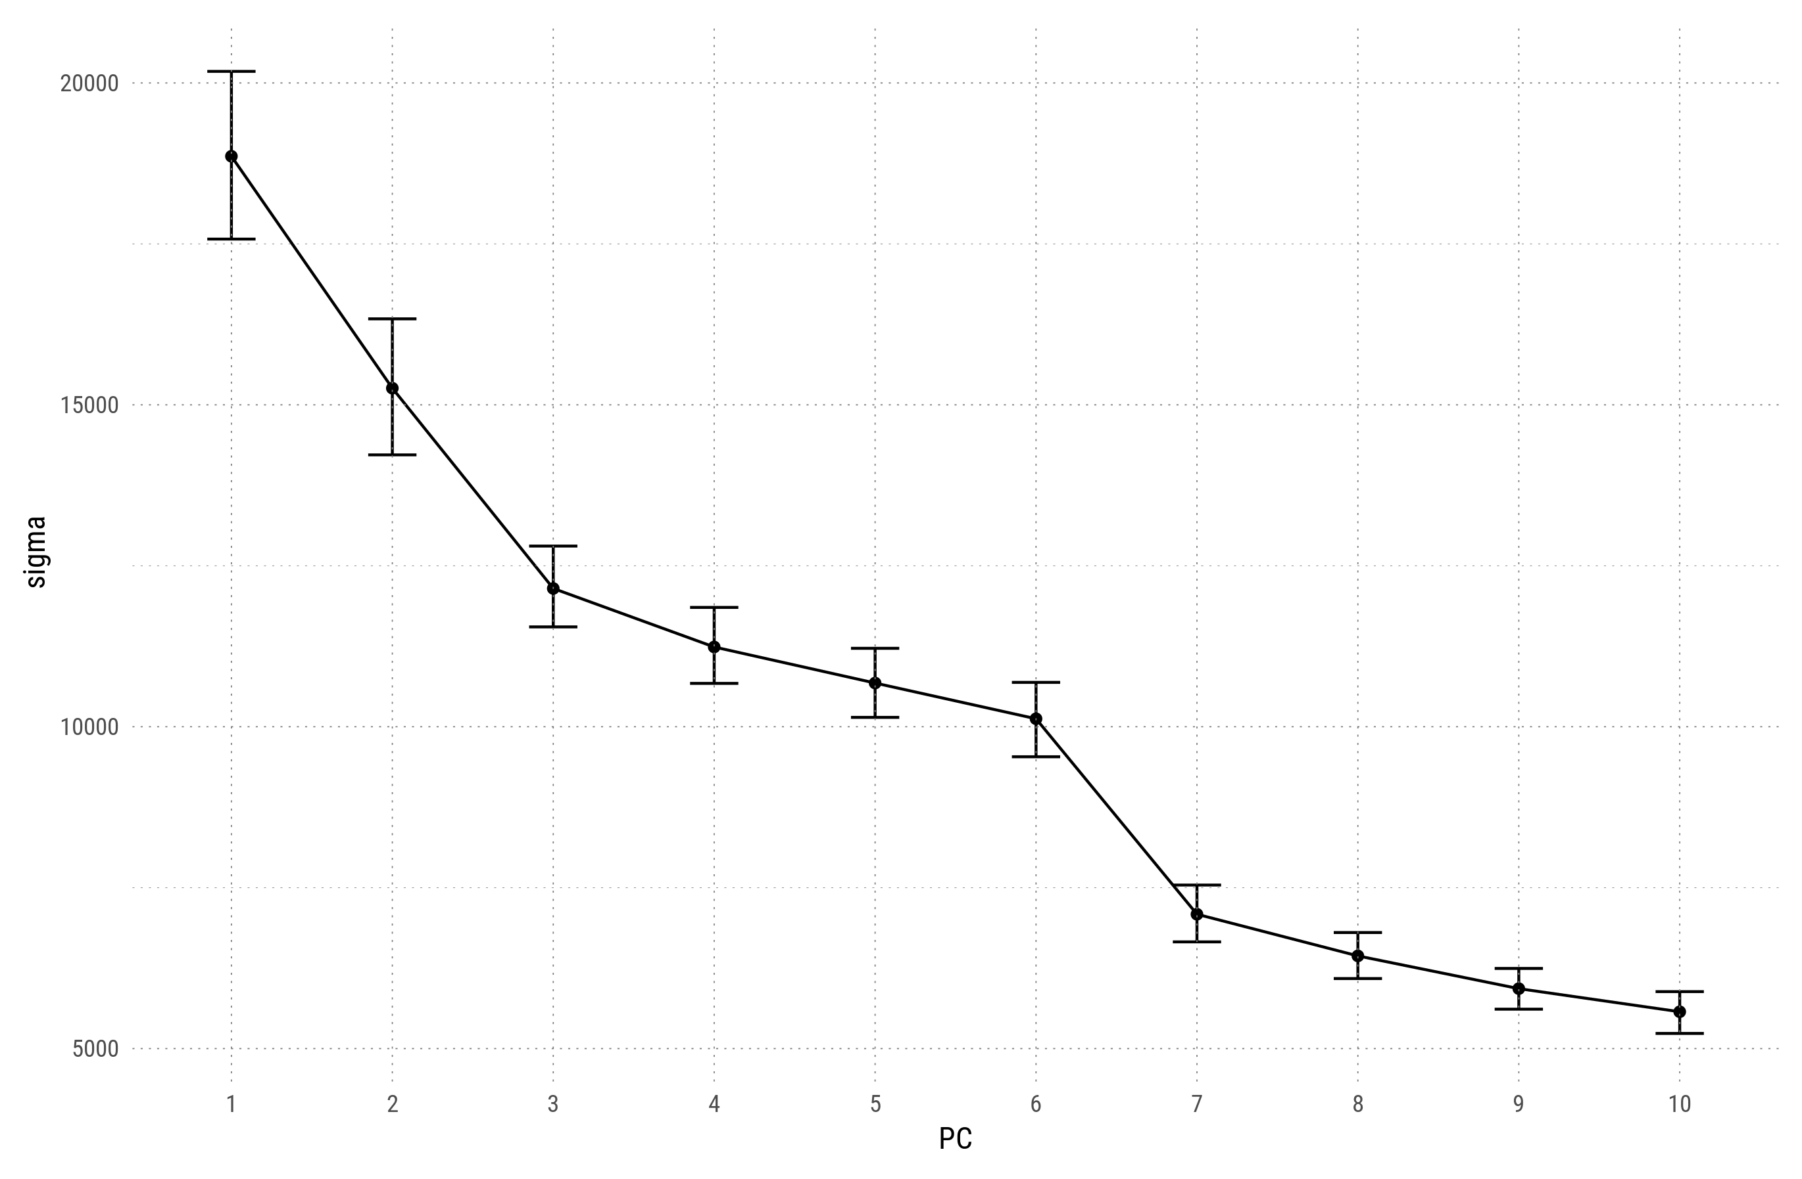
First 4 EOFs derived from the 200hPa detrended geopotential zonal anomaly field between 30°S and 80°S with zonal wave 1 filtered out. Erros bars represent the 95% cuantile range estimated via bootstrap.

Slide 5
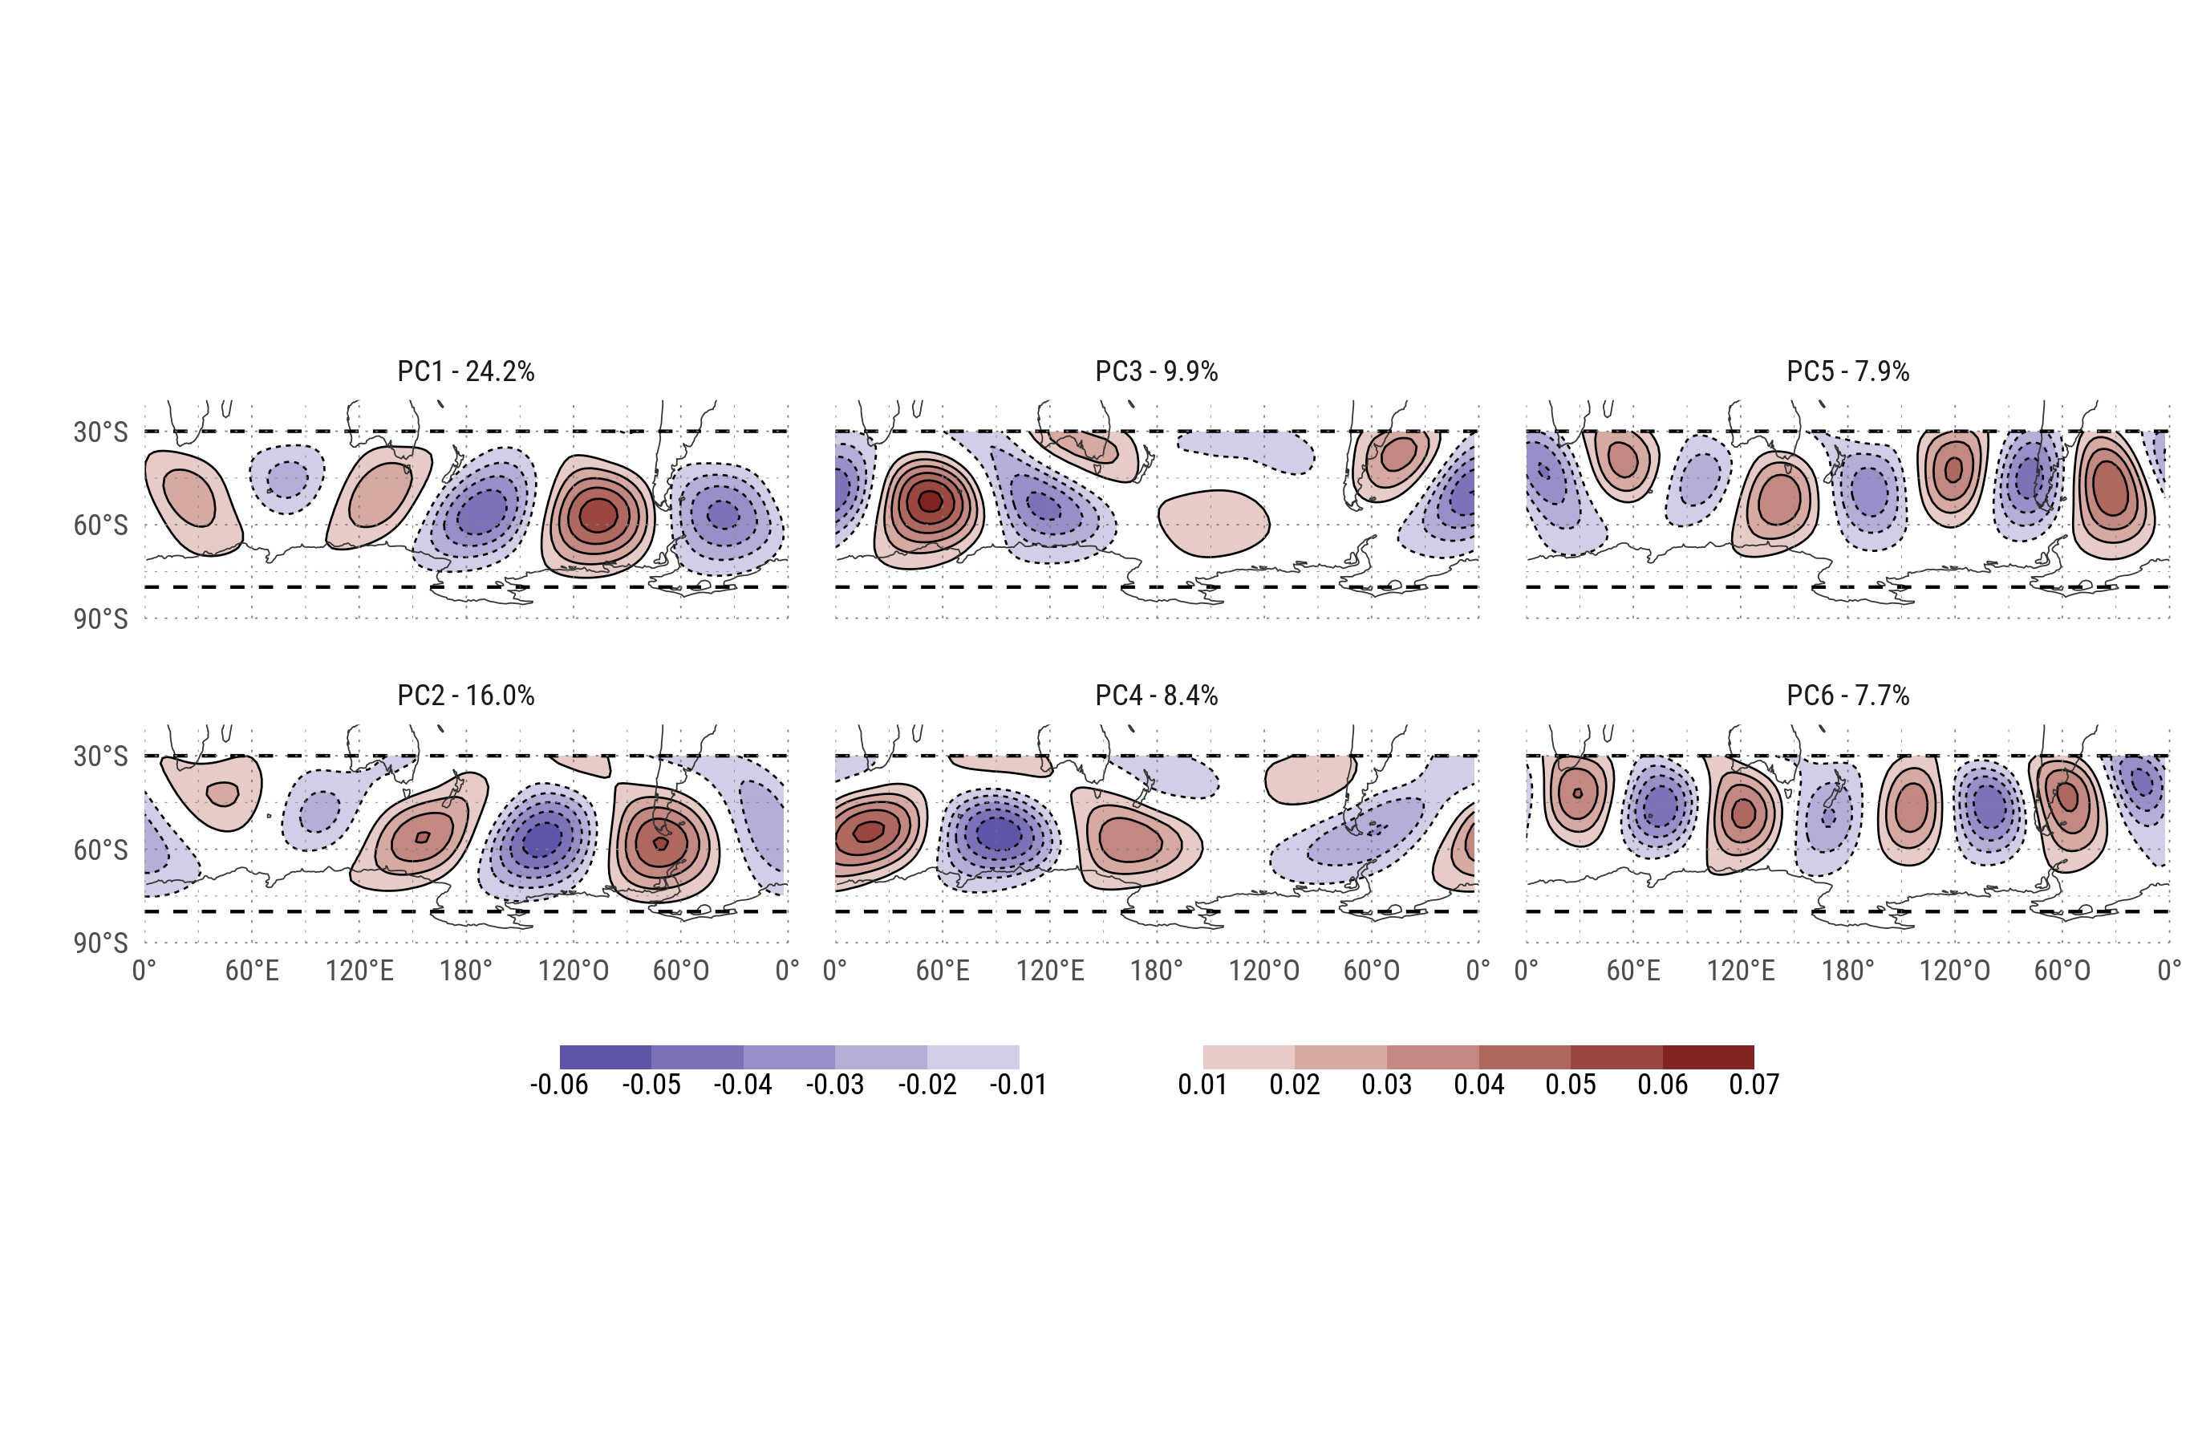
EOFs

Slide 6
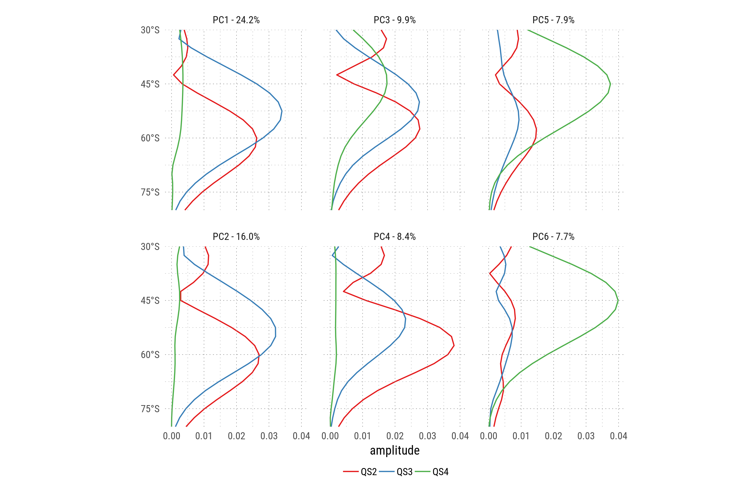
Fourier decomposition by latitude of each EOF.

Slide 7
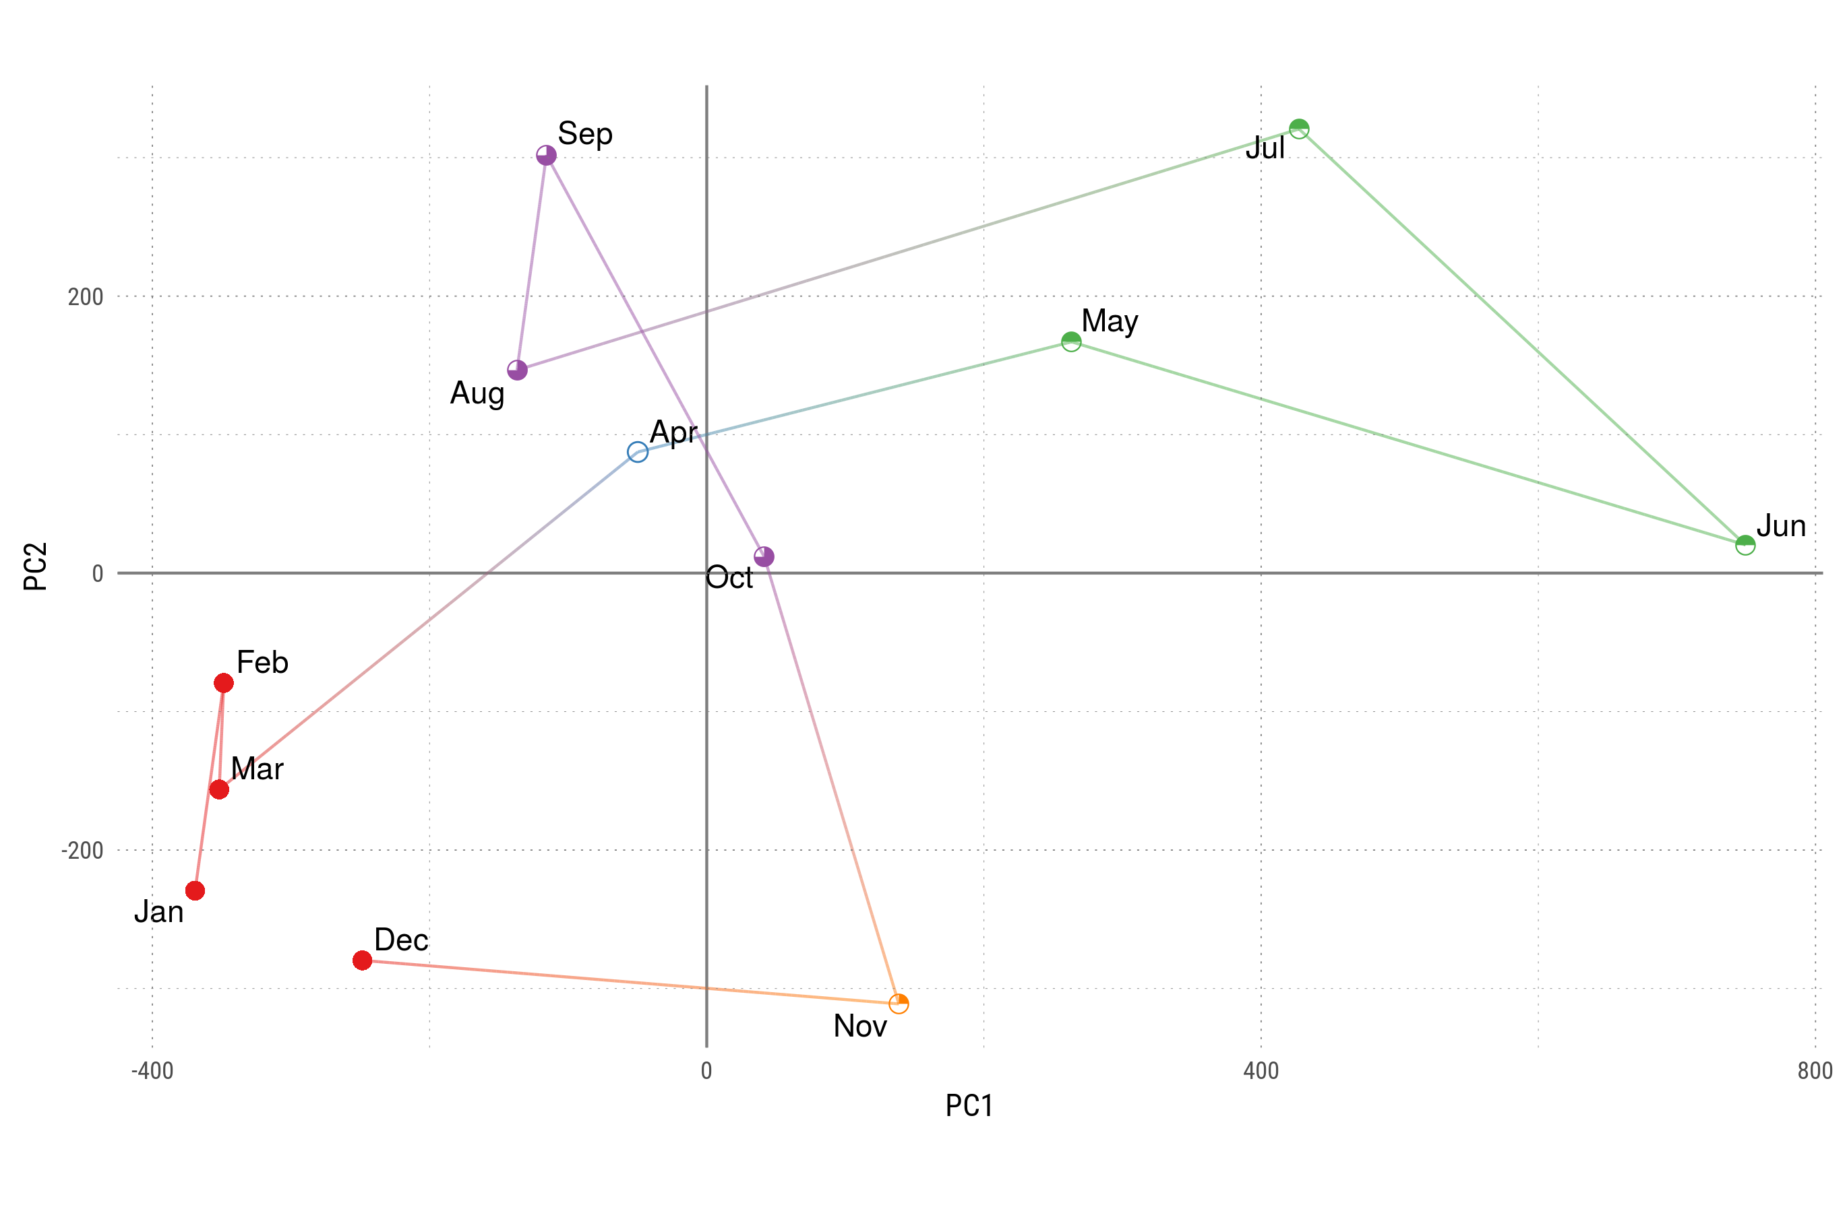
Monthly mean values for each PC. Colors and shapes divide months into 5 'seasons'.

Slide 8
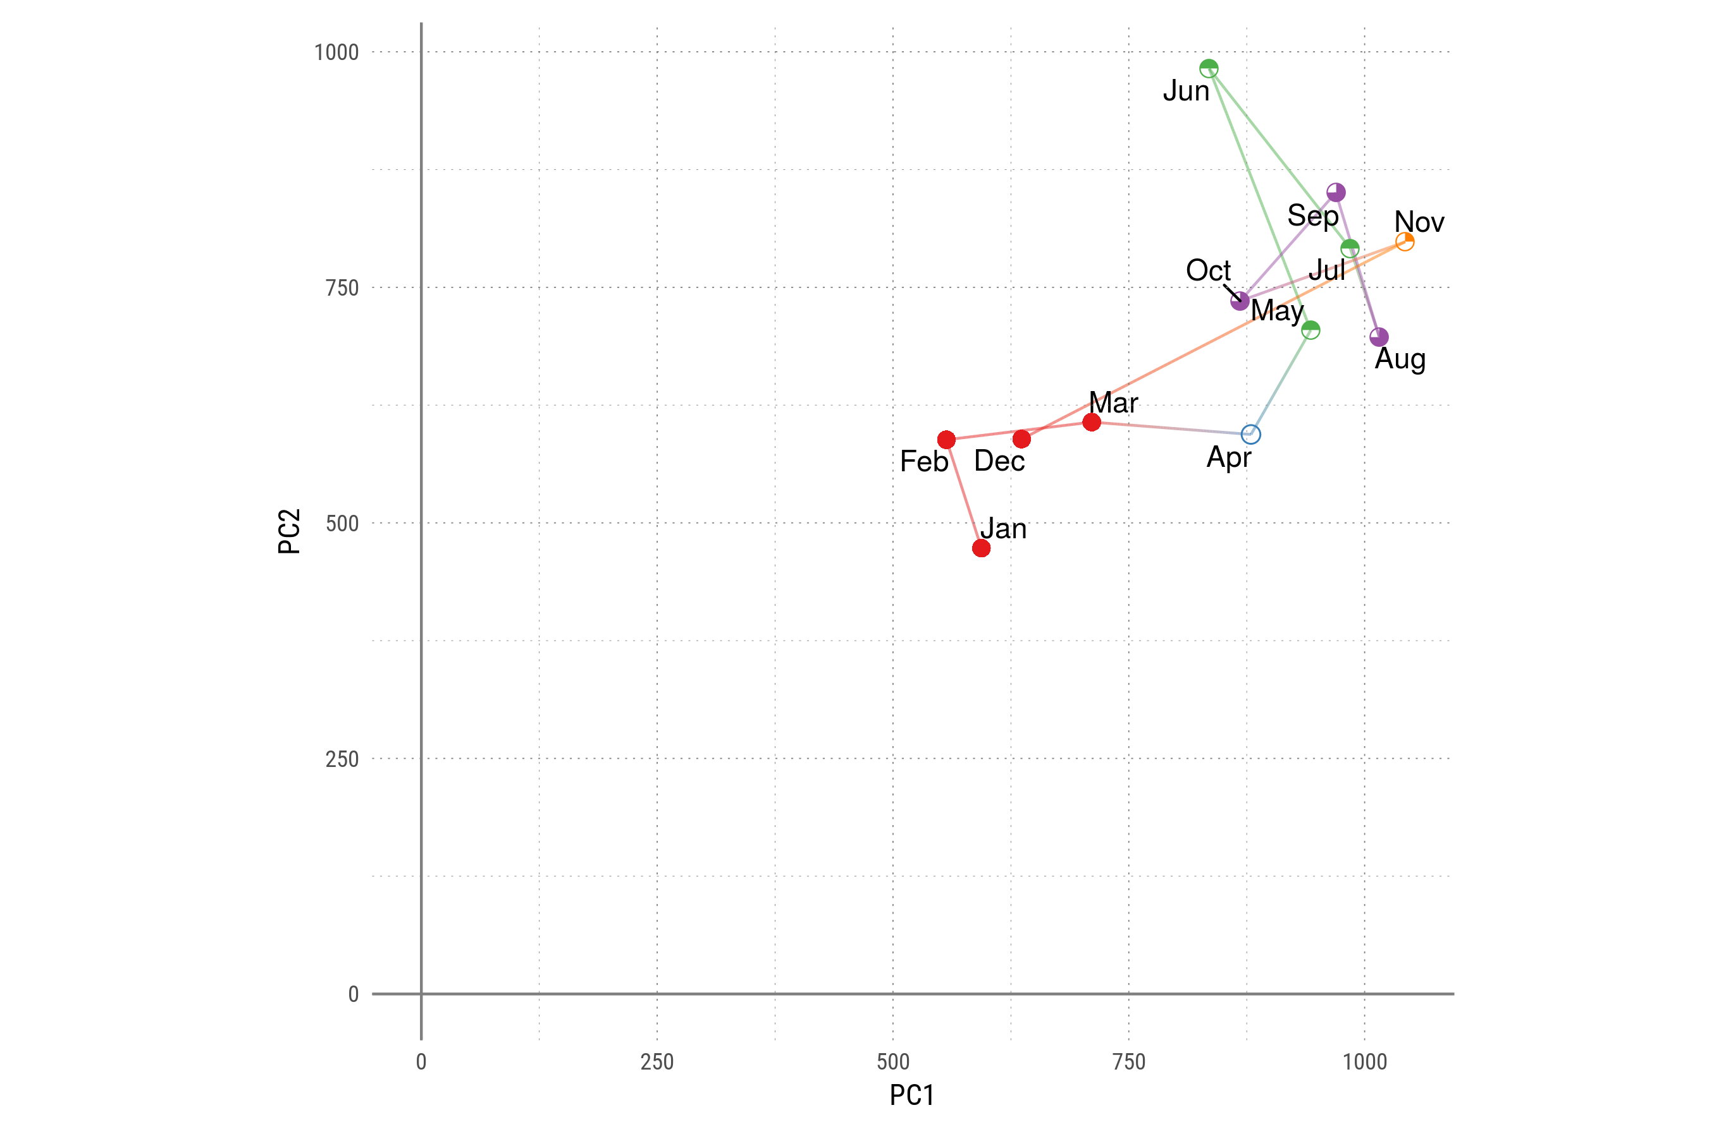
Monthly standard deviation for each PC. Colors and shapes divide months into 5 'seasons'.

Slide 9
Cluster Dendrogram
700
600
500
400
Height
300
200
100
Mar
Apr
Dec
Jan
Feb
Jun
Aug
Oct
May
Jul
Sep
Nov
.
hclust (*, "complete")
Hierarchical clustering of the months of the year according to the standard deviation of each PC scaled by it's variance.

