Slide 1
04 - figuras
Elio Campitelli

Slide 2
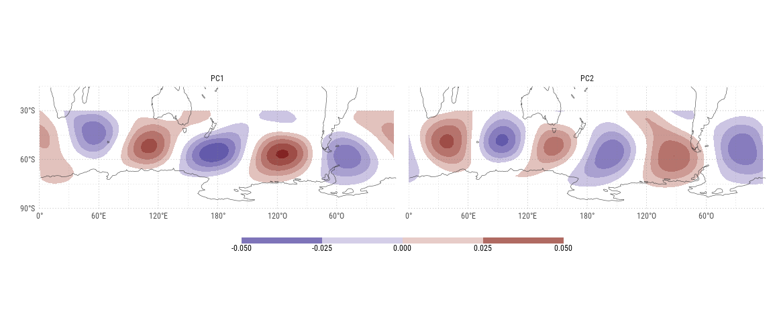
Persistencia y eventos.

Slide 3
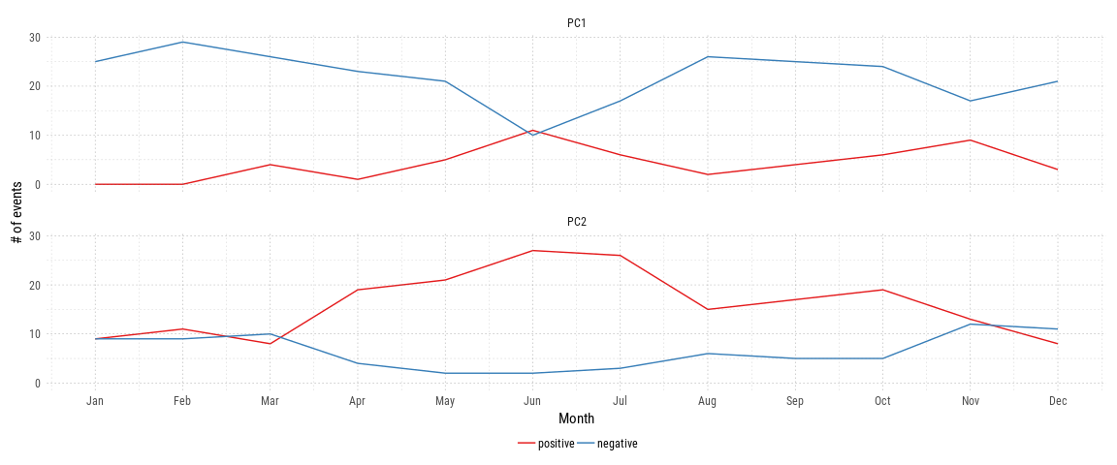
Number of positive and negative events (+- 0.5 sigma) for each PC and each month.
Notes:
Se ve clarmaente un ciclo anual (que es obvio por las divisones anteriores). Lo importante es ver que hay muy pocos eventos en algunas categorías, como positivos en PC1 verano o negativos en PC2 invierno.

Slide 4
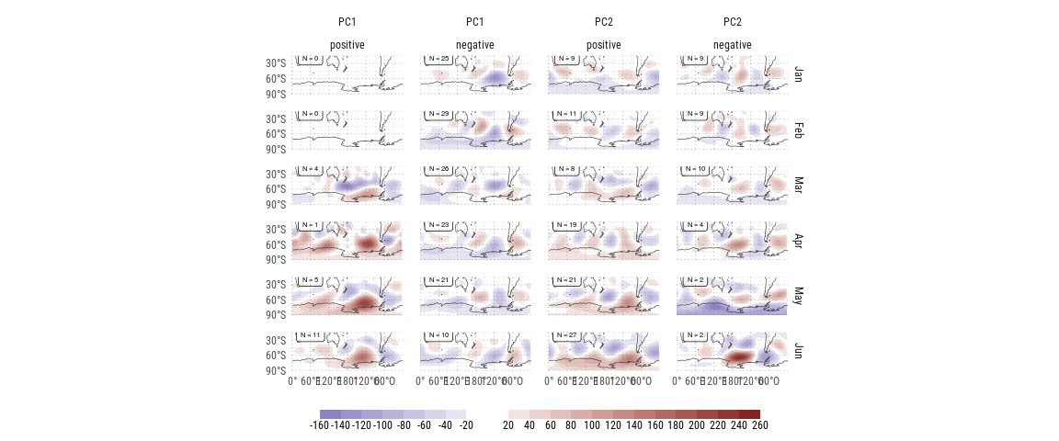
Mean gh anomaly (positive - neutral; negative - neutral) for positive and negatives events for each PC and each month.

Slide 5
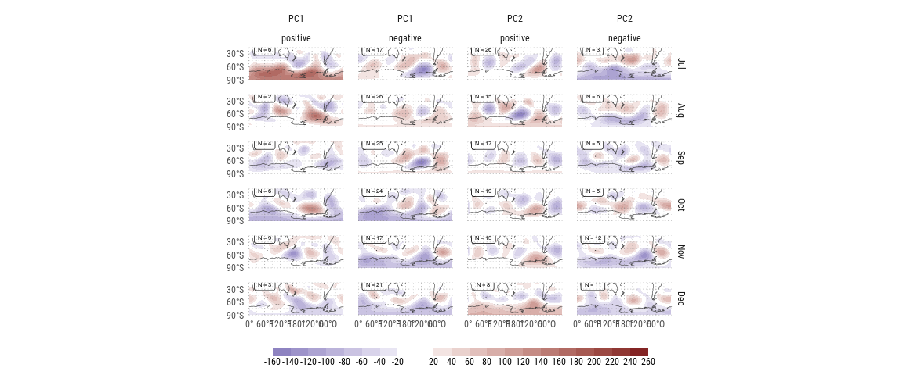
Mean gh anomaly (positive - neutral; negative - neutral) for positive and negatives events for each PC and each month. (continued)

Slide 6
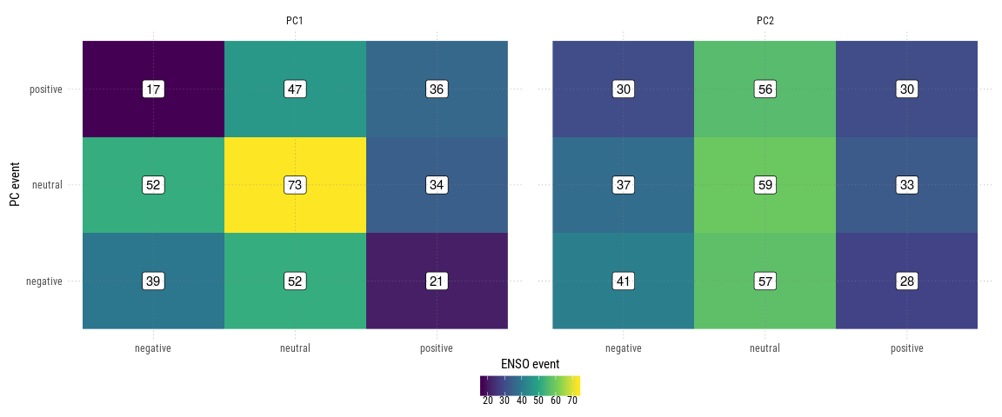

Slide 7
PC | statistic | p.value | parameter | method
PC1 | 14.545147 | 0.0057438 | 4 | Pearson’s Chi-squared test
PC2 | 1.490105 | 0.8283927 | 4 | Pearson’s Chi-squared test

Slide 8
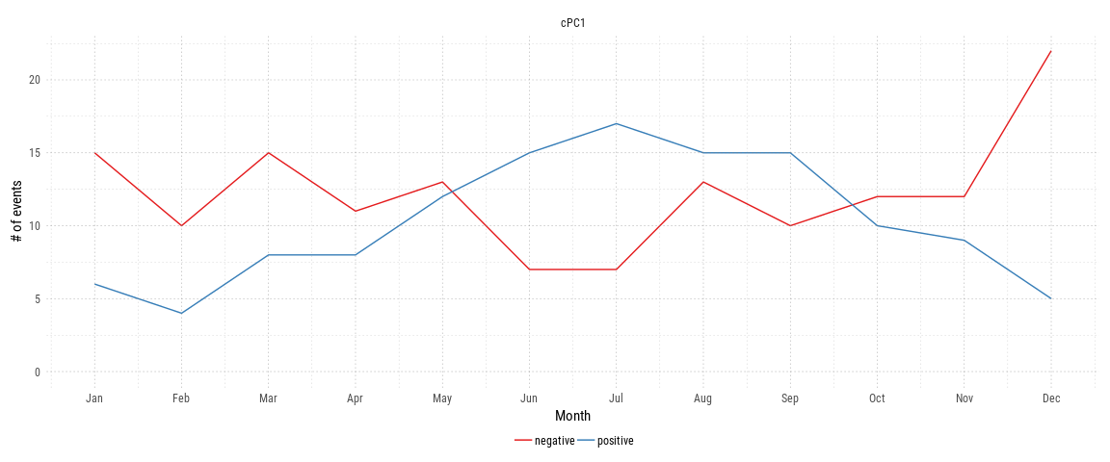
Number of positive and negative events (+- 0.5 sigma) for each PC and each month.

Slide 9
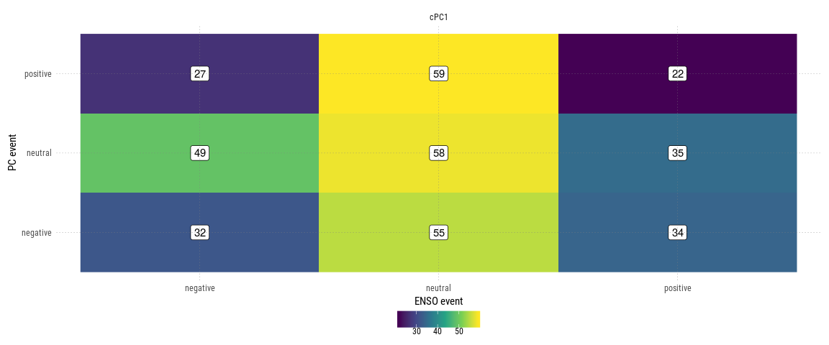

Slide 10
PC | statistic | p.value | parameter | method
PC1 | 14.545147 | 0.0057438 | 4 | Pearson’s Chi-squared test
PC2 | 1.490105 | 0.8283927 | 4 | Pearson’s Chi-squared test

Slide 11
Relación con QS3
## `geom_smooth()` using method = 'loess' and formula 'y ~ x'

Slide 12
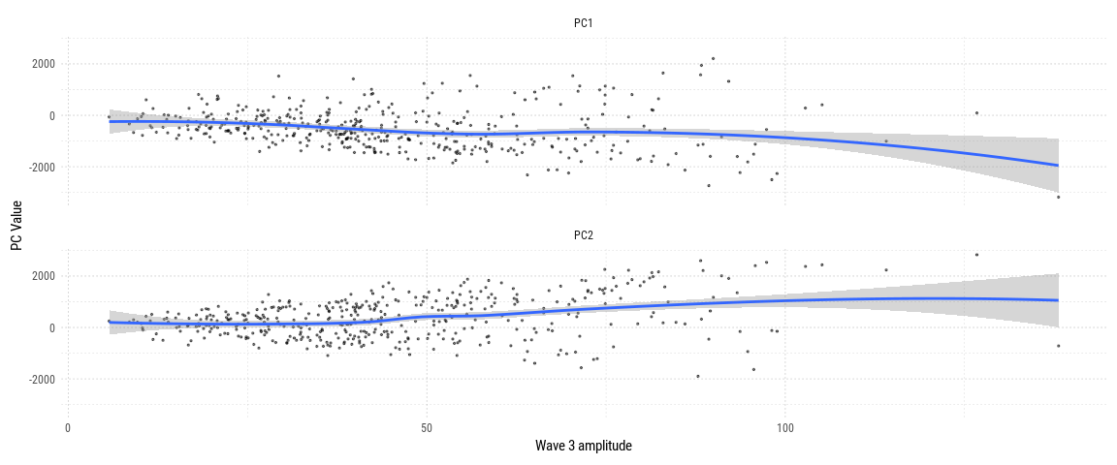
Relationship between wave 3 amplitude and the first 2 principal components.
Notes:
La relación entre los PCs y la amplitud no es evidente así por separado.

Slide 13
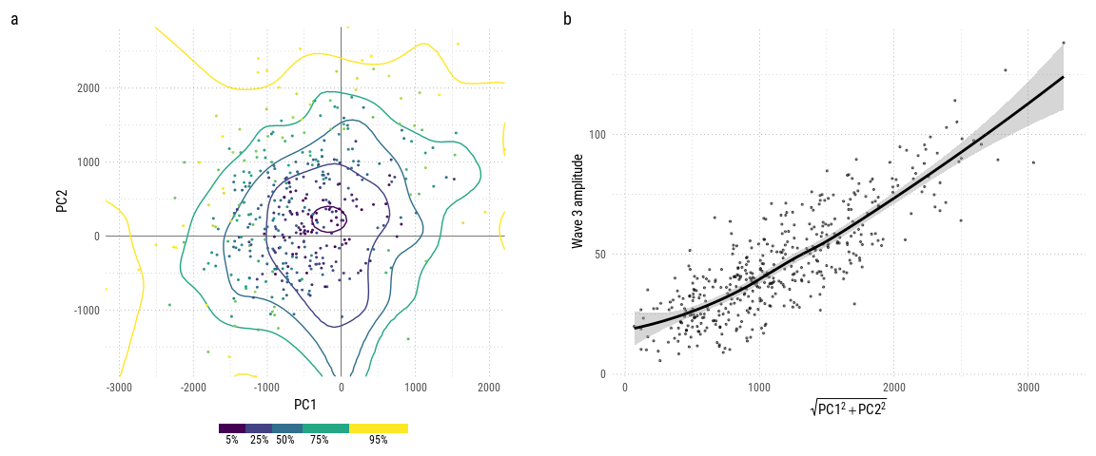
Relationship between 2 first EOFs and amplitude of wave 3. a) Monthly mean wave 3 amplitude as a function of PC1 and PC2; contours represent a smooth surface from data points b) Amplitude of monthly mean wave 3 amplitude as a function of PC1 and PC2 magnitude; line is a loess smooth.
Notes:
La relación conjunta entre las variables sí es muy fuerte. Claramente la amplitud de la onda 3 está asociada a la magnitud del vector (PC1, PC2)

Slide 14
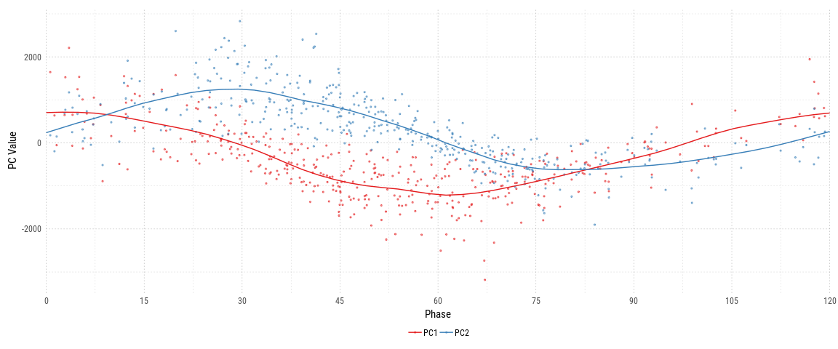
Phase of zonal wave 3 and value of PCs 1 to 2. The line is a loess smooth.
Notes:
PC1 y PC2 también tienen información sobre la fase de la onda 3.

Slide 15
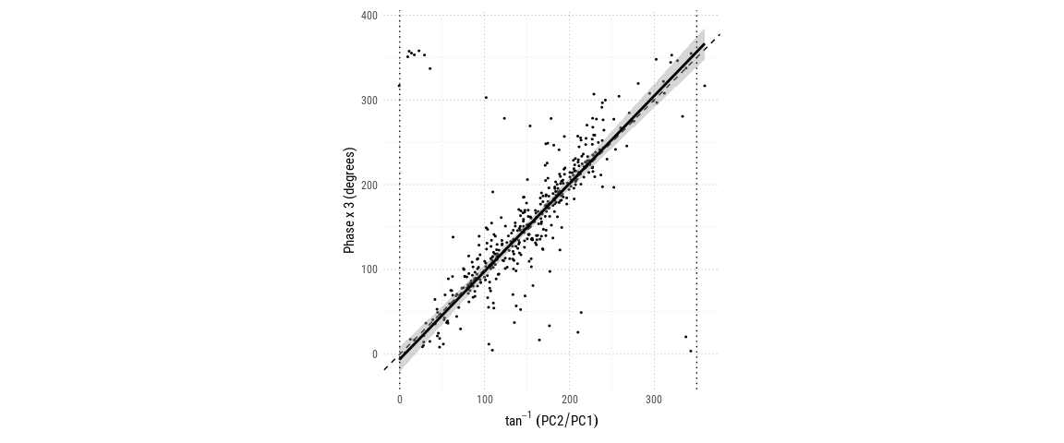
Relationship between wave 3 phase and angle between PC2 and PC1. Points to the left of the left dotted line are duplicates from the right of the right dotted line. Dashed line is the x = y line and solid line is a linear fit based on the Theil-Sen estimator.
Notes:
The first two principal modes are closely related to the zonal wave 3. In fact, it can be shown that they define a rotation of the complex plane defined by the real an imaginary part of the wave3 fourier transform.

Slide 16
PC | PC1 | PC2
R | 0.0344394 | -0.0012245
I | -0.0000661 | -0.0371226

Slide 17
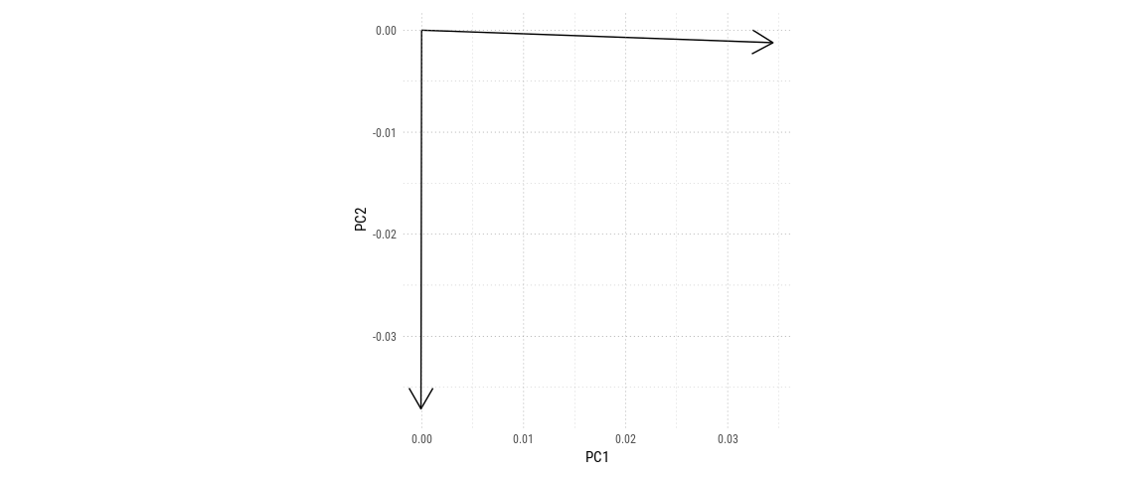
Angle between PC1 and PC2 and Real and Imaginary part of wave 3

