Slide 1
05 - Más CEOF
Elio Campitelli

Slide 2
Usando Complex EOF.
La idea de CEOF es capturar patrones propaganes mediante EOF. Se convierte una serie x en X + iH(x) donde H(x) es la transformada de Hilbert, esencialmente la serie original corrida en 90° en el espacio de Fourier.
El resultado es un EOF con valores complejos a partir del cual se puede calcular magnitud y fase.

Slide 3
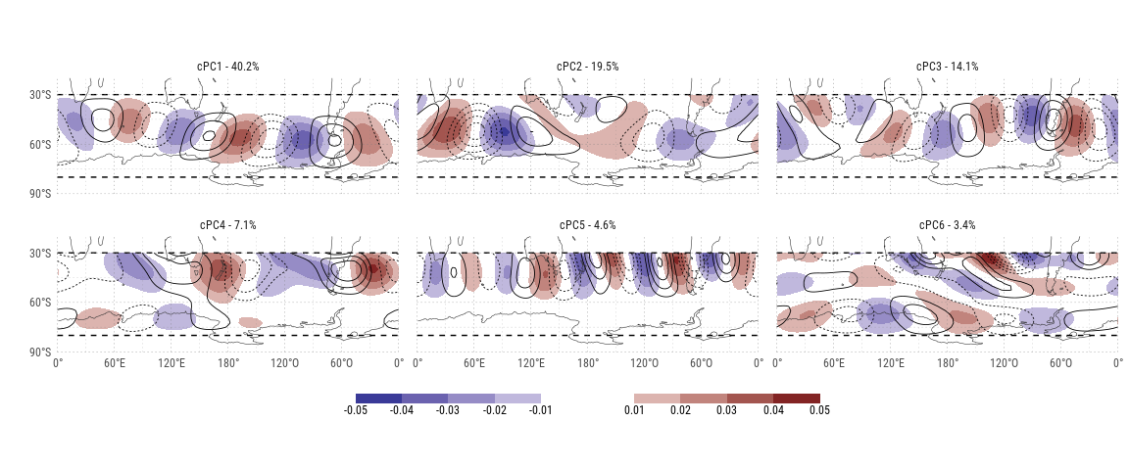
Real (shading) and imaginary (contours) parts of the first 6 CEOFs.

Slide 4
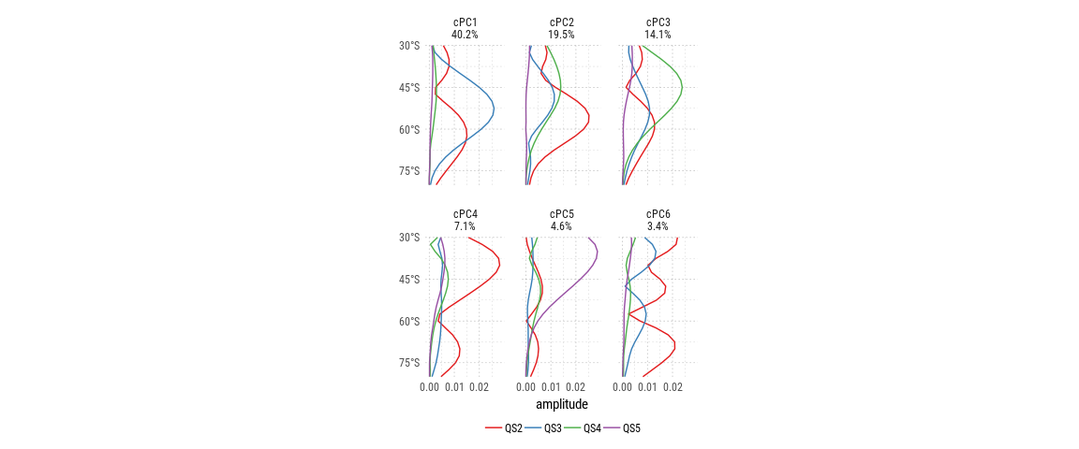
Fourier decomposition by latitude of each cEOF.

Slide 5
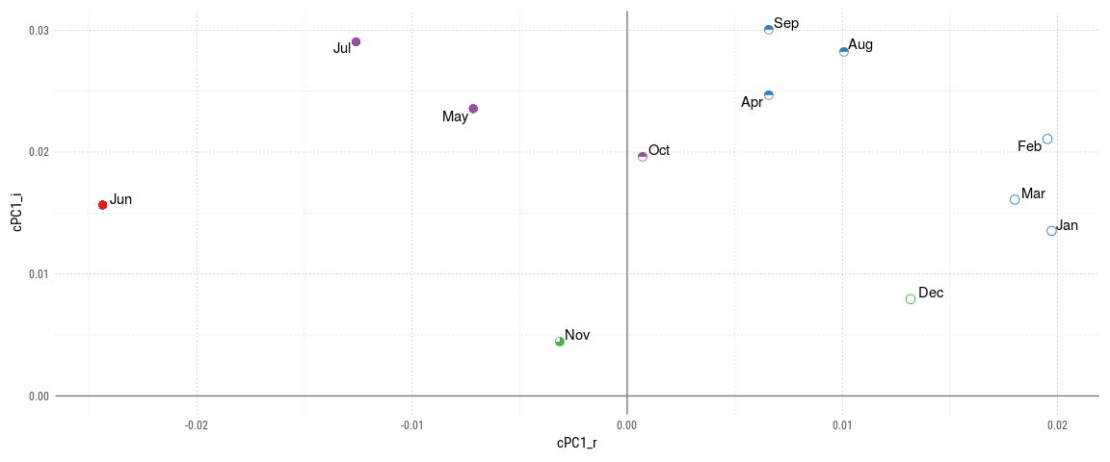
Monthly mean values for each PC. Colors and shapes divide months into 5 ‘seasons’.

Slide 6
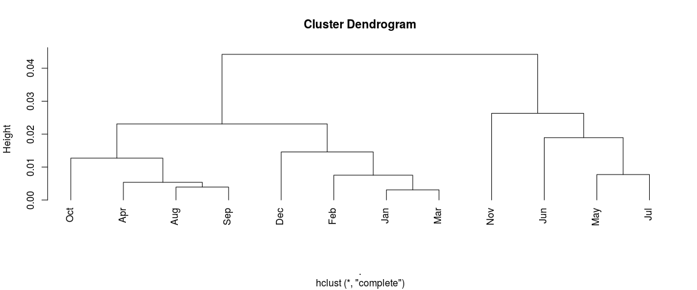
Hierarchical clustering of the months of the year according to the standard deviation of each PC scaled by it’s variance.

Slide 7
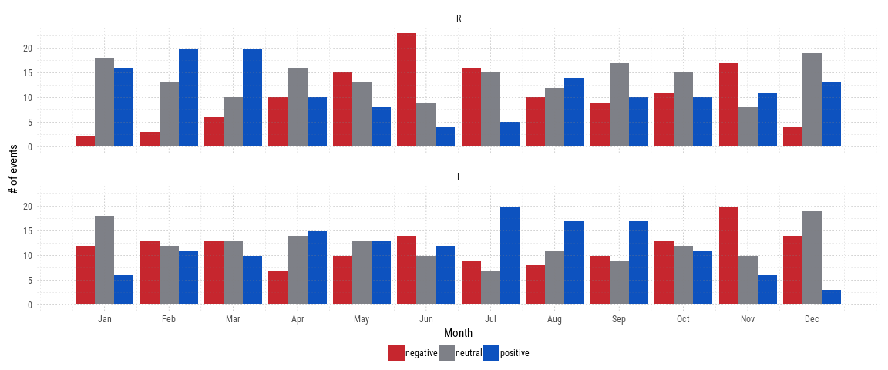
Number of positive and negative events (+- 0.5 sigma) for each PC and each month.

Slide 8
## time R I ## 1: 1979-12-01 0.025531181 -0.009245886 ## 2: 1980-01-01 0.026159483 0.008647654 ## 3: 1980-02-01 0.061980833 -0.002855979 ## 4: 1980-03-01 0.010498338 -0.005207460 ## 5: 1980-04-01 -0.009695811 0.032265608 ## --- ## 428: 2015-07-01 0.019092810 -0.014493214 ## 429: 2015-08-01 0.020062130 -0.003334156 ## 430: 2015-09-01 -0.068149985 0.018928223 ## 431: 2015-10-01 -0.056811199 0.047927304 ## 432: 2015-11-01 -0.018543134 -0.013411875
## time R I cPC part gh ## 1: 1979-12-01 positive negative cPC1 R 0.025531181 ## 2: 1980-01-01 positive neutral cPC1 R 0.026159483 ## 3: 1980-02-01 positive negative cPC1 R 0.061980833 ## 4: 1980-03-01 neutral negative cPC1 R 0.010498338 ## 5: 1980-04-01 neutral neutral cPC1 R -0.009695811 ## --- ## 860: 2015-07-01 neutral negative cPC1 I -0.014493214 ## 861: 2015-08-01 neutral negative cPC1 I -0.003334156 ## 862: 2015-09-01 negative neutral cPC1 I 0.018928223 ## 863: 2015-10-01 negative positive cPC1 I 0.047927304 ## 864: 2015-11-01 negative negative cPC1 I -0.013411875

Slide 9
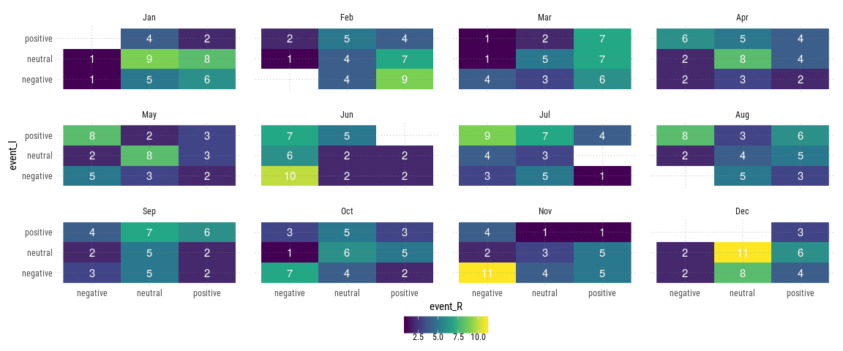

Slide 10
