Slide 1
Title Goes Here

Slide 2
Introduction

Slide 3
Data & Methods
ERA5, ERA5 BE, ERA 20C
If

Slide 4
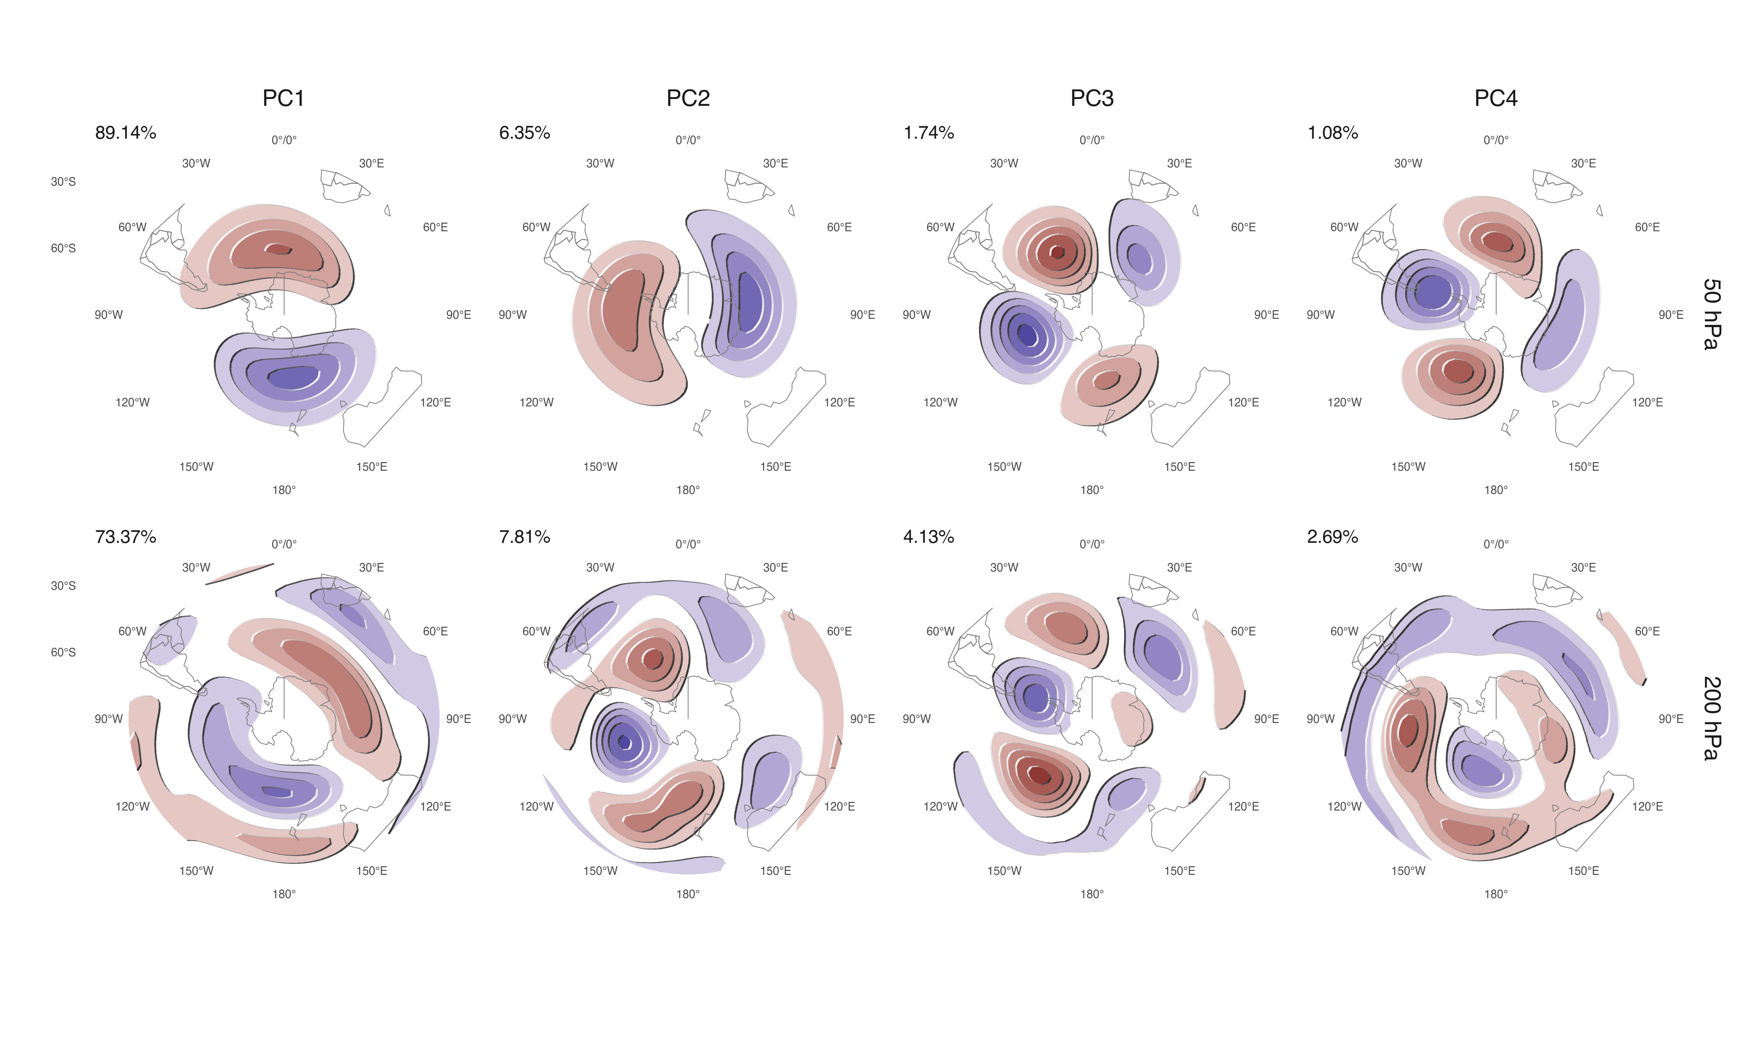
PC1, PC2 y PC3 de las anomalías zonales de altura geopotencial en 200hPa entre 80S y 20S.

Slide 5
(ref:cap-cor-eof-naive) Correlation of the absolute magnitude of complex EOFs between 200 hPa and 50 hPa.

Slide 6
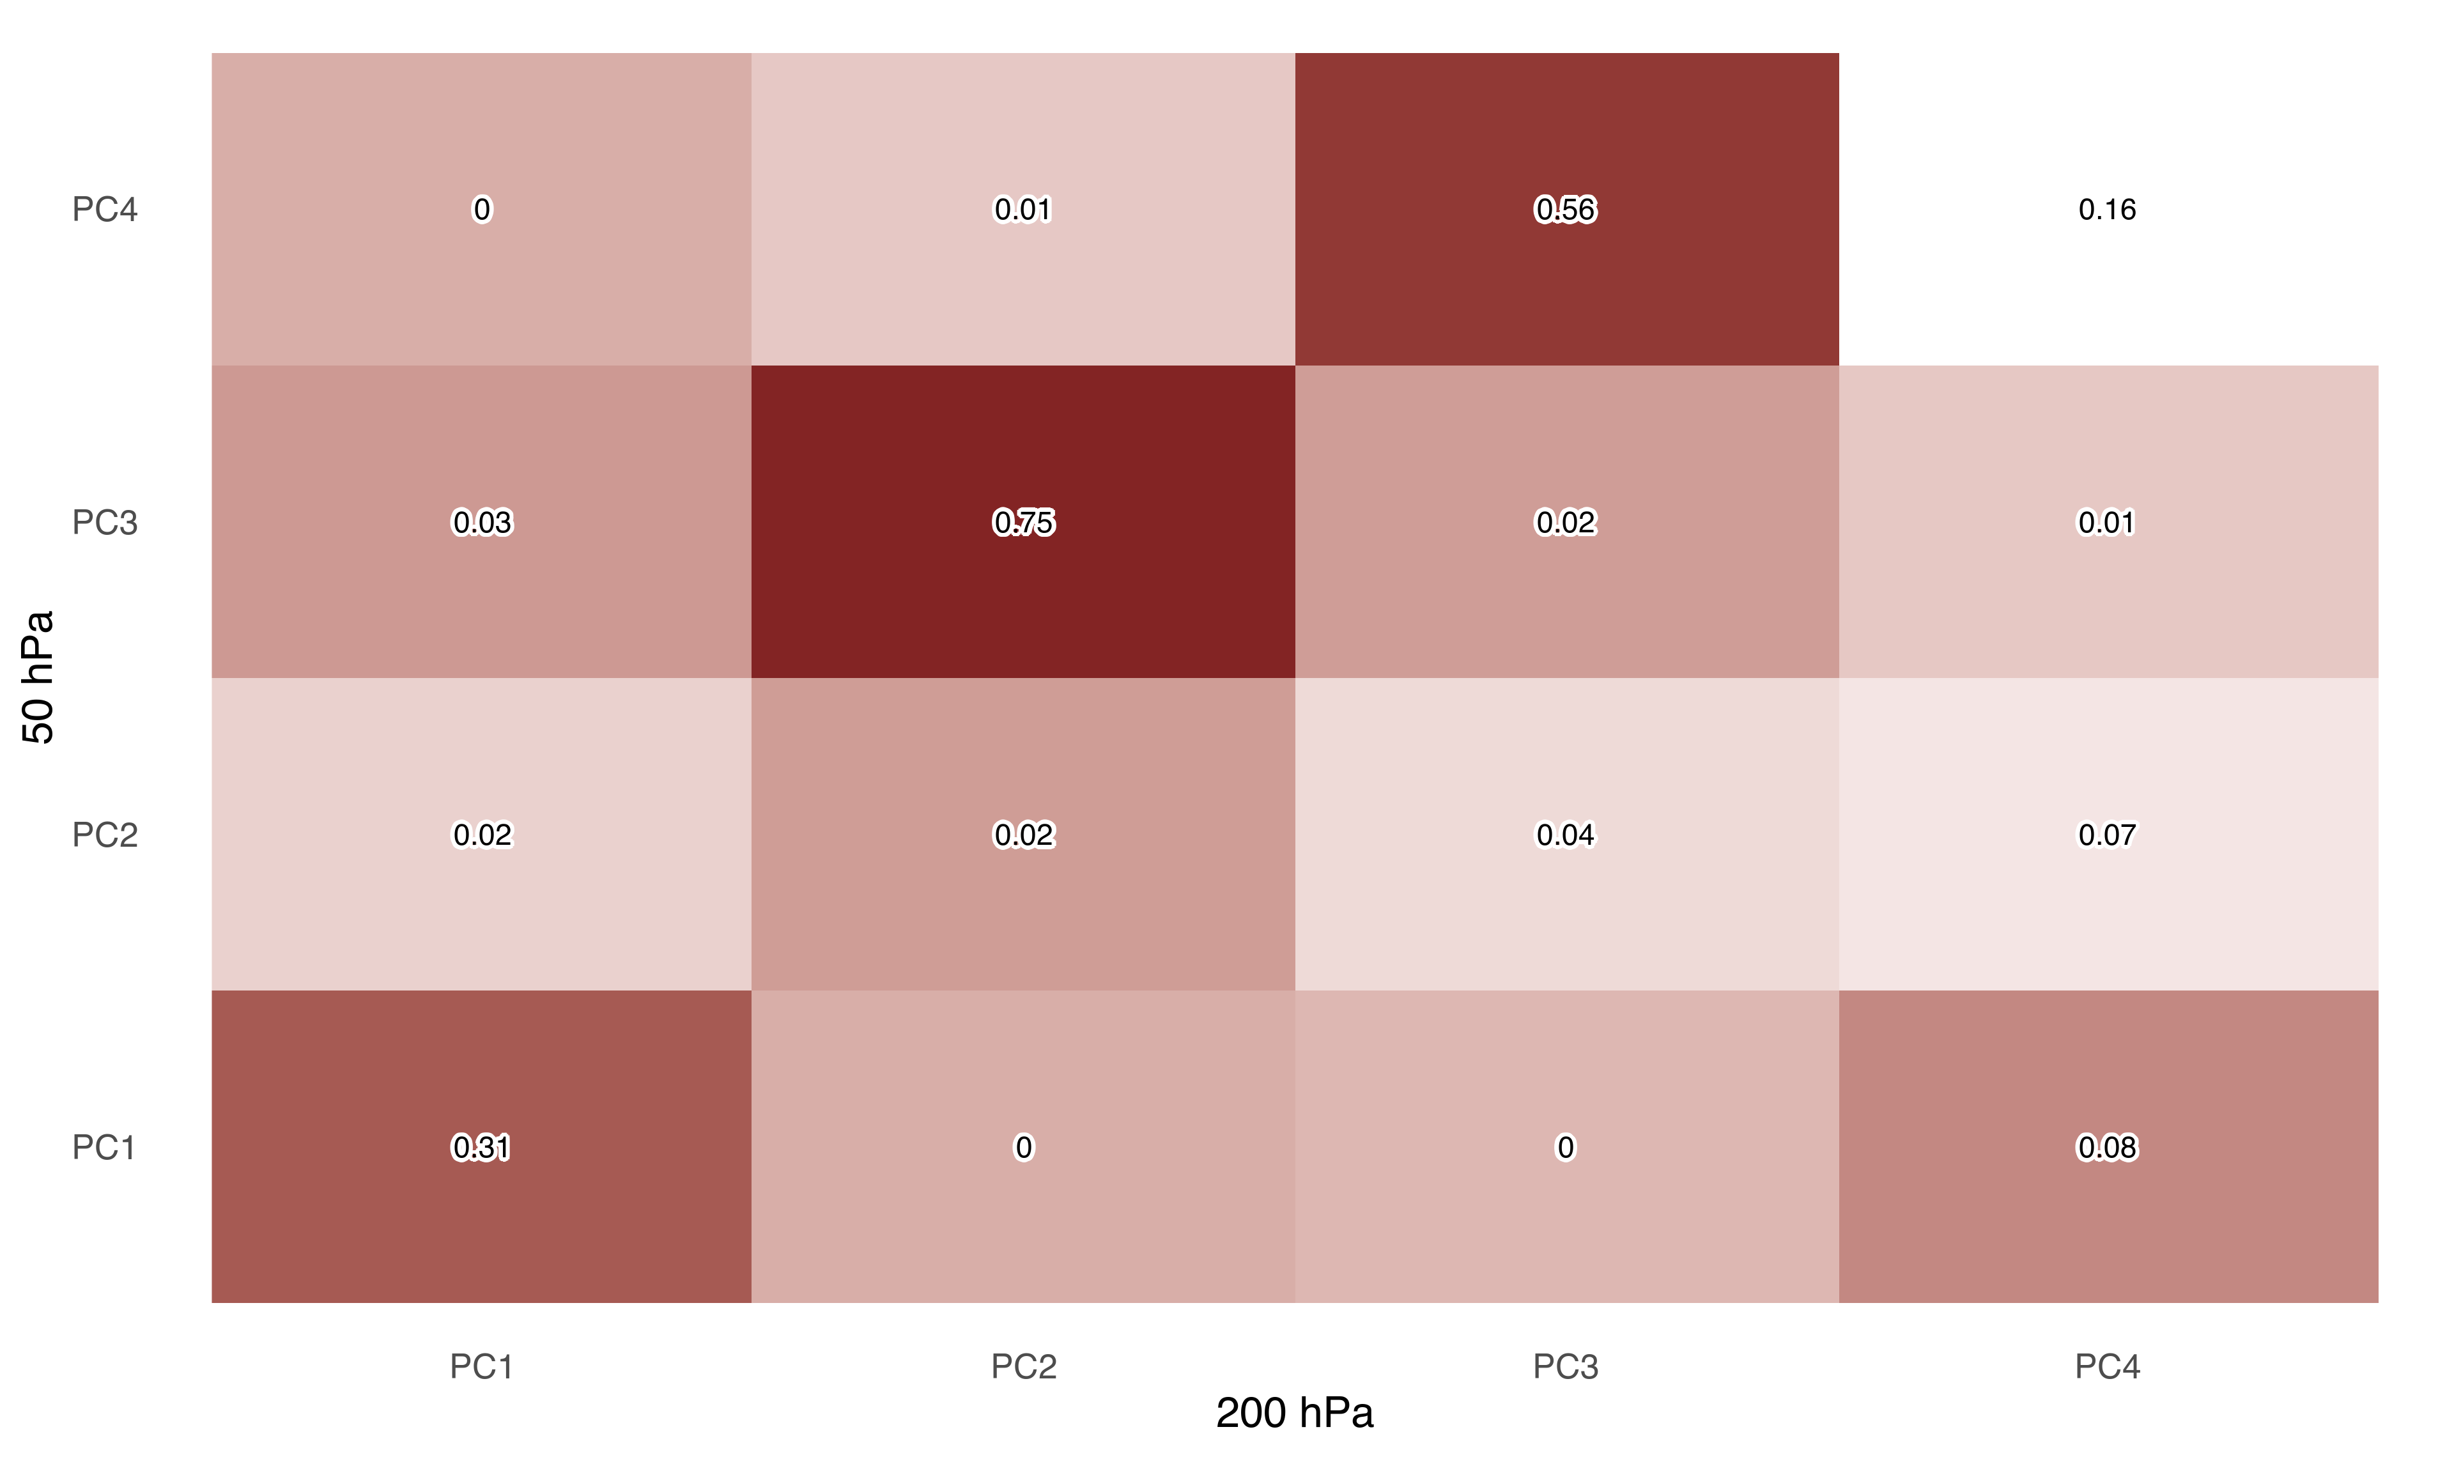
(ref:cap-cor-eof-naive)

Slide 7
–>

