Slide 1
Comparative analysis of software for inferring cell-cell communication in single-cell RNA sequencing data
MASTER'S THESIS
MASTER'S DEGREE IN BIOINFORMATICS
Student: Korchi Meziani, Elías
Supervisor: Zúñiga Trejos, Sheila

Slide 2
Table of Contents
Introduction
Objectives
Methodology
Results and Discussion
Conclusions

Slide 3
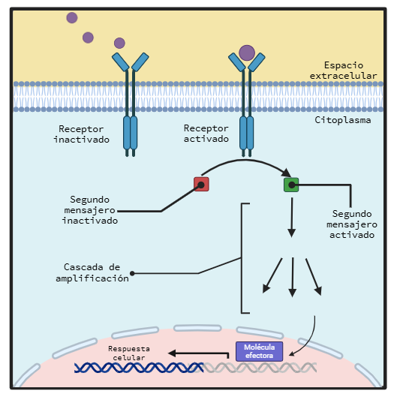
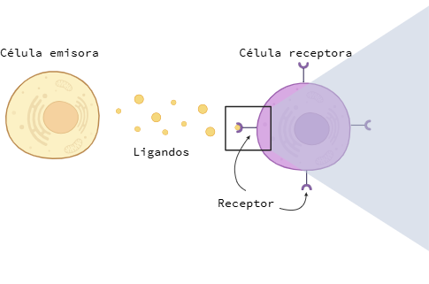
1. Introduction
2. Objectives
3. Methodology
4. Results and Discussion
5. Conclusions
Cell-cell communication
Notes:
Cell-cell communication is the process by which cells detect and respond to signals from their environment. In this process, secretory cells produce and release signaling molecules, known as ligands. Once the ligand reaches the receptor, a series of intracellular signaling cascades occur, typically mediated by second messengers. These second messengers are responsible for transmitting the signal from the receptor to the cell nucleus. During the signaling cascade, regulatory mechanisms are activated to modulate the intensity and duration of the signal, ensuring that the target cells' response is appropriate to the received stimulus. The arrival of intracellular signals ultimately leads to changes in gene expression and, consequently, the synthesis of specific proteins.

Slide 4
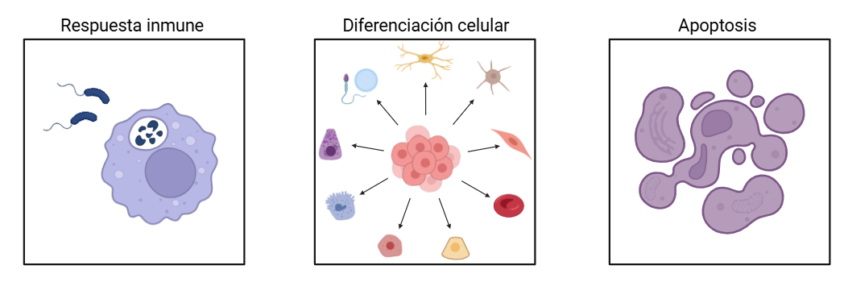
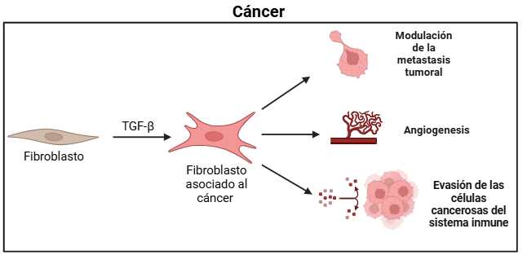
1. Introduction
2. Objectives
3. Methodology
4. Results and Discussion
5. Conclusions
Normal cellular response
Altered cellular response
Notes:
Cell-cell communication (CCC) coordinates cellular responses in vital processes of multicellular organisms, such as the immune response, cell differentiation, and apoptosis. It has been demonstrated that alterations in CCC are associated with various diseases, as disruptions in this process can affect the normal function of cells and tissues. A prominent example is cancer.
When fibroblasts receive the transforming growth factor beta ligand, they transform into cancer-associated fibroblasts, which modulate tumor metastasis, influence angiogenesis, and contribute to the immune system evasion of cancer cells and their resistance to therapies.

Slide 5
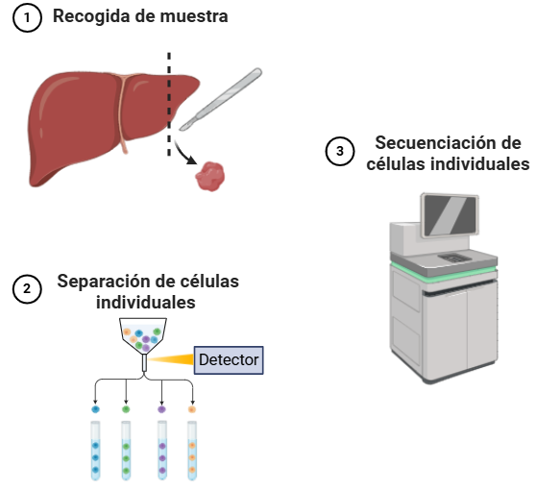
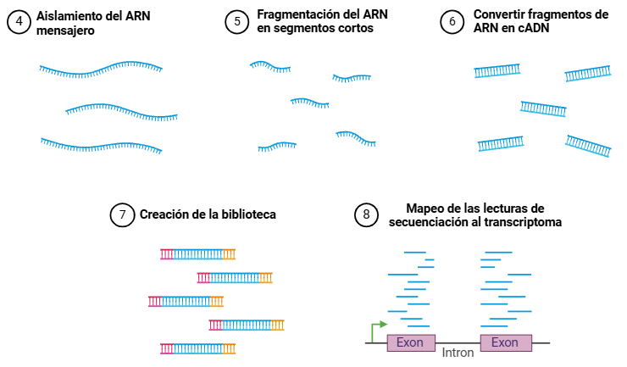
4. Resultados y discusión
1. Introduction
2. Objectives
3. Methodology
4. Results and Discussion
5. Conclusions
Single-cell RNA sequencing
Notes:
For CCC analysis, it is essential to identify the cell's transcriptome. The transcriptome consists of messenger RNA molecules that contain DNA information. Knowing the number of transcripts in a cell allows us to estimate gene expression and determine which genes are being encoded, including those coding for ligands and receptors.
The most commonly used technique for identifying the transcriptome is single-cell RNA sequencing.
The first step is sample collection, the second step involves isolating and capturing individual cells, and the third step is sequencing itself. The general sequencing process involves isolating messenger RNA from other cellular molecules, fragmenting it into short segments, converting it into complementary DNA, preparing the sequencing library, and finally mapping the reads obtained after sequencing. This mapping helps identify the genes encoded in the cell.

Slide 6
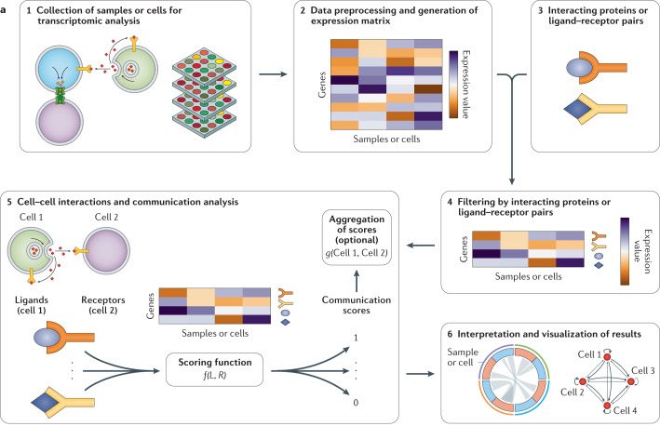
1. Introduction
2. Objectives
3. Methodology
4. Results and Discussion
5. Conclusions
CCC inference software from scRNA-seq data
Obtaining the transcriptome of the sample through sequencing
Bioinformatic procedures to remove artifacts and generate the gene expression matrix
Referencing to a curated database to reveal ligands and receptors
Notes:
Once the transcriptome is obtained, the workflow continues with processing the data to create a gene expression matrix (GEM), which records the gene expression levels of individual cells. Each row in the matrix represents a gene, and each column represents a cell. After the matrix is created, it is necessary to identify genes that code for ligands and receptors. This is achieved by comparing the matrix with public protein-protein interaction databases.

Slide 7
1. Introduction
2. Objectives
3. Methodology
4. Results and Discussion
5. Conclusions
CCC inference software from scRNA-seq data
Filtering the gene expression matrix by ligand-receptor interacting pairs
Mathematical relationship of gene co-expression between ligands and receptors with communication functions to calculate the communication score
Visualization through plots and interpretation of results
Notes:
The fourth step involves filtering the expression matrix to include only the ligands and receptors of the cell.
The fifth step is to identify ligand-receptor (LR) interactions, with the software referencing public databases that cover a wide range of interactions. Since CCC is represented as a mathematical relationship between ligand expression and receptor expression, the software evaluates communication using communication functions to score the interactions and create the cell interaction matrix. This matrix represents the cellular interactions within the sample. Each row corresponds to an interaction, while the columns contain relevant information such as sender and receiver cells or communication scores.
The sixth step involves using graphs for visualization and interpreting the results.

Slide 8
Pseudo-bulk approach
4. Resultados y discusión
1. Introduction
2. Objectives
3. Methodology
4. Results and Discussion
5. Conclusions
CCC inference software from scRNA-seq data
vs
Cellular resolution approach
It groups cells into clusters or cell types based on gene expression patterns.
It averages gene expression within each group.
It reduces technical noise from biological variability.
It loses individual resolution..
It keeps data at the single-cell level.
There is no averaging of gene expression. It preserves cellular variability and heterogeneity.
More realistic CCC inference.
It requires advanced techniques to handle the high dimensionality of the data.
Notes:
There are two main approaches used in software for analyzing CCC:
Pseudo-bulk Approach
Since sample sequencing can involve working with hundreds of thousands of cells, this approach groups these cells by averaging their gene expression profiles within each group. This helps reduce technical noise inherent to the biological variability of CCC. However, averaging the gene expression values within groups results in the loss of individual resolution. Consequently, it does not biologically represent CCC since interactions occur between individual cells rather than at the group level.
Single-Cell Resolution Approach
On the other hand, the single-cell resolution approach retains data at the individual cell level without averaging the gene expression of ligands and receptors. By doing so, it preserves cell variability and heterogeneity, providing a more realistic representation of CCC. Since this approach works with large volumes of data on a cell-by-cell basis, optimization procedures are implemented to handle the high dimensionality.

Slide 9
1. Introduction
2. Objectives
3. Methodology
4. Results and Discussion
5. Conclusions
Justification
Most CCC inference softwares follow a pseudo-bulk approach, losing individual resolution.
CCC operates at the cellular level, not at the group level.
Recently, software with a single-cell resolution approach has been developed.
These methods propose a more realistic representation of CCCs because they allow for the direct inference of LR interactions between individual cells.
Is the single-cell resolution approach more effective than the pseudo-bulk approach for identifying and characterizing intercellular communications?
Notes:
Most of the tools developed to infer CCC use a pseudo-bulk approach, which results in a loss of resolution in the process.
As mentioned, CCC operates at the cellular level, not at the group level. Recently, software with a single-cell resolution approach has been developed, allowing for the direct inference of LR interactions between individual cells. These methods provide a more accurate representation of CCCs.
It is crucial to perform rigorous comparisons between the single-cell resolution approach and the classical pseudo-bulk approach to evaluate their capabilities.

Slide 10
Main Objective
1. Introduction
2. Objectives
3. Methodology
4. Results and Discussion
5. Conclusions
Establish an analysis pipeline for the study of CCCs in scRNA-seq data.
Specific Objectives
Evaluate and compare the accuracy of the tools CellChat and NICHES in predicting LR interactions using validated databases such as FANTOM5 and proteomics, and measure the consistency and concordance of their predictions against variations in sample size, employing indices such as Jaccard and Similarity.
Analyze the runtime and memory consumption of CellChat and NICHES when processing different scRNA-seq datasets.

Slide 11
CellChat
1. Introduction
2. Objectives
3. Methodology
4. Results and Discussion
5. Conclusions
NICHES
It uses its own curated database, CellChatDB, although in this benchmark, FANTOM5 is used.
It assigns a probability value to each ligand-receptor (LR) interaction.
This value is modeled by the law of mass action.
It averages the expression of the ligand and receptor in each group using the geometric mean.
Zero-preserving method.
It uses the FANTOM5 database.
The score for each ligand-receptor (LR) interaction is obtained by multiplying the expression of the ligand by that of the receptor.
Zero-preserving method.
If one of the components, either ligand or receptor, has zero expression, the interaction is considered nonexistent.
Notes:
The representative tool of the pseudo-bulk approach is CellChat, a software that has been validated in various benchmarks as a reliable option.
It initiates CCC inference by detecting ligands, receptors, and interactions using its own curated database, CellChatDB.
To quantify CCCs, CellChat scores interactions using a probability value modeled based on the law of mass action, calculated as the geometric mean of the expression values of a ligand and its receptor.

Slide 12
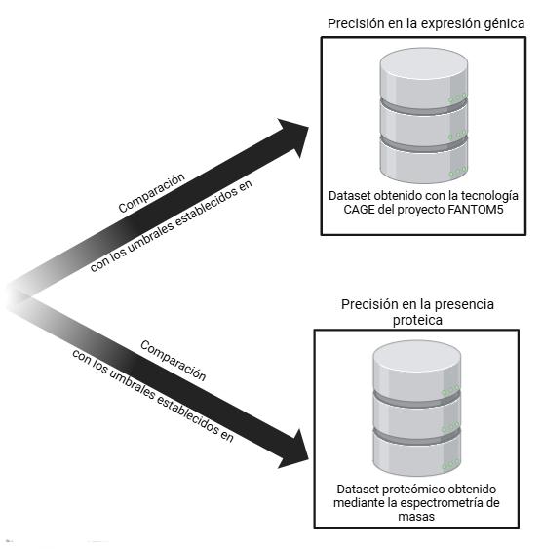
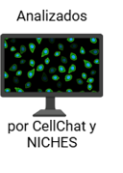
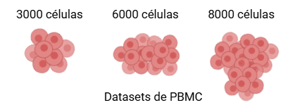

1. Introduction
2. Objectives
3. Methodology
4. Results and Discussion
5. Conclusions
Evaluation of Precision
Notes:
The first metric evaluated in this comparative study between NICHES and CellChat is precision. Following the approach of Cabello-Aguilar et al., who created a pseudo-gold standard using the FANTOM5 project dataset—based on CAGE technology—and a proteomics database.
The dataset obtained through CAGE technology was used to assess the accuracy of gene expression, as CAGE offers greater precision than scRNA-seq in measuring the gene expression of ligands and receptors. The authors established a threshold of 10 TPM for both the ligand and the receptor to consider an interaction as expressed.
The proteomics database was used to verify the presence of proteins in the predictions, since mass spectrometry is more accurate than scRNA-seq in protein detection. The authors set a threshold of an average spectral count greater than 2.
Following Cabello-Aguilar’s methodology, PBMC datasets were analyzed using both CellChat and NICHES, and then compared against these thresholds to evaluate the precision of each software in terms of both gene expression and protein presence. Finally, precision was assessed using the Area Under the Precision-Recall Curve (AUPRC).

Slide 13
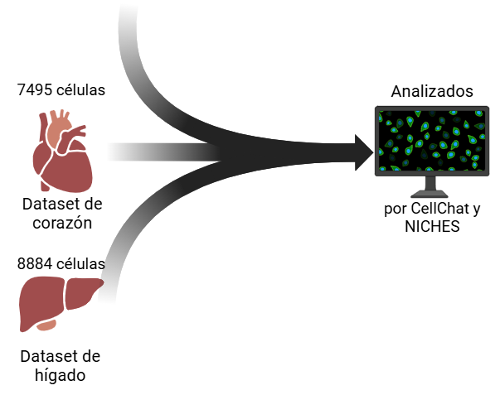
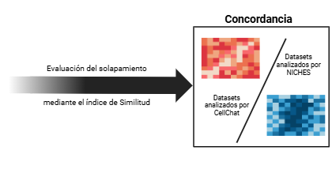
1. Introduction
2. Objectives
3. Methodology
4. Results and Discussion
5. Conclusions
Evaluation of Concordance
Notes:
The second step in the comparison was to evaluate concordance, which measures how consistent the predicted cell-cell interactions are between the different tools—in this case, CellChat and NICHES. The number of interactions in the analyzed datasets was examined, and the overlap in the number of interactions predicted by both tools was measured for each dataset using the similarity index, a modified version of the Jaccard index.

Slide 14
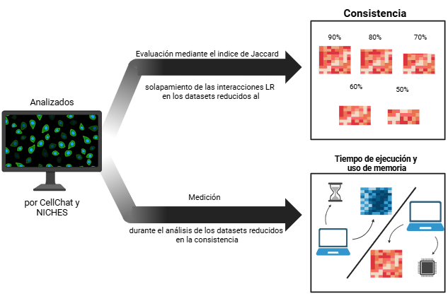
1. Introduction
2. Objectives
3. Methodology
4. Results and Discussion
5. Conclusions
Evaluation of Consistency and Computational Resources
Notes:
The third step of the benchmark involved assessing the consistency of the software. Consistency refers to a tool’s ability to maintain predictive performance across different proportions of cells from the original dataset. To evaluate this, datasets were subsampled at the proportions shown on screen, the number of interactions in these reduced datasets was analyzed, and the percentage of overlapping interactions within each reduced set was calculated for each software.
The final step of the benchmark was the evaluation of runtime and memory usage

Slide 15
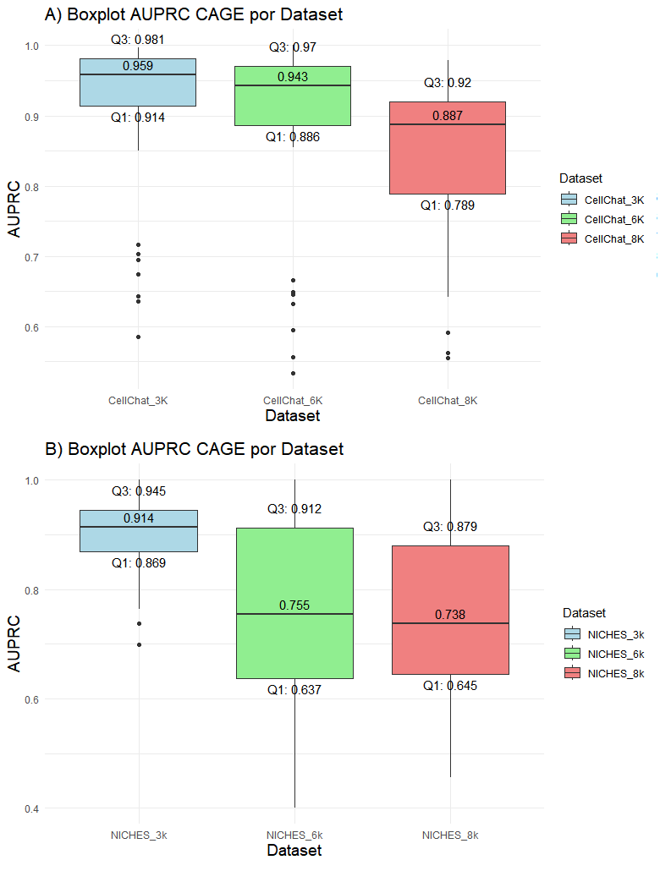
1. Introduction
2. Objectives
3. Methodology
4. Results and Discussion
5. Conclusions
Protein Expression Precision
Notes:
After obtaining the AUPRC values for gene expression precision, the precision results for each dataset were visualized using boxplots.
The median values in CellChat’s boxplots are higher than those of NICHES, indicating greater precision in gene expression across all three datasets. It can also be observed that CellChat has more outliers than NICHES, particularly those falling below the interquartile range, suggesting that gene expression predictions for certain cell types are being severely underestimated.
The IQR (Interquartile Range), calculated as the difference between the third quartile and the first quartile

Slide 16
1. Introduction
2. Objectives
3. Methodology
4. Results and Discussion
5. Conclusions
Protein Expression Precision
CellChat
Dataset | Third Quartile | First Quartile | IQR
PBMC 3k | 0.981 | 0.914 | 0.067
PBMC 6k | 0.970 | 0.886 | 0.085
PBMC 8k | 0.920 | 0.789 | 0.131
CellChat presented a total of 17 outliers, while NICHES only showed 2 outliers.
NICHES
Dataset | Third Quartile | First Quartile | IQR
PBMC 3k | 0.945 | 0.869 | 0.076
PBMC 6k | 0.912 | 0.637 | 0.276
PBMC 8k | 0.879 | 0.645 | 0.234
NICHES' predictions are more spread out around the median in contrast to CellChat.

Slide 17
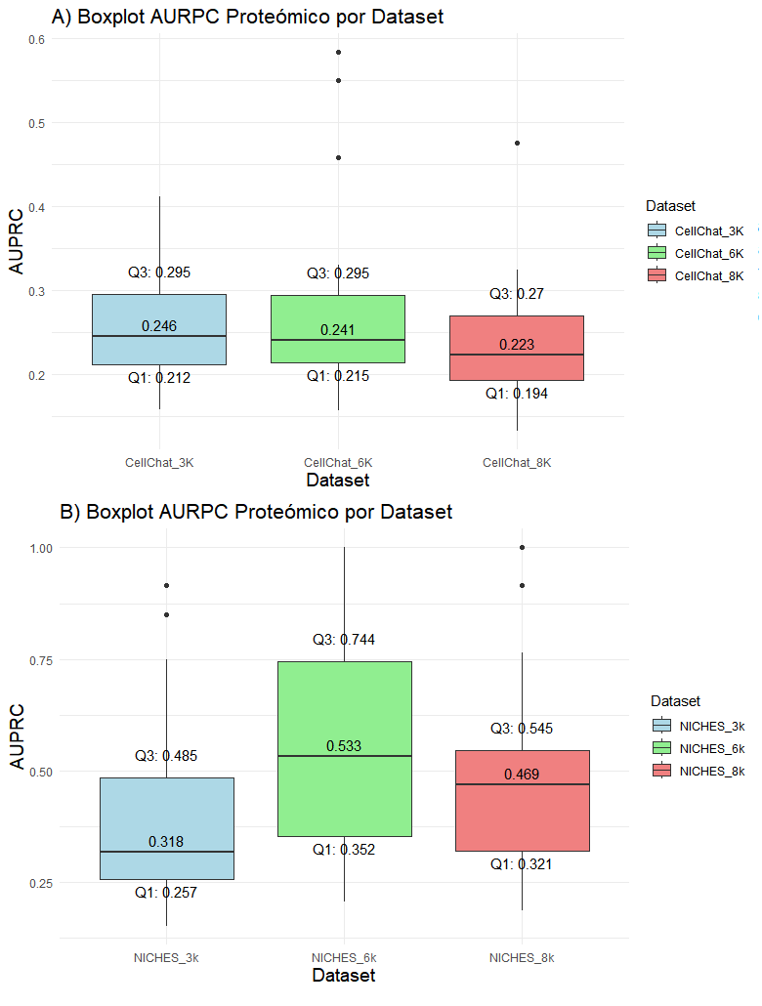
1. Introduction
2. Objectives
3. Methodology
4. Results and Discussion
5. Conclusions
Protein Expression Precision

Slide 18
1. Introduction
2. Objectives
3. Methodology
4. Results and Discussion
5. Conclusions
Protein Expression Precision
CellChat
Dataset | Third Quartile | First Quartile | IQR
PBMC 3k | 0.295 | 0.212 | 0.083
PBMC 6k | 0.295 | 0.215 | 0.081
PBMC 8k | 0.270 | 0.194 | 0.076
NICHES reaches a maximum value of 1 for both PBMC 6k and PBMC 8k, detecting the protein presence of all interactions.
As with the CAGE data, CellChat's predictions are concentrated around the median.
NICHES
Dataset | Third Quartile | First Quartile | IQR
PBMC 3k | 0.485 | 0.257 | 0.228
PBMC 6k | 0.744 | 0.352 | 0.392
PBMC 8k | 0.545 | 0.321 | 0.224

Slide 19
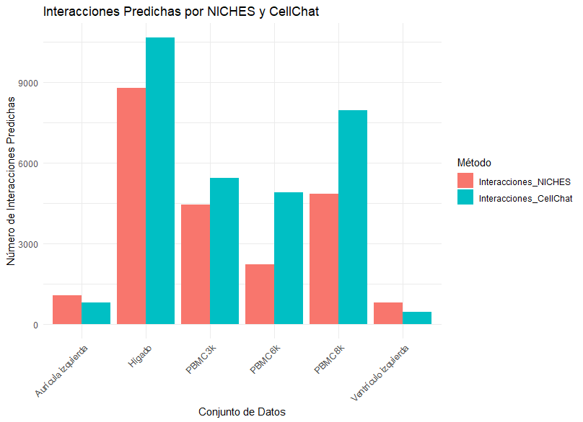
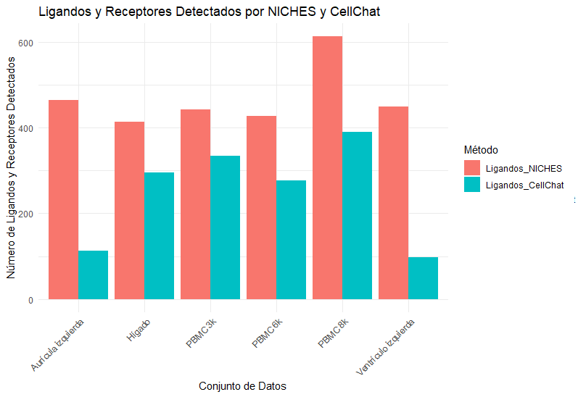
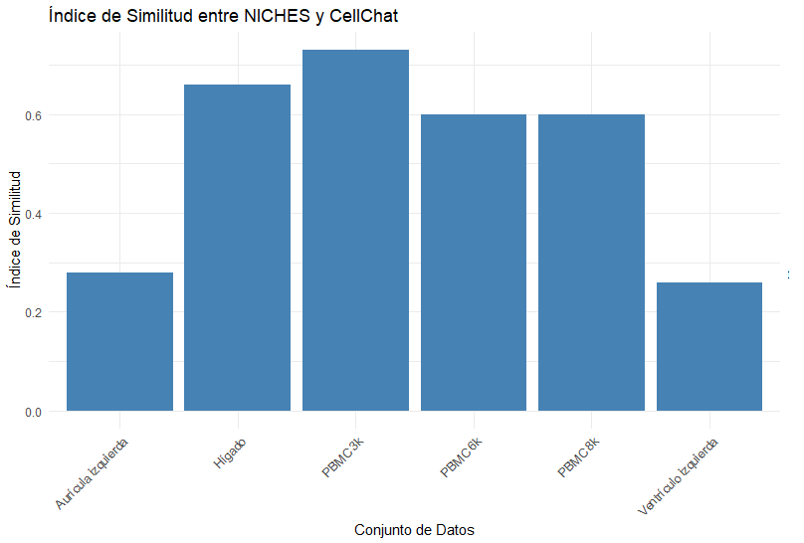
1. Introduction
2. Objectives
3. Methodology
4. Results and Discussion
5. Conclusions
Concordance
NICHES predicted fewer interactions than CellChat, except in the atrium and left ventricle data.
NICHES identified more ligands and receptors than CellChat in all datasets.
Most datasets showed a positive similarity (≥ 60%) between NICHES and CellChat

Slide 20
1. Introduction
2. Objectives
3. Methodology
4. Results and Discussion
5. Conclusions
Consistency
CellChat
Reduction | Jaccard Index
90% | 0.959
80% | 0.900
70% | 0.895
60% | 0.822
50% | 0.782
The maximum value of the Jaccard index in CellChat is 0.959, while in NICHES it is 0.665.
CellChat retained 78% of the original interactions when the dataset was reduced to 50%, while NICHES only identified 61%.
NICHES showed a more pronounced decrease in its Jaccard index, indicating that it was more sensitive to the reduction in dataset size than CellChat.
NICHES
Reduction | Jaccard Index
90% | 0.665
80% | 0.653
70% | 0.637
60% | 0.627
50% | 0.611

Slide 21
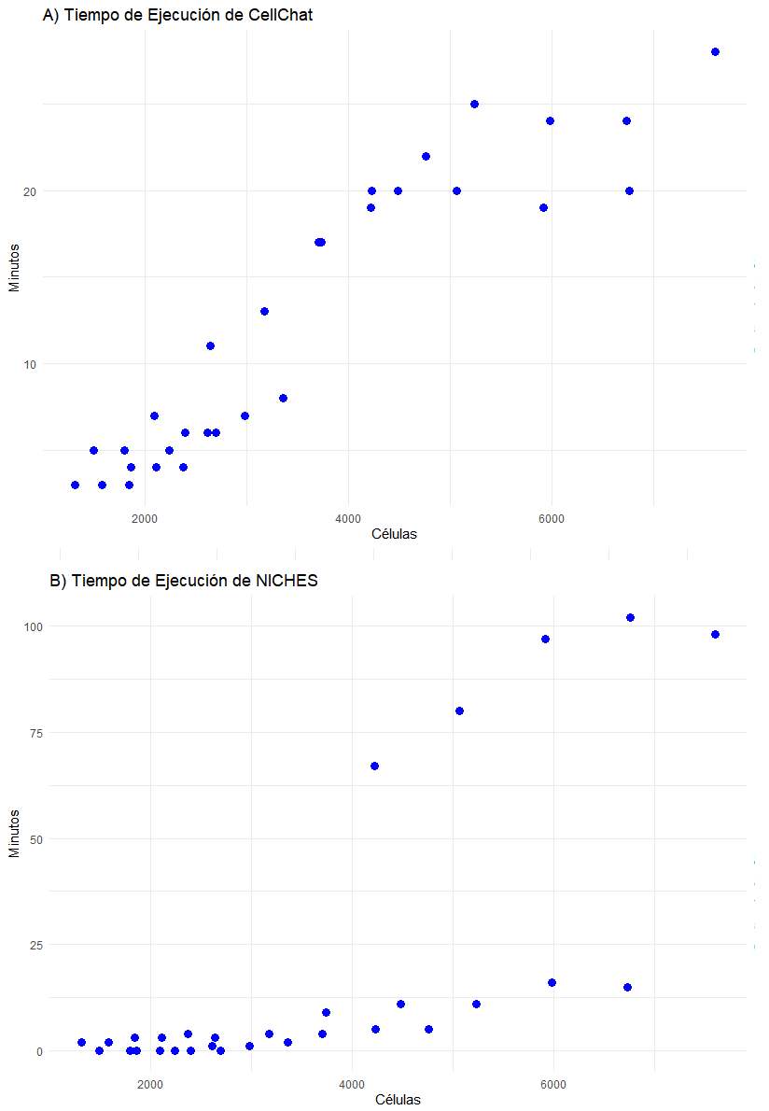
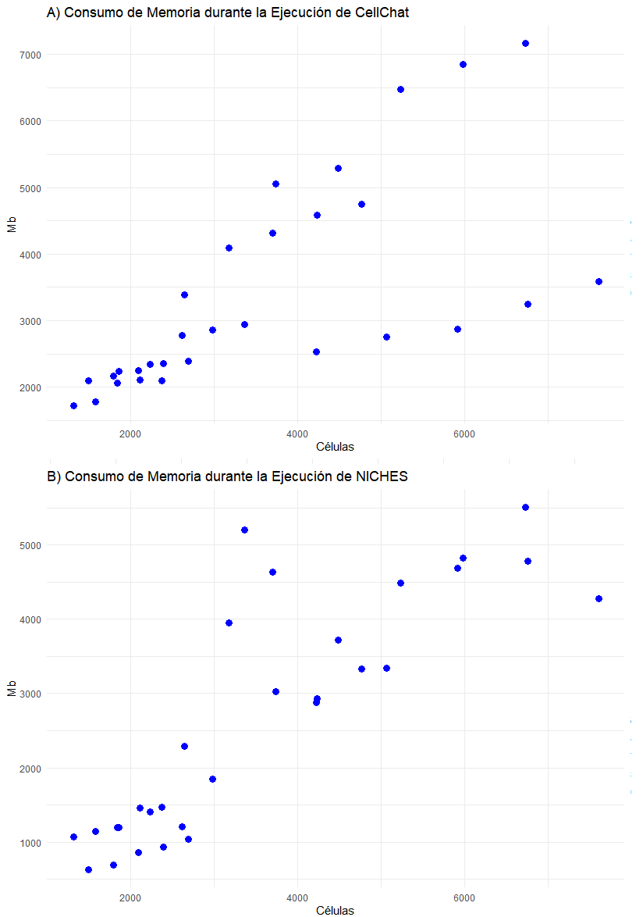
1. Introduction
2. Objectives
3. Methodology
4. Results and Discussion
5. Conclusions
Computational Resources
CellChat shows a more pronounced and linear trend in resource consumption.
In NICHES, the number of cell types significantly affects the runtime.

Slide 22
Effects
1. Introduction
2. Objectives
3. Methodology
4. Results and Discussion
5. Conclusions
Methodological Approach of CellChat
Methodology
Number of Interactions
Probability Value
Averaged Gene Expression
Reduction of Technical Noise
produce
Gene Expression Precision
Consistency, Concentration of Predictions
Protein Presence Precision
It does not have a technique to handle high-dimensionality data
produce
Runtime and Memory Consumption
Notes:
CellChat employs a probabilistic approach based on the law of mass action, allowing it to assign a probability to each ligand-receptor (LR) interaction, calculated from the average gene expression of individual cells. Additionally, it accounts for cofactors and cooperativity among protein subunits. This method can lead to the identification of more interactions by averaging expression levels across cells within groups, thus increasing the likelihood of detecting ligands and receptors within clusters. The interaction probability is based on the geometric mean of the expression values of a ligand and its subunits in one cell group, and a receptor and its subunits in another, including any cofactors. A zero expression value for any subunit implies that the ligand is inactive. However, by averaging gene expression, CellChat smooths out cellular heterogeneity and tends to produce a more uniform range of predicted interactions.
On the other hand, although CellChat applies optimizations in data interpretation through dimensionality reduction and clustering techniques, it does not reduce the number of cells analyzed.

Slide 23
1. Introduction
2. Objectives
3. Methodology
4. Results and Discussion
5. Conclusions
Methodological Approach of NICHES
Methodology
Effects
Precision in Gene Expression
Absence of Averaging
Maintains the inherent biological variability
produce
Number of Ligands and Receptors
Precision in Protein Presence
Concentration in its predictions
Random sampling that reduces the number of cells
produce
Runtime and Memory Consumption
Notes:
Like CellChat, NICHES employs a method that preserves zeros when calculating ligand and receptor expression. In other words, if any component—whether a ligand or receptor subunit—has zero expression, the interaction is automatically considered nonexistent and assigned a value of zero. The absence of an averaging approach in NICHES helps capture the inherent variability in gene expression across different tissues.
NICHES also uses a random sampling scheme to reduce the number of connections considered, selecting a representative subset of cell-cell interactions rather than evaluating all possible connections. This approach facilitates computation and significantly reduces resource demands.

Slide 24
1. Introduction
2. Objectives
3. Methodology
4. Results and Discussion
5. Conclusions
NICHES and CellChat show significant differences in the accuracy of their predictions. CellChat is more accurate in predicting gene expression, presenting higher AUPRC values in CAGE data-based analyses. On the other hand, NICHES is more precise in detecting protein presence, showing higher AUPRC values in proteomic data.
NICHES tends to be more conservative and stable in predicting specific ligand-receptor interactions, but at the cost of detecting fewer interactions compared to CellChat.
CellChat demonstrated greater consistency when faced with dataset size reduction, maintaining a higher proportion of predicted interactions even with significant reductions in the number of cells.
NICHES is more efficient when analyzing datasets with a reduced number of cells, showing shorter runtime and lower memory usage. However, its efficiency decreases as the number of cell types in the datasets increases, significantly increasing its runtime.

Slide 25
Thanks!

