Slide 1
Wildfire Prediction
Elio Khouri and Ilana-Mahmea Siegel

Slide 2
Problem and Significance
Problem: Predicting Wildfire Risk
Why It Matters
Urgency (Wildfires 📈)
Impact (Human lives, economy, ecosystem)
Human Cost: Over 133 lives lost in 5 years (CAL FIRE Statistics).
Economic Burden: Damages exceeding $300 million in 2022.
Environmental Impact: Escalating soil erosion, water contamination, habitat disruption
Health Implications
Need for Prediction
Proactive Approach
Strategic Planning
Notes:
ELIO
Why It Matters
Impact
Human Cost: Over 133 lives lost in 5 years (CAL FIRE Statistics).
Economic Burden: Damages exceeding $300 million in 2022.
Environmental Impact: Escalating soil erosion, water contamination, habitat disruption
Health Implications
Air Quality Deterioration: PM2.5 emissions projected to rise by 60% by mid-century.
Health Risks: Increased ER visits for asthma, respiratory issues.
Vulnerable Groups: Children and elderly most affected.

Slide 3
Previous Approaches and Drawbacks
Models
typically NNs
Features
Location, date, immediate weather
Longer-term weather
Other features: vegetation, fire history
Don’t compare impact of features
Notes:
Mea

Slide 4
Our Experimental Framework
Baseline Model
Baseline Model + Weather History
Baseline Model + Fire History
Baseline Model + Total History
Location
Location
Location
Location
Time
Time
Time
Time
Immediate Weather Conditions
Immediate Weather Conditions
Immediate Weather Conditions
Immediate Weather Conditions
Historical Weather Data
Historical Fire Incident Data
Historical Weather Data
Historical Fire Incident Data
Notes:
Mea
Elio – weather history

Slide 5
Data Sources
01
CALFIRE
Features
Filtering
02
Kaggle Fire History (U.S. Gov Source)
Spatial Wildfire Occurrence, 1992 - 2015
SQLite Database
SQL Modifications, then export
Assumptions about duplicate, manual error
03
LCD Stations: 139 ct.
Web Scraping
Feature Selection and Cleaning
Feature Engineering and Matching
Time Interval Conversion
04
GHCN Stations: 641ct.
AWS Query
Filtering by Elements Measured
Unit Conversion
File restructuring (rows to columns)
About 7 - 8 GB of Raw Data
Notes:
Fires – mea
– elio Kaggle
Weather – elio
– query aws - mea
– fires – 2 sources. Structure. Cal fire simple. Kaggle sql queries to get one file
– features
– assumptions about duplicates, manual error
– weather – 2 sources. one file per station; station directory file.
– features
– lcd scraping for lat/lon
– ghcn aws query; filtering by elements measured

Slide 6
Combining Data (Matching, Filtering, Reformatting)
Fires
Weather
Time & Location
Combining the CALFire incident data and the spatial wildfire occurrence from Kaggle.
Combining the LCD 15 minute interval data with the GHCN daily interval data.
Combining all of our data into a single dataset.
Matching: date, name, distance to burned area ratio.
Validate Location
Feature conversion from minute to daily intervals (LCD).
Feature engineering to create a feature match between datasets.
Feature Conversion from metric units (GHCN).
All sources of data needed unique identifiers in order to match and combine.
Time (Year / month, day, hour / minute)
Location (Lat / Long)
Notes:
Fires – mea
Weather – elio
– ghcn reformatting columns for features, converting units – mea
Year filter, etc. – elio
– fires
– matching on date (+-); name(?); distance to burned area
– validate location
– weather
– aggregating 15-min measurements to daily + extra features (lcd)
– converting units (ghcn), reformatting
– year filter, standardize dates

Slide 7
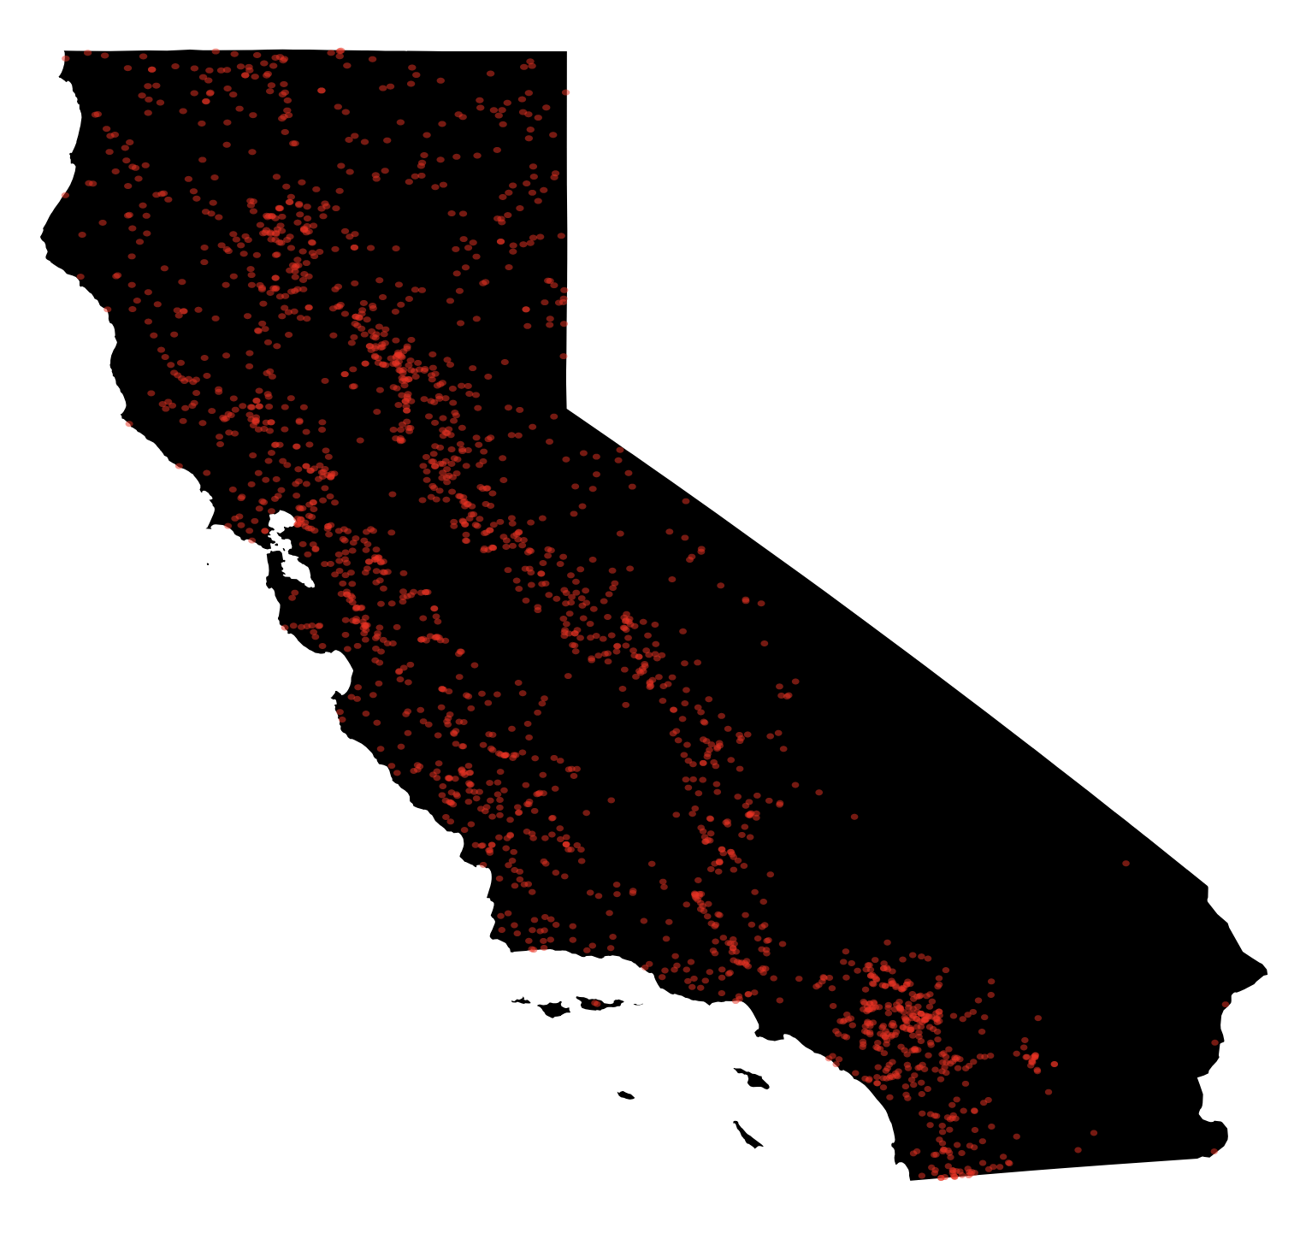
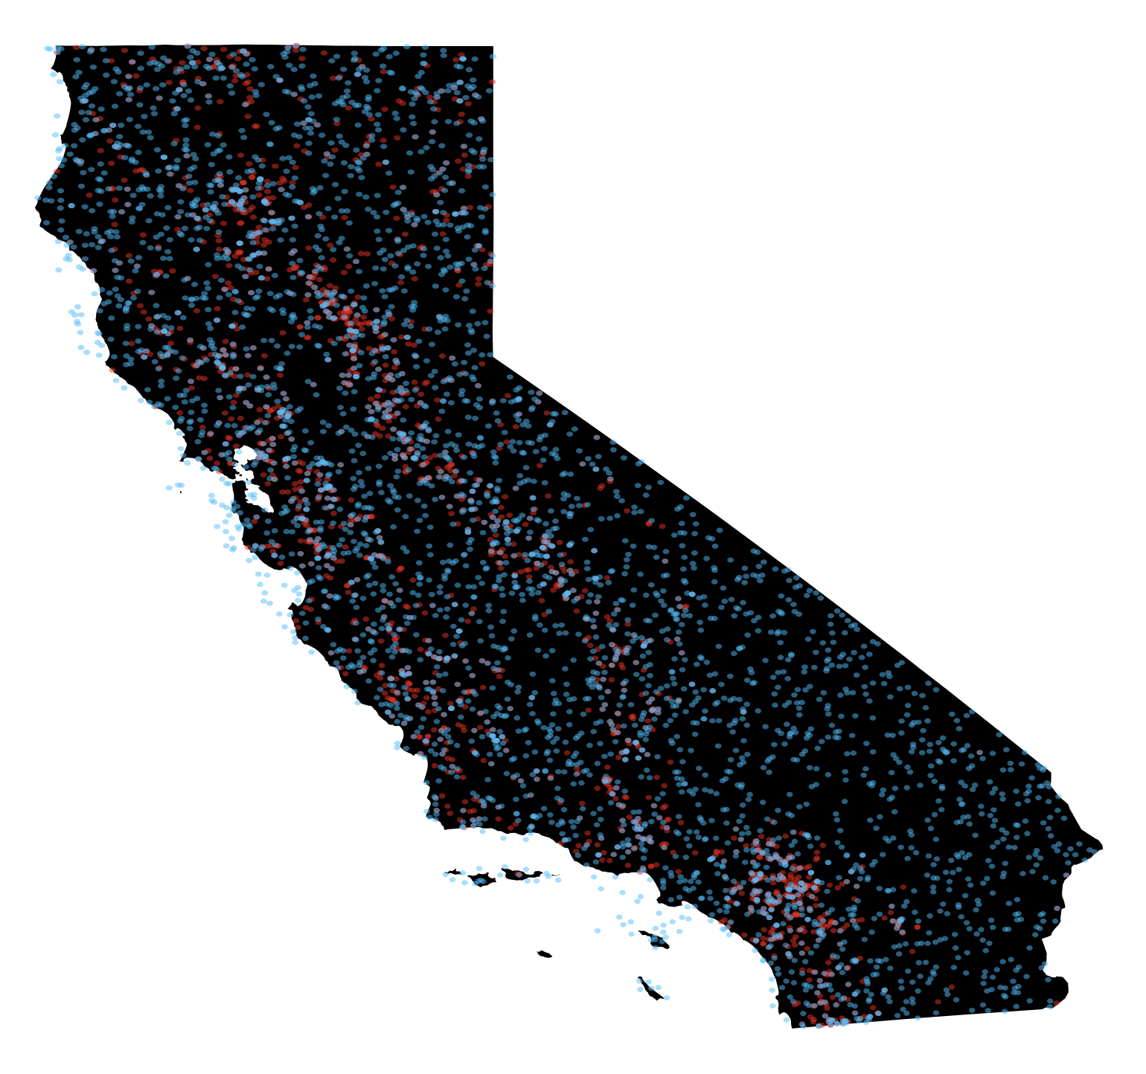
Negative Examples
Why?
Generate: [name, year, month, day, hour, minute, lat, lon, class_label]
No-fire to fire ratio
Overwhelming
Even
2:1
Distribution
Random
¼ pinned to positive example locations
Notes:
Mea
– why?
– ratio; ratio issues
– creation process
– distribution

Slide 8
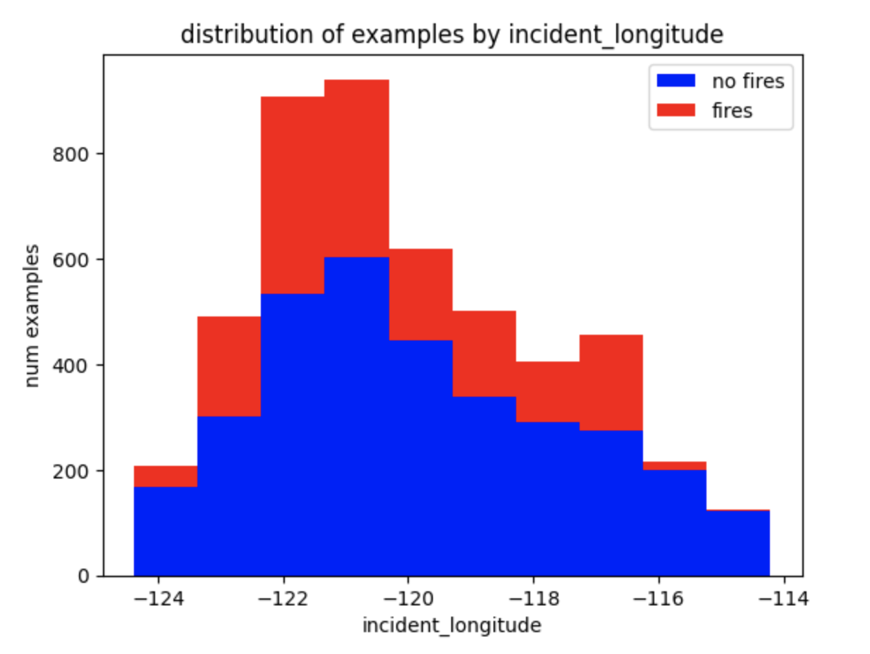
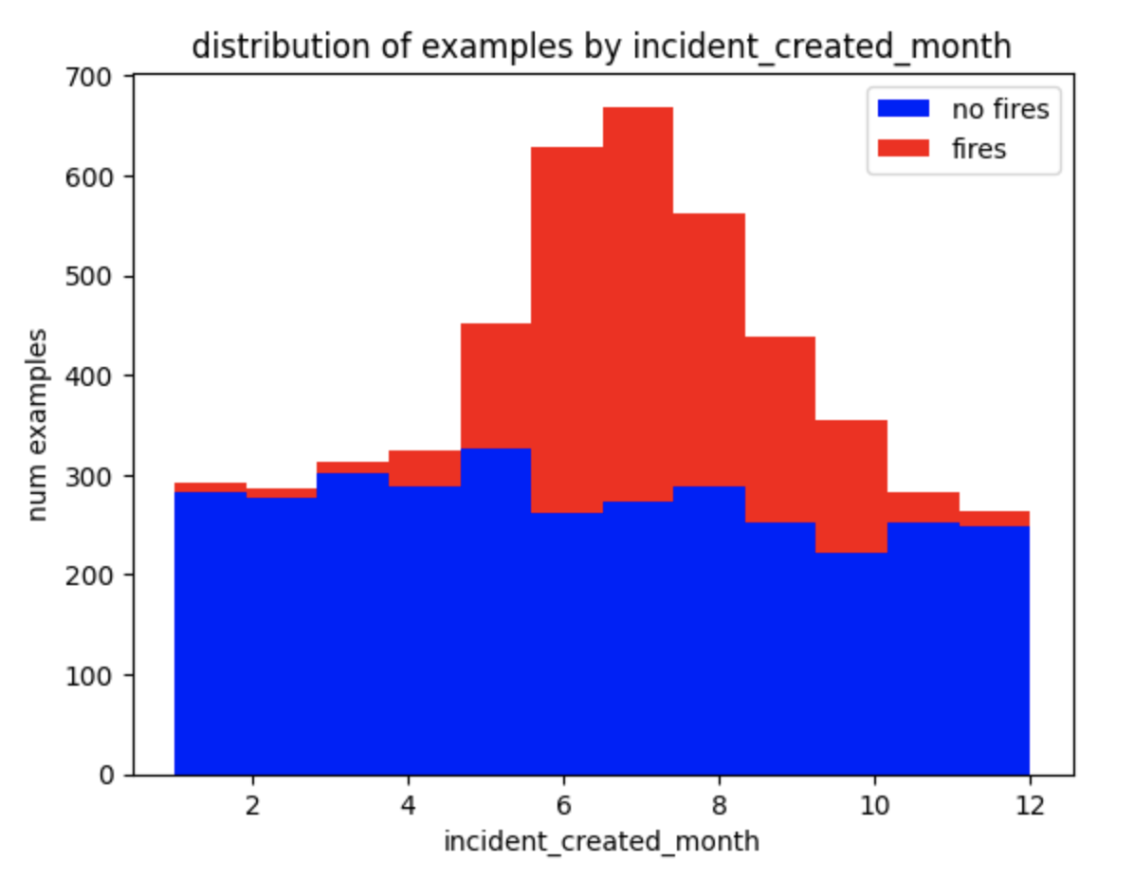
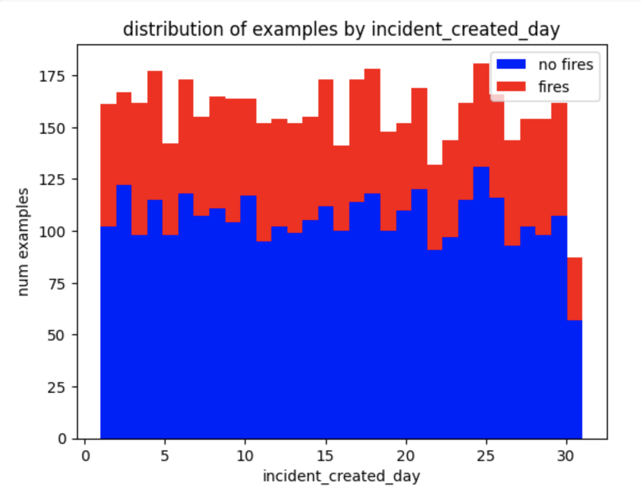
Cleaning and Exploratory Data Analysis
Cleaning
Many invalid values filtered out when combining datasets
Drop mostly nan cols (e.g. snow) 126 → 81 cols
Drop nan rows 5817 → 4863 rows
More EDA to see about dropping more cols instead of rows (data, modeling cycle)
Domain knowledge: research for replacement vals, invalid vals
Notes:
Cleaning
Already filtered out many invalid vals (e.g. lon in lat place, outside state, etc.)
Drop mostly nan cols 126 → 81
Drop nan rows 5817 → 4863
More EDA to see about dropping more cols instead of rows (data, modeling cycle)
Domain knowledge, research for replacement vals, invalid vals
How variables are distributed
E.g. what’s the average distance to weather station and std
(images – histograms, df.describe(), map, df.head())

Slide 9
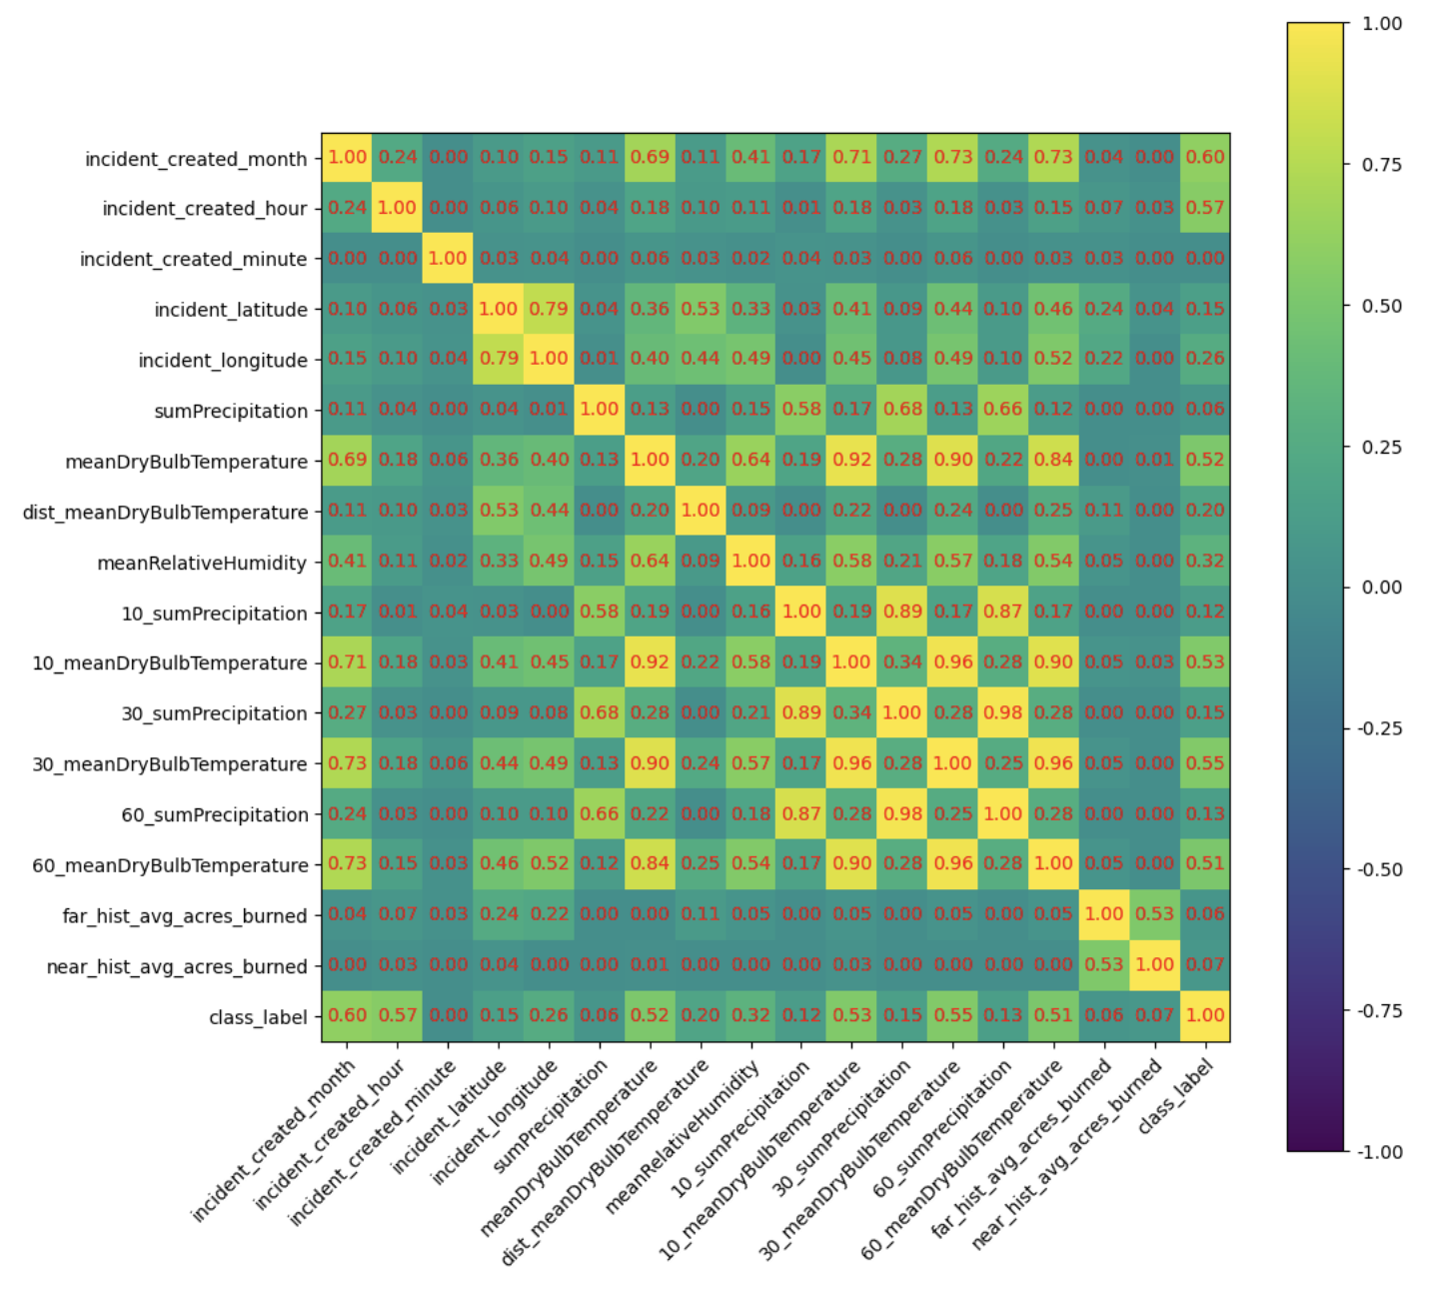
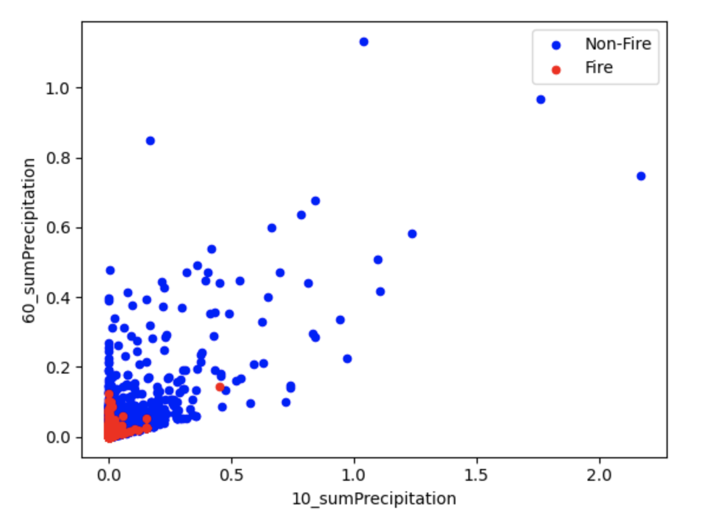
Exploratory Data Analysis – Intra-Feature Correlation
Remove features
No correlation w/ class label (e.g. start day, minute)
Strong correlation between features (e.g. immediate, 10-, 30-, 60-day temp → remove 10- and 30-day?)
Experiment
Notes:
Correlation matrix heatmap (e.g. month and temp)
If any deletions or decisions not to delete

Slide 10
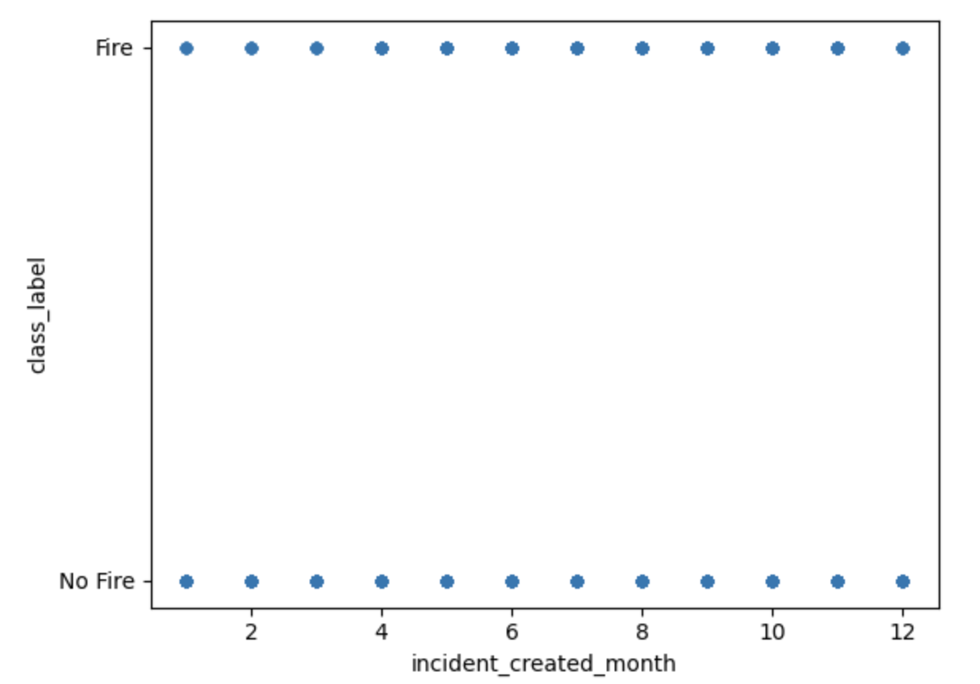
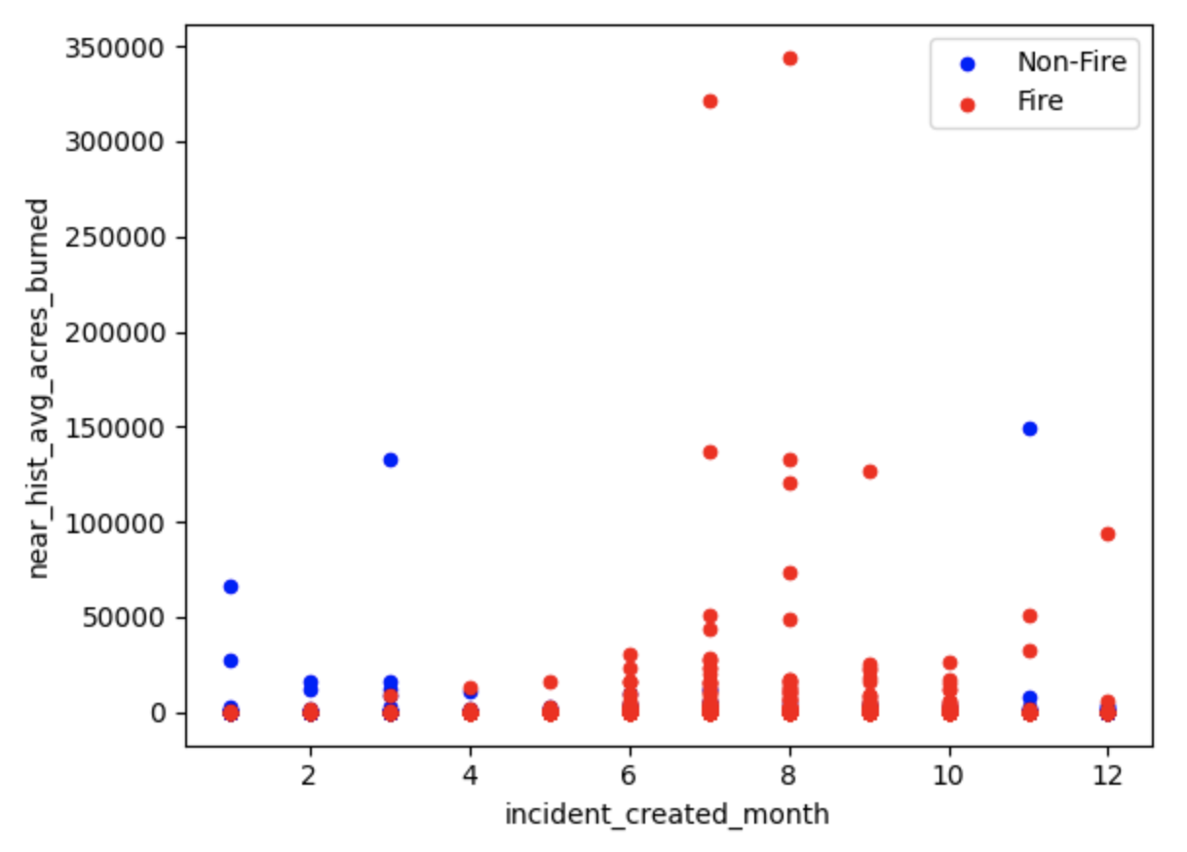
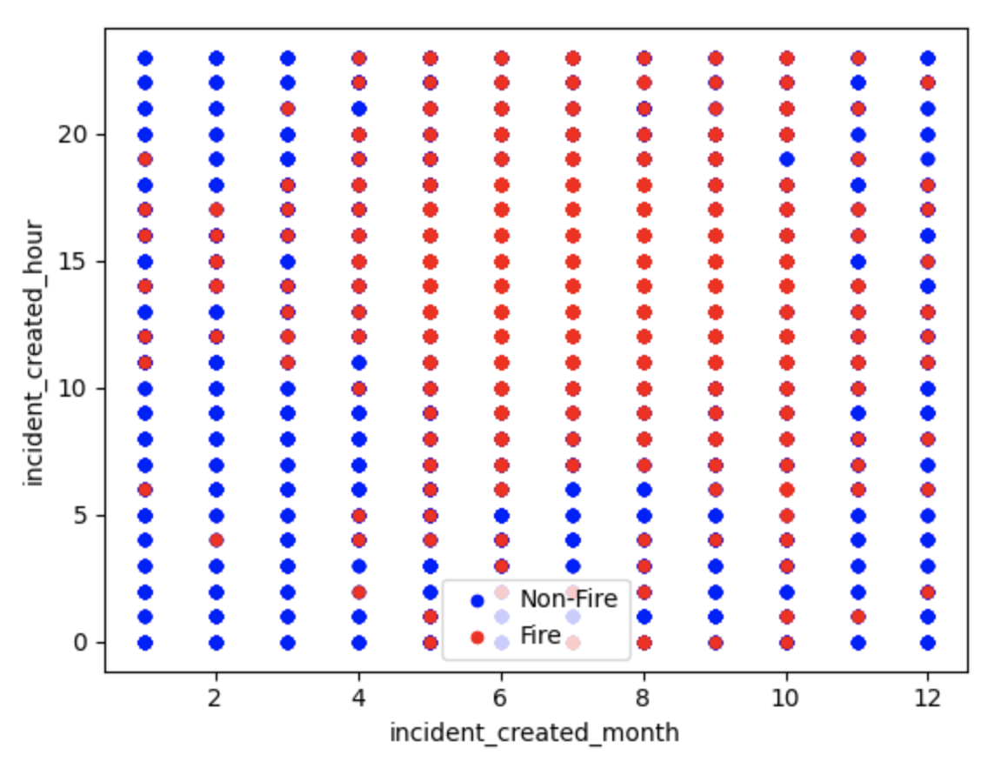
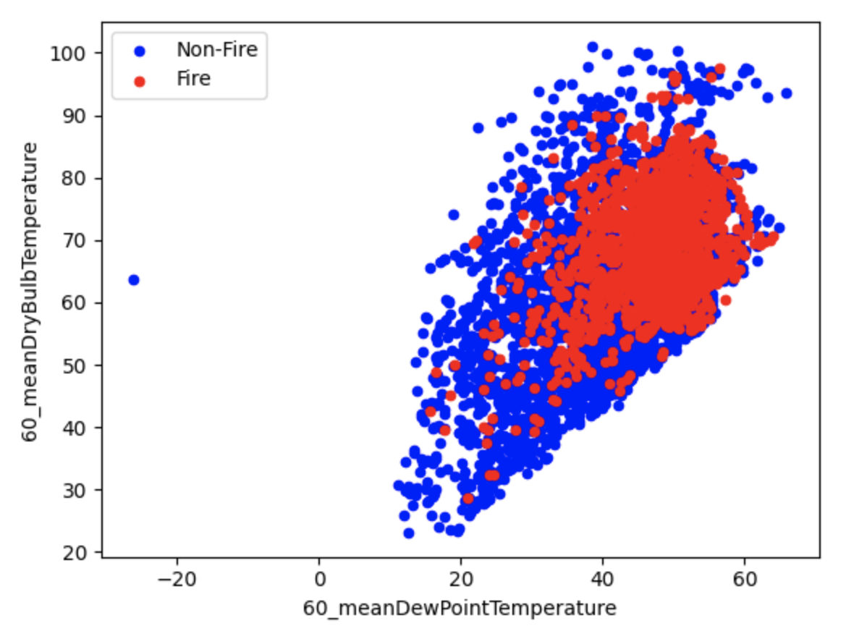
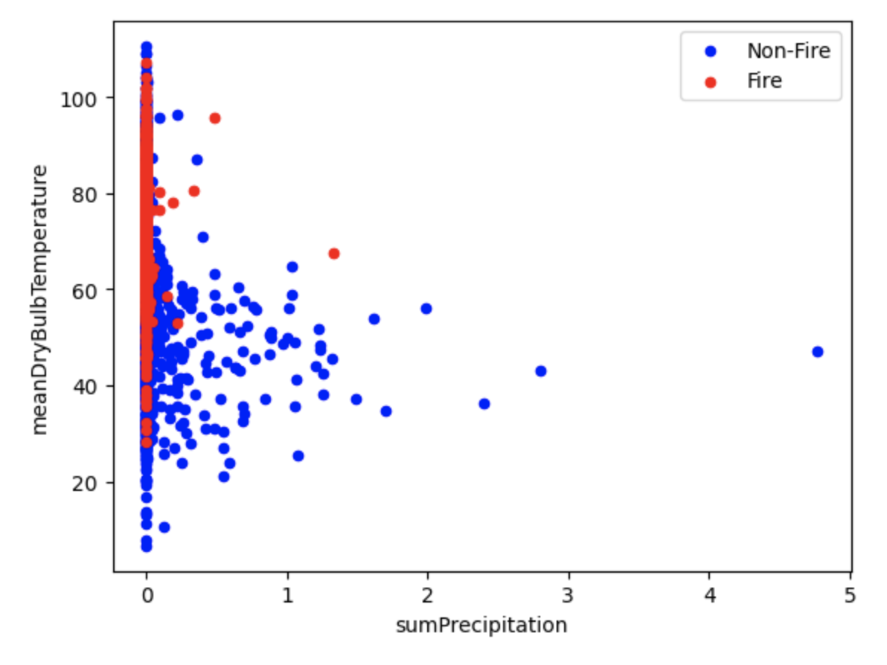
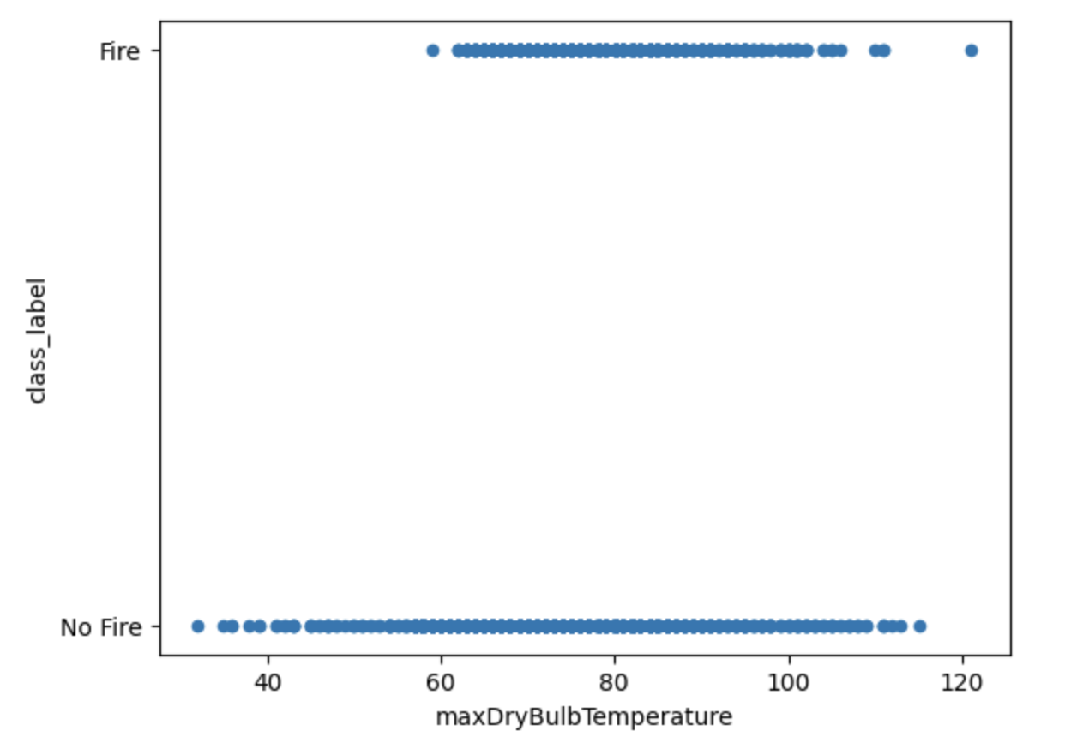
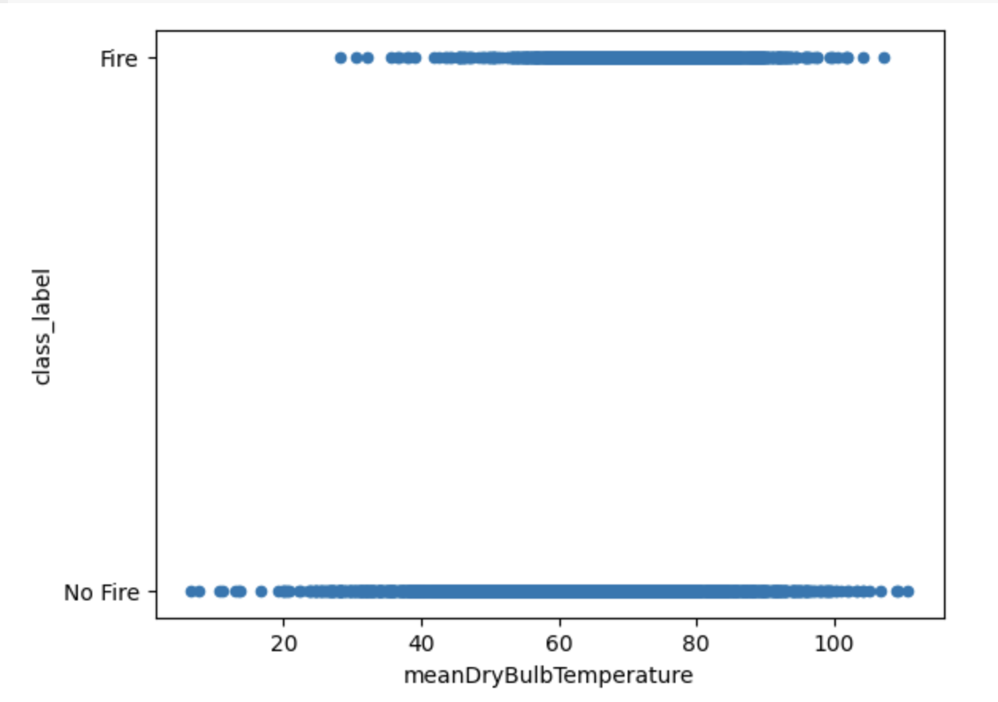
Exploratory Data Analysis – Feature/Label Correlation
Hard to visualize in 1-2 D
Still exploring

Slide 11
Next Steps
More EDA
Creating a model
Nonlinear relationships → SVM, random forest, NN
Combination feature (e.g. weather measurement and dist to station) → NN
Feature exploration, engineering cycle
Notes:
mea

Slide 12
Questions?

