Slide 1










55866 Data Science
Telehealth & Data
Presented By:
Elior Sastiel, Dan & Roie Cohen

Slide 2

Telemedicine holds great potential for reducing the variability of diagnoses as well as improving clinical management and delivery of health care services worldwide by enhancing access, quality, efficiency, and cost-effectiveness
In particular, telemedicine can aid communities traditionally underserved – those in remote or rural areas with few health services and staff – because it overcomes distance and time barriers between health-care providers and patients.
Further, evidence points to important socioeconomic benefits to patients, families, health practitioners and the health system, including enhanced patient-provider communication and educational opportunities.

Slide 3
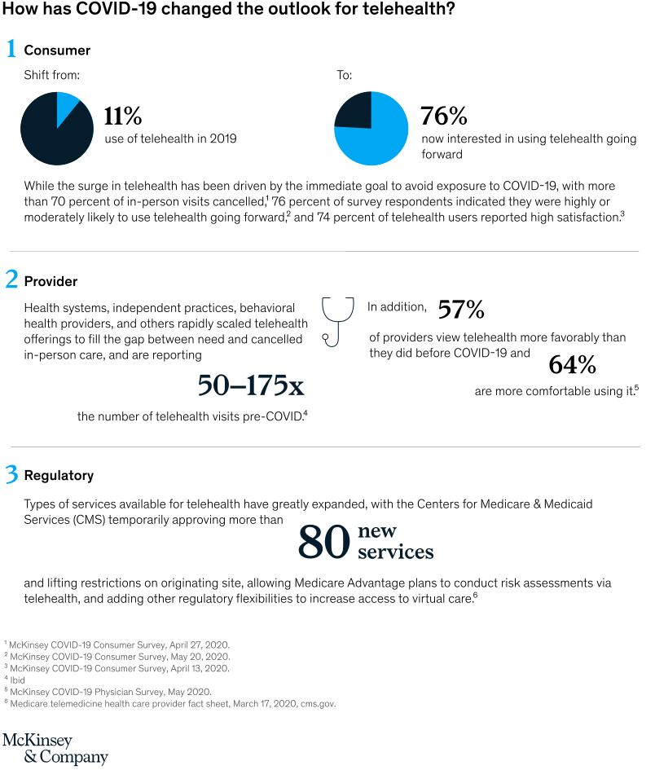
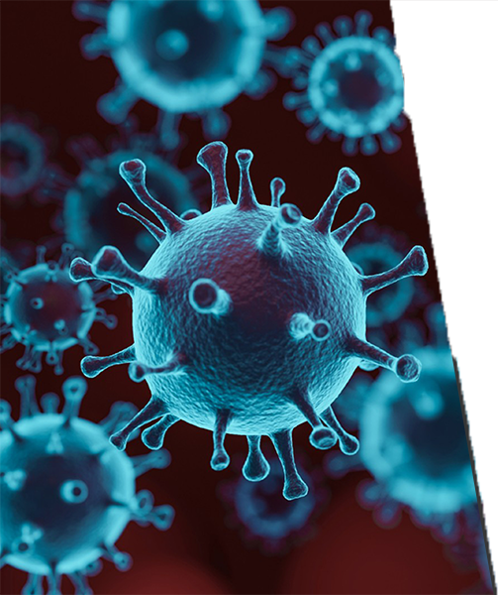

Slide 4
Our Research Question
Can a disease be predicted according to self reported symptoms

Slide 5
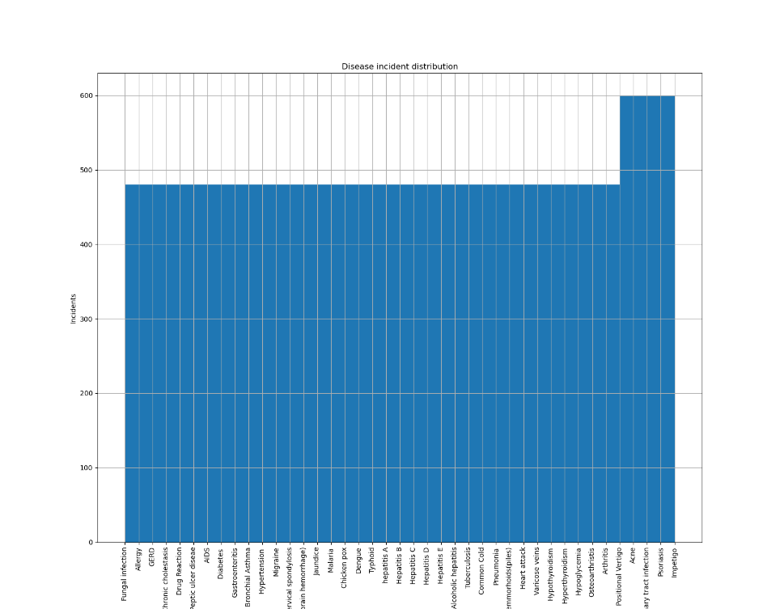
The Dataset
Disease Symptom Prediction - Kaggle
Dataset.csv
Disease Description.csv
For each disease in the dataset a matching text file containing information about the disease by Mayo Clinic
The information includes information such as Causes, Risk Factors, Treatment
4920 incidents of one of 41 listed diseases, each incident lists up to 17 symptoms out of 132 possibilities.
The dataset is almost uniformly distributed with about 500 incidents per disease

Slide 6
Dataset Distribution
First stage after cleaning the dataset was to better understand the content and distribution of the dataset
Since the dataset represents information in 132 space, we used dimensionality reduction techniques to view the data in a 2 dimension plot.
Using these techniques we can also detect if any clusters exist within the dataset on a lower dimension representation and therefore base prediction on less features.
2 algorithms were selected :PCA and TSNE

Slide 7
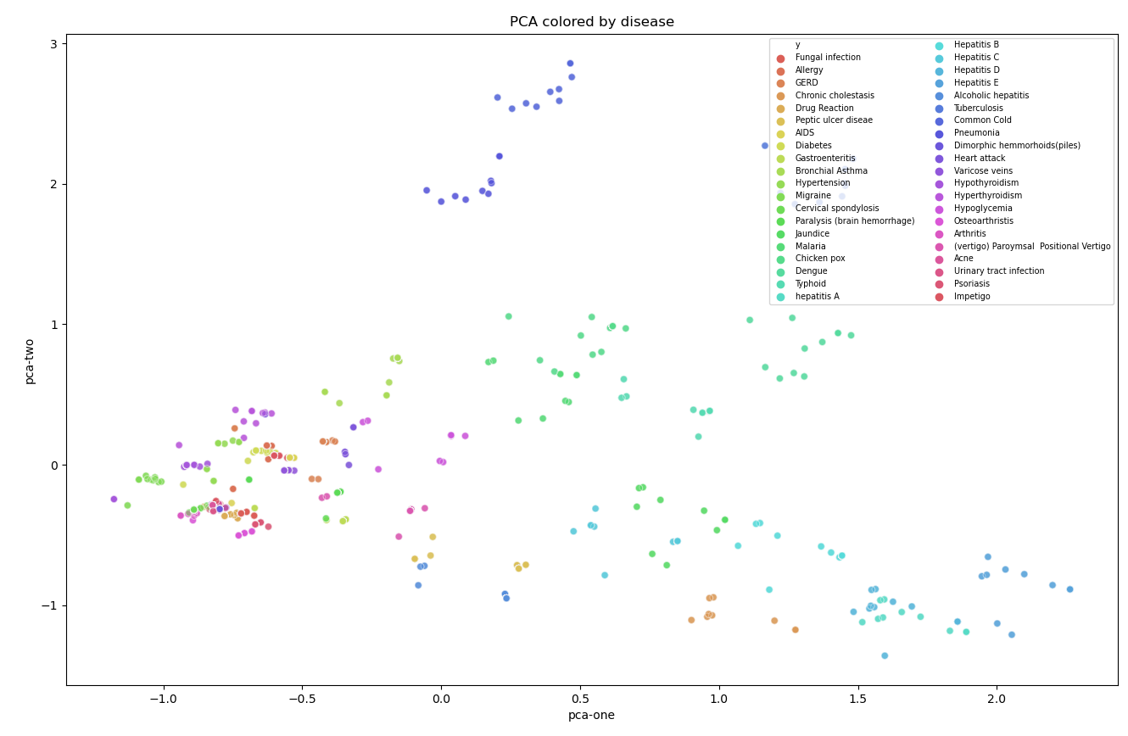
PCA
In the figure to the right we can see the samples of the dataset each one colored according to the disease it relates to using the first 2 components of the PCA the explained variation by the 2 components is 0.12 and 0.10.
Although some diseases do appear to be separated, most of the samples are grouped together and can’t be separated using 2 components.
“Winter Diseases”:
Common Cold
Pneumonia
No Common cause:
Chickenpox,Typhoid, Dangue, Malaria
Liver Diseases: Hepatitis variants Chronic Cholestasis Jaundice

Slide 8
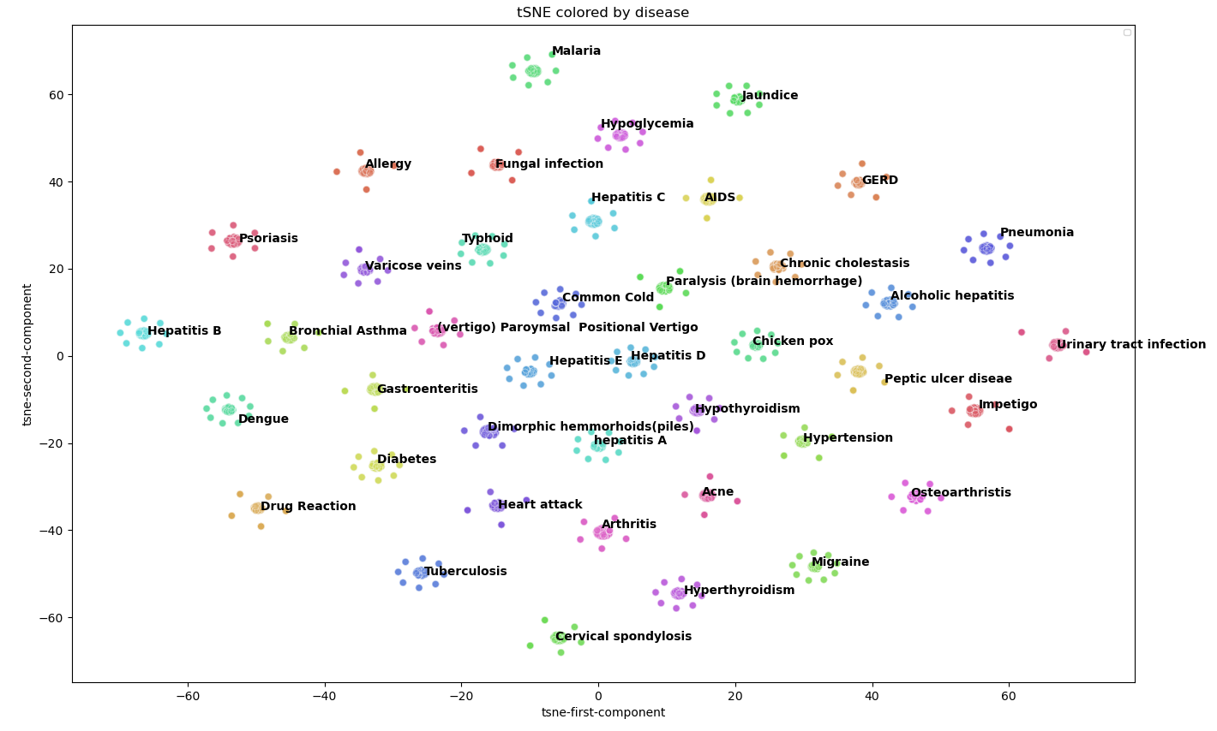
tSNE
t-SNE reduction to 2 components yields perfect results with distinctable separation between the different indications
This result suggests that our dataset is overfitted due to the high dimensionality and samples to features ratio.

Slide 9
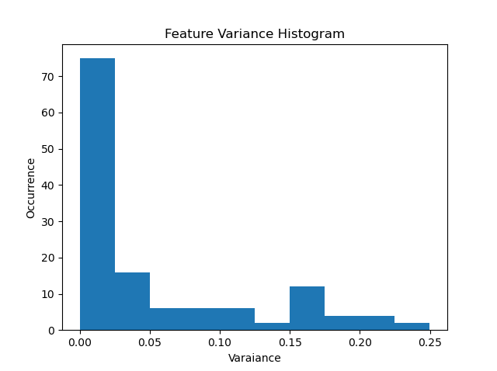
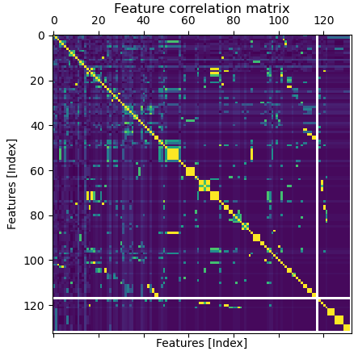
Overcoming Overfitting
Since our goal is to be able to generalize self reported symptoms and those are subjective and prune to variability and errors we need to establish a way of reducing the features so that they generalize to our requirements.
In order to do so we assessed the features in 2 methods:
Variance of features to detect features which are related to a small subset of the diseases or non subjective
Correlation between features finding those who can be inferred from one another
Features relating to approximately only one condition
Selected Cutoff

Slide 10
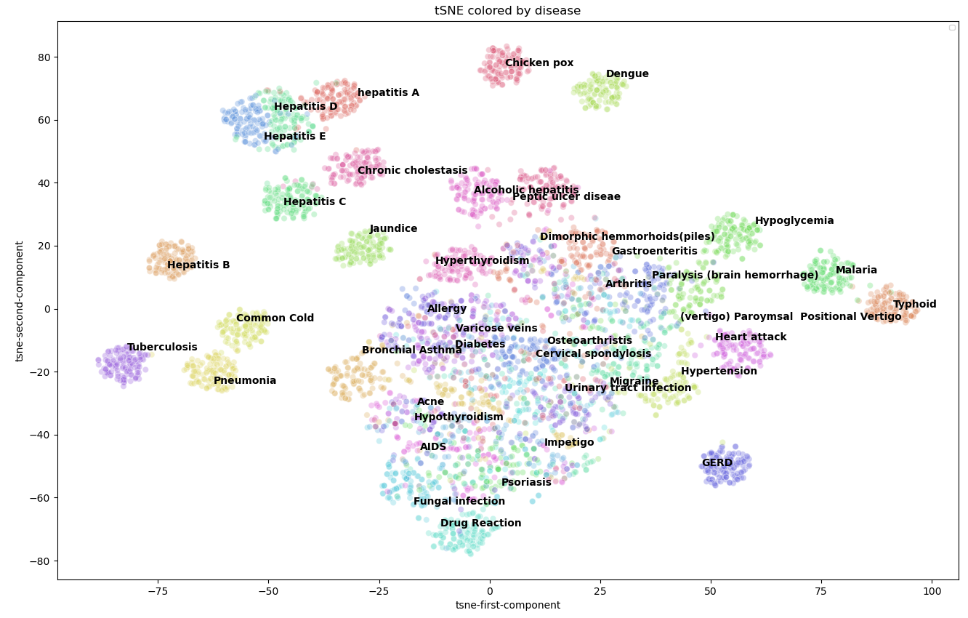
tSNE on the reduced dataset
Dataset was reduced to 30 features and we can see that the data now is less obviously separated
There are some nice clusters around Liver diseases (Hepatitis, Chronic cholestasis and Jaundice)

Slide 11
Introducing LDA (Still under review)
Our goal is to be able to diagnose a patient by analyzing his self reported symptoms.
For that we will be using LDA topic modeling in order to process a patients reporting into topics.
This will allow us to explore similarities between the different diseases and

Slide 12
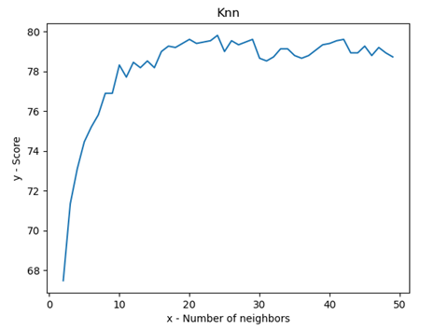
KNN
For the beginning, we decided to run the simplest classification algorithms - KNN.
First – we run KNN on the Data before we dropped irrelevant features, the score was 1.
In one hand the result is good but data was not so difficult.
So we dropped some features, and we run the KNN again and the result is shown in the chart
We split the data to 70% train and 30% test.

