Slide 1










55866 Data Science
Telehealth & Data
Presented By:
Elior Sastiel, Dan & Roie Cohen

Slide 2

Telemedicine holds great potential for reducing the variability of diagnoses as well as improving clinical management and delivery of health care services worldwide by enhancing access, quality, efficiency, and cost-effectiveness
In particular, telemedicine can aid communities traditionally underserved – those in remote or rural areas with few health services and staff – because it overcomes distance and time barriers between health-care providers and patients.
Further, evidence points to important socioeconomic benefits to patients, families, health practitioners and the health system, including enhanced patient-provider communication and educational opportunities.

Slide 3
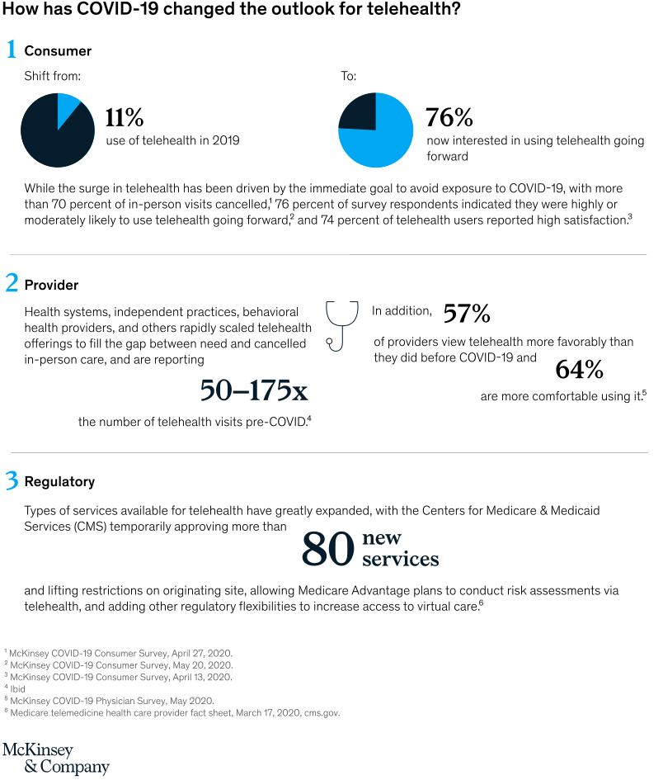


Slide 4
Our Research Question
Can a disease be predicted according to self reported symptoms

Slide 5
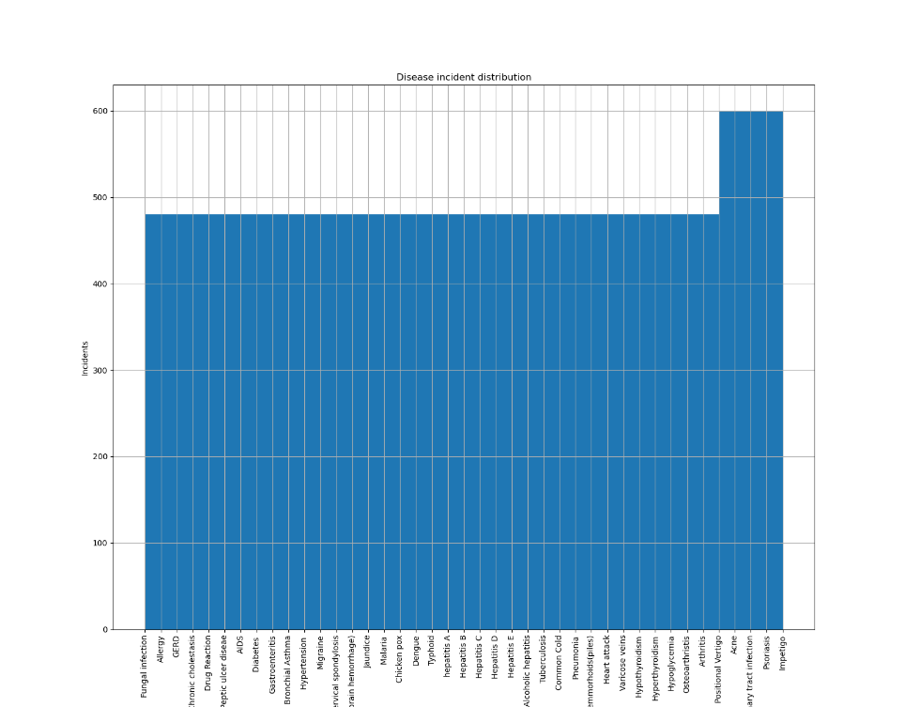
The Dataset
Disease Symptom Prediction - Kaggle
Dataset.csv
Disease Description.csv
For each disease in the dataset a matching text file containing information about the disease by Mayo Clinic
The information includes information such as Causes, Risk Factors, Treatment
4920 incidents of one of 41 listed diseases, each incident lists up to 17 symptoms out of 41 possibilities.
The dataset is almost uniformly distributed with about 500 incidents per disease

