Slide 1
FINTECH ARCHITECTURE & STRATEGY
APIs
A non-technical executive guide to Application Programming Interfaces, RESTful standards, and live market data feeds.
TARGET AUDIENCE
CORE FOCUS
Master's in Finance
Top-Level Concepts & Live Demos

Slide 2

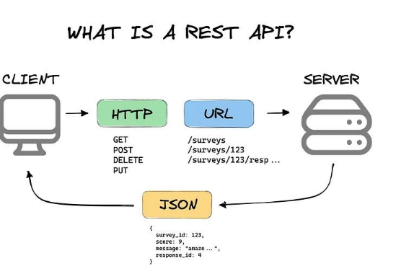
CORE CONCEPT
What is an API? Think of a Restaurant Waiter
The Customer (You / Your App)
You sit at the table with a menu. You know what you want (e.g., current stock price), but you cannot walk into the kitchen to prepare it yourself.
The Waiter (The API)
Takes your order (Request), delivers it safely to the kitchen, and brings back your dish (Response) in a clean, standardized format.
The Kitchen (Server / Database)
The bank's internal database holding millions of trade logs. It remains secure and protected behind the counter.

Slide 3


BUSINESS VALUE
Why Modern Finance Runs on APIs
Real-Time Data Feeds
Payment Gateways
Open Banking Regulation
Stock exchanges deliver tick-by-tick market pricing straight into Bloomberg terminals and trading desks via instant API responses.
Services like Stripe or PayPal process checkout payments instantly without ever holding customer credit card details on retail servers.
Regulatory mandates force legacy banks to share account data safely with fintech wealth management apps like Plaid and Mint.

Slide 4
ARCHITECTURE STANDARDS
RESTful vs. Non-RESTful APIs
STANDARD
RESTful API
SPECIALIZED
Non-RESTful API
"The Universal Web Language"
"Legacy or High-Speed Custom Protocols"
Web Native: Uses standard HTTP web links & web rules
SOAP / XML: Heavy, strict financial messaging protocols
Stateless: Each request contains 100% of required info
WebSockets: Continuous open pipe for sub-millisecond trading
Predictable: Clean URLs like /stocks/AAPL
Stateful: Server continuously tracks active user sessions
Format: Returns lightweight JSON text responses
Custom XML: Verbose structured data envelopes

Slide 5
THE REST MECHANICS
HTTP Verbs in Financial Terms
GET
Fetch Data (Read Only)
GET /api/v1/rates/USD
Get current Bitcoin exchange rate or download Q3 balance sheet PDF.
POST
Submit / Create New Record
POST /api/v1/orders
Submit a new buy order for 100 shares of Apple to an execution engine.
PUT
Update Existing Data
PUT /api/v1/positions/4092
Adjust stop-loss price threshold on an open trade position.
DELETE
Cancel / Remove
DELETE /api/v1/orders/8821
Cancel a pending limit order before market close.

Slide 6
DATA PAYLOADS
Understanding JSON: The Currency of REST APIs
HTTP RESPONSE 200 OK
JSON Payload
Human-Readable Key-Value Pairs
When an API responds, it doesn't send formatted web graphics. It sends raw structured text called JSON (JavaScript Object Notation).
{ "ticker": "AAPL", "currency": "USD", "market_price": 224.50, "pe_ratio": 33.8, "market_cap_billions": 3420, "trading_volume": 48120900 }
Key Finance Takeaway
Excel sheets, Python models, and trading bots parse this identical JSON payload instantly to compute financial ratios.

Slide 7
CLASSROOM INTERACTIVE
Live Demo: Try an API in Your Browser
Open any web browser tab and paste this public REST URL (No API Key Required):
https://open-meteo.com/en/docs/ecmwf-api
Live Exchange Rates
What happens when you click?
Other Keyless Finance APIs
Your browser sends a live GET request to the central server, returning real-time spot foreign exchange rates for over 150 currencies.
• Bitcoin Price: api.coindesk.com/v1/bpi/currentprice.json
• CoinGecko Crypto: api.coingecko.com/api/v3/simple/price?ids=bitcoin&vs_currencies=usd

Slide 8
EXECUTIVE SUMMARY
Three Rules for Future Financial Leaders
01
02
03
APIs are Digital Contracts
REST is the Standard
Data Drives Valuation
They define exactly how financial institutions exchange valuable data securely without direct database access.
RESTful web APIs powered by JSON format are predictable, scalable, and form the backbone of fintech innovation.
Financial institutions with open, reliable API connectivity achieve faster customer acquisition and higher tech multiples.

