Slide 1
VERSION CONTROL & COLLABORATION
GitHub & Git: Version Control
Understanding remote repositories, local synchronization, branching, and pull requests for business & finance leaders.
CORE CONCEPT
PRACTICAL FOCUS
Git vs. GitHub Ecosystem
The 12-Step Feature Branch Flow

Slide 2


MENTAL MODEL
What is GitHub? Think "Track Changes" with a Cloud Vault
Remote Repository (GitHub / GitLab)
The central source of truth in the cloud. It regulates every single action, keeping a clear audit log of who changed what, when, and why.
Local Repository (Your PC)
Your personal local copy. Crucial Rule: Your local PC is NOT automatically synced with the remote vault. You must explicitly push and pull files.
Commit History & Comments
Every modification is accompanied by a mandatory comment explaining the business motivation behind the change.

Slide 3

CORE INVARIANT
Why Git Doesn't Auto-Sync (And Why That's Good)
Protection & Control
Isolated Sandbox
Rigorous Protocol
Prevents unfinished or broken code on your laptop from immediately crashing the production financial system.
Allows analysts to experiment safely on new financial models on a private branch without affecting the master branch.
Shipping changes to master requires following strict commands (Fetch, Pull, Branch, Push, and Merge Request).

Slide 4
STEP-BY-STEP WORKFLOW (1/3)
Phase 1: Assessing & Updating Master
git status
Steps 1–2
Check Status & Fetch Metadata
Check your current branch, then fetch global info from GitHub to see if you are behind recent updates.
git fetch
git checkout master
Steps 3–4
Switch to Master & Pull Latest Changes
Switch to the master branch and pull remote commits to ensure your starting point is up to date.
git pull origin master

Slide 5

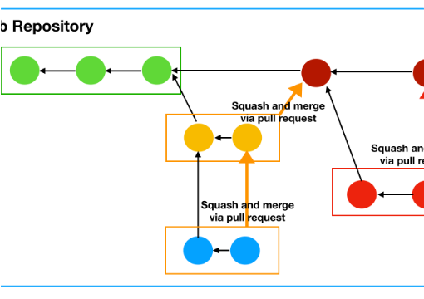
STEP-BY-STEP WORKFLOW (2/3)
Phase 2: Branching & Local Modifications
Step 5: Create New Branch from Fresh Master
Crucial timing: Create your feature branch after updating master so you don't start from stale code.
git branch my-feature-name
Step 6: Switch to Your New Branch
Creating a branch doesn't automatically move you into it; explicitly check it out.
git checkout my-feature-name
Steps 7–9: Edit Files & Track New Additions
Perform changes locally. Add untracked new files using git add . and verify with git status.
git add . && git status

Slide 6
STEP-BY-STEP WORKFLOW (3/3)
Phase 3: Saving, Publishing & Merging
Step 10
Local Commit & Remote Push
git commit -am "added cash flow forecast"
Save a local checkpoint with a comment. Nobody sees it until you push your branch to GitHub.
git push origin my-feature-name
Step 11
Initiate Merge / Pull Request (via Web UI)
Web Interface
Open GitHub/GitLab web interface. Request to merge your feature branch into master for team review.
git checkout master
Step 12
Final Alignment on PC
Switch back to master locally and pull to make your local PC identical to the newly updated remote master.
git pull origin master

Slide 7
EXECUTIVE REFERENCE
Git Commands Quick Reference Table
Command | What It Does | Financial Analogy
git status | Shows branch state & modified files | Portfolio balance audit
git fetch | Downloads remote updates without merging | Downloading raw ticker metadata
git pull origin master | Updates local master to match remote vault | Syncing ledger with central bank
git branch [name] | Creates an isolated working copy | Opening a trial scenario model
git commit -am "[msg]" | Saves timestamped local snapshot | Saving Excel version "v2_draft"

Slide 8
EXECUTIVE SUMMARY
Three Golden Rules of Version Control
01
02
03
Pull Before You Branch
Commit Early & Often
Master is Sacred
Always update your master branch before creating a new branch to avoid working on outdated versions.
Local commits are free checkpoints. Write clear messages explaining the business rationale for each change.
Never push directly to master. Always use feature branches and peer-reviewed Pull/Merge Requests.

