Slide 1
Crime and Poverty
Project 1
November 21, 2020
Presenters: Sean Galloway, Peter Vlahos, Elliot Chen, Cora Micsunescu

Slide 2
Table of Contents
Null Hypothesis
Definitions and Context

Slide 3
Null Hypothesis
Our hypothesis is the following. We hypothesize that a decrease in the violent crime rate results in reductions in the poverty rate and a simultaneous increase in median income and median home prices. Our confidence level is 95% or a p-value of 0.05. We hypothesize that the p-value of these statistics in Oak Park, zip codes 95817 and 95820, is statistically different from Sacramento County. Our observed variables are the crime rate, poverty rate, income rate, and median home prices of Oak Park and Sacramento County. Our expected values are the crime rate, poverty rate, income rate, and median home prices for all of Sacramento County. Based on the observed versus the typical values, we can calculate the p-value. If the p-value is less than 0.05, we will accept the hypothesis. This analysis matters as police forces could use it to understand better where to assign resources.

Slide 4
Definitions of Terms Used
“PC Personal”: refers to California Penal Code Crimes Against the Person which include Homicide, Mayhem, Kidnapping, Hostages, Robbery, Attempts to Kill, Assaults, False Imprisonment and Human Trafficking, and Assault and Battery.
“PC All”: refers to California Penal Code of all other types of crime including crimes against property, crimes against public justice, crimes against the person involving sexual assault, criminal threats, and miscellaneous crimes.
Additional information can be found here: https://leginfo.legislature.ca.gov/

Slide 5
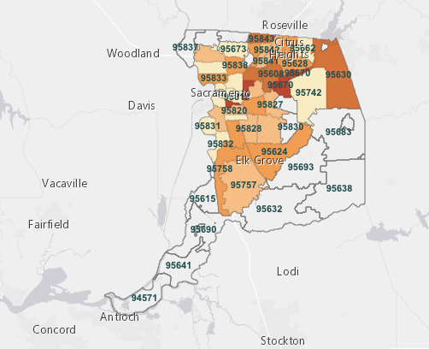
Sacramento County with Postal Zip Codes

