Slide 1
Crime and Poverty
Project 1
November 21, 2020
Presenters: Sean Galloway, Peter Vlahos, Elliot Chen, Cora Micsunescu

Slide 2
Data Sources
Sacramento County Datasets: https://data.saccounty.net/datasets/9a7f2df25a584ff9b55db274704ad7c9_0/geoservice.
Capitol Impact list of Sacramento County Zip Codes: http://www.ciclt.net/sn/clt/capitolimpact/gw_ziplist.aspx?FIPS=06067
Census API: https://api.census.gov/data.html
Google Maps API: https://cloud.google.com/maps-platform

Slide 3
Data Cleaning
Cleaned the data obtained from Census, Sacramento County and Google Maps using the following methodology:
Rename columns
Add columns
Drop null rows
Drop incomplete data
Filter out years to only include 2014-2018
Parse year data from the timestamp
Try/Except blocks

Slide 4
Null Hypothesis
Oak Park has had historically high crime rates and high poverty rates. Recently it has experienced rising median home prices due to gentrification. Simultaneously, the crime rates and poverty rates have decreased. Does the data reflect these trends? Does Oak Park follow the same trends found in rest of Sacramento County?
A decrease in the poverty rate is correlated with a decrease in the crime rate.
An increase in the median home price leads to a decrease in crime.
Sacramento County and Oak Park both follow the same trends with respect to the relationships between poverty, crime, and median home values.
Confidence level of 95%

Slide 5
Definitions of Terms Used
“PC Personal”: refers to California Penal Code Crimes Against the Person which include Homicide, Mayhem, Kidnapping, Hostages, Robbery, Attempts to Kill, Assaults, False Imprisonment and Human Trafficking, and Assault and Battery.
“PC All”: refers to the California Penal Code definition of all the types of crime including crimes against property, crimes against public justice, crimes against the person, criminal threats, and miscellaneous crimes.
Additional information can be found here: https://leginfo.legislature.ca.gov/

Slide 6
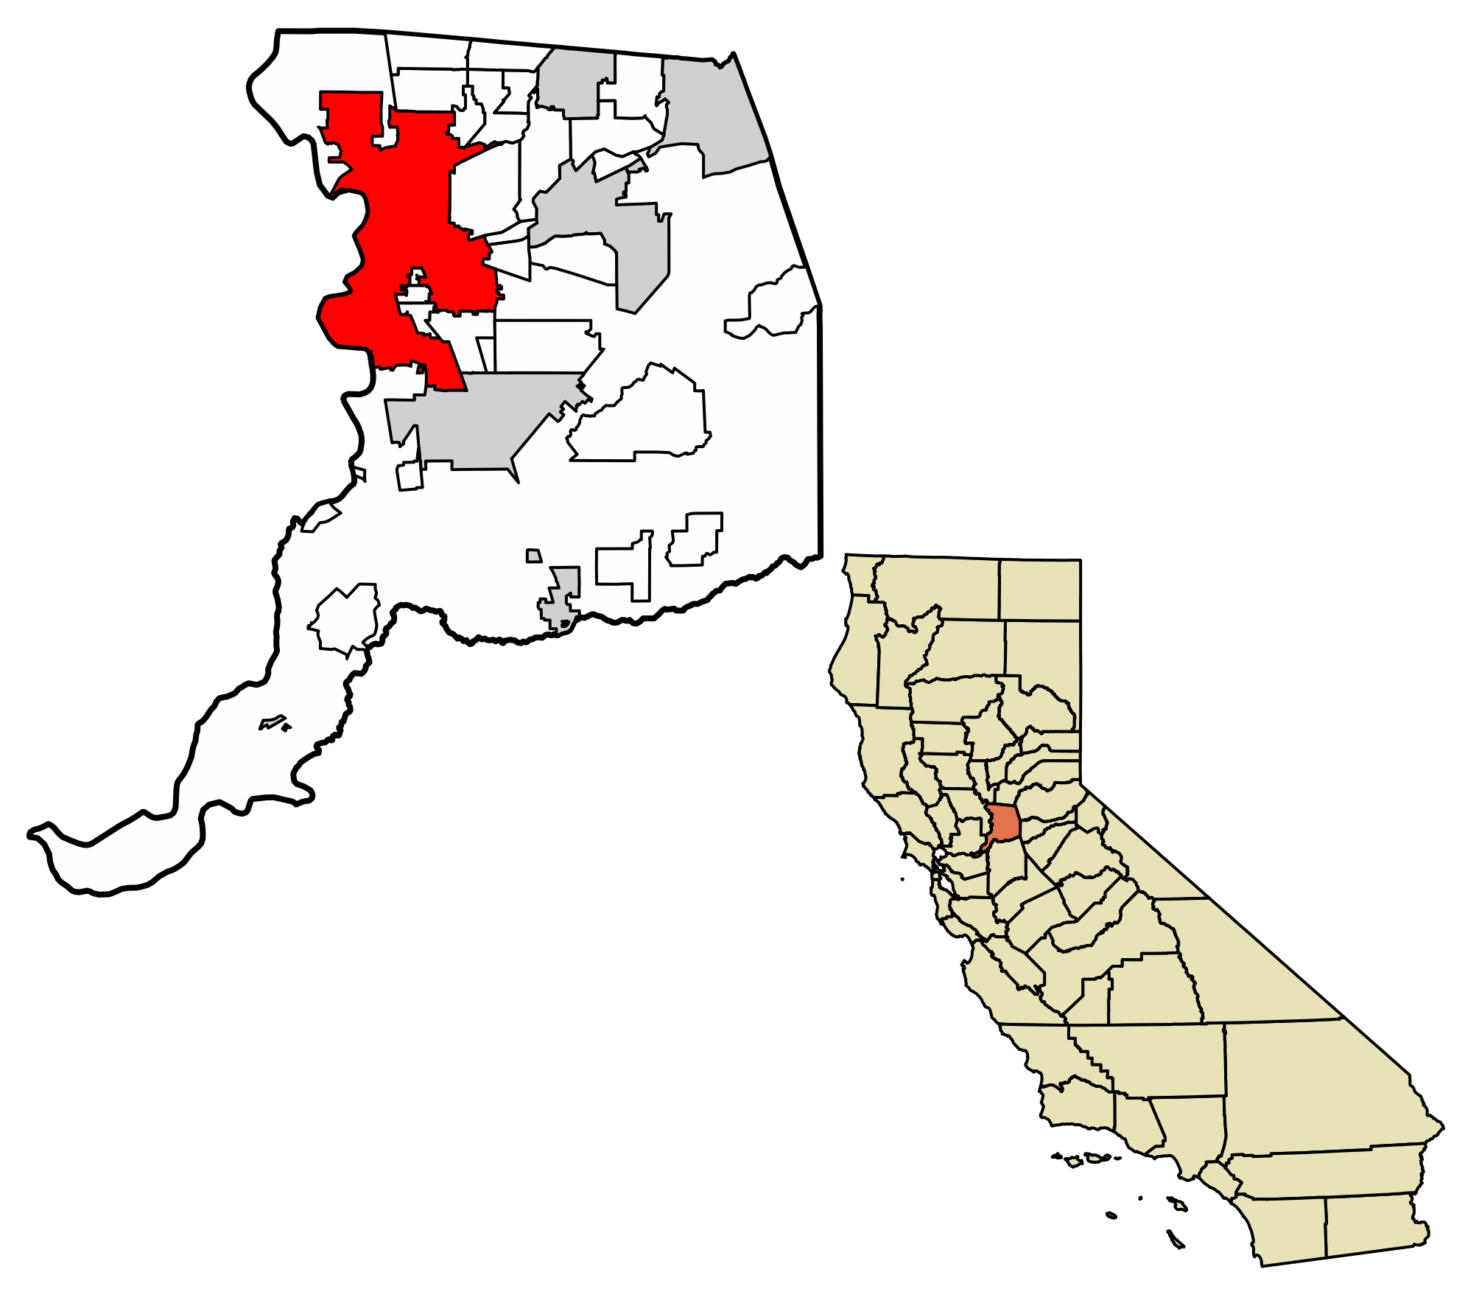
Sacramento County, California

Slide 7
Questions
What are the overall crime rate trends in Sacramento County and Oak Park in particular?
What are the crime rates for Oak Park for 2014-2018?
How would a heat map of the crime rate for each zip code in Sacramento County appear?
How would a heat map of the poverty rate for each zip code in Sacramento County appear?
What is the crime rate versus the poverty rate for Sacramento County for 2014-2018?
Is there a correlation between the poverty rate and the crime rate?
Is there a correlation between median home prices and the crime rate?

Slide 8
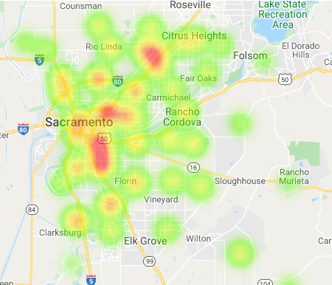
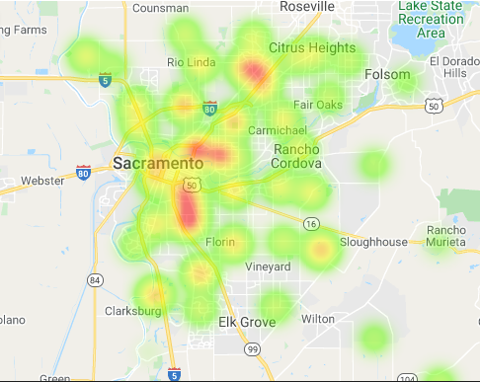
Overall poverty rate was flat
2014
2018

Slide 9
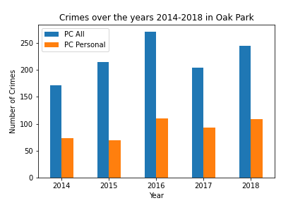
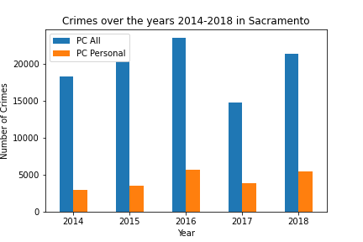
Overall Crime Rate was flat

Slide 10
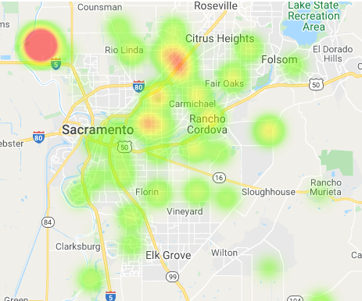
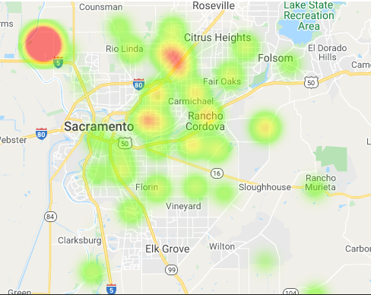
A heat map of the crime rates reflects the same trend
2014
2018

Slide 11
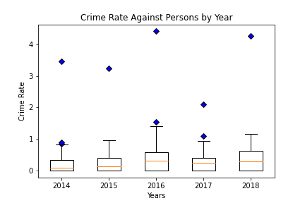
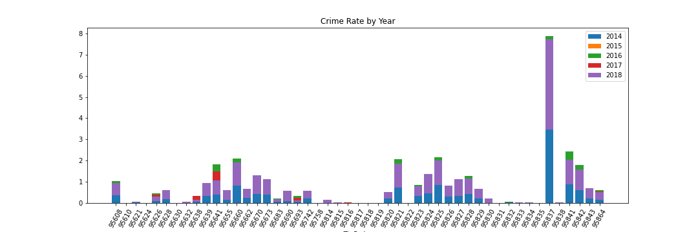
An outlier in the data was identified, additional analysis confirmed it
The bar graph above clearly illustrates we have an outlier, 95837. The zip code was removed from further analysis as it threw off subsequent calculations.

Slide 12

Is there a correlation between the poverty rate and the crime rate?
Our hypothesis is that as the poverty rate goes up, the crime rate increases.

Slide 13
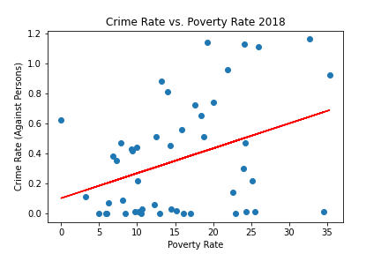
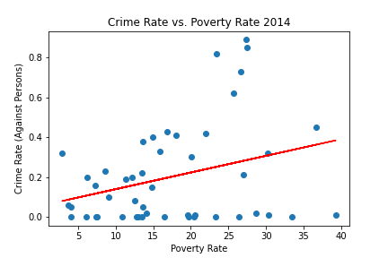
Sacramento County
The average p-value is 0.02 and the average r-square value is 0.12. Given these values and the diagrams’ appearance, our hypothesis is confirmed.

Slide 14
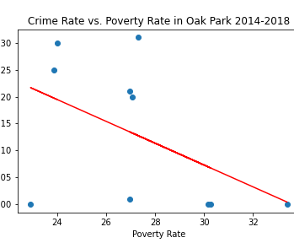
Oak Park
The p-value is 0.23 and the r-square value is 0.16. Given these values and the diagram’s appearance, we conclude that Oak Park goes against the overall trend in Sacramento County.

Slide 15
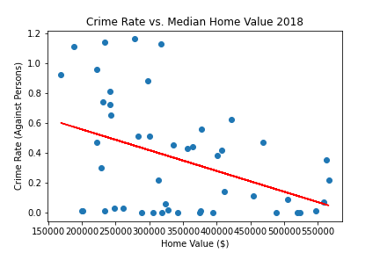
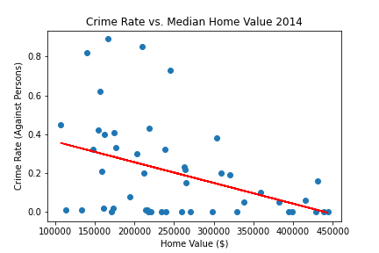
Crime Rate vs. Median Home Values in Sacramento County for 2014-2018
The average p-value is 0.01 and the average r-square value is 0.15. Given these values and the diagrams’ appearance, our hypothesis, which is that as median home values increase the crime rate decreases, is confirmed.

Slide 16
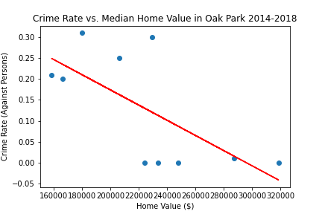
Crime Rate vs. Median Home Values in Oak Park for 2014-2018
The p-value is 0.03 and the r-square value is 0.46. The chart demonstrates that Oak Park follows the same trend as Sacramento County.

Slide 17
Overall Conclusions
We had two main hypotheses:
Rising median home prices correlate with lower crime rates
Rising poverty rates correlate with higher crime rates
Overall the data for Sacramento County conformed to these hypotheses. When we looked exclusively at Oak Park, results from the data were mixed. Oak Park had a decreasing crime rate as median home prices went up, as expected. In contrast, Oak Park had a decreasing crime rate even as the poverty rate went up, which did not conform to our hypotheses. More research into Oak Park is needed to understand this.

