Slide 1
Crime and Poverty
Project 1
November 21, 2020
Presenters: Sean Galloway, Peter Vlahos, Elliot Chen, Cora Micsunescu

Slide 2
Null Hypothesis
Our null hypothesis is the following: a decrease in the violent crime rate results in reductions in the poverty rate and a simultaneous increase in median income and median home prices. Our confidence level is 95% or a p-value of 0.05. We hypothesize that the p-value of these statistics in Oak Park, zip codes 95817 and 95820, is statistically different from Sacramento County. Our observed variables are the crime rate, poverty rate, income rate, and median home prices of Oak Park and Sacramento County. Our expected values are the crime rate, poverty rate, income rate, and median home prices for all of Sacramento County. Based on the observed versus the expected values, we can calculate the p-value. If the p-value is less than 0.05, we will accept the hypothesis. This analysis matters as police departments could use it to understand better where to allocate resources.

Slide 3
Definitions of Terms Used
“PC Personal”: refers to California Penal Code Crimes Against the Person which include Homicide, Mayhem, Kidnapping, Hostages, Robbery, Attempts to Kill, Assaults, False Imprisonment and Human Trafficking, and Assault and Battery.
“PC All”: refers to California Penal Code of all other types of crime including crimes against property, crimes against public justice, crimes against the person involving sexual assault, criminal threats, and miscellaneous crimes.
Additional information can be found here: https://leginfo.legislature.ca.gov/

Slide 4
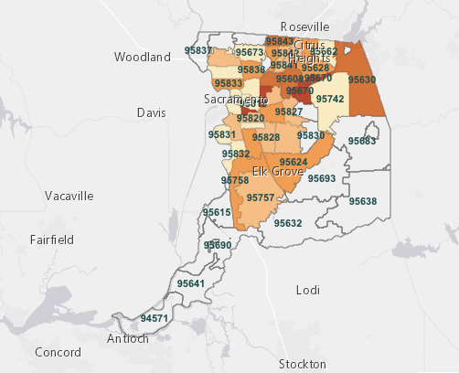
Sacramento County with Postal Zip Codes

Slide 5
Questions
What are the overall crime rate trends in Sacramento County and Oak Park in particular?
What are the crime rates for Oak Park for 2014-2018?
How would a heat map of the crime rate for each zip code in Sacramento County appear?
How would a heat map of the poverty rate for each zip code in Sacramento County appear?
What is the crime rate versus the poverty rate for Sacramento County for 2014-2018?
Is there a correlation between the poverty rate and the crime rate?
Is there a correlation between home prices and the crime rate?

Slide 6
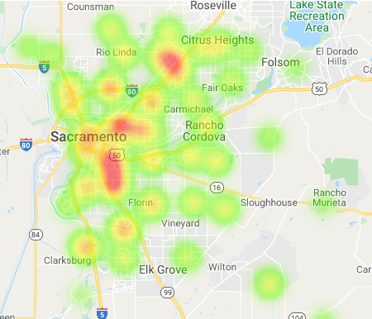
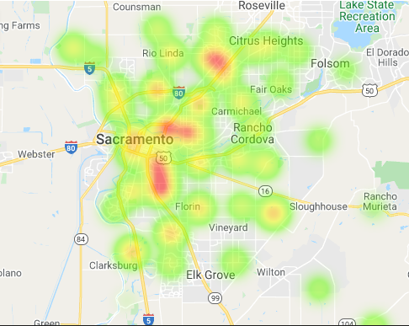
Overall Poverty Rate was flat
2014
2018

Slide 7
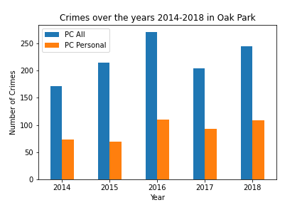
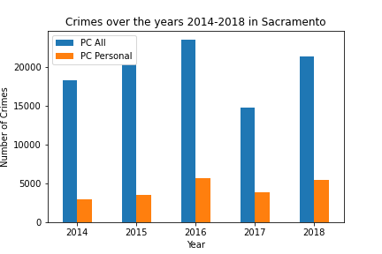
Overall Crime Rate was flat

Slide 8
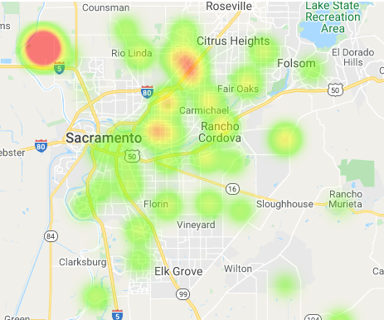
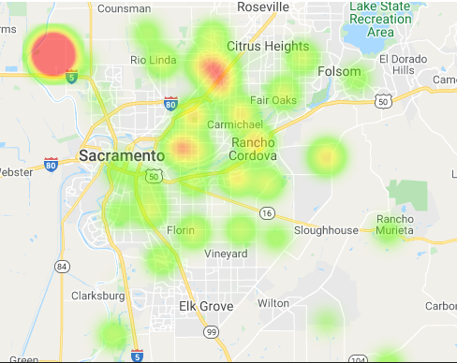
A heat map of the crime rates reflects the same trend
2014
2018

Slide 9
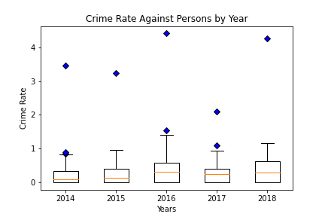
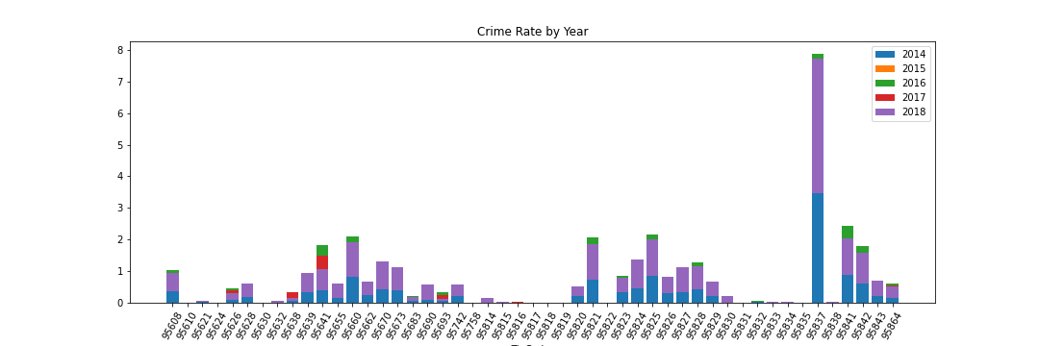
An outlier in the data was identified, additional analysis confirmed it
The bar graph above clearly illustrates we have an outlier, 95837. The zip code was removed from further analysis as it threw off subsequent calculations.

Slide 10

Is there a correlation between the poverty rate and the crime rate?
Our hypothesis is that as the poverty rate goes up, the crime rate goes up.

Slide 11
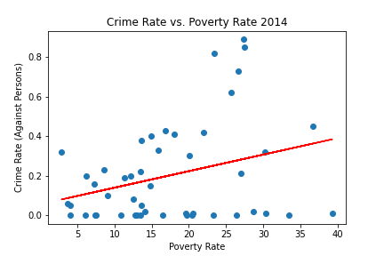
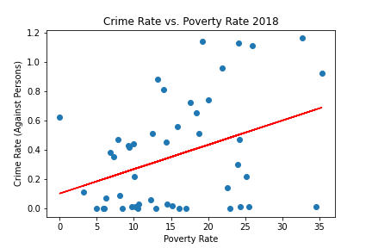
Sacramento County
The average p-value is 0.02 and the average r-square value is 0.12. Given these values and the diagrams’ appearance, our hypothesis is confirmed.

Slide 12
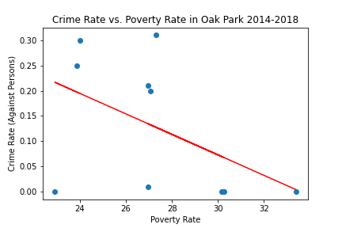
Oak Park
The p-value is 0.23 and the r-square value is 0.16. Given these values and the diagrams’ appearance, we conclude that Oak Park goes against the overall trend in Sacramento County.

Slide 13
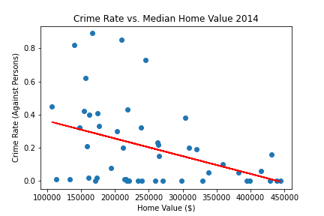
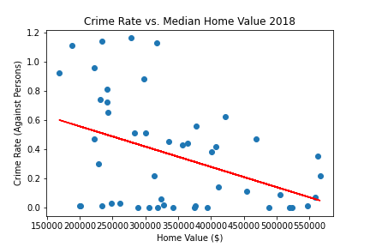
Crime Rate vs. Median Home Values in Sacramento County for 2014-2018
The average p-value is 0.01 and the average r-square value is 0.15. Given these values and the diagrams’ appearance, our hypothesis, which is that as median home values increase the crime rate decreases, is confirmed.

Slide 14
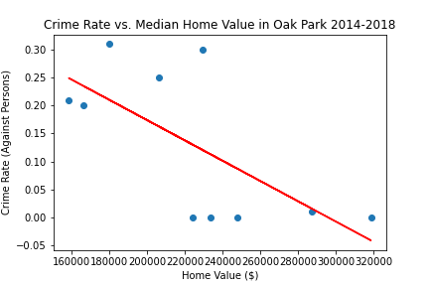
Crime Rate vs. Median Home Values in Oak Park for 2014-2018
The p-value is 0.03 and the r-square value is 0.46. The chart demonstrates that Oak Park follows the same trend as Sacramento County.

