Slide 1
WeShed
By Eliot Shea, Rojo Lopez,
Noal Gesler, and Steven Knudson

Slide 2
General Overview of the project
Our project serves the purpose of allowing musicians to keep up to date with their practice while expanding their horizons with others. Backing tracks are accompanied by music to help the musician get a feel for the song.

Slide 3
State of the Project and what was accomplished this increment
For this increment streaks, favorite songs, suggested searching, searching for users, friendships, challenges, achievements, and css modifications were accomplished.

Slide 4
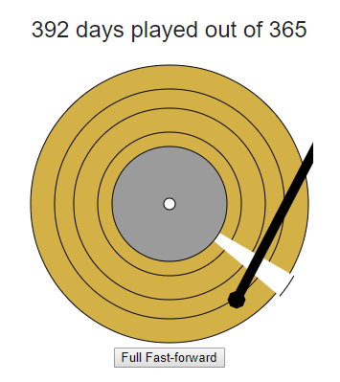
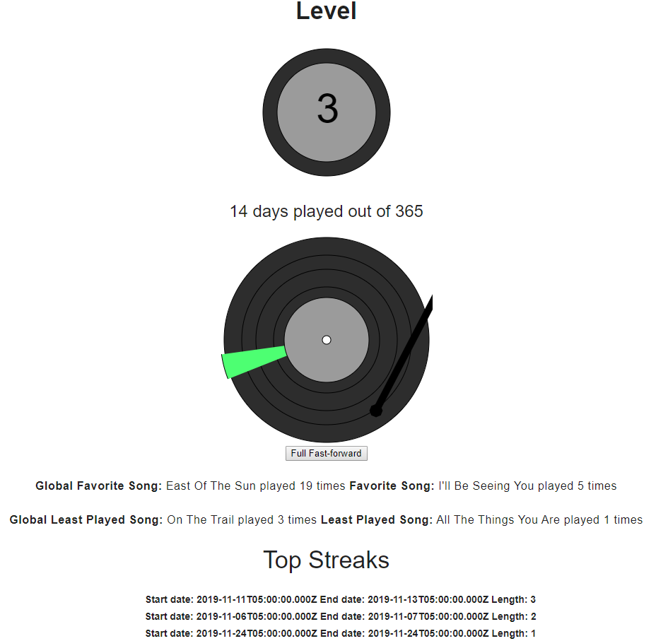
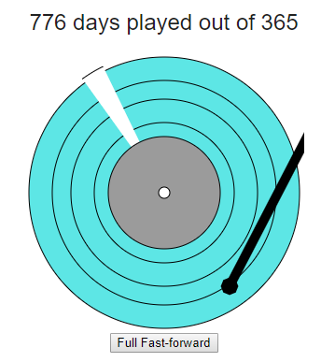
Demo

Slide 5
Change in scope of the project from the initial plan proposed and why the change occurred
For the change in scope of the project we found that achievements, favorites, and streak-tracking held similarities, therefore, we decided to make achievements based off progress instead of having diverse conditionals.

