Slide 1
WeShed
By Eliot Shea, Rojo Lopez,
Noal Gesler, and Steven Knudson

Slide 2
General Overview of the project

Slide 3
State of the Project and what was accomplished this increment
For this increment the streaks, favorite songs, achievements, and css modifications were accomplished.

Slide 4
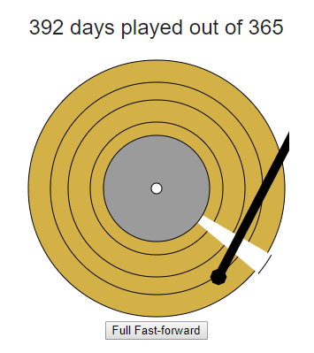
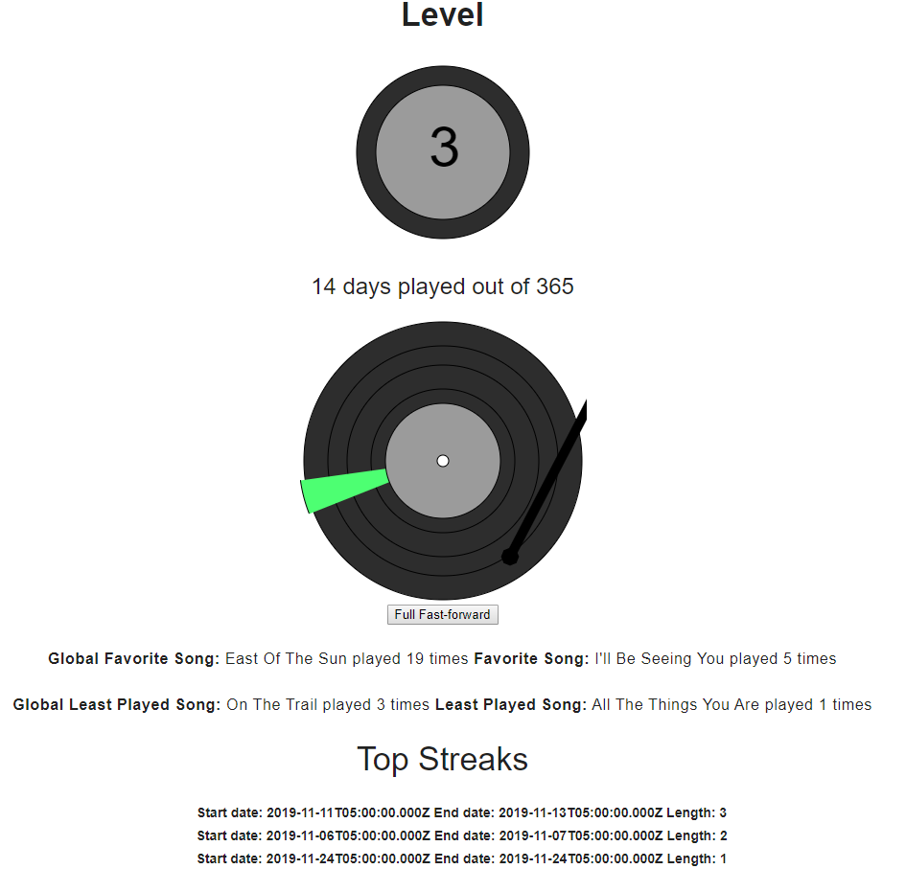
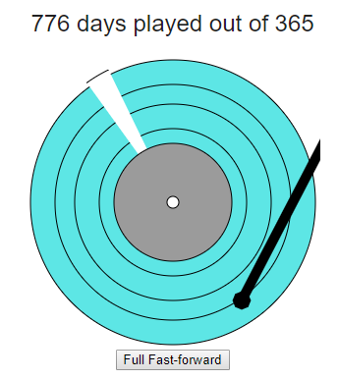
Demo

Slide 5
Change in scope of the project from the initial plan proposed and why the change occurred
For the change in scope of the project we found that achievements, favorites, and streak-tracking held similarities, therefore, we decided to make achievements based off progress instead of having diverse conditionals.

