Slide 1
PARALLAX
The next company
worth your conviction
Claude research teams for venture investors
eliott-crypto.github.io/PARALLAX
01
Notes:
PARALLAX is a hackathon prototype for emerging venture funds and angel investors. Present the live app alongside this deck. The intended customer benefit is a clearer next diligence decision, not a validated forecast of investment returns.
Sources:
https://github.com/eliott-crypto/PARALLAX

Slide 2
Business: the next diligence call
CUSTOMER HYPOTHESIS
Emerging venture funds
and angel investors
Which company
benefits now?
What evidence
could change
our minds?
An investor has a market thesis.
The hard choice is where to spend
the next hour of diligence.
02
Notes:
This is a proposed target customer and pain hypothesis. We have not supplied verified user interviews, customers, revenue, market size or time-saved results. The prototype focuses on turning a market belief into an evidenced research priority. Sources are product requirements and implementation, not a customer survey.
Sources:
https://github.com/eliott-crypto/PARALLAX/blob/main/README.md

Slide 3
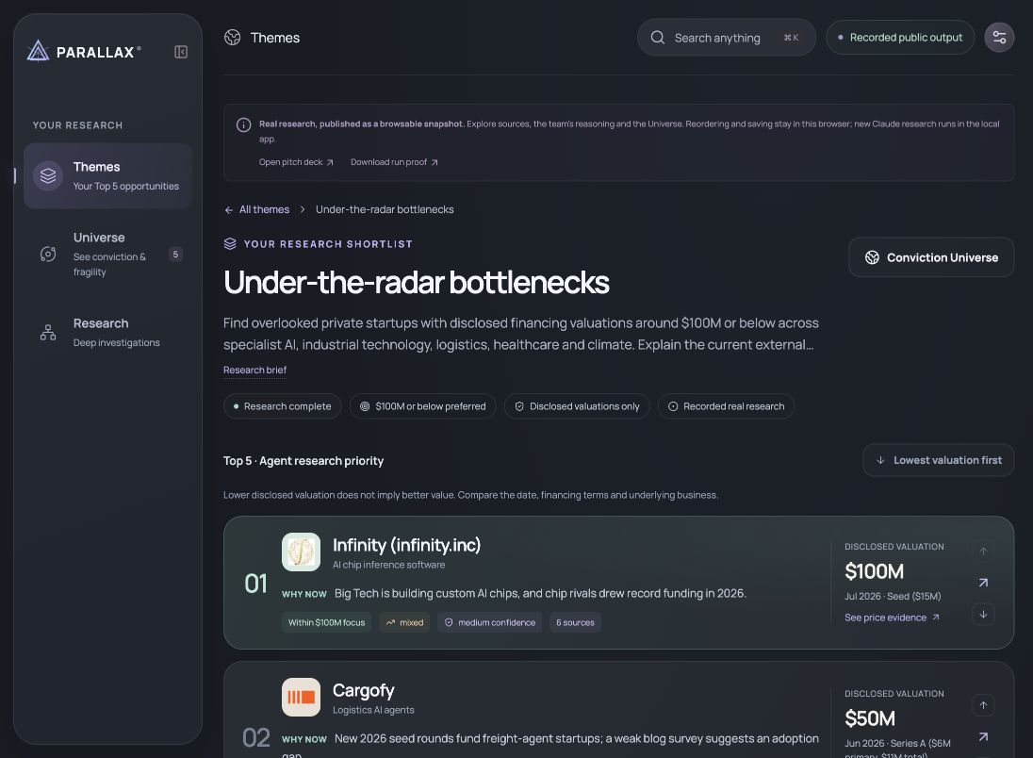
Real output: a Top 5 you can investigate
Four companies at $100M or below. Click a company for its evidence and what could break the thesis.
03
Notes:
Actual completed source-reviewed shortlist. Prices are historical company-stated or reported marks, with dates and qualifications. The source audit includes external review.
Sources:
https://eliott-crypto.github.io/PARALLAX/

Slide 4
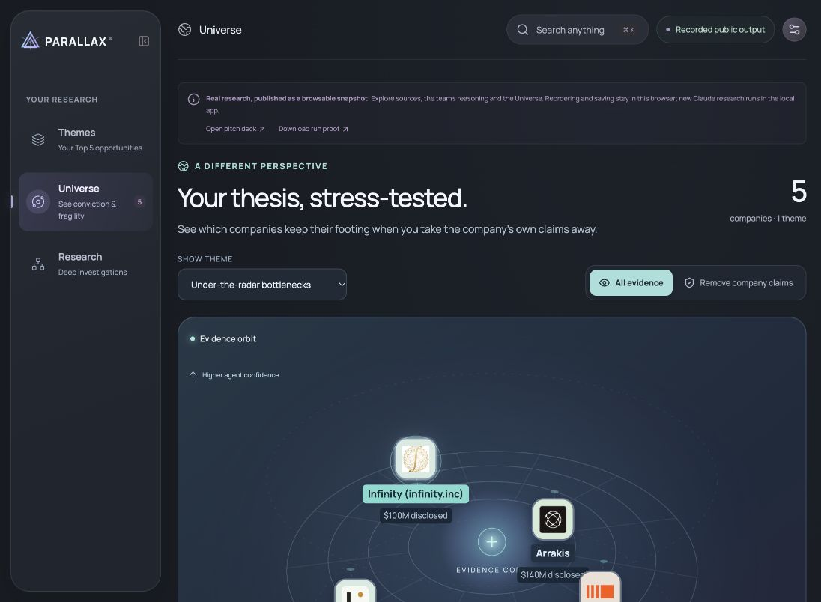
Demo: remove the company’s own claims
Watch the evidence move. Closer means more cited support. Height means agent confidence.
04
Notes:
Demonstrate the independence lens. This visual measures admitted research support, not expected returns.
Sources:
https://github.com/eliott-crypto/PARALLAX/blob/main/src/lib/universe.ts

Slide 5
Architecture: nine agents that challenge each other
Specialists hand off findings and citations. A fresh verifier challenges the thesis before the committee decides.
PUBLIC PROFESSIONAL / MARKET RESEARCH
Founder analyst
Bull
Scout
Causal analyst
Company hunter
Verifier
Competitive
analyst
Bear
Bull revision
Investment
committee
Persisted evidence and bounded budgets support long runs, interruption recovery and an inspectable history.
05
Notes:
There are nine distinct research roles. Bull revision is a feedback pass, not a tenth distinct role. Founder and Competitive run in parallel, then Bull and Bear run in parallel. Verifier performs fresh search. Orchestration persists actual provider usage, budgets, events and admitted evidence. Theme shortlist discovery is a separate smaller team with parallel scouts, price verification, adversarial review and ranking.
Sources:
https://github.com/eliott-crypto/PARALLAX/blob/main/server/orchestrator.ts
https://github.com/eliott-crypto/PARALLAX/blob/main/server/store.ts
https://github.com/eliott-crypto/PARALLAX/blob/main/server/claude.ts

Slide 6
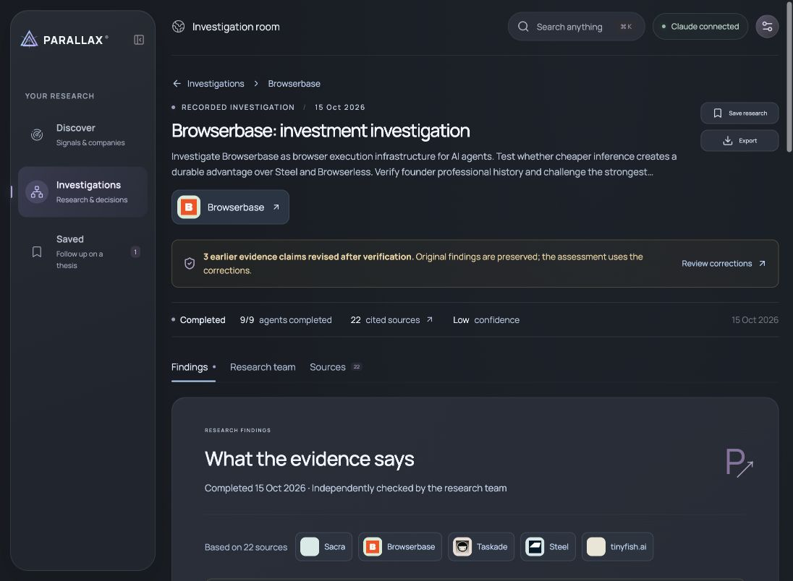
A real correction changed the thesis
RECORDED BROWSERBASE INVESTIGATION
Salesforce and Visa
The cited article named them under
competitor Sauce Labs. Verification
withdrew the Browserbase attribution.
MONITOR
Low research confidence
9 agent roles 28 evidence records 22 source URLs
06
Notes:
Actual saved Claude execution: recordings/6b8771ef-7394-40b7-b702-222cbbad204f.json. Completed final decision MONITOR, confidence LOW. Input tokens303540 plus output44738 =348278 total provider tokens. 28 evidence records and22 distinct stored URLs. The later committee used claude-opus-5-5. A source-quality review flagged the customer-attribution problem, then a real Verifier pass retrieved sources and a Bull revision incorporated the correction. Preserve that distinction: the entire discovery was not an unassisted first-pass success. Original outputs, the token-budget interruption and later recovery remain in the trace. The cited Contrary source places Salesforce and Visa in the Sauce Labs competitive section, not Browserbase. The final memo withdraws the claim.
Sources:
https://github.com/eliott-crypto/PARALLAX/blob/main/recordings/6b8771ef-7394-40b7-b702-222cbbad204f.json
https://github.com/eliott-crypto/PARALLAX/blob/main/docs/LIVE_RESEARCH_REVIEW.md
https://github.com/eliott-crypto/PARALLAX/blob/main/docs/RECORDED_INVESTIGATION.md

Slide 7
Responsible design: evidence before confidence
01
Company, valuation amount and date
A funding amount or SAFE cap cannot substitute for a priced valuation.
02
Only admitted research URLs
Source corrections retain the original audit trail.
03
Unknowns stay visible
Unpriced companies remain outside the ranked list.
04
A bounded research process
Public professional records, server-side keys and explicit partial results.
Publisher investment hit rates remain unmeasured. A citation can still be misread.
07
Notes:
These are current prototype controls, not a guarantee that every source is correct or that all current company information is complete. Valuation gates require sourced amounts and dates, reject unsupported candidate references and exclude proposed rounds, SAFE caps and asking prices. Research URLs must derive from retrieved search/citation protocol sources. Private credentials remain server-side. Professional investigation uses public work records. Source history is a history of agent-assigned claim assessments and corrected interpretations, not independently audited publisher accuracy or investment returns.
Sources:
https://github.com/eliott-crypto/PARALLAX/blob/main/server/boards.ts
https://github.com/eliott-crypto/PARALLAX/blob/main/server/claude.ts
https://github.com/eliott-crypto/PARALLAX/blob/main/src/lib/source-intelligence.ts

Slide 8
The pilot proposal
PROPOSED PRICING
Five pilot funds
$299
Test one real investment theme
with your own diligence questions.
per analyst / month
Team plan with shared themes
and research usage limits
Measure the decision: time spent,
source coverage and whether a
challenge changes the priority order.
Pricing and demand are hypotheses. No verified customers or revenue claimed.
08
Notes:
Pricing is a proposed hypothesis:299 USD per analyst per month, plus a team plan to be specified. No verified paying customers, contracted pilot funds, revenue, margin or willingness-to-pay evidence has been provided. The ask is an invitation to recruit five pilot funds. Usage limits and unit economics need measurement because long Claude investigations can be token-intensive. Success criteria are proposed pilot measures rather than achieved results. The public GitHub Pages output provides a recorded research replay. Fresh Claude execution requires the separate Node server and a private API key.
Sources:
https://github.com/eliott-crypto/PARALLAX

