Slide 1
Heyi LayerNorm Optimization
AIG AIM

Slide 2
PR Version Summary

Slide 3
TE-LayerNorm Perf Summary
Fundamentally improve performance across different shapes, achieving performance improvements in both forward and backward phase.
Fwd: achieve 1.0~5.6x performance boost against hip kernel on MI300X, 0.8~1.5x performance boost against H100;
Bwd: achieve 1.0~5.3x performance boost against hip kernel on MI300X, 0.66~1.5x performance boost against H100;

Slide 4
TE-LayerNorm Perf Summary
Tuned branch:
Perform an exhaustive traversal of all possible parameter combinations for a specific hidden size offline. This part need update to sync with online tuning strategy and summit a PR.
General branch:
Performance improvement relies on algorithm optimization. The forward and backward passes use different optimization methods.

Slide 5
TE-LayerNorm General-Forward-Phase
General forward kernel optimization will summit a PR.
KeyPoint:
Changed from first calculating the mean then calculating the variance to obtaining both mean and variance in a single pass based on Welford algorithm.
An introduction of welford algorithm is provided by Wikipedia here:
https://en.wikipedia.org/wiki/Algorithms_for_calculating_variance?section=5#Parallel_algorithm
Added a Stats_ge struct in utils.cu.
Extended the kernel_traits class with an additional template parameter (defaulting to the Stats struct used by the tuned kernel).
Modified kernel launches for the general case to explicitly specify the kernel_traits parameter.

Slide 6
TE-LayerNorm General-Forward-Phase
More shapes and types for general forward kernel...
M | N | In-Dtype | Out-Dtype | Base-fwd (us) | Opt-fwd (us) | fwd-boost (HIP/Opt)
6800 | 928 | fp16 | fp16 | 64.368 | 20.149 | 3.19
16000 | 1472 | fp16 | fp16 | 192.124 | 61.059 | 3.15
46000 | 2240 | fp16 | fp16 | 574.380 | 338.737 | 1.70
34003 | 3957 | fp16 | fp16 | 793.507 | 519.099 | 1.53
6800 | 928 | fp32 | fp32 | 70.400 | 24.001 | 2.93
16000 | 1472 | fp32 | fp32 | 223.896 | 91.833 | 2.44
46000 | 2240 | fp32 | fp32 | 680.078 | 447.538 | 1.52
34003 | 3957 | fp32 | fp32 | 882.146 | 632.478 | 1.39
6800 | 928 | fp32 | bf16 | 69.094 | 23.736 | 2.91
16000 | 1472 | fp32 | bf16 | 197.039 | 85.414 | 2.31
46000 | 2240 | fp32 | bf16 | 637.176 | 421.385 | 1.51
34003 | 3957 | fp32 | bf16 | 811.177 | 556.470 | 1.46

Slide 7
TE-LayerNorm General-Backward-Phase
General backward kernel optimization will summit a PR.
KeyPoint:
Mitigated register spilling in the backward pass of the general branch under certain condition. (When M is large, the performance improvement is more significant.)
Accumulate dgamma and dbeta during dx computation/write-back rather than in hot loops; only cache y, not dy.
Optimized the dispatch strategy for the backward finalize kernel in the general branch.
If n%32==0, launch the tuned kernel; otherwise, launch the general kernel.

Slide 8
TE-LayerNorm General-Backward Phase
More shapes and types for general backward kernel...
M | N | In-Dtype | Out-Dtype | Base-bwd(us) | Opt-bwd(us) | bwd-boost (HIP/Opt)
6800 | 928 | fp16 | fp16 | 161.415 | 113.413 | 1.42
16000 | 1472 | fp16 | fp16 | 275.917 | 222.245 | 1.24
46000 | 2240 | fp16 | fp16 | 1286.382 | 1042.155 | 1.23
34003 | 3957 | fp16 | fp16 | 1716.719 | 1646.7 | 1.04
6800 | 928 | fp32 | fp32 | 162.071 | 114.569 | 1.41
16000 | 1472 | fp32 | fp32 | 733.466 | 250.962 | 2.92
46000 | 2240 | fp32 | fp32 | 1606.342 | 1239.285 | 1.30
34003 | 3957 | fp32 | fp32 | 2019.947 | 2175.452 | 0.93
6800 | 928 | fp32 | bf16 | 164.584 | 128.685 | 1.28
16000 | 1472 | fp32 | bf16 | 731.358 | 286.572 | 2.55
46000 | 2240 | fp32 | bf16 | 1611.027 | 1242.662 | 1.30
34003 | 3957 | fp32 | bf16 | 2028.18 | 2172.27 | 0.93

Slide 9
TE-LayerNorm PR to submit
According to meeting discussion, three PRs will be submitted based on the TransformerEngine@f3938a3:
1. A performance improvement PR for the forward kernel, providing performance comparison data.
2. A performance improvement PR for the backward kernel, providing performance comparison data.
3. After Wangye provides the online tuning framework, we will incorporate our tuning strategy and submit a PR.

Slide 10
Slides Used During The Discussion

Slide 11
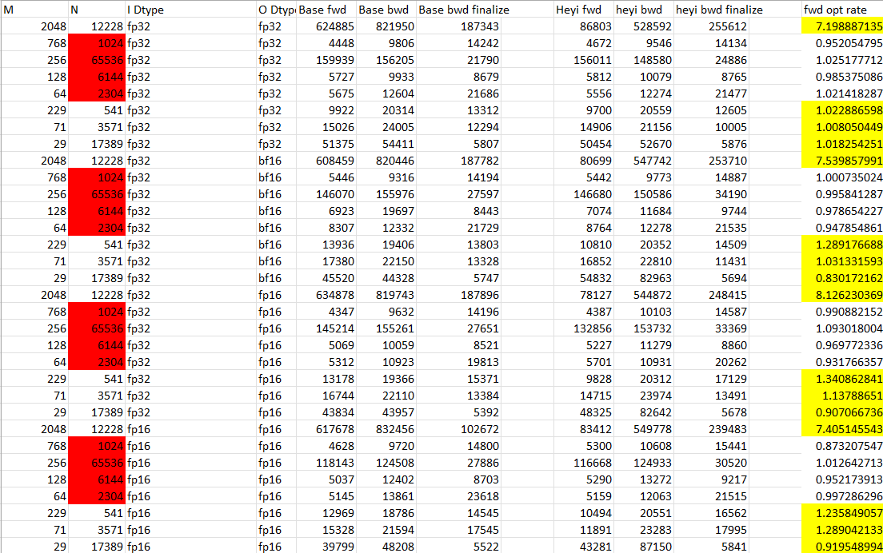
Summary--fwd
The red fill will run the tuned kernel, which has not been covered and the rate should be considered fluctuation; the performance gains for other shapes are minor or slightly negative, and should likewise be regarded as fluctuation.

Slide 12
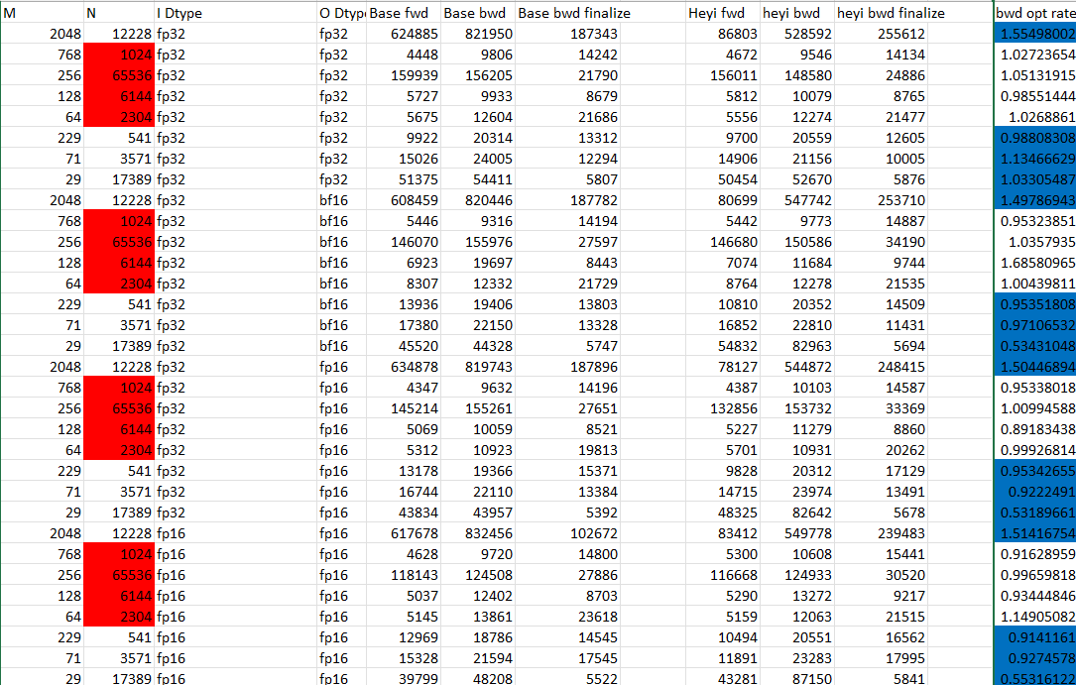
Summary--bwd
Some shapes show improvements, while some shapes degrade. Scratch memory usage is observed, and compared to the base version, the changes in scratch usage vary—some increase, some decrease.

Slide 13
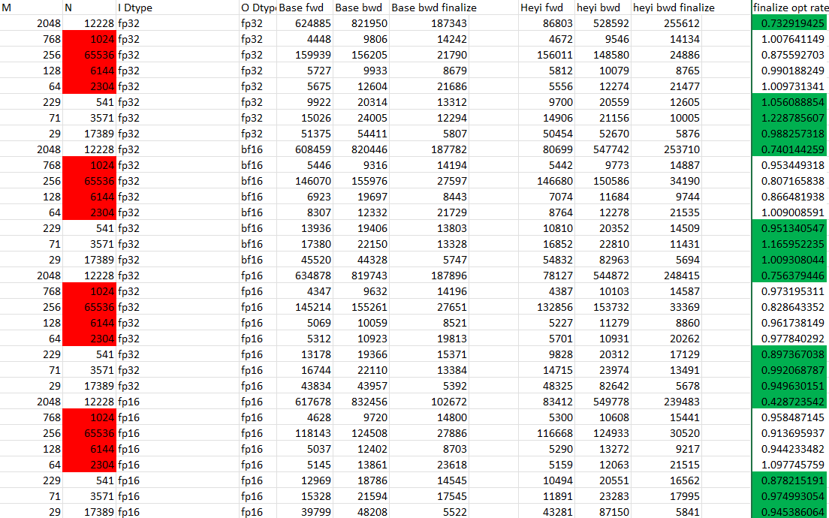
Summary—bwd finalize
After reviewing the general and tuned kernel code, the general kernel mainly uses a straightforward implementation, while the tuned kernel leverages share memory(dim3 block(32,32)). Therefore, a condition was added when launching the general backward finalize kernel to route to tuned kernel if cols%32==0.

Slide 14
Forward Kernel
Stage 1
Due to the significant performance gap between the general and tuned kernel, and because they use different reduction methods(the tuned kernel use struct Stats is based on Welford algorithm, while the general kernel use struct Reducer is based on naïve implementation),the Stats was adapted for use in general version.Performance changed from 733 to 645.(76800,1600)
Stage 2
Fixed the method for calculating “valid_count”: previously it counted non-zero elements, but now it uses params.cols < hiddensize for determination. Also,the warp-level computation in Stats was changed from warp reducer to the Welford algorithm. Performance changed from 645 to 574.(76800,1600)
Stage 3
Scratch usage of 784 was observed, indicating high register pressure, which is believed to be caused by the array xf existing throughout the entire kernel. The solution is to compute each thread’s m,m2 and n using the Welford algorithm directly within the kernel, then realse xf after computation. During normalization, xf is reloaded. Additionally, gamma and beta arrays are loaded only at normalization stage. Performance changed from 574 to 353.(76800,1600)

Slide 15
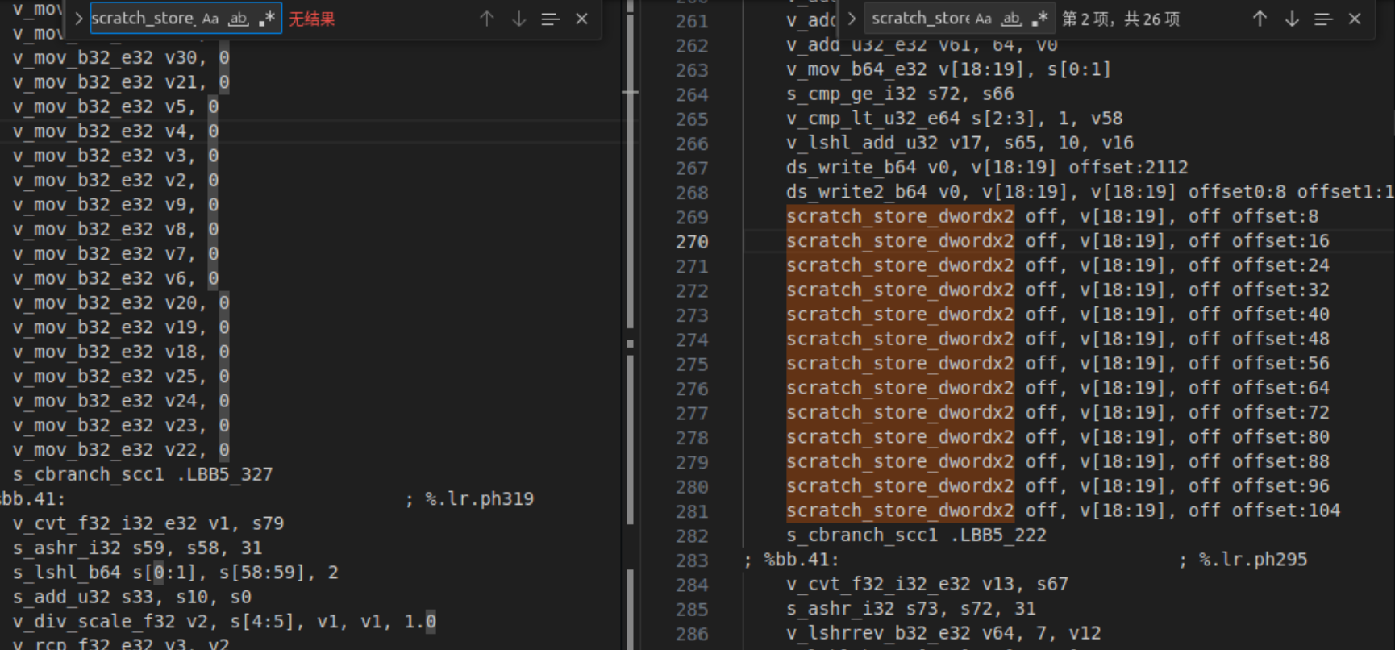
bwd
Initially, we followed the forward kernel approach to reduce dy lifetime and lazily load array gamma, but saw almost no performance improvement. Comparing the general and tuned kernel implementations, they are largely similar—the tuned kernel uses a static Reducer, while the general uses a dynamic one—leaving limited room for change. By chance, we discovered that performing a dummy write before writing dx to global memory eliminates scratch usage and significantly improves performance: from 526 to 347 us. It was also observed that this dummy write can eliminate scratch, but it’s not generally applicable.

Slide 16
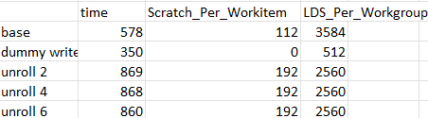
bwd
At this stage, since both the tuned and general kernels use the Reducer structure for reduction, we have not yet adopted the Stats structure(as in the forward kernel) to reduce. Additionally, partial unrolling of the loop containing the dirty write led to a nearly 50% performance regression compared to the baseline, and scratch_per_workitem from 112 to 192.

Slide 17
Some questions&&next to do
When does Scratch_Per_Workitem occur, and how is LDS_Per_workgroup calculated?
The case where ctas_per_row > 1 has not been optimized;
Backward general kernel scratch: replaced to the reduction structure form Reducer to Stats(similar to the changes made in forward general kernel);
Can bwd general finalize kernel be optimized when cols % 32 != 0?
For (2048,12228),why scratch_per_workitem worsens but performance still improves; also (29,17389),why the scratch_per_workitem increase significantly and performance degrades by factor of 2.

Slide 18
Use the Welford algorithm in the Bwd kernel
Although the migration was successful, the kernel time increased to around 750 µs, which is over 30% slower than the 570 µs baseline.
Through analysis, we believe that the Welford algorithm is not suitable for reduction in the backward kernel. In the forward kernel, both the mean and variance are required for normalization. The standard approach calculates the mean first and then the variance, requiring two passes. Welford can compute both in a single pass, but it needs to maintain three variables (`m`, `m2`, and `n`).
However, in the backward stage, only the mean is needed to compute `dx`, which can be efficiently obtained with a single pass without using Welford.

Slide 19
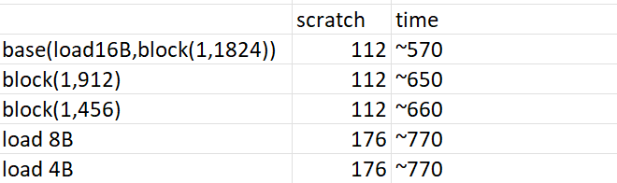
Reduce the base tile size
For this shape (76800, 1600), the gridDim is (1, 1824). Reducing the number of blocks along the row dimension by a factor of 2 or 4 leads to performance degradation. With bytes_per_load == 16 and the input type being bf16 (i.e., each thread processes 8 elements at a time), reducing it to 4 or 2 also results in performance degradation, along with increased scratch usage.

Slide 20
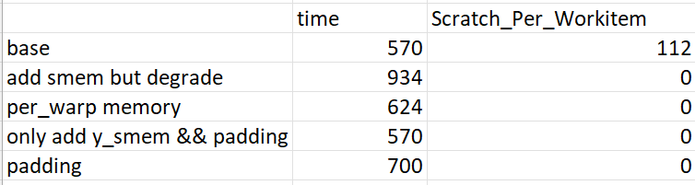
Perhaps the cause of the spill has been found
By comparing the .ll file, .s file, and source code, we believe that the spill is caused by the intermediate arrays y and dy. By writing y and dy into LDS and reading them back from LDS when needed, scratch_per_workitem was reduced to 0, but performance degraded. Despite the optimizations applied to the y and dy arrays, there was no performance improvement. The comparison is shown below:

