Slide 1
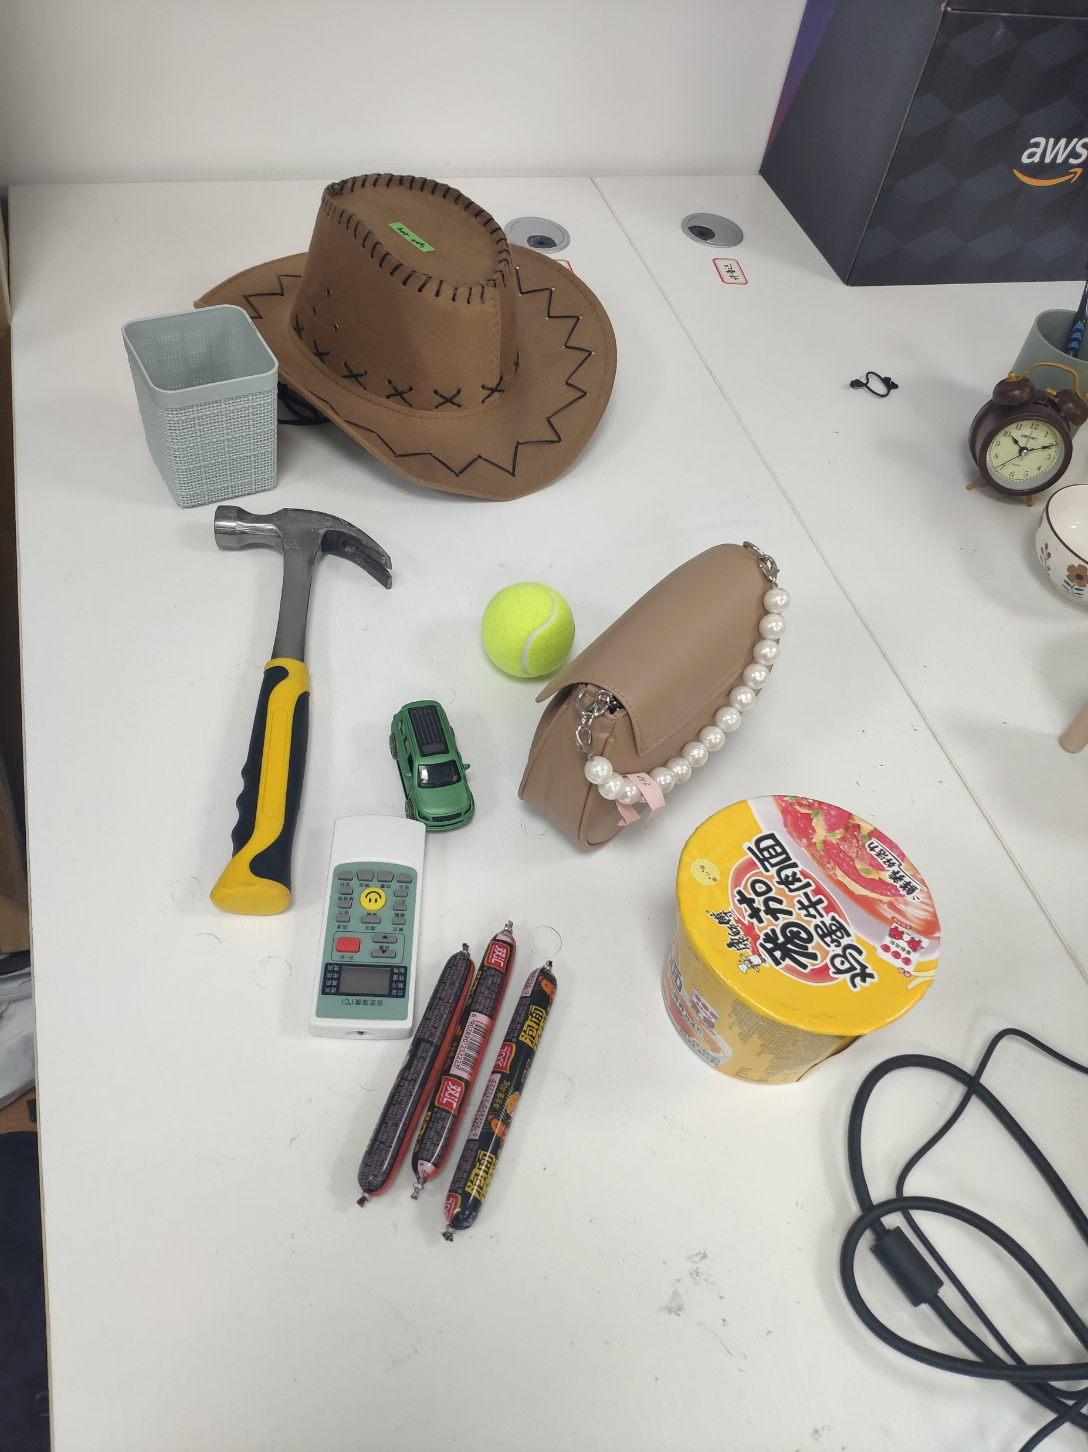
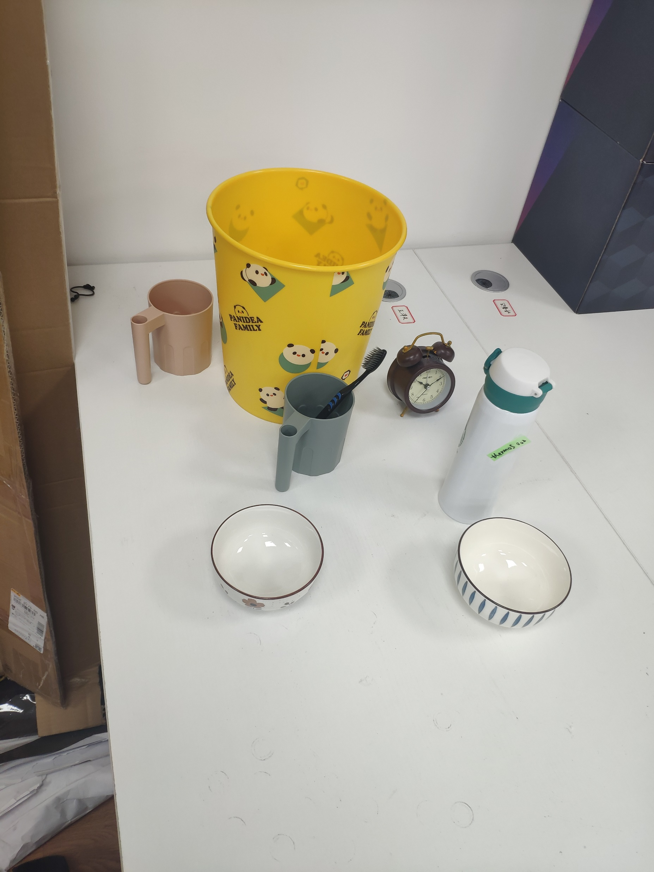
003 hat
003 container
003 trash-bin
005 hammer
002 mug
029 toothbrush
002 tennis-ball
013 handbag
012 clock
014 toy-car
001 mug
002 thermos
004 remote
013 bowl
018 bowl
020 ramen-box
003 sausage

