Slide 1
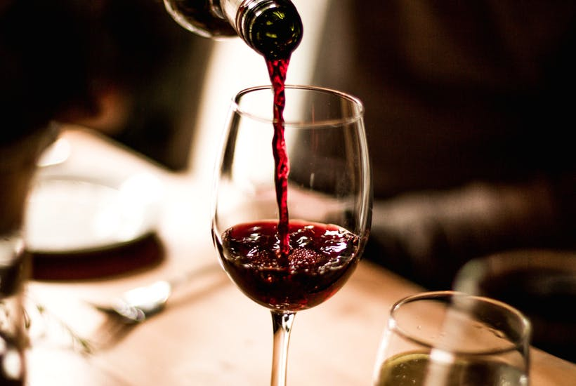
Wine Quality Predictive
Elijah M Raffo
Jiazhou Li
Xunyi Jiang

Slide 2
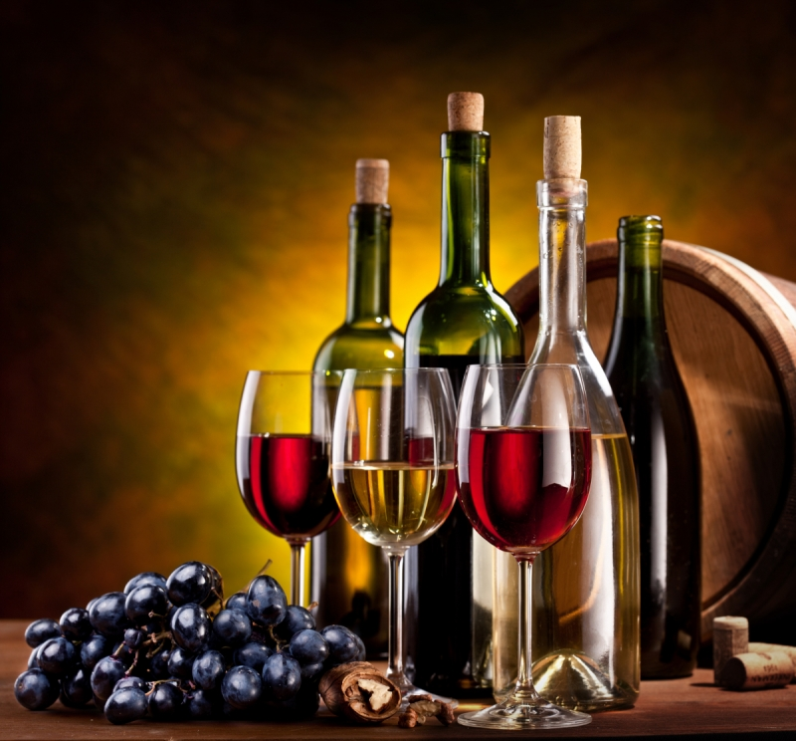
Introduction
Primary data is from Analytic Vidhya
Find out what makes good quality wine
2 datasets: red and white wine
Our goal is to create a robust model for classification whose variables are linked to real world methods of testing batches of wine
Notes:
做一个好酒，最重要的是alcohol，and then是volatile acidity

Slide 3
Descriptive analytics
Target Variable:
Quality
(score between 0 to 10)
Variables:
Fixed acidity,
volatile acidity,
citric acid,
residual sugar,
chlorides,
free sulfur dioxide,
total sulfur dioxide,
density,
pH (scale 0 to 14)，
sulphates,
alcohol
quality.
Notes:
input variables (based on physicochemical tests)
taget variable--- output variable,(based on sensory data)
PH:describes how acidic or basic a wine is, from 0 to 14 (acidic to basic)most wine ph’s around 3 to 4. white wine 3-3.4 is desirable, red wine 3.3-3.6
residual sugar: the amount of sugar remaining after fermentation stops, wines with greater than 45 grams are considered sweet
Chlorides: the amount of salt in the wine
Volatile acidity: the amount of acetic acid in wine, which at too high of levels can lead to an unpleasant, taste sour
most acids involved with wine or fixed or nonvolatile

Slide 4
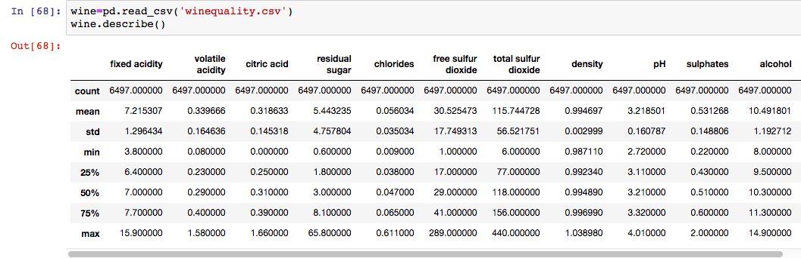
Descriptive analytics
Both red wine and white wine
Notes:
为了看有没有missing data，
用 describe to find out the total counts which is 6497

Slide 5

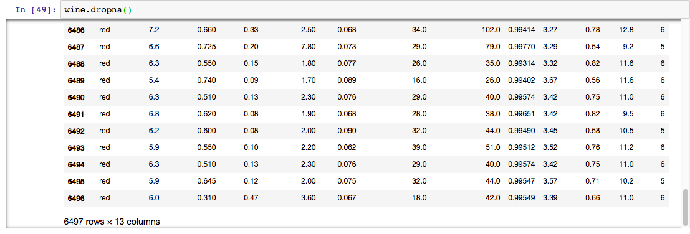
Raw data:
Descriptive analytics
No missing data
Notes:
13 column, 6497 row
after cleaning data, has the same column and row, so there’s no missing data

Slide 6
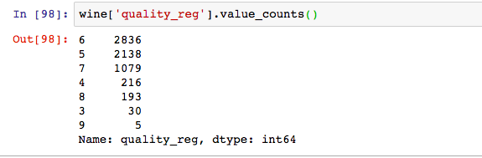
Descriptive analytics
2836 datas are in the quality score 6

Slide 7
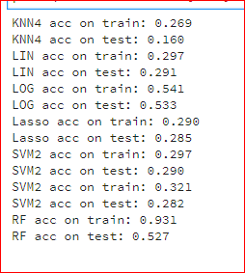
Regression
2) Classification
Good >= 6
Bad < 6
3) Red and White

Slide 8
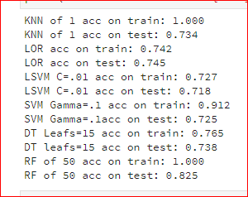
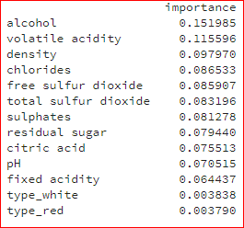

Slide 9
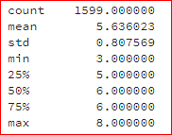
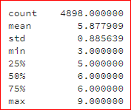
Wine Classification
White Wine
Red Wine

Slide 10
Tests | Wine | Red | White
KNN | 73.4% [1] | 68.8% [30] | 68.2% [10]
Logistic Regressor | 74.5% | 75.7% | 73.2%
Lin SVM [C] | 71.8% [.01] | 74.5% [.1] | 70.5% [.01]
Supoort Vector Machine [Gamma] | 72.5% [.1] | 71.0% [.01] | 72.7% [1]
Decision Tree [leaf node] | 73.8% [15] | 73.5% [20] | 75% [30]
Random Forest [n_estimator] | 82.5% [50] | 81.0% [50] | 82.5% [100]

Slide 11
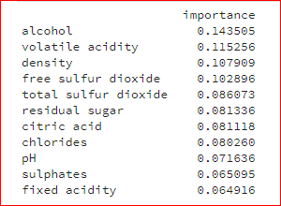
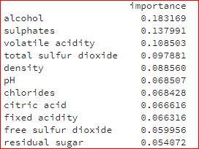
Wine Classification
White Wine
Red Wine

Slide 12
Regression
Wine Data
Regression
Red
Classification
White
Classified

Slide 13
 | White Classification |  | Red Regression
KNN | 69.3% | KNN | 3.8%
Logistic Regressor | 71.9% | Logistic Regressionn | 77.1%
Lin SVM | 70.4% | Lasso | 15.5%
Supoort Vector Machine | 79.4.% | Ridge | 15.6%
Decision Tree | 73.9% | Decision Tree | 8.0%
Random Forest | 83.8% | Random Forest | 33.0%

Slide 14
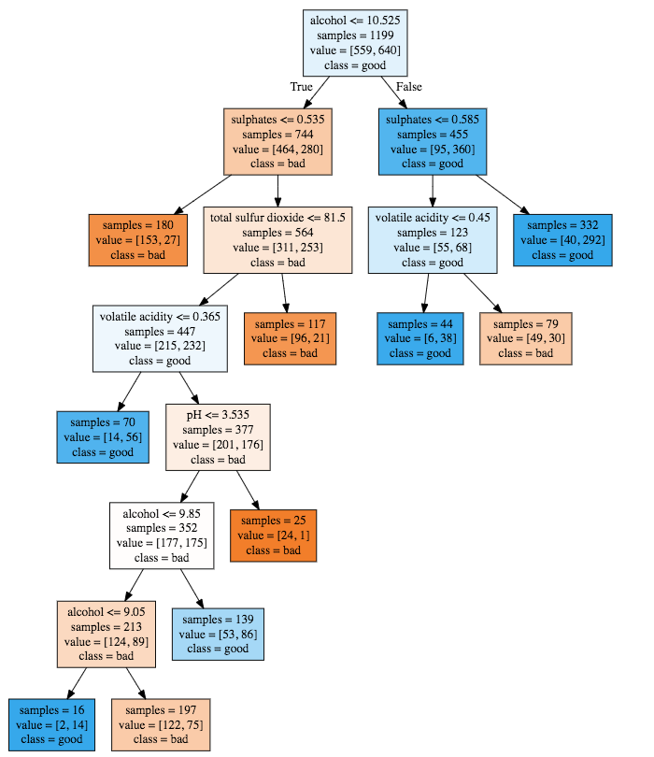
Decison Tree
Red wine
Alcohol= 8.8
Sulphates= 0.45
Class bad
Notes:
举例：说如果alcohol小于等于10.35 ---- true ---volatilc acidity，如果va小于等于0.237 那就是good，如果大于 bad

Slide 15
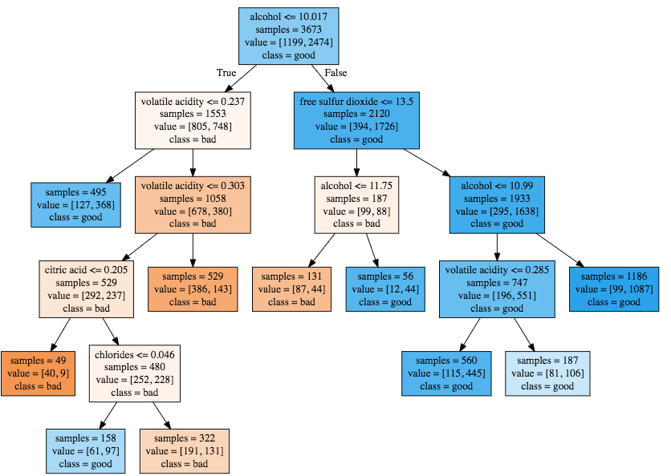
White Wine
alcohol= 10.1
free sulfur dioxide= 30
volatile acidity= 0.28
Class Good

Slide 16
Findings
-Making a “good” wine is possible
-The characteristics of red and white
-Decision Tree is useful and accurate

Slide 17
For a Better Accuracy
-More Descriptive Data
-Domain Knowledge
Using the Findings
-Optimizing wine blends

Slide 18
THANK YOU

