Slide 1
Video Game Database
Trenten Meyer, Elijah Raffo, Johnny Whitaker

Slide 2
Data Collection
Console
Database Design
Entity Relationship
Scenario
Queries
Accessories
Games
Relational Schema

Slide 3
The Video Game Industry
U.S. video game sales reach record breaking $43.4 Billion in 2018. Experiencing 18% growth
Video game market expected to be worth over $90 Billion by 2020. $78.61 Billion in 2017
64% of American households are home to at least one person who plays video games regularly (3 hours a week).
60% of Americans play video games daily
45% of U.S. gamers are women

Slide 4
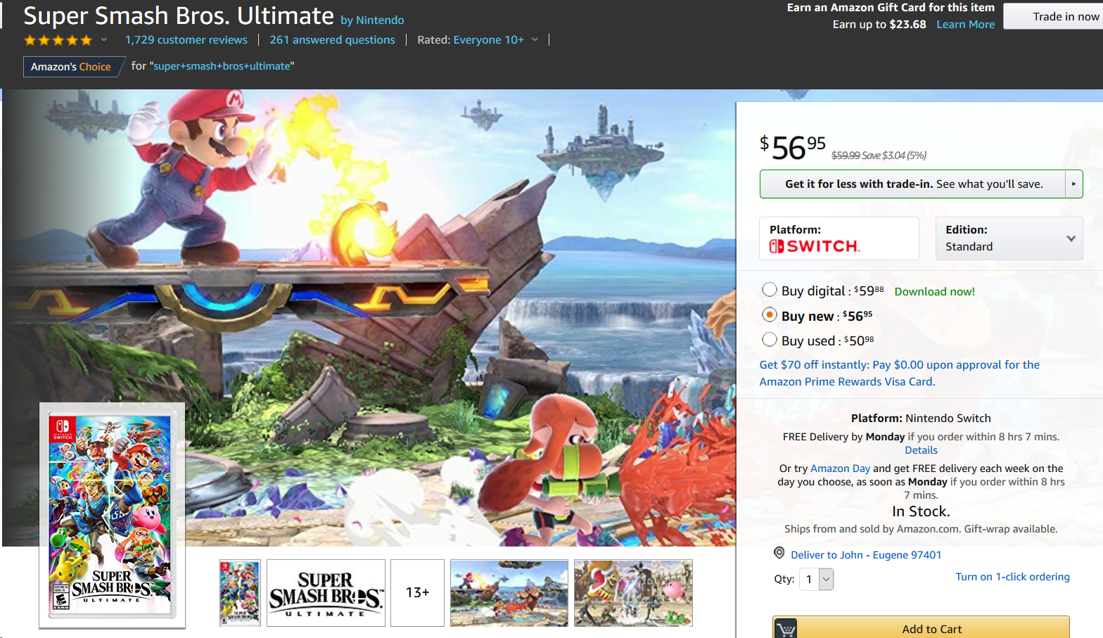

Slide 5
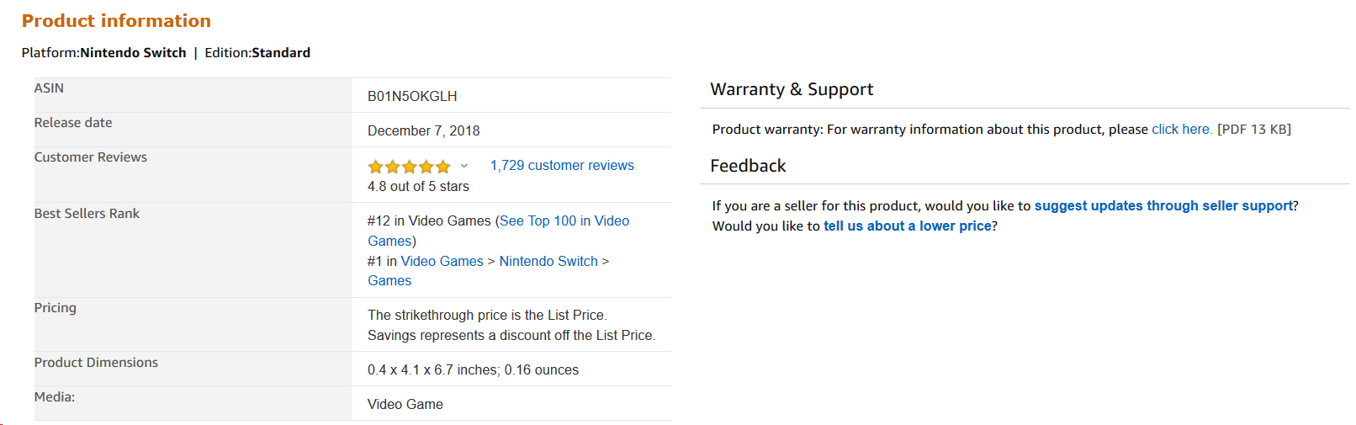

Slide 6
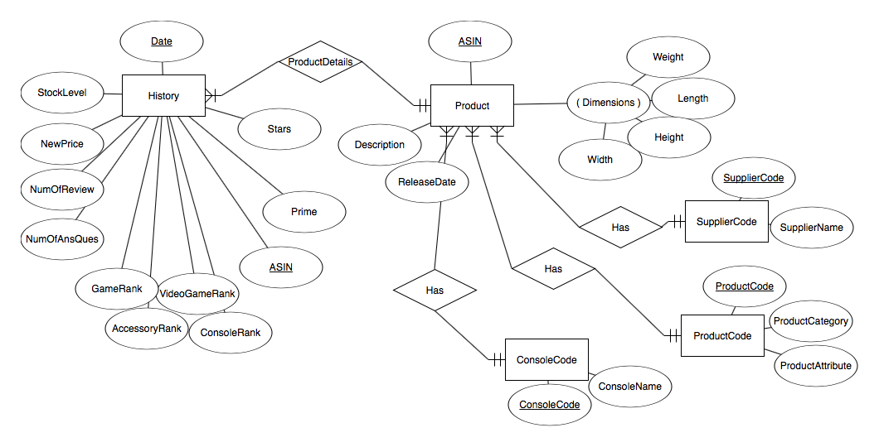
Entity Relationship

Slide 7
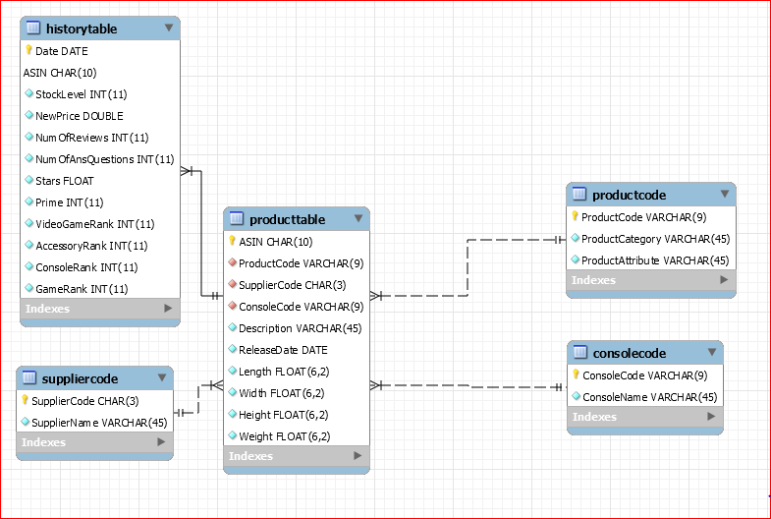
Relational Schema

Slide 8
Console
Games
Price
2 Kids
X - Mas
Best Present

Slide 9


Video Game Query

Slide 10
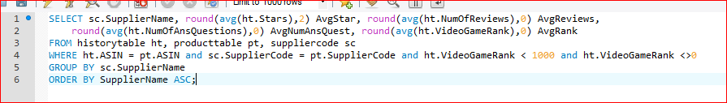
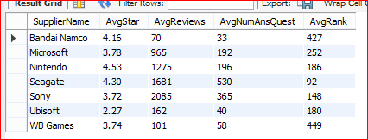
Supplier Performance

Slide 11
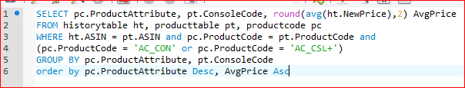
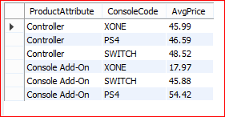
Accessory Query

Slide 12
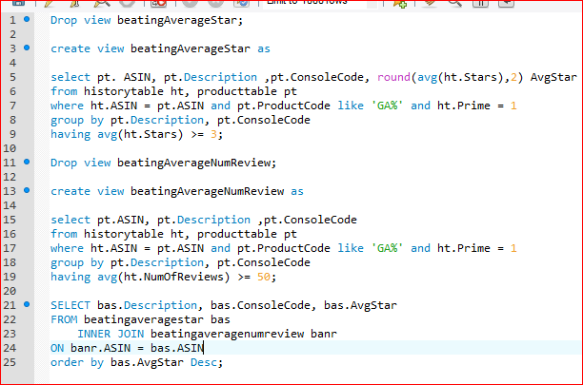
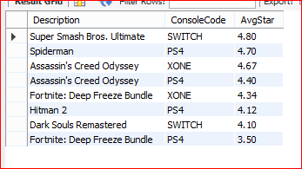
“Viewunion”

Slide 13
Nintendo Switch
Business Impact
Reactive Database
Thank You

Slide 14
Bibliography
Video game industry facts sourced from the Electronic Software Association

