Slide 1
Using Git to manage Workshop Assets

Slide 2
Why use Git?
Maintain common repository of assets
Single point to update
Simplify and minimize distributed VM’s
Support “waypoints” to help keep people on track
Built-in backups!

Slide 3
Fundamental assumptions
“Central” Git repository on GitHub
Workshop is broken into multiple Labs. Each lab may or may not be dependent on prior lab.
Workshop participants start by cloning the central repo to get initial assets.
Participants can reset workspace to known good point at the end of any lab.

Slide 4
Git Repository Organization
‘master’ branch
contains fully completed workshop artifacts
‘step-n-updates’ branch
exists for each Lab in the workshop
Represents the desired state when Lab N has been completed.
‘step-n’ tag
Anchor point for resetting workspace to known good state

Slide 5
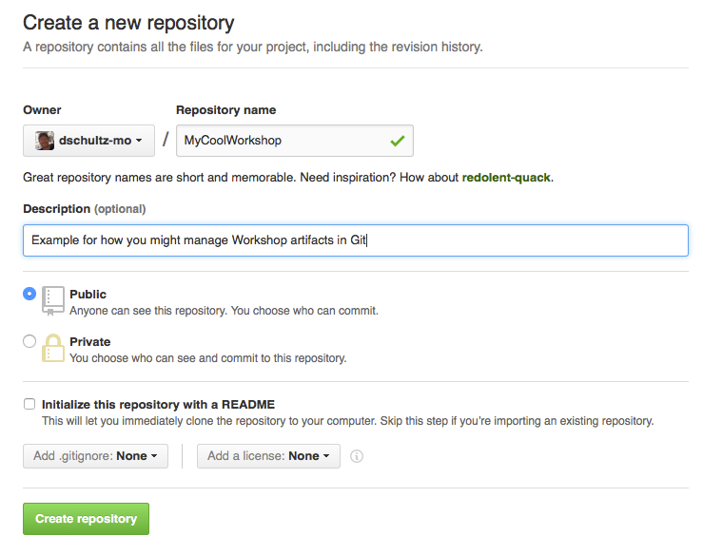
Create GitHub repo
Create a GitHub repository
Repository name will be the base directory for all work in the workshop
Public
Optionally add a .gitignore
Make note of URL

Slide 6
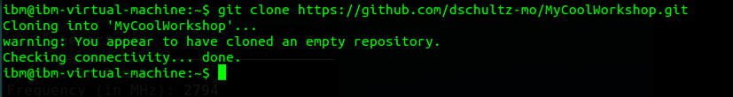
Create Local clone
Clone the repository locally
For example, in a base snapshot of a VM that you will provide to workshop participants
git clone https://github.com/dschultz-mo/MyCoolWorkshop.git

Slide 7
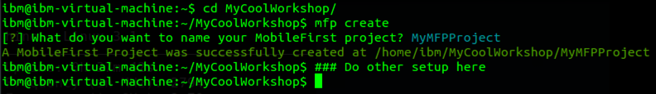
“step-0” Starting Point
master
step-0
Create/populate with artifacts that you will provide as a starting point (before ANY lab work has been done)
Stage and commit your changes
Set a tag as “step-0”

Slide 8
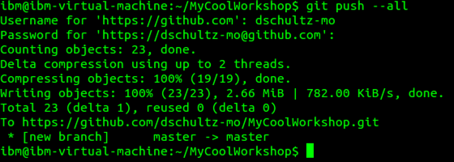
Push updates to Git Hub
Push updates
Use --all to ensure any new branches are created on the Git Hub repo

Slide 9
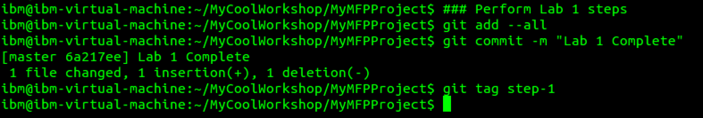
Perform Lab 1 exercises
master
step-0
step-1
Perform Lab 1 exercises just as a participant would.
When finished, commit changes
Tag with ‘step-1’

Slide 10
Complete all Labs
master
step-0
step-1
step-n
Continue working each lab in turn until finished with entire workshop
Push all changes to Git Hub
git push –all
git push --tag

Slide 11
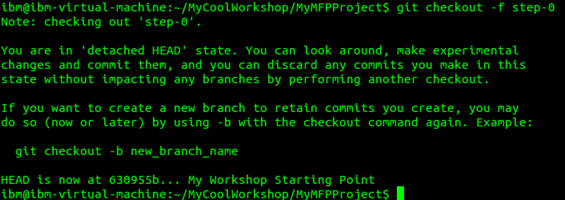
Delivering Workshop - Startup
Participants start by cloning from Git Hub
Participants reset to workshop starting point using checkout to tag

Slide 12

Delivering Workshop - Waypoints
Participants can reset their environment to a known good state

Slide 13
Making updates and corrections
It is inevitable that you will need to make updates to your assets.
In order to continue to support waypoints, you must create a branch for each lab
The waypoint labels will be applied to the HEAD of the branches

Slide 14

Making corrections to step-0
step-0
step-1
step-n
master
step-0
step-0-updates
Create a branch rooted at the current step-0 tag
Make changes, add, commit
Move the tag

Slide 15

Propagate changes to step-1
step-0
step-1
step-n
master
step-0
step-0-updates
step-1
step-1-updates
Create a branch rooted at the current step-1 tag
Merge the changes from step-0-updates
Resolve conflicts, add, commit, move tag

Slide 16
Propagate changes through all steps and master
step-0
step-1
step-n
master
step-0
step-0-updates
step-1
step-1-updates
step-n
step-n-updates
Continue through all waypoints, creating branches, merging and tagging
Merge step-n into master so master contains final completed version

Slide 17
Propagating changes - details
master
step-0-updates
step-0
step-1-updates
step-1
step-n-updates
step-n
git checkout –f step-0-updates
// make changes
git add –all
git commit –m “memo text A”
git checkout –f step-1-updates
git merge --nocommit --no-ff step-0-updates
git commit -m “memo text”
git checkout –f step-n-updates
git merge --nocommit –no-ff step-(n-1)-updates
git add –all
git commit –m “memo text A”
// make more changes
git commit -m “memo text B”
// repeat for master branch
For each branch
Git tag -f -a step-x -m “Completion of Lab x”

