Slide 1

Braude College of Engineering · Software Engineering Department
Capstone Project - Phase A (61998)
Multi-Modal LLM Style Analysis
Detecting Misattributed Creations in the Shakespeare Corpus through LLM-Based Style Normalization
Project Code: 26-2-R-6
Students: Eliran Melihov · Miron Hanukaiev
Advisors: Dr. Renata Avros · Prof. Zeev Volkovich
GitHub: github.com/eliranmeleh/Multi-Modal-LLM-Style-Analysis
1 / 15
Notes:
We are Eliran and Miron, and this is our Phase-A project: Multi-Modal LLM Style Analysis.
In one sentence: we designed a method that uses a large language model to find which creations in the Shakespeare corpus may not be his - no training, no labels.
Our supervisors are Dr. Renata Avros and Professor Zeev Volkovich, and this project continues their own study from 2025.

Slide 2
PROBLEM DEFINITION
The problem & the need
▪ The question. Which of the 49 creations attributed to Shakespeare are genuinely his, and which bear another hand? An ideal computational tool for this question would have three properties:
Judges a text on its own
No external pool of comparison authors to gather - and nothing to rebuild for each new author.
Needs no training
Works out of the box - no labeled examples and no models to train.
Explains itself
A result a literary scholar can read in plain stylistic terms - not just a score.
The gap: existing computational methods rarely offer all three at once - so this project sets out to build one that does: unsupervised, interpretable, and transferable, complementing existing approaches.
26-2-R-6 · Multi-Modal LLM Style Analysis
2 / 15
Notes:
Let's start with the problem.
Forty-nine creations are attributed to Shakespeare.
Which of them are really his - and which show another hand?
We asked a simple question: what would the ideal tool look like?
It would have three properties.
First - it judges a text on its own.
No pool of other authors - and nothing to rebuild for a new author.
Second - it needs no training.
No labeled examples, no models to train - it works out of the box.
Third - it explains itself.
A literary scholar can read the result in plain stylistic terms, not just a score.
And here is the gap: today's methods rarely give all three at once.
So we set out to build one that does.

Slide 3
WHAT THE PROJECT SETS OUT TO ACHIEVE
Project goals
▪ Unsupervised & zero-shot. Design and implement an authorship-anomaly pipeline driven by LLM-based style normalization - no labels, no training.
▪ Interpretable. Produce results a literary scholar can read directly - a per-creation score in plain stylistic terms, not an opaque number.
▪ Methodological cross-check. Benchmark against existing stylometry findings on the corpus as a complementary view of the same question.
▪ Generalizable. The same pipeline applies to any author's corpus by substitution - Shakespeare is only an example, with no “Shakespeare” hard-coded anywhere.
▪ Open & reproducible. Deliver an open-source implementation other researchers can reuse and extend.
26-2-R-6 · Multi-Modal LLM Style Analysis
3 / 15
Notes:
From that gap, we set five goals.
Three of them are exactly the three properties you just saw - now we commit to them.
An unsupervised, zero-shot pipeline - no labels, no training.
Interpretable output - a score per creation, in plain stylistic terms.
And generality - swap the corpus, and the same pipeline works for any author.
Nothing says 'Shakespeare' in the code.
The other two go beyond the tool itself.
A cross-check: we compare our results with existing stylometry on the same corpus - when two independent methods agree, the evidence is stronger.
And open-source, reproducible code that others can reuse - every run logged, one command to repeat.

Slide 4
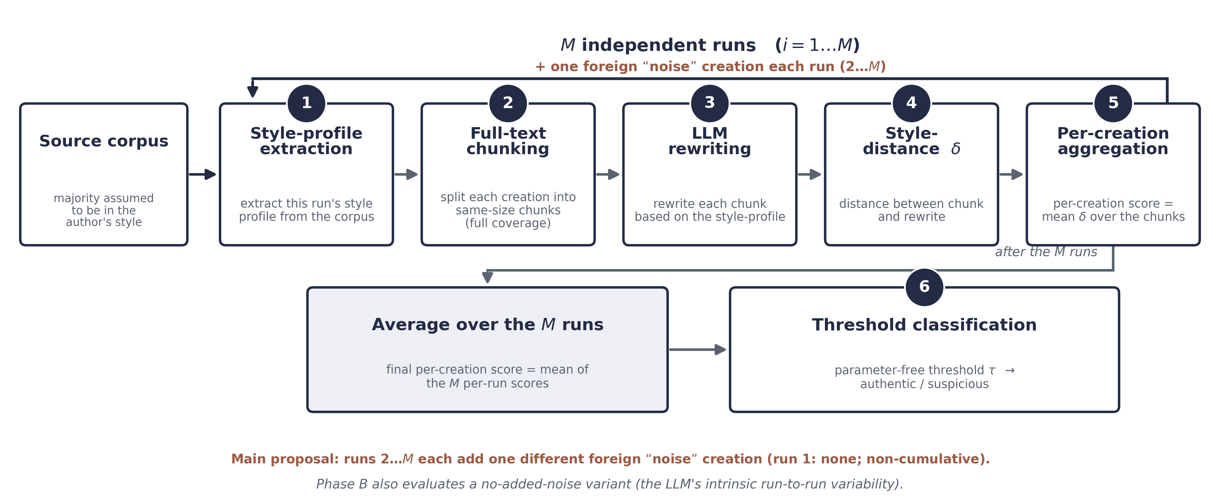
PROPOSED SOLUTION - METHOD AT A GLANCE
Methodology - pipeline overview
The core idea - rewrite each passage into the corpus’s own style - how much it must change is the distance the method measures (small change → authentic, large → another hand).
26-2-R-6 · Multi-Modal LLM Style Analysis
4 / 15
Notes:
Here is the whole method in one picture.
Let me walk through it quickly - the next slides explain each step in depth.
Step one - profile. The model reads the whole corpus and writes one style profile.
Step two - chunking. We split every creation into chunks of about four hundred words.
Step three - rewriting. The model rewrites each chunk into the profile's style - keep the content, change only the style.
Step four - the distance. For each chunk we measure delta: how much the rewrite had to change.
Step five - aggregation. Chunk deltas become one score per creation, averaged over several independent runs - that is the loop in the diagram.
From run two on, each run also adds one different noise creation, to test stability.
Step six - the threshold. One split of the forty-nine scores into authentic and suspicious.
Single round, no feedback loop.
That is the whole flow.
Now let's zoom in, step by step.

Slide 5
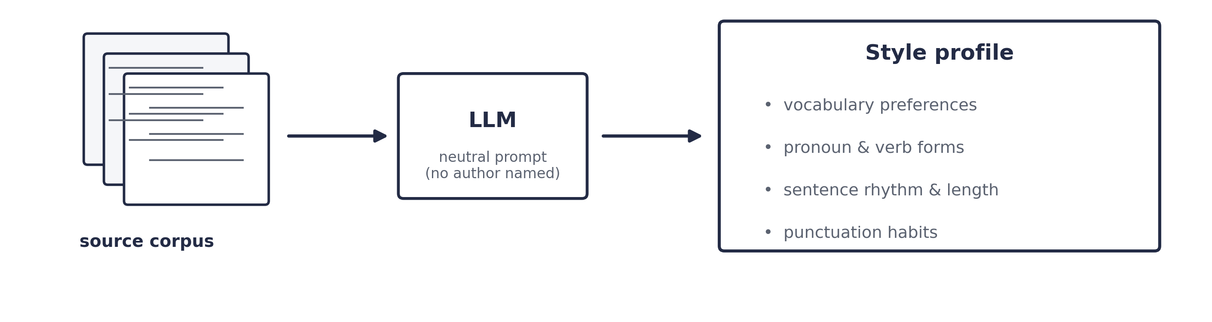
METHOD - STEP 1 OF 6
Step 1 - Style-Profile Extraction
▪ Input. The full text of every creation in the corpus (most are assumed to be already in the author's style) - whole creations, not samples.
▪ What the LLM does. Produces a generic style profile - vocabulary, pronoun and verb forms, sentence rhythm, punctuation.
▪ Neutral prompt. No mention of “Shakespeare” or any author, so the profile carries no memorized-author bias.
▪ Noise injection (main proposal). Each profiling run after the first adds one different foreign creation as “noise” to the corpus before extraction (run 1: none; non-cumulative), so no single intruder can bias the profile; Phase B also tests with no added noise.
26-2-R-6 · Multi-Modal LLM Style Analysis
5 / 15
Notes:
The model reads the full text of every creation in the corpus.
We assume most of it is already in the author's style.
It writes one general style profile.
Notice the direction here: the model reads a lot, but writes only a short description.
Reading a lot is easy for a language model.
The key point: the prompt never names Shakespeare - or any author.
So the profile carries no memorized bias, and the method stays general.
The fourth bullet is noise injection.
Every run after the first adds one different foreign creation to the corpus.
Run one has none, and it does not accumulate.
So no single intruder can bias the profile.
In Phase B we also test a version with no added noise - the model is not deterministic, so every run already varies a little.
We will come back to this at the aggregation step.

Slide 6
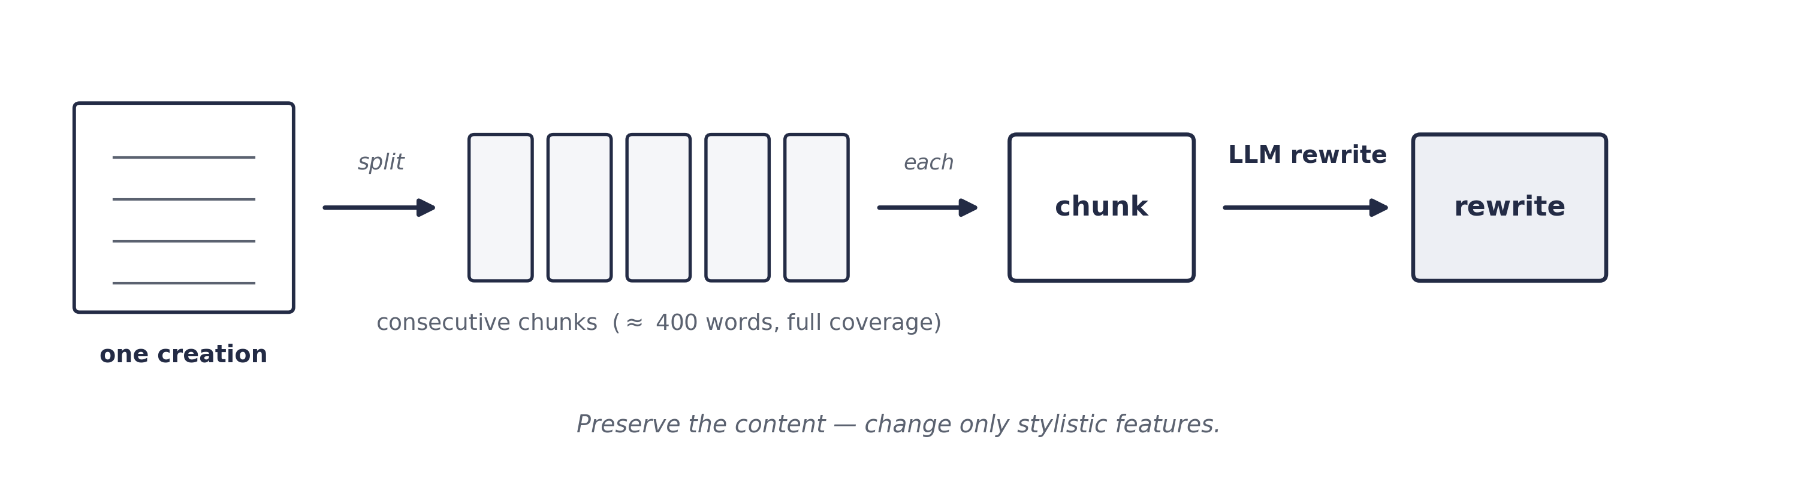
METHOD - STEPS 2-3 OF 6
Steps 2 & 3 - Chunking and LLM Rewriting
▪ Step 2 - Chunking. Split each creation into consecutive same-size chunks (P ≈ 400 words each). Full coverage - every word, no sampling.
▪ Step 3 - Rewriting. The LLM rewrites each chunk into the profile’s style - preserve the content, change only the style. How much it must change is exactly the distance the method measures (Step 4).
26-2-R-6 · Multi-Modal LLM Style Analysis
6 / 15
Notes:
Step two: chunking.
We split each creation into same-size chunks, one after the other - P is about four hundred words.
Full coverage: every word, no sampling.
Why chunks, and not the whole creation at once?
Two reasons.
First, faithfulness.
On short passages, the model rewrites accurately.
On a long text, it starts to drift and paraphrase.
Notice: it is the opposite of step one.
Reading a lot is safe.
Writing a lot, faithfully, is not.
Short chunks keep the rewrite honest.
Second, resolution.
A score per chunk shows where in a creation a different hand appears.
Step three: rewriting.
The model rewrites each chunk into the profile's style.
The instruction is clear: keep the content, change only the style.
How much it has to change - that is exactly what we measure next.

Slide 7
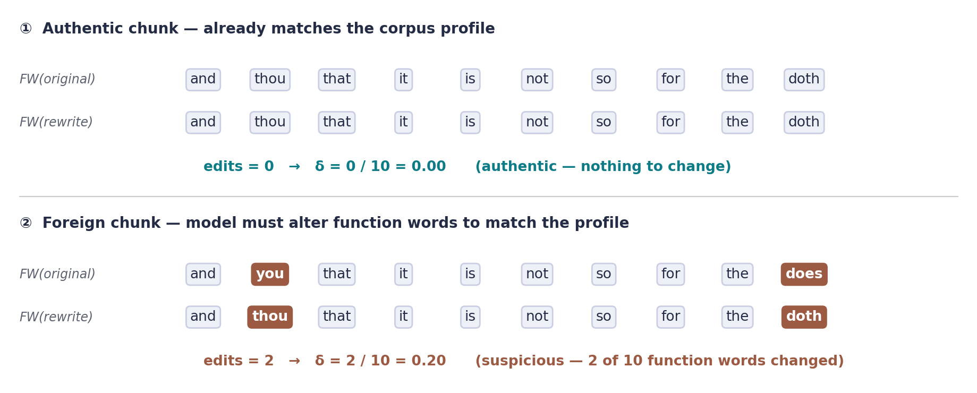
METHOD - STEP 4 OF 6
Step 4 - Function-Word Edit Distance (δ)
$$δ(chunk, rewrite) = \frac{edits(FW(chunk), FW(rewrite))}{max(|FW(chunk)|, |FW(rewrite)|)}$$
▪ FW(text). The ordered sequence of ~120 function words - modern (you, has) and Early Modern (thou, hath) - with no author-specific cue baked in.
▪ Read δ directly. The share of function words the rewrite had to change - a chunk already in the corpus's style barely changes (δ → 0); one by another hand needs more rework (δ large).
▪ One example metric. Function-Word Edit Distance is one of several distance metrics compared in Phase B.
26-2-R-6 · Multi-Modal LLM Style Analysis
7 / 15
Notes:
This is the heart of the method - the distance.
We call it delta - the Function-Word Edit Distance.
We take the sequence of function words - from the original, and from the rewrite.
Then we count how many edits turn one sequence into the other - insert, delete, replace.
So the order of the words matters, not just how many times each word appears.
The list has about a hundred and twenty function words - modern ones like 'you' and 'has', and Early-Modern ones like 'thou' and 'hath'.
So the metric is not biased toward Shakespeare.
Look at the example on the slide.
The authentic chunk already fits the style: almost nothing changes, and delta is near zero.
The foreign chunk needs a few swaps - 'you' to 'thou', 'does' to 'doth'.
Two out of ten function words changed: delta is zero point two.
And remember: this metric is one example - in Phase B we compare several and choose one.
That is the distance.
From here, Miron will turn it into a decision.

Slide 8
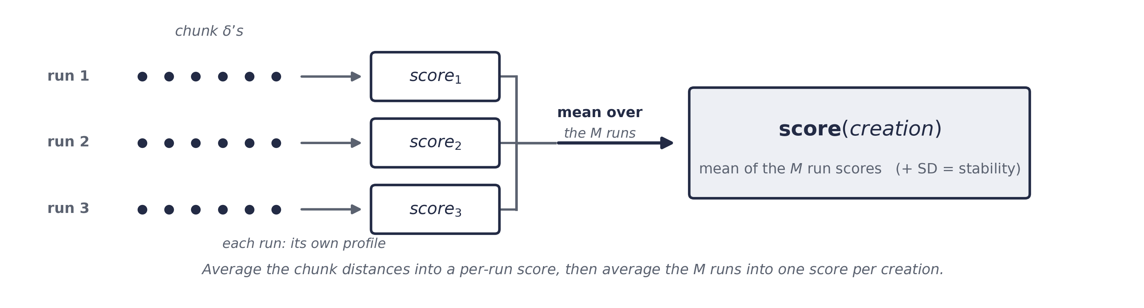
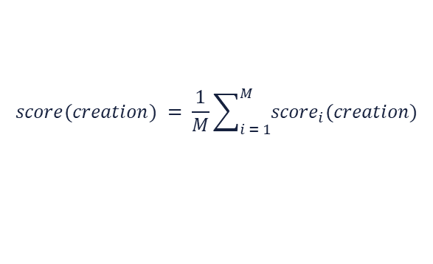
METHOD - STEP 5 OF 6
Step 5 - Aggregation & Robustness
▪ Aggregation. Average δ over a creation’s chunks → mean over the independent runs → one score per creation.
▪ Independent runs. The pipeline runs several times, each re-extracting its profile; averaging cancels the LLM’s run-to-run randomness.
$${score}_{i}(creation) = \frac{1}{|chunks(creation)|}\sum_{chunk ∈ creation}{δ(chunk, {rewrite}_{i})}$$
$$score(creation) = \frac{1}{M}\sum_{i = 1}^{M}{{score}_{i}(creation)}$$
26-2-R-6 · Multi-Modal LLM Style Analysis
8 / 15
Notes:
Inside each run, we average the chunk DELTAS, and we’ll have one score per creation. Then we average across the independent runs, as said before - each run extracts its own fresh profile. That averaging cancels the model's run-to-run randomness. And here the noise injection pays off.
In Phase B we’ll also test the version with no added noise.

Slide 9
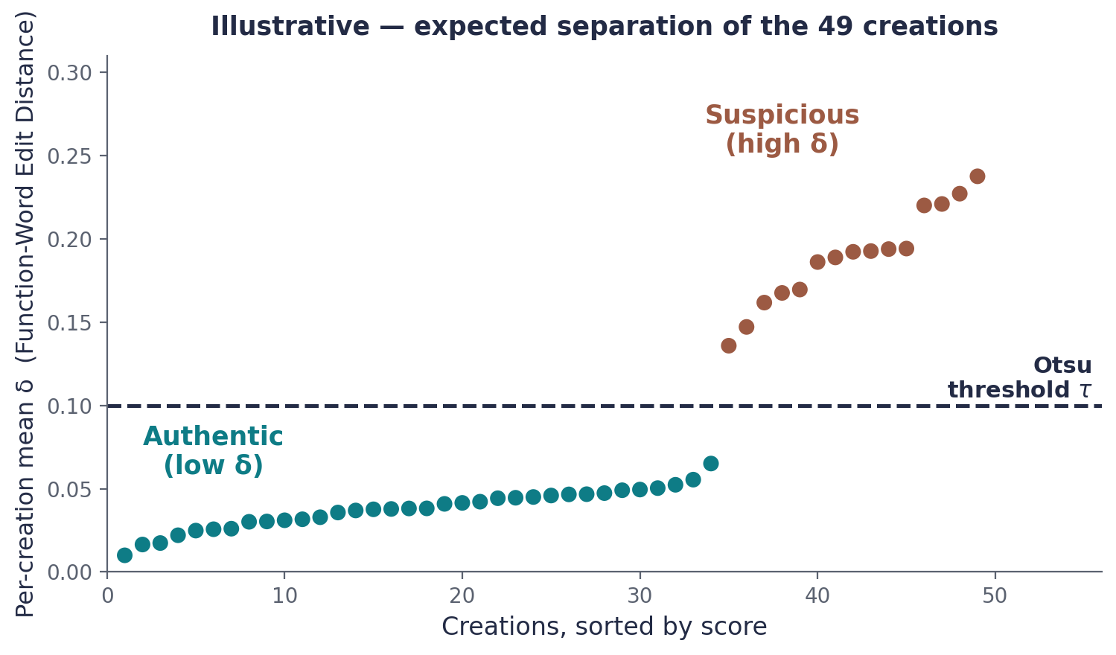
METHOD - STEP 6 OF 6
Step 6 - Threshold Classification
▪ Threshold split. Otsu’s parameter-free threshold τ - one option illustrated here, of several classifiers (e.g. Gaussian-mixture) compared in Phase B - splits the 49 scores into authentic vs. suspicious; it fits because the suspicious class is not a rare minority.
▪ Single round (Phase A). Each run re-extracts its profile → scores averaged over the independent runs → one threshold split, with no feedback loop. Iterative purification is deferred to Phase B, adopted only if the single-round threshold proves unstable.
26-2-R-6 · Multi-Modal LLM Style Analysis
9 / 15
Notes:
We now have forty-nine scores.
Otsu's method finds the split point automatically - it is parameter-free, borrowed from image processing.
What will appear above the threshold is suspicious, and Below - authentic. Otsu fits our case because the suspicious group is a second group in size.
Theoretically we do this once - we average the runs; we are making one split and then stop - there won’t be feedback loop.
We could repeat with only the 'authentic' creations - that is called purification. It might sharpen the split, but a wrong early label could spread and get stronger. So, in case of unstable single split we will implement purification in Phase B.
And Otsu is one option, the one we illustrate. In Phase B we will compare others, like a Gaussian mixture.

Slide 10
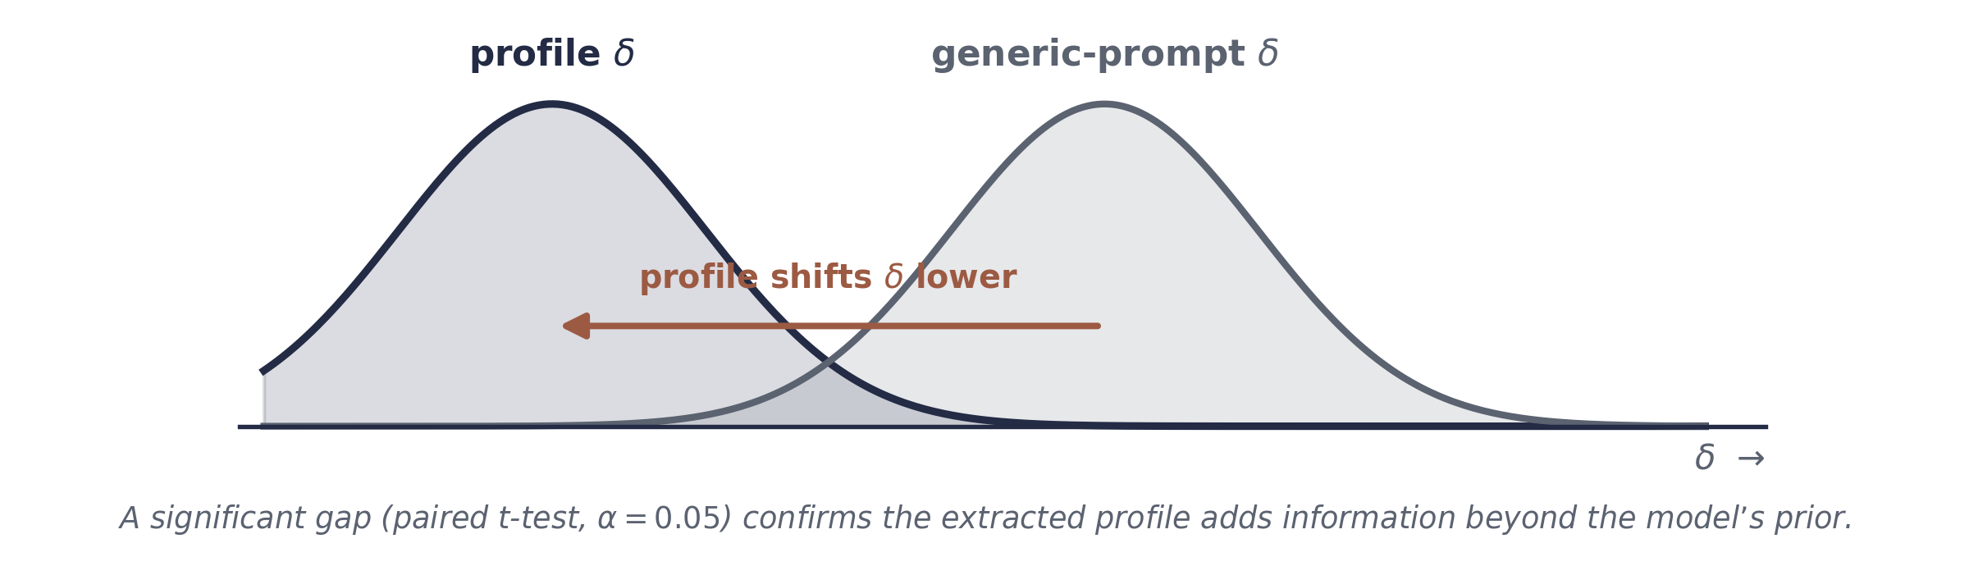
SUCCESS METRICS & EXPECTED RESULTS
Evaluation - success metrics
Success metrics (checked in Phase B)
▪ Profile contribution. Profile δ < generic-prompt δ (paired t-test, α = 0.05).
▪ Agreement with scholarly consensus. The method’s suspicious set matches established scholarly-consensus co-authorship findings (e.g. Henry VIII / Fletcher, Henry VI / Marlowe) on at least 4 of 5 firmest cases.
Expected outputs: sorted scatter of all 49 scores with the threshold marked, a labeled suspicious-creations list with continuous scores, and per-creation confidence.
26-2-R-6 · Multi-Modal LLM Style Analysis
10 / 15
Notes:
We will know we succeeded with Two numerical metrics that will be checked in Phase B.
First, profile contribution: rewriting with our extracted profile must lower delta more than a generic prompt.
Second, agreement with scholarly consensus: our suspicious set must match the firmest scholarly cases - like Henry the Eighth with Fletcher, and Henry the Sixth with Marlowe - on at least four of five.
The expected outputs are a sorted scatter plot of the 49 scores with a threshold line, a list of suspects with their continuous scores, and a confidence level for each work.

Slide 11
TESTING PLAN
How the method will be validated
Check | Procedure | Passes if
Mixture Detection | Constructing a text composed mostly of Author A with a small injection of Author B. | The method distinguishes between them
Stability - noise (main proposal) | One different foreign creation injected per run. | Authentic labels stay stable
Calibration - runs M | Rewriting the same chunks M times. | δ stable across the M runs; otherwise raise M and repeat
26-2-R-6 · Multi-Modal LLM Style Analysis
11 / 15
Notes:
Our validation plan includes three checks.
Each has an explicit pass condition.
Mixture Detection: Constructing a text composed mostly of Author A with a small injection of Author B,
Passes if the method distinguishes between them.
Stability: one different foreign creation injected per run.
Passes if the authentic labels do not move.
In Phase B we also run it with no added noise.
Calibration: We rewrite the same chunks M times.
If delta varies too much, we raise M and repeat.

Slide 12
EXECUTION PLAN & RISK MITIGATION
Phase B - work plan & key risks
1
Reproducibility & sensitivity
Independent runs on identical inputs; vary P and check label stability.
2
Full-corpus run
All 49 creations, single round; scatter + Otsu; record the suspicious set.
3
Optional refinement
Re-extract the profile from authentic-only creations and repeat.
Constraints & risk mitigation: LLM memorization → control experiment / held-out corpus · run-to-run randomness → average several independent runs & pin model · long-context paraphrasing → short chunks & sensitivity sweep · non-bimodal scores → Gaussian-mixture fallback.
26-2-R-6 · Multi-Modal LLM Style Analysis
12 / 15
Notes:
This is our Phase-B work plan, and it contains 3 stages.
1: reproducibility and sensitivity - repeat runs on the same input, vary the chunk size P, and check that the labels will stay stable. 2: the full run - all forty-nine creations, single round, scatter and classification.
3: optional refinement - Re-extract the profile from authentic-only creations and repeat.
We use specific technical safeguards to mitigate our three main risks.

Slide 13
TECHNOLOGY
Tools & technologies
Tool | Purpose
Python 3.11 | Primary implementation language
Pipeline LLM | Style extraction & rewriting; needs a long context window - the model is chosen in the POC, judged by rewrite fidelity & run-to-run stability
Gemini 2.5 / GPT-class / Claude | Candidate pipeline LLMs compared on the pilot subset
python-Levenshtein | Function-word edit-distance computation
scikit-image | Otsu's automatic 1-D threshold
scikit-learn | Comparison classifiers (cross-check vs. the prior baseline)
NumPy / Pandas | Numerical & tabular data handling
Matplotlib / Seaborn | Scatter plots, histograms, convergence curves
Project Gutenberg | Text corpus - 49 creations (identical to the prior study)
Git / GitHub | Version control, prompt/code sharing, submission artifact
26-2-R-6 · Multi-Modal LLM Style Analysis
13 / 15
Notes:
On phase B we’ll use a long-context language model for extraction and rewriting, selecting the best candidate based on performance stability. Our supporting toolchain will rely on standard Python data science libraries.

Slide 14
WHERE THE PROJECT STANDS, WHAT'S NEXT
Summary & Phase B outlook
▪ What Phase A delivers. A fully specified, unsupervised, interpretable, transferable LLM-based method for authorship-anomaly detection - with metric, algorithm, evaluation, and risks all defined.
▪ Why it matters. It needs no comparison corpus and no training, and its output reads directly in stylistic terms - a complementary cross-check to existing methods.
Unsupervised
Interpretable
Transferable
What's next
▪ Phase B implements and validates the method end-to-end, then compares the distance-metric family and reports which separates best.
▪ Deliver an open-source, reproducible repository with all results and plots.
26-2-R-6 · Multi-Modal LLM Style Analysis
14 / 15
Notes:
To summarize - we have a fully specified method. The metric, the algorithm, the evaluation, and the risks - all defined.
It is unsupervised, interpretable, and transferable.
It needs no comparison corpus and no training, and its output reads directly in stylistic terms - an extra cross-check to existing methods.
In Phase B we’ll implement and validate the method end-to-end, and we’ll compare the family of distance metrics, and report which one separates best.

Slide 15

Thank you
Questions & discussion
Eliran Melihov · Miron Hanukaiev
Advisors: Dr. Renata Avros · Prof. Zeev Volkovich
github.com/eliranmeleh/Multi-Modal-LLM-Style-Analysis
15 / 15
Notes:
Thank you for your attention.

