Slide 1
Geo-Secret
Hila Bahri
Eliran Moyal
Alex Livshiz

Slide 2

What is Geo-Secret

Slide 3
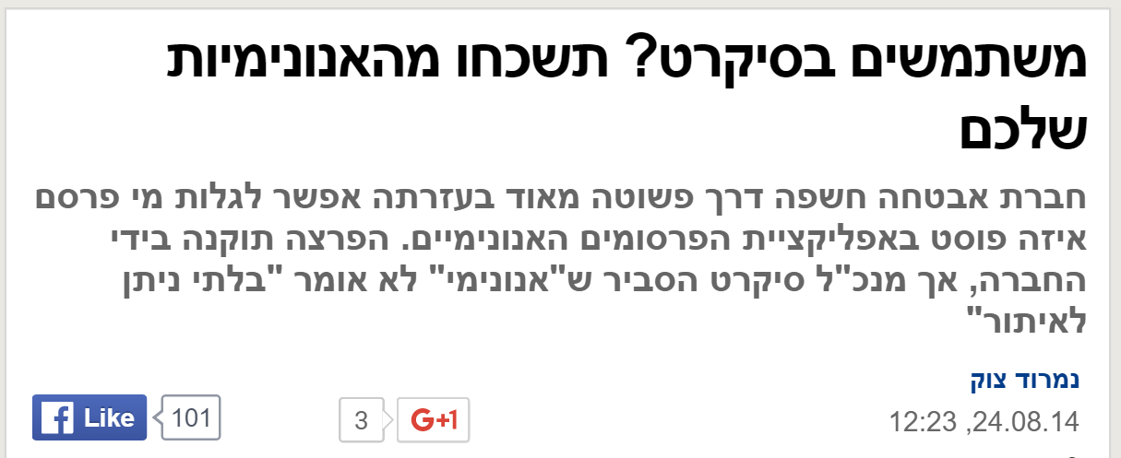

The original Secret

Slide 4
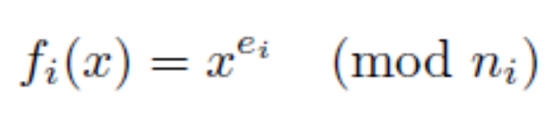

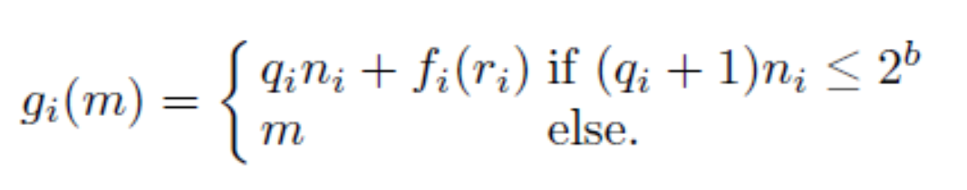

Ring Signatures
We take sufficienly large b (160 bits larger then any n_i)
Now all trap door functions are of the same domain -

Slide 5

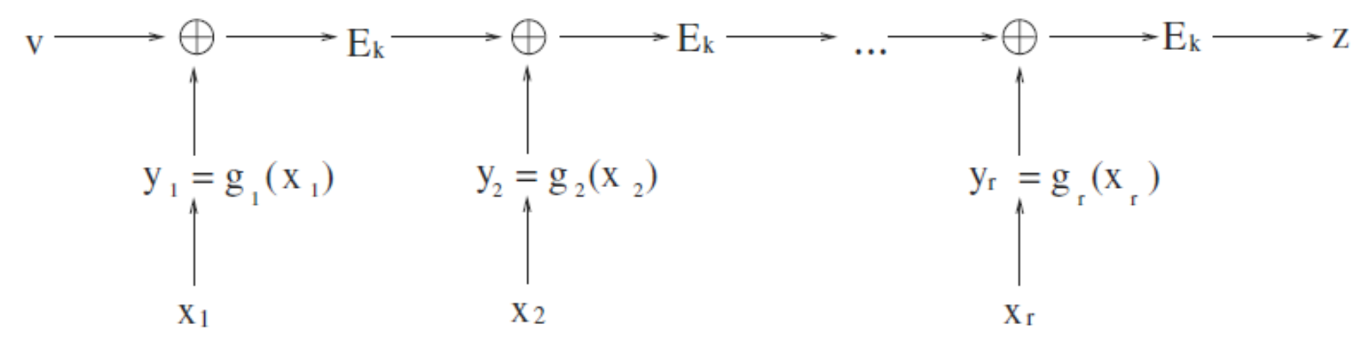
Ring Signatures
We use symmetric encryption:
Where k = hash(message)
Combining function

Slide 6
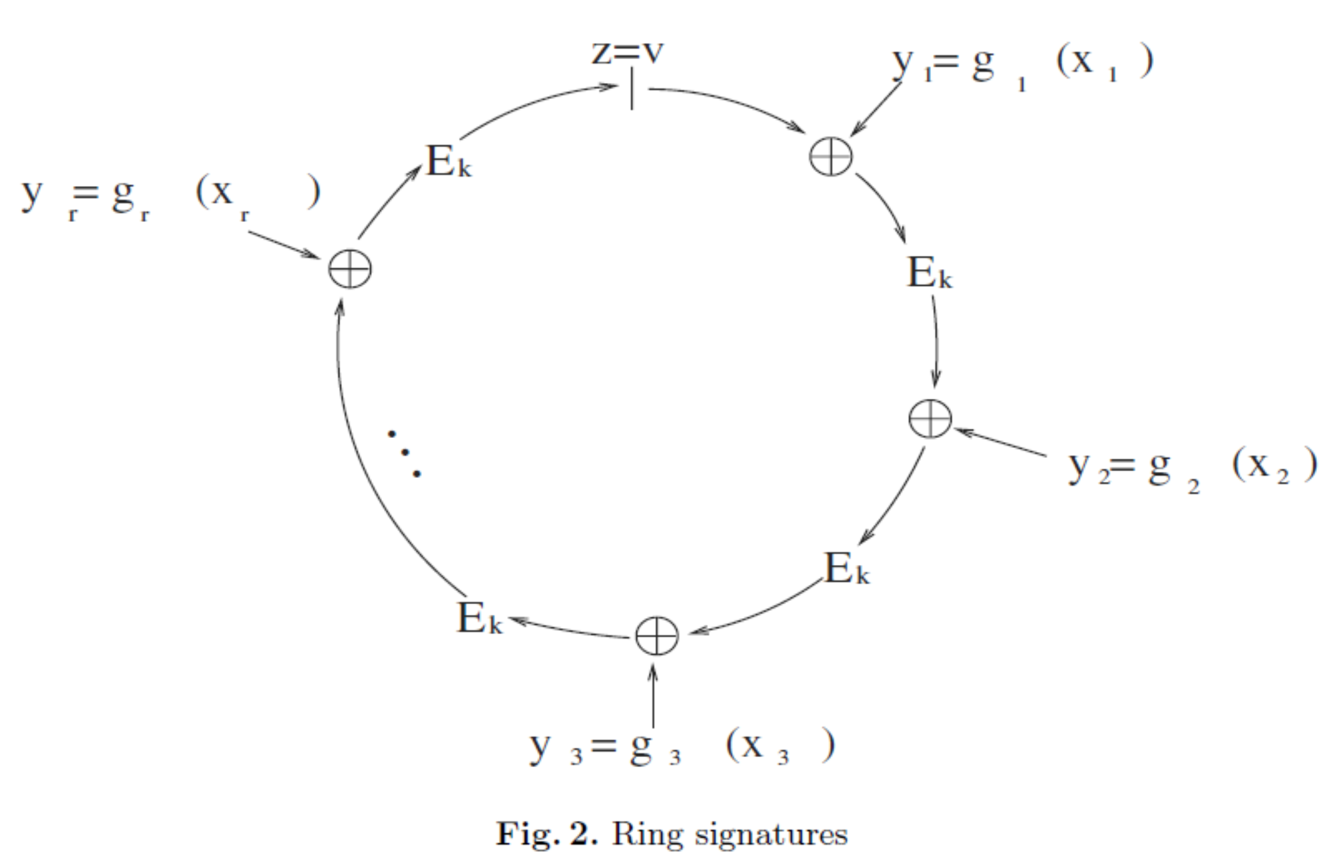
Ring Signatures
Closing the ring

Slide 7
Demo

