Slide 1

Geo-Secret
Hila Bahri
Eliran Moyal
Alex Livshiz

Slide 2

What is Geo-Secret

Slide 3
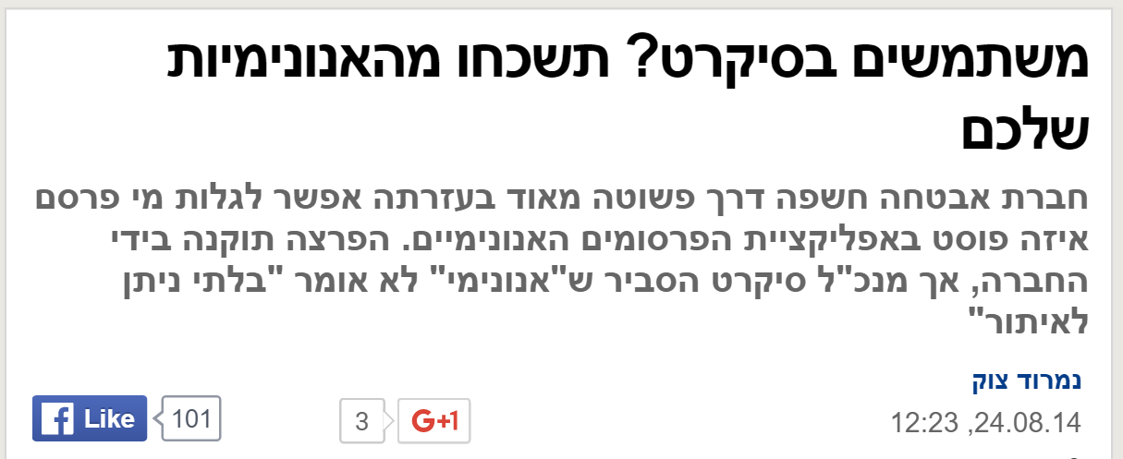

The original Secret

Slide 4


Ring Signatures – Rivest, Shamir, Tauman
RSA
Encryption
Public key: n, e
Decryption
Private key: d, e

Slide 5

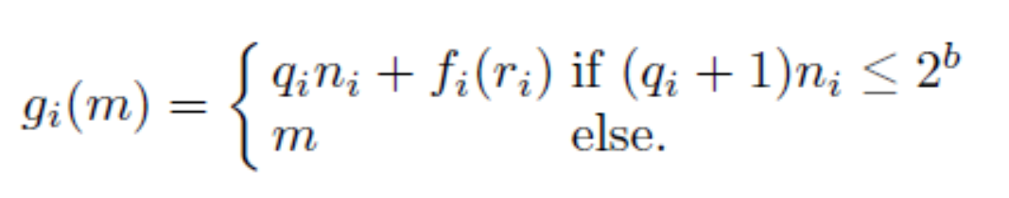

Ring Signatures
The problem is that if n_1 < n_2 it’s easy to differentiate between the encryptions
We take sufficienly large b (160 bits larger then any n_i)
Now all trap door functions are of the same domain -

Slide 6

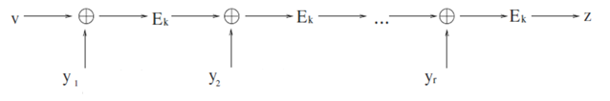
Ring Signatures
We use symmetric encryption:
Where k = hash(message)
Combining function

Slide 7
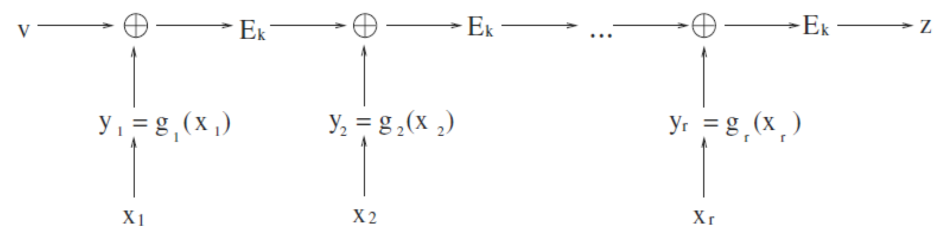



Ring Signatures
is our parameter
Now we can solve the equation
Now we can calculate

Slide 8
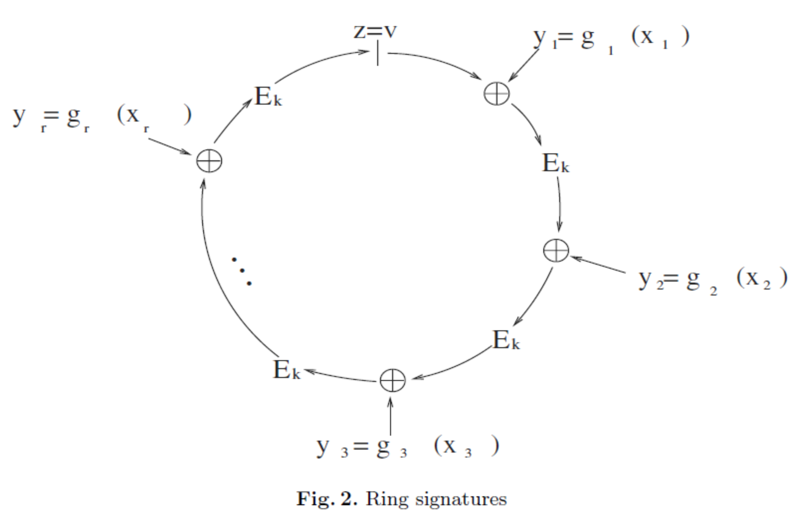
Ring Signatures
Closing the ring

Slide 9
Demo

