Slide 1
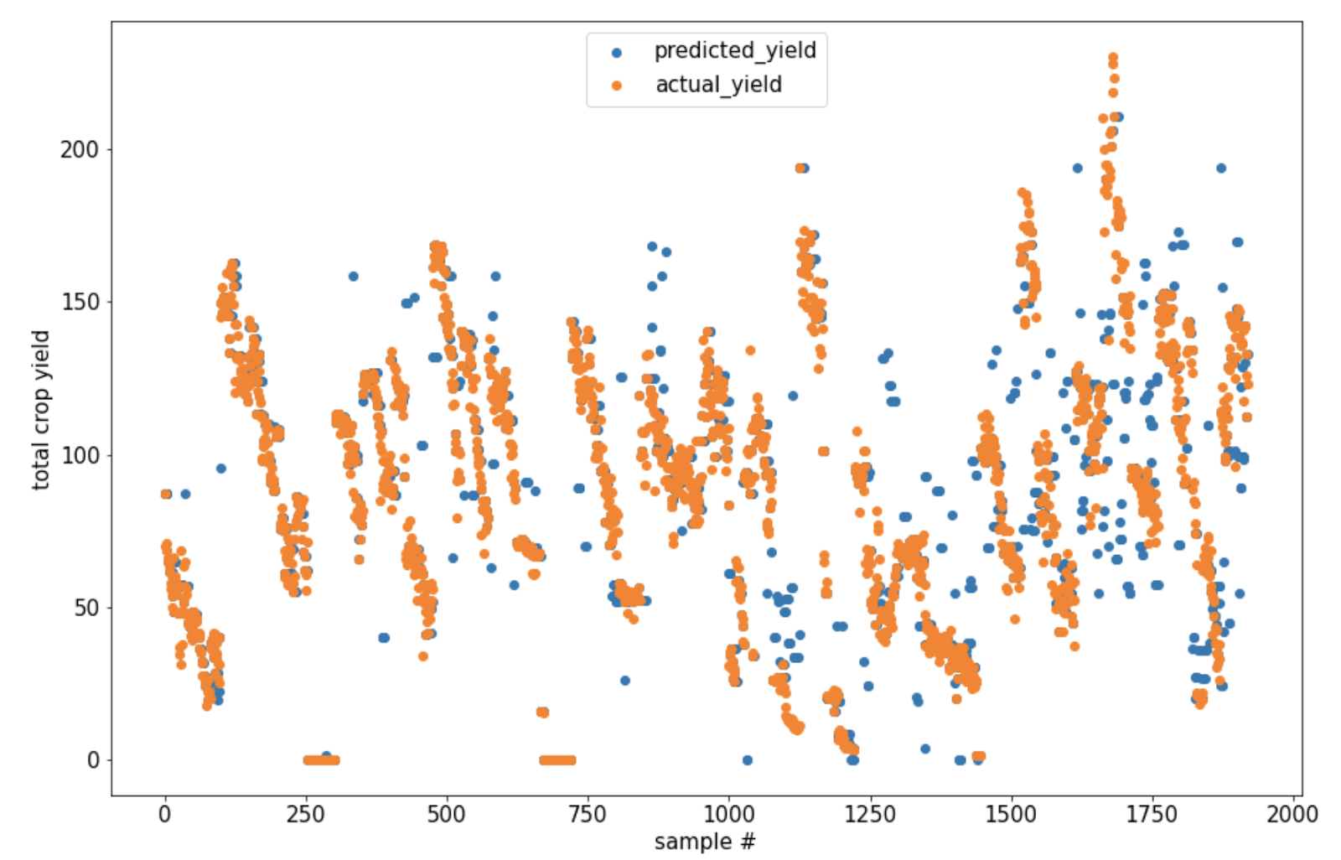
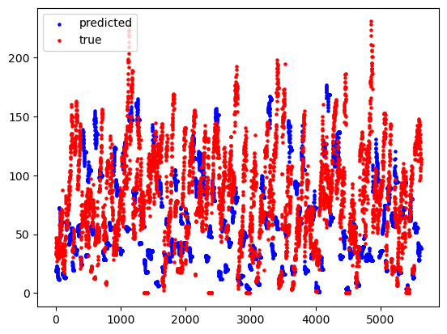
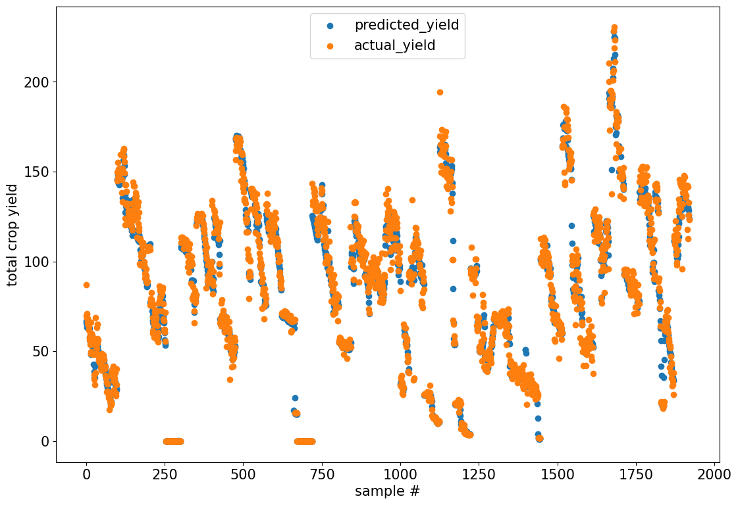
Predicting Global Crop Yields
From Water Resource Availability and Socioeconomic Factors Across Countries
We combined datasets from Aquastat data and https://ourworldindata.org/crop-yields to implement 3 Regression Models:
Regression Decision Tree
Linear Regression Model
Regression Neural Network
MSE: 664
MSE: 2361
MSE: 95.3
The “total renewable water resources” and “GDP per capita” were most significant factors in predicting total crop yield.
Team Members: Eli Richmond, Ryan Chapados, Alec Warren & Ayushi Shirke

