Slide 1
Open Source Best Practices as a Foundation for Quality Management
14th exida Symposium, Spitzingsee, Oct 27-28 2026
Philipp Ahmann, ETAS GmbH

Slide 2
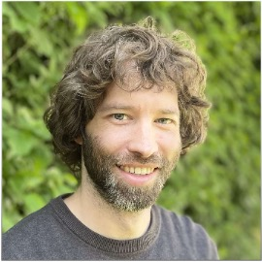




whoami - Philipp Ahmann
 | Sr. OSS Community Manager Automotive OSS Process Lead
 | Chair of the Technical Steering Committee Lead of the Systems Working Group
 | Advisory Board Member of LF Europe
 | Eclipse Safe Open Vehicle Core Committer
 | OSS enthusiast and promoter

Slide 3
Agenda
Motivation & Teaser
Literature examples and further reading
Quality Management & ISO 9001
Best practices programs/frameworks
Project examples from the wild
The special role of Eclipse S-CORE like projects
Summary

Slide 4
Motivation & Teaser

Slide 5


Setting the scene
Based on ELISA
Lighthouse-OSS
  Traditional software development methods
  were built for proprietary software
  No existing quality standard matches
  established open source development practices
  But OSS Communities have demonstrated
  mature processes and consistent quality
  OSS is a viable choice for regulated industries, but there is a lack of a matching standard
Photo by William Bout on Unsplash

Slide 6
Real world statements from OSS contributors
“I cannot upstream this software, it is not good enough.”
(Engineer wihin an automotive company asked to upstream some of their work)
Being publicly exposed, may put pressure on you.

Slide 7
Real world statements from OSS contributors
”Technically, my patch remained the same,
but I had to adopt a lot on documentation and style.”
(Engineer within an automotive company after upstreaming some of their work.
Work was delivered internally following ASPICE processes)
Documentation and coding style are practice and important to keep maintainability

Slide 8
Literature examples
& further reading

Slide 9
Look into existing evidences in literature
Based on ELISA
Lighthouse-OSS
Examples of literature which focuses on Open Source practices:
[1] 2017 - Evaluation of open-source OS for Safety-Critical Applications
(P. Berntsson)
[2] 2020 OSS Development Process Systematic Review
(B. Napoleao, F. Petrillo, S. Hallé)
[3] 2025 - Towards a more sustainable and secure software tooling in free/libre open source software environments
(S. Tatschner)

Slide 10
Categories and practices described in literature [2]
Based on ELISA
Lighthouse-OSS
Category | Example Practices in OSS | What it means
Governance | Meritocratic leadership Transparent decision-making Clearly defined roles | Governance provides predictability and accountability. It helps external users, contributors, and assessors understand who can make decisions, how decisions are recorded, and how project direction is established.
Development Practices | Self-assigned tasks Code ownership Version control | Development Practices provide the technical foundation for reliable OSS development. They make it possible for distributed contributors to work together, maintain the codebase, review changes, and preserve traceability.
Quality Engineering (Maturity model) | Clean commit history Coding conventions Structured peer review & testing | Quality Engineering provides evidence that the project does not merely define good practices, but applies them consistently. It supports defect prevention, maintainability, regression control, and release confidence.
Documentation | User-facing documentation Developer documentation | Documentation describes how the project records and communicates information needed to use, develop, maintain, integrate, and assess the software. It enables adoption, contribution, maintenance, and assessment. It reduces reliance on tacit knowledge and helps external users understand whether the project is suitable for their context.
Sustainability (Risk management) | Secure sustainable funding models Monitor and improve Bus Factor | Sustainability describes whether the project can continue to operate, maintain itself, respond to issues, and support users over time. A project may be technically excellent but still risky for downstream adoption if it depends on too few people, lacks funding, or cannot sustain maintenance.

Slide 11
What a Quality Management System expects
Based on ELISA
Lighthouse-OSS
Objectives:
Leadership
(Customer Focus, Quality policy, Roles, …)
Planning
(Risks, opportunities, quality, changes, …)
Support
(Resources, Competence, Awareness, Communication, …)
Execution:
Operation (execution of above)
Performance evaluation
(internal monitoring, customer satisfaction)
Improvement
Many parts are covered in the practices mentioned on the previous slides and has evidence in literature [1][2][3]
As the QM systems are based on company structures not everything is relevant/applicable to Open Source
Some elements may be good to be added to OSS projects (but OSS projects do not have access to these standards)

Slide 12
Quality Management
& ISO 9001

Slide 13
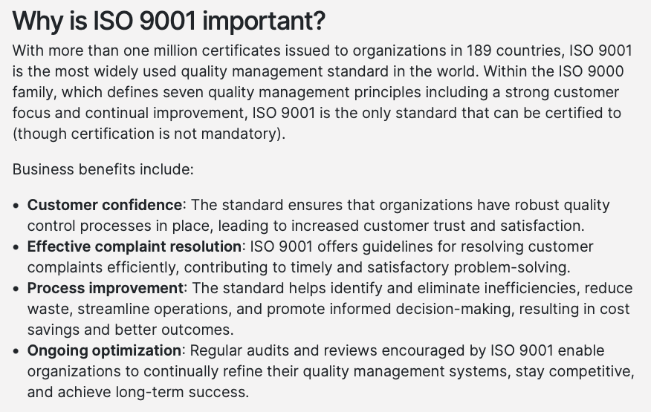
What Quality Management Actually Needs
Defined and controlled processes
Responsibilities and authority
Competence
Evidence of execution
Monitoring and evaluation
Continual improvement
A quality-management system does not require every organization to use the same toolchain or development lifecycle.
https://www.iso.org/standard/9001

Slide 14
Example: Change Control
OSS:
Issue
Proposed modification
Automated gates
Review
Approval
Merge
Release note
Typical quality questions:
Why was the change needed?
Who reviewed it?
What verification was performed?
Which criteria were applied?
Which released artifact contains it?
Repositories can become part of the quality record, if workflows are defined and consistently applied.

Slide 15
Example: Competence and Responsibility
Maintainer and reviewer roles
Code ownership
Contribution history
Approval permissions
Documented governance
Nomination processes
Good to know:
“Contribution volume is not the same as competence.”
Rights are given in repositories.
The maintainer owns the code.
Every commit is traceable.
Without an approval nothing gets merged.
Contribution guidelines are put in repos.
New maintainers are added by merit.
Getting code into an OSS project may be much harder than getting something into a commercial proprietary product behind closed walls.

Slide 16
Best practices programs/frameworks

Slide 17
Best practices programs/frameworks
Based on ELISA
Lighthouse-OSS
ELISA Lighthouse OSS Checklist
Apache Project Maturity Model
OpenSSF: Scorecard,
Best Practices Badge, OSPS Baseline
LFX Insights
CNCF TAG Security Self-Assessment
Eclipse Trustable Software Framework
OpenChain ISO/IEC 5230
TODO Group Guides
CHAOSS (community health)
LF - AI Responsible AI Framework
Other (non-OSS) quality guidelines:
NIST Software Development Framework
INCOSE Systems Engineering Body of Knowledge” (SEBoK)
ISO 42003 - Implementation Guide for AI Management
AMMITEC - Maritime Software Quality Guidelines

Slide 18
Apache Project Maturity Model

Slide 19
What it is:
The Apache Project Maturity Model provides a suggested framework for evaluating the overall maturity of an Apache project community and the codebase that it maintains. While this model is specific to projects of the Apache Software Foundation (ASF), many of these factors apply to any open source project.
handout slide
https://community.apache.org/apache-way/apache-project-maturity-model.html#overview

Slide 20
What you could potentially also find in standards:
The project is independent from any corporate or organizational influence.
The project maintains a public list of its contributors who have decision power. The project's PMC (Project Management Committee) consists of those contributors.
The project's PMC (Project Management Committee, see CS10) approves each software release in order to make the release an act of the Foundation.
Decisions require a consensus among PMC members and are documented on the project's main communications channel. The PMC takes community opinions into account, but the PMC has the final word.
The project strives to answer user questions in a timely manner.

Slide 21
What you would typically NOT find in standards:
The community strives to be meritocratic and gives more rights and responsibilities to contributors who, over time, add value to the project.
The project documents how contributors can earn more rights such as commit access or decision power, and applies these principles consistently.
“Dictators, benevolent or not, are not welcome in Apache projects.”

Slide 22

Specifics of the model
Compared to automated tools like in OpenSSF Scorecard, the rating is done manually
This allows the judgement of soft elements, but also requires higher effort
Results are a self assessment.
handout slide
https://opendal.apache.org/community/maturity/
Photo by Randy Jacob on Unsplash

Slide 23
OpenSSF Scorecards

Slide 24
What it is:
Scorecard assesses open source projects for security risks through a series of automated checks.
It was created by OSS developers to help improve the health of critical projects that the community depends on.
You can use it to proactively assess and make informed decisions about accepting security risks within your codebase.
You can also use the tool to evaluate other projects and dependencies, and work with maintainers to improve codebases you might want to integrate.
Scorecard helps you enforce best practices that can guard against:
handout slide

Slide 25
Practices which are checked:
Does the project have unfixed vulnerabilities?
Does the project use tools to help update its dependencies e.g. Dependabot
Does the project contain a security policy?
Does the project run tests in CI, e.g. GitHub Actions, Prow?
Does the project use fuzzing tools, e.g. OSS-Fuzz?
Does the project use Branch Protection?
Does the project require code review before code is merged?
https://scorecard.dev

Slide 26
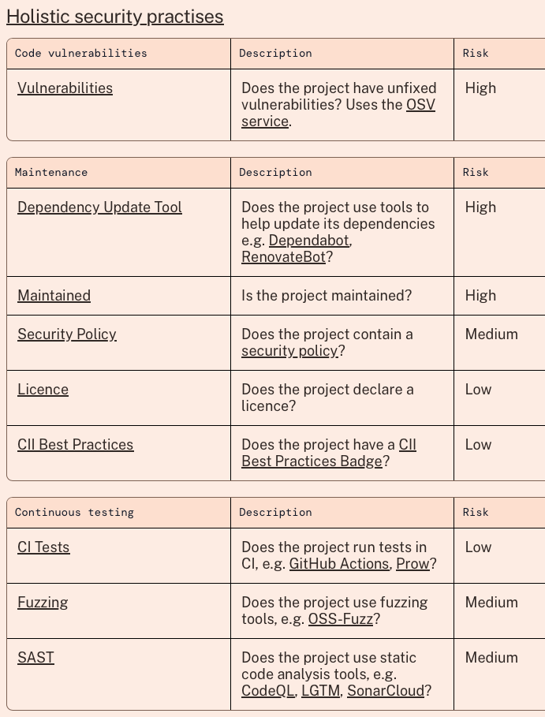
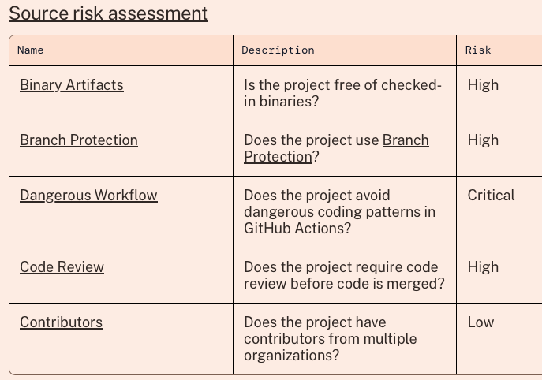
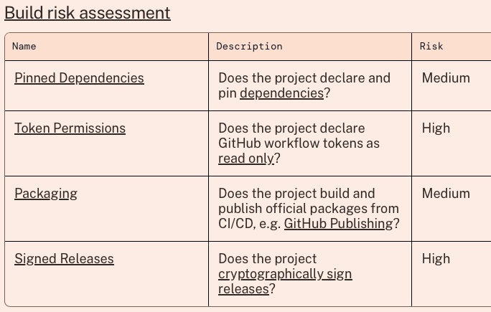
Specifics of the framework
Automated tools which can be executed locally or be added as GitHub actions
Take about 10 minutes to get started from the command line.
Focus on security, less on overall quality.
Not taking soft elements into account. (in contrast to Apache)

Slide 27
LFX Insights

Slide 28
What it is:
LFX Insights helps developers and their organizations make smarter decisions about the open source projects they depend on.
Assess a project’s overall health, with a summary of key activity, community, and security signals.
See contributor affiliations and organization-level insights
See whether a project follows security best practices, including vulnerability management, documentation quality, and governance signals.
handout slide
https://insights.linuxfoundation.org/docs/introduction/what-is-insights/

Slide 29
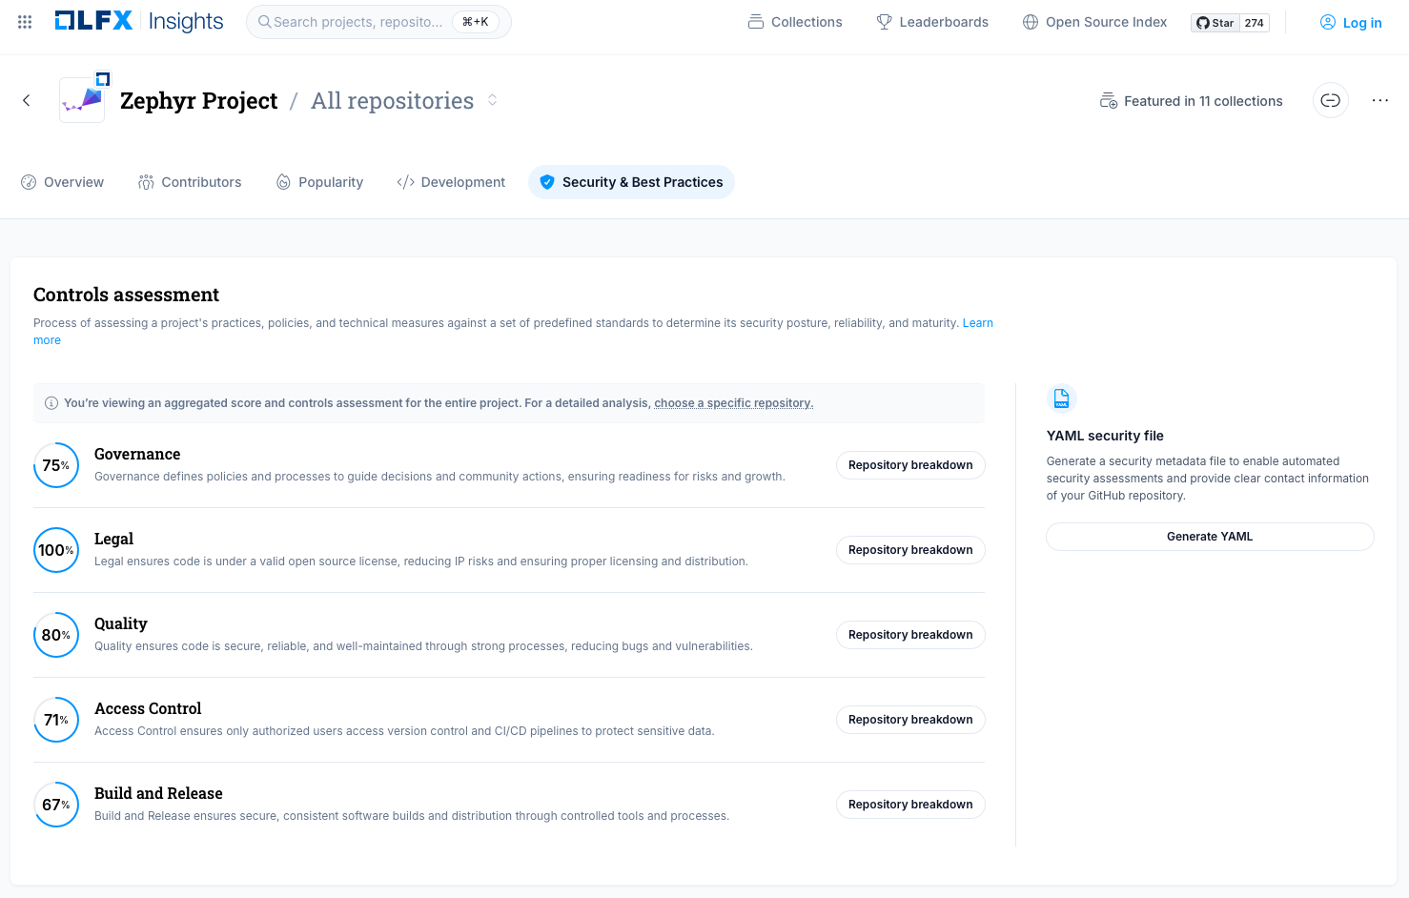
LFX Insights – based on Zephyr project
Governance
defines policies and processes to guide decisions and community actions, ensuring readiness for risks and growth.
Legal
ensures code is under a valid open source license, reducing IP risks and ensuring proper licensing and distribution.
Quality
ensures code is secure, reliable, and well-maintained through strong processes, reducing bugs and vulnerabilities.
Access Control
ensures only authorized users access version control and CI/CD pipelines to protect sensitive data.
Build and Release
ensures secure, consistent software builds and distribution through controlled tools and processes.
https://insights.linuxfoundation.org/project/zep

Slide 30
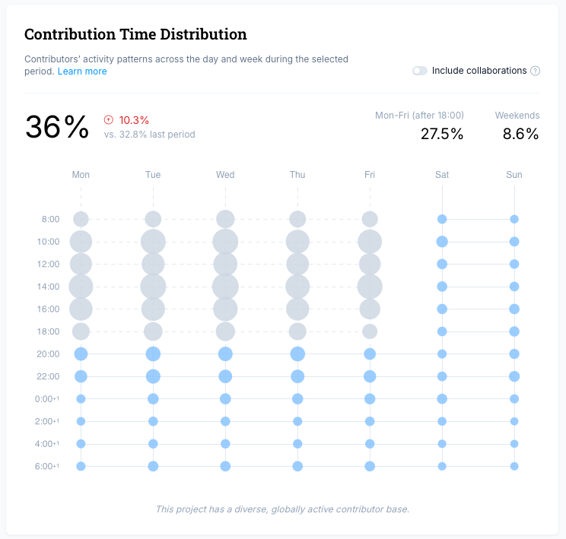
Example: Heat map of contribution times
Contribution time and number can be an argument that the open source project is or is not a hobbyist activity.
Example:
  Most Zephyr contributions happen Monday to Friday between 8:00 and 20:00.
Note:
  The data has weakness as it depends on profile settings in GitHub and just provides an indicator
https://insights.linuxfoundation.org/project/zep/development?timeRange=past365days&start=2025-09-17&end=2026-09-17&widget=contributions-outside-work-hours

Slide 31
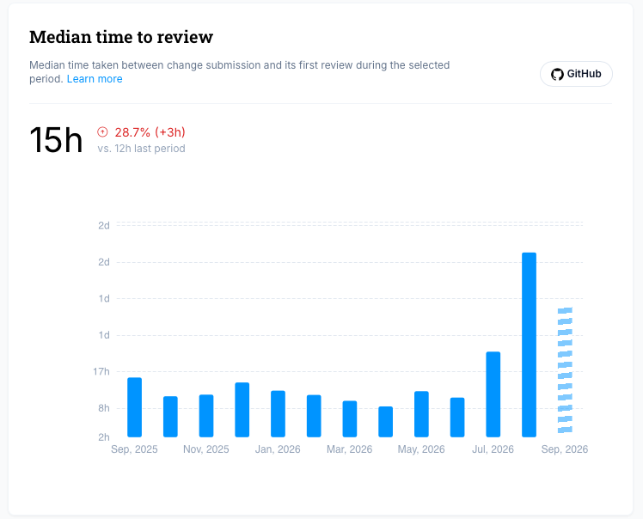
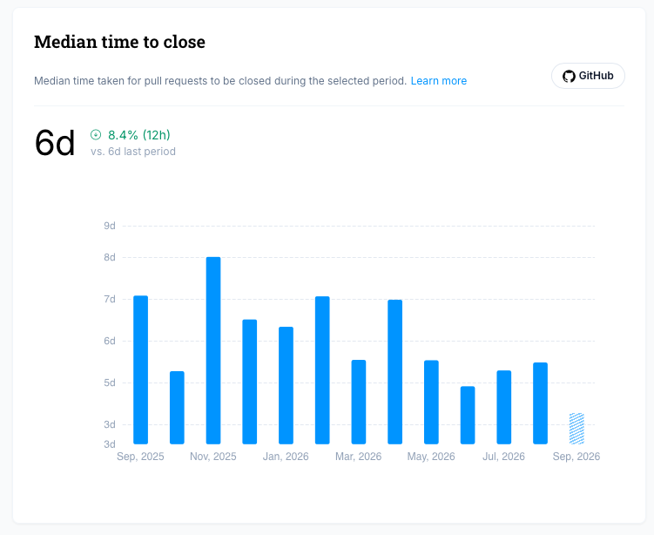
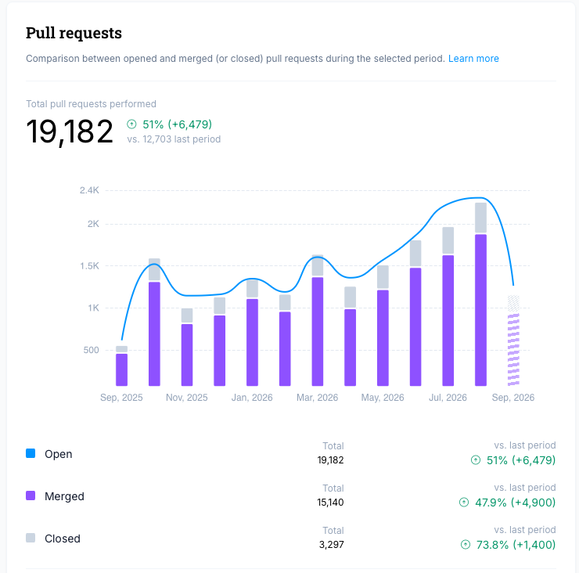
Not every number let you directly derive something.
The time it takes to close a PR is not telling you something about quality.
Compare:
  100% Code coverage also does not tell you something about the code quality.
Note:
  Set things into context and do explicit checks.
  As everything is public you are able to perform checks
Frameworks are hints to best practices, but measurements can be wrong.
https://insights.linuxfoundation.org/project/zep/development?timeRange=past365days&start=2025-09-17&end=2026-09-17&widget=median-time-to-close

Slide 32
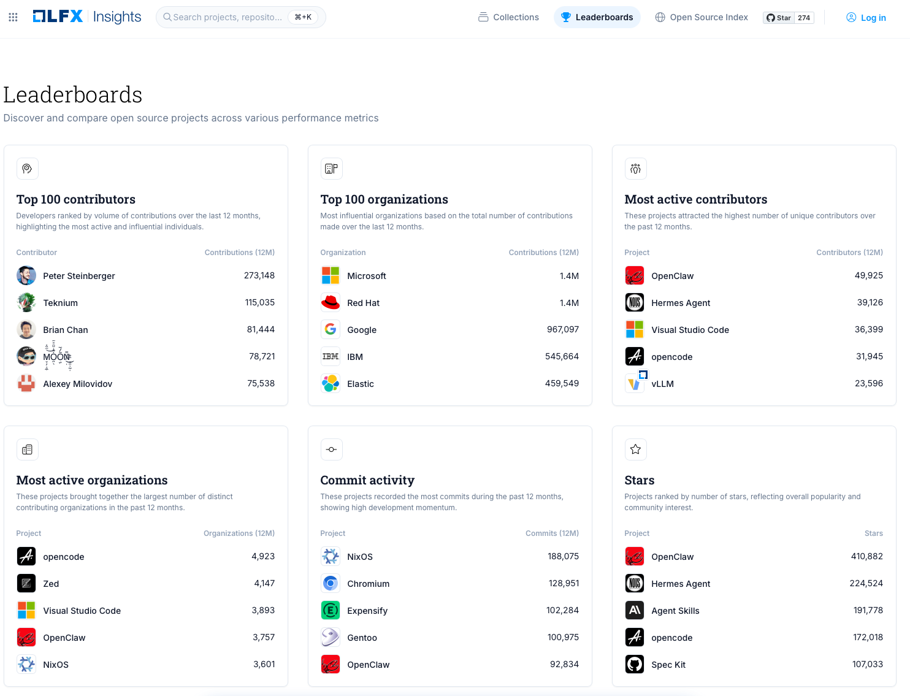
Specifics of the tooling
Wide knowledge base and many projects listed.
Projects beyond Linux Foundation covered.
Documentation and conference talks exist around the tooling
Also pulls in OpenSSF Scorecards
Good to know:
Provide collections, statistics and more on companies, contributors, not just best practices on individual projects
handout slide
https://insights.linuxfoundation.org/leaderboards

Slide 33
Project examples from the wild

Slide 34
What OSS projects may already provide to you…
peer review,
automated testing/verification,
continuous integration,
traceable and transparent contribution processes,
and collaborative governance

Slide 35
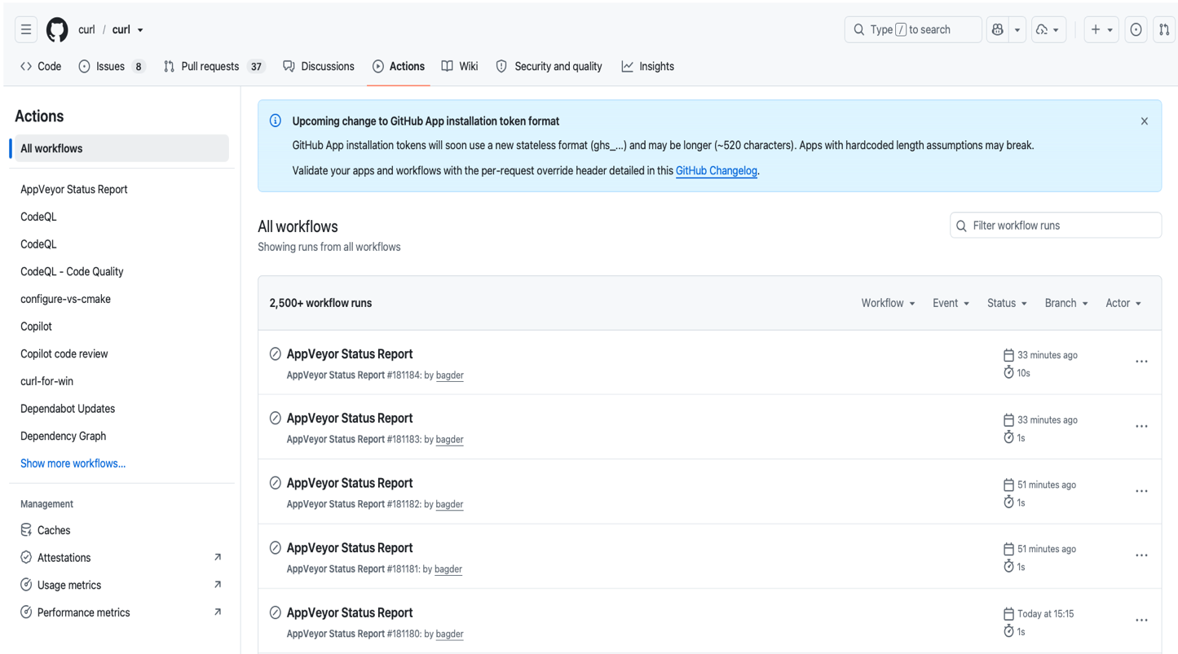
Automation: Pipelines, actions, testing…
Projects need to be efficient
(as maintainer resources are limited)
Scripting (&AI) help to automate where possible
Automated testing and static analysis are performed (e.g. via CodeQL)
https://github.com/curl/curl/actions

Slide 36
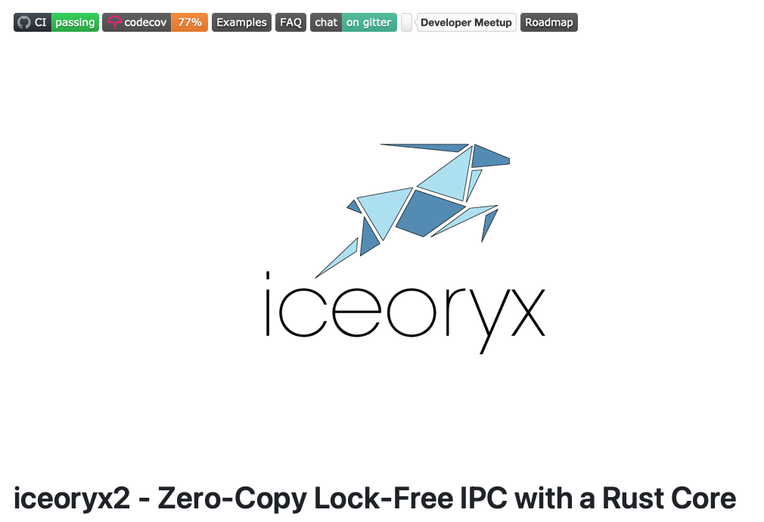
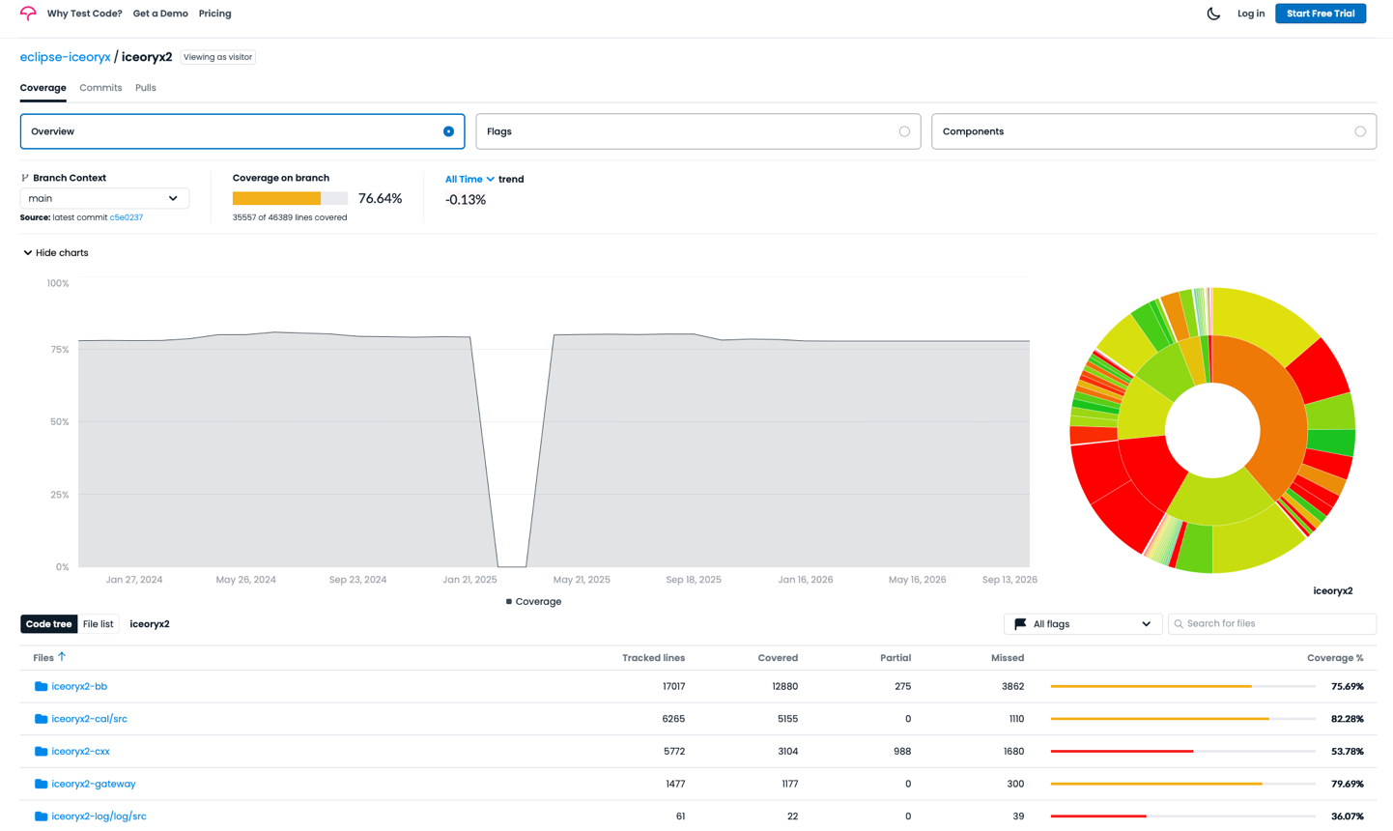
Code coverage measurements
https://app.codecov.io/gh/eclipse-iceoryx/iceoryx2?search=&trend=all%20time
https://github.com/eclipse-iceoryx/iceoryx2

Slide 37
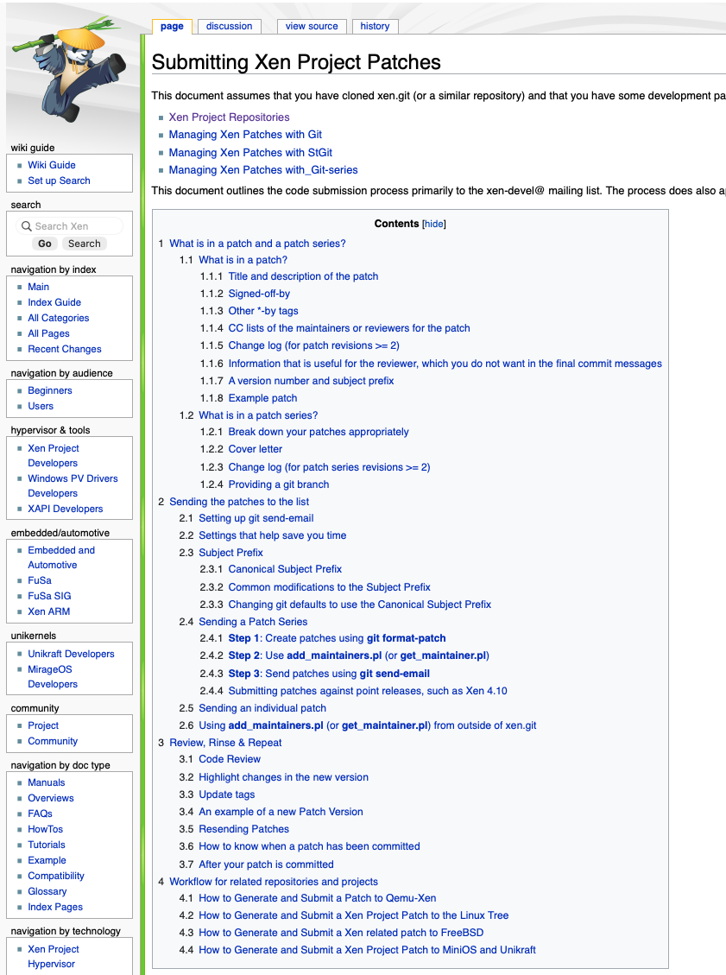
Contribution guides to reduce frustration
Poor submissions simply delay patches and frustrate both sides
Clear contribution guidelines help to have proper submissions
Automated scripts can support formatting and formalities to lower effort of maintainers.
“When you get a friendly response on your mail, it was most likely one of my bots.”
- A kernel maintainer
What is in a patch?
Sending patches
Review
https://wiki.xenproject.org/wiki/Submitting_Xen_Project_Patches

Slide 38
General Best Practices Aspects

Slide 39

The role of maintainers
Committed to their code
No easy replacement
Follow their own schedule, quality culture
Always observed by the public
Strong entrepreneurship
Often paid by a company
(for many “hardened” projects industry relies on)
Photo by Edemekong Andem on Unsplash

Slide 40
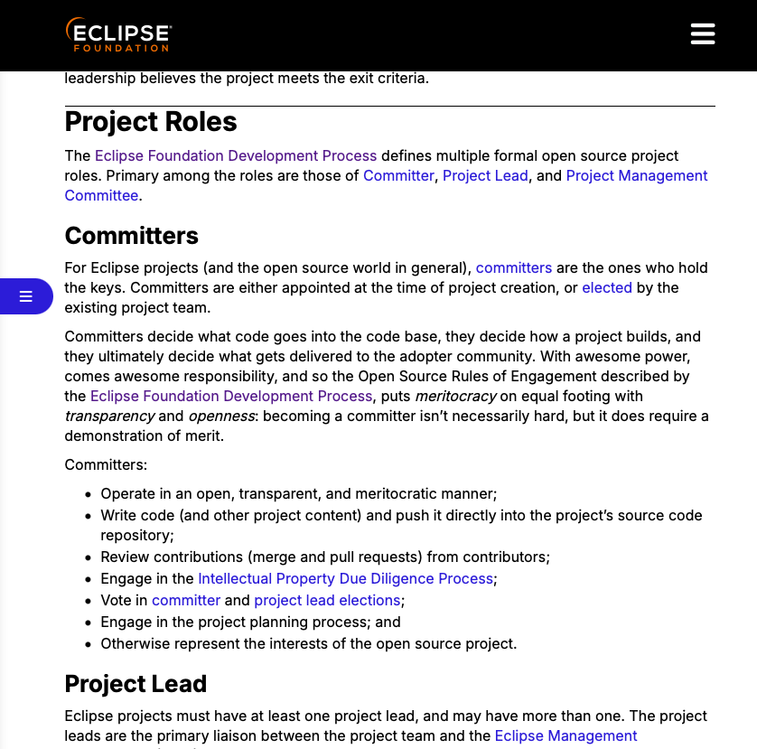
Foundations/Projects provide role definitions
Common roles:
Maintainer / Committer / Project Lead
Contributor / Community member
Extended roles:
Governing Board member
(Technical) Steering Committee member
Project / Working Group Leader
Seldom/Uncommon roles:
Quality/Security/Safety Manager
Good to know:
Roles vary by project or foundation
Maintainers file is very common
https://www.eclipse.org/projects/handbook/#roles

Slide 41
Role of Eclipse S-CORE process

Slide 42
Process model and its implementation
The Project Management Plan:
Describes the process implementation („makes a meta-model concrete“)
It provides the tailoring to practices
It mentions the tools which are used
The Process Description (a meta-model):
Tool reference kept out wherever possible
Links standards to the process artifacts
(ISO 26262, ISO 21434, ASPICE)
Defines work products and provides guidance as well as templates
The Docs-as-code tooling implements the process with traceability, checks, gating, and more.
Good to know: Docs-as-code and process_description can be used standalone

Slide 43
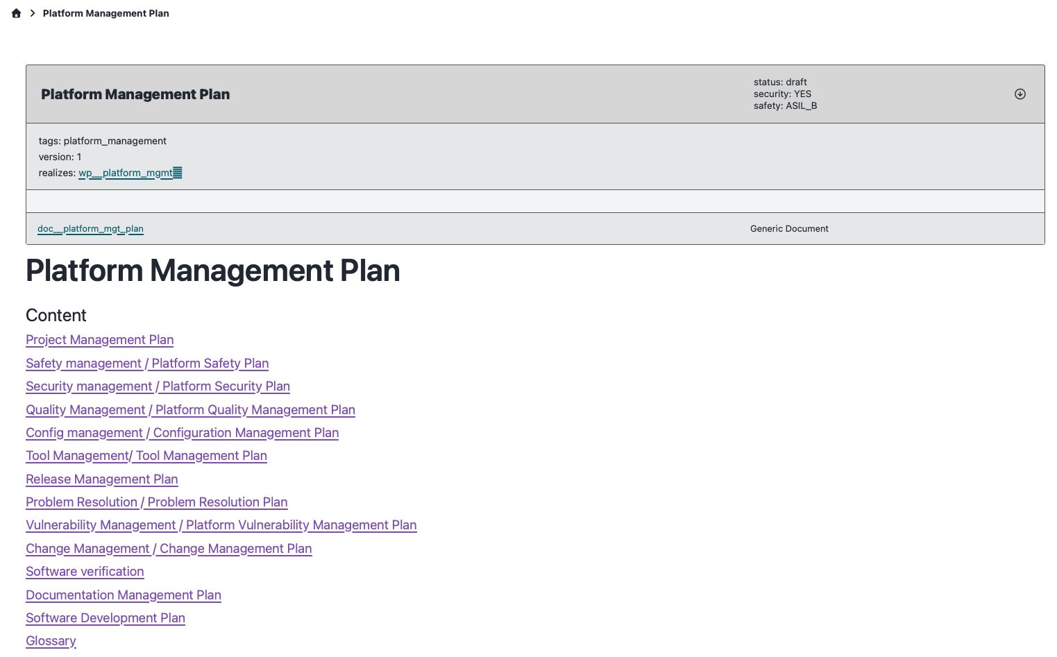
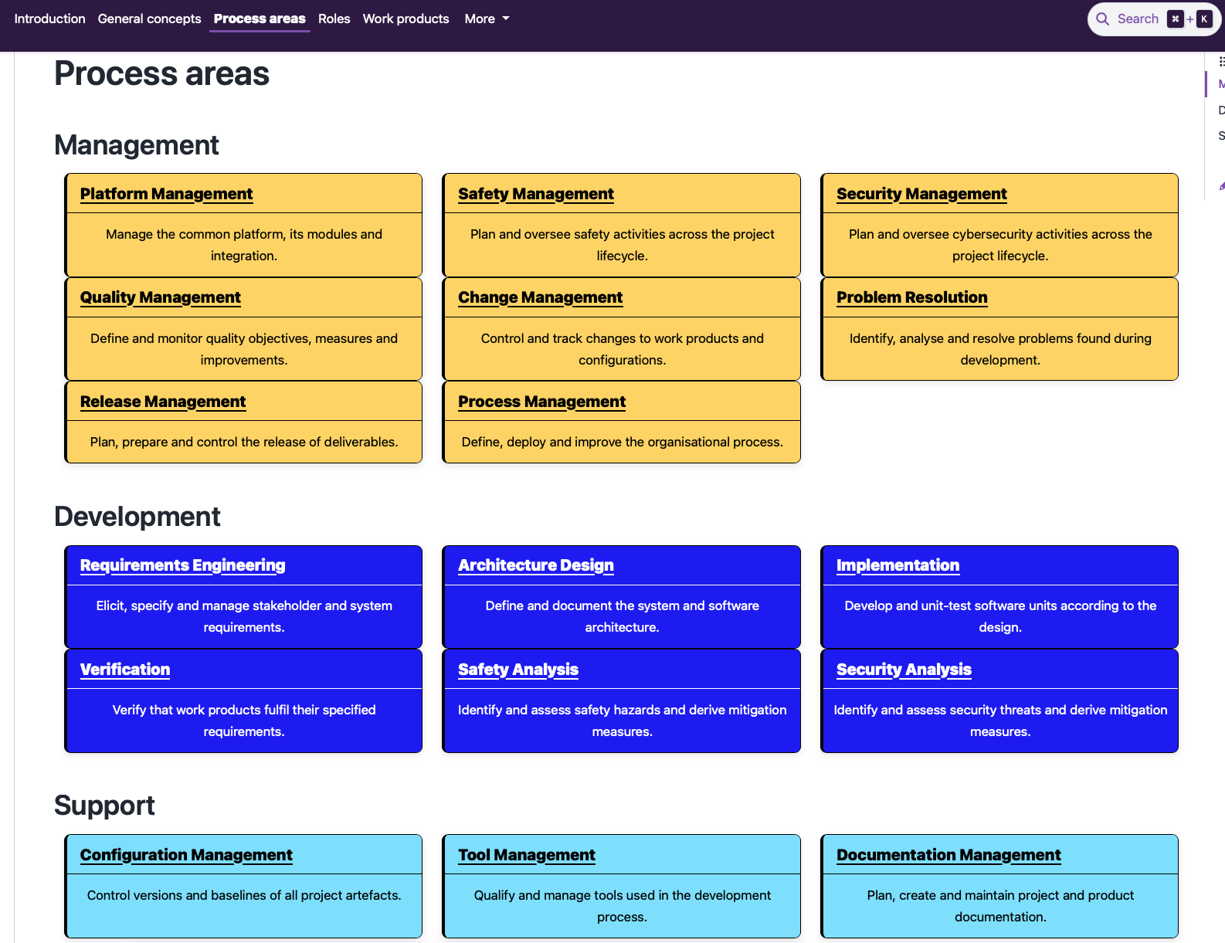
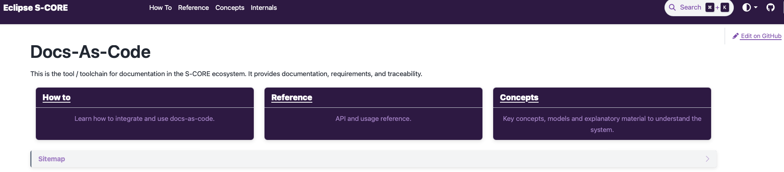
Process model and its implementation
Project Management Plan
Process Description
handout slide
https://eclipse-score.github.io/score/main/platform_management_plan/index.html
https://eclipse-score.github.io/process_description/main/standards/index.html
Docs-as-code tooling
https://eclipse-score.github.io/docs-as-code/main/

Slide 44
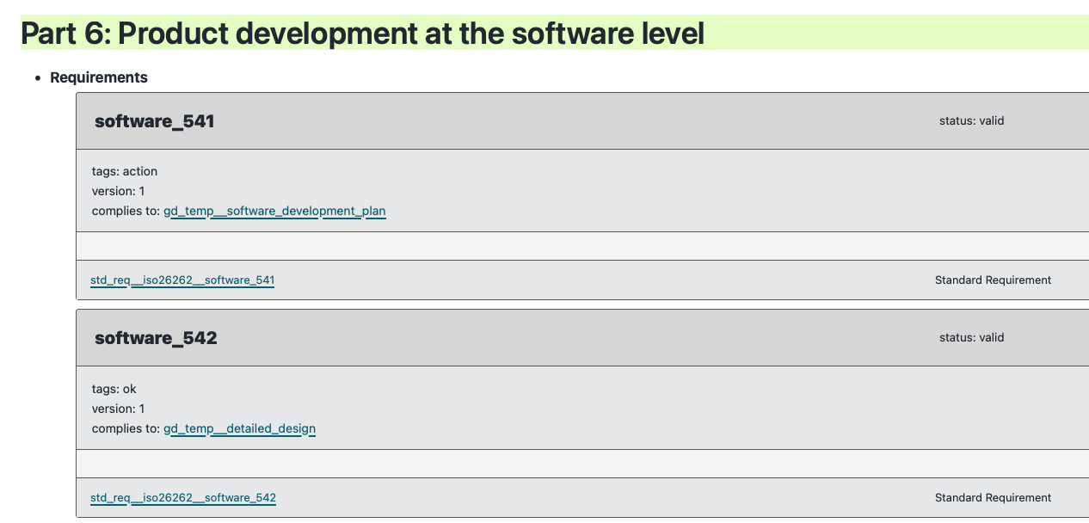
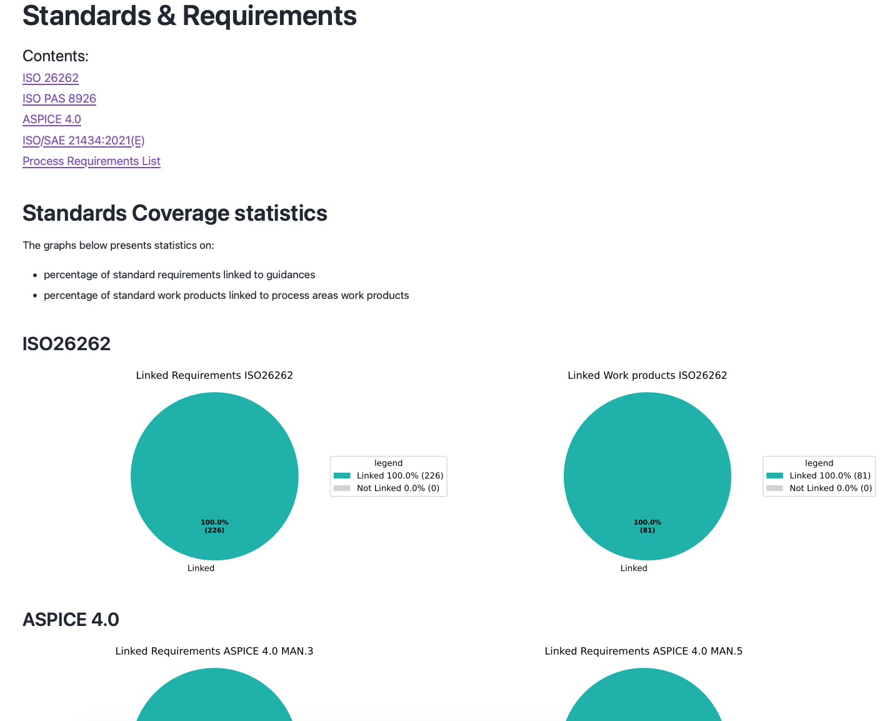
Dealing with standards
Standards hold a copyright
Simply taking the text from standards
is not possible
Discussed with ISO on how to reference best
Abstract reference to chapters possible:
software_541 = Part 6 chapter 5.4.1
Good to know:
Creating work products and
following the process enables
a standard compliant development
https://eclipse-score.github.io/process_description/main/standards/index.html#

Slide 45
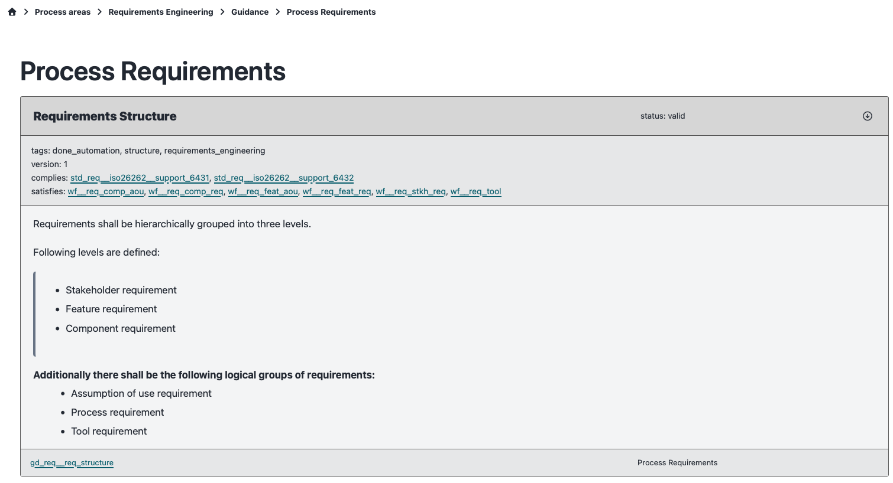
The role of tools (requirements)
Manual inspections/reviews are limited to a bare minimum
Automation is used wherever (reasonably) possible
Docs-as-code is preferred over any binary format document
(this benefits also further data processing)
https://eclipse-score.github.io/process_description/main/process_areas/requirements_engineering/guidance/requirements_process_reqs.html

Slide 46


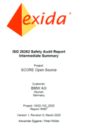




Tight coupling of process & tools + regular audits
Fully open-source toolchain established.
7 external process audits completed/ findings implemented,
1 more audit to go to cover complete SW-development process.
ITF
GitHub
External audits performed by exida
…coming up.
Process automation/ improvements
ITF
#1
#3
#5
#7
ITF
#2
#4
#6
#8
All Safety Audit findings resolved
Test
Test
100%
!
Overall effort in series project
Complete effort
to go live.
“With S-CORE, the shared content for the industry is increased by far,…
… nevertheless, some effort is still needed to reach a fully qualified system.
Qualified system acc. ISO26262
Provided by
Eclipse S-CORE
„Pre-qualified“ S-CORE Stack
Provided by a
“common” OSS project
Unqualified
Code
Community-/Shared Effort
Additional-/Individual Effort

Slide 47
How Eclipse S-CORE differs to traditional OSS
What you mostly will not see in a random (but mature) OSS project:
Strong Automotive influence from the inception.
Mostly driven by industrial & paid contributors.
Heavy tool support to enforce processes (not only CI/CD)
Respect various requirements from ISO 26262, ISO 21434 and ASPICE as part of the development
Regular accompanied auditing
Good to know: Eclipse S-CORE is an automotive project
under Foundational Open Source Stewardship by the Eclipse Foundation!

Slide 48
Summary

Slide 49
From OSS projects into companies
Open source practices can provide substantial quality evidence.
The evidence must be translated, evaluated, and placed into context.
Open source practices represent modern software development
and can be incorporated into a company’s quality management system
The goal is not to force open source into a V-model,
but to make its proven practices understandable and usable for quality management.
Do not ask only whether an open source project follows your process.
Ask whether its practices provide the evidence needed for your quality argument.

Slide 50
Join our efforts!

Slide 51

Get Involved
Lighthouse SIG meets every other Friday 12:00 PM
https://elisa.tech/community/meetings/
Mailing list
https://lists.elisa.tech/g/lighthouse
Discord
https://discord.gg/TnWZpDUu
Contributions in GitHub welcome!
https://github.com/elisa-tech/lighthouse-oss/
https://github.com/elisa-tech/lighthouse-oss/wiki
Photo by Hannah Busing on Unsplash

Slide 52
Backup

Slide 53
Abstract
Modern software development has become highly iterative and code-centric, moving beyond traditional waterfall and V-model approaches. Nevertheless, open source software forms the foundation of many security- and safety-critical systems and has repeatedly demonstrated its ability to deliver high-quality software at scale. This success is enabled by practices such as peer review, automated testing, continuous integration, traceable and transparent contribution processes, and collaborative governance.
This session explores what research and industry experience reveal about effective open source development practices and how these practices relate to established quality management methodologies, such as ISO 9001. It presents examples of open source projects, including Eclipse S-CORE, that have adopted development processes aligned with industry and regulatory standards, including ISO 26262, ISO/SAE 21434, and Automotive SPICE.
The presentation also examines project health and maturity assessment frameworks, including LFX Insights and OpenSSF Scorecards, developed by open source foundations, communities, and ecosystem initiatives dedicated to measuring project health, sustainability, and maturity. By mapping proven open source practices to quality management principles, the session highlights how organizations can leverage open development models while maintaining the rigor required for safety- and quality-critical applications.
The session is informed by ongoing work within the ELISA (Enabling Linux in Safety Applications) Project, where open source best practices, project maturity models, and quality management principles are currently being analyzed and mapped to the needs of safety-critical domains.

