Slide 1

Making Penguins Fly

Slide 2
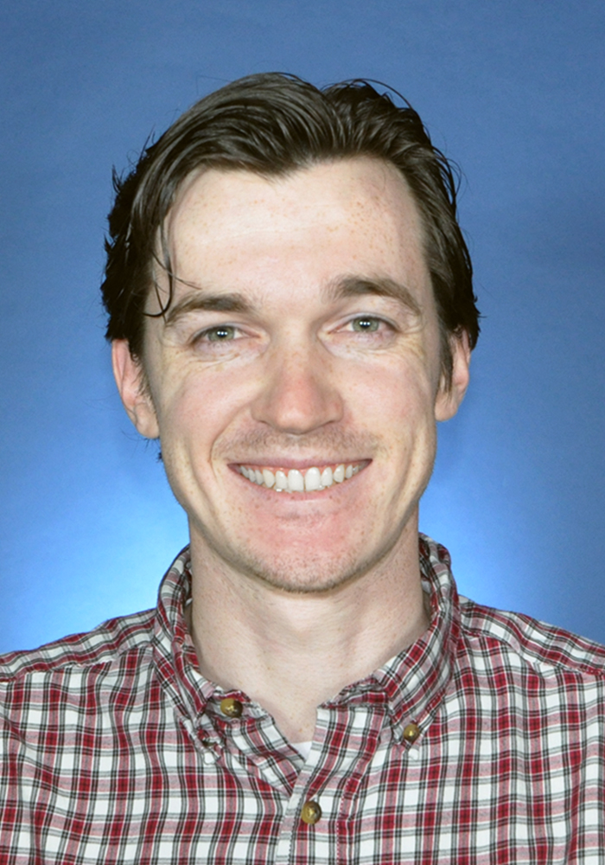
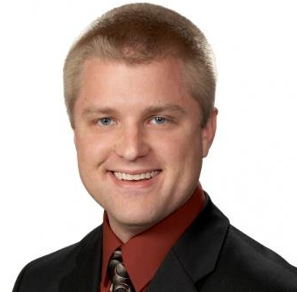
Presenters
Matthew Weber
Associate Technical Fellow @ The Boeing Company
Michael Monaghan
Software Engineer @ NASA Goddard Space Fight Center

Slide 3









… aiming to make it easier for companies to build and certify Linux-based safety-critical systems whose failure could result in loss of human life, significant property damage or environmental damage.
Automotive
(use-case)
Open Source Engineering Process
Systems
Medical
(use-case)
Safety Architecture
Tool Investigation and Code Improvement
Aerospace
(use-case)
Linux Features for Safety-Critical Systems

Slide 4

Aerospace Working Group
“… shall develop use cases to inform and influence Linux architecture and related tools, work to derive technical requirements for avionics operating systems, and seek to enhance and expand avionics software lifecycle processes, practices, and tools to enable use of Linux in avionics systems that are certified to high design assurance levels.”
See our annual briefing for more 2024 details and plans for 2025
(Slides) (Recordings)

Slide 5
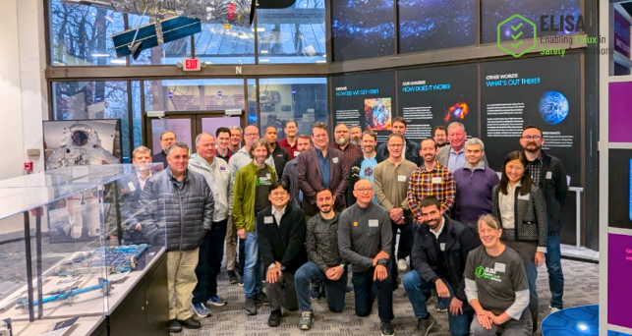

NASA Goddard Workshop
Hosted by our friends at NASA, we hosted the first in person meeting for the group with great success.
Two day event
Attendees: 30 in-person & 40 virtual
18 Talks & 20 Speakers
Tour of NASA Facilities
Some of the attending organizations: Red Hat, Bosch, NASA, Wind River, TelePIX, Sony, Linux Foundation
Link to workshop’s content and video recordings

Slide 6
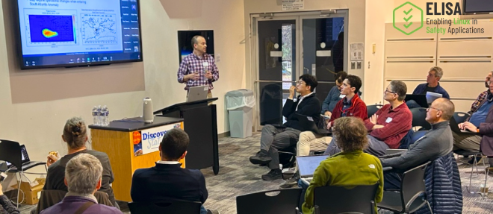
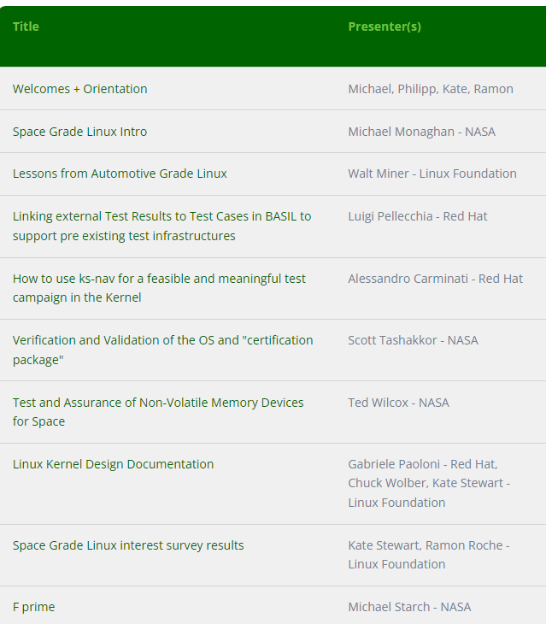
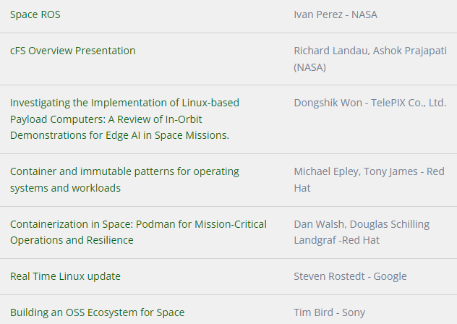
NASA Goddard Workshop: Sessions
Link to workshop’s content and video recordings

Slide 7
Space Grade Linux (SGL)

Slide 8
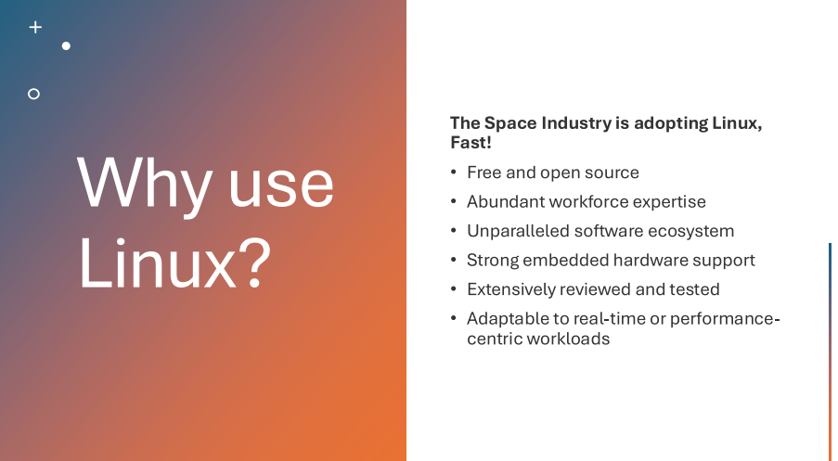

Slide 9
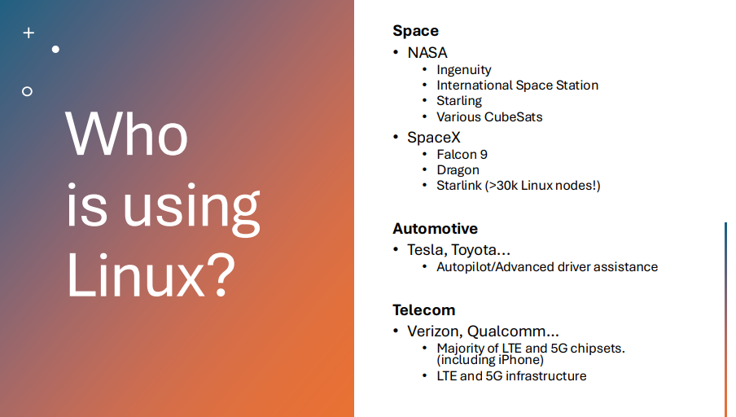

Slide 10
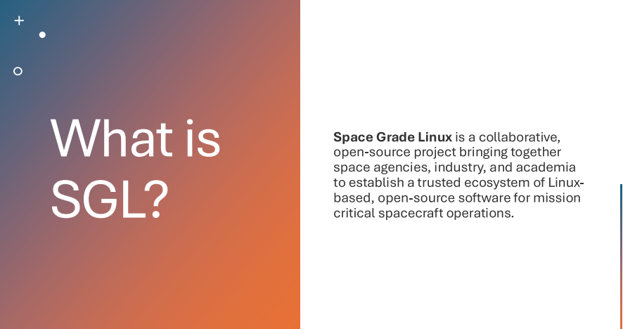

Slide 11
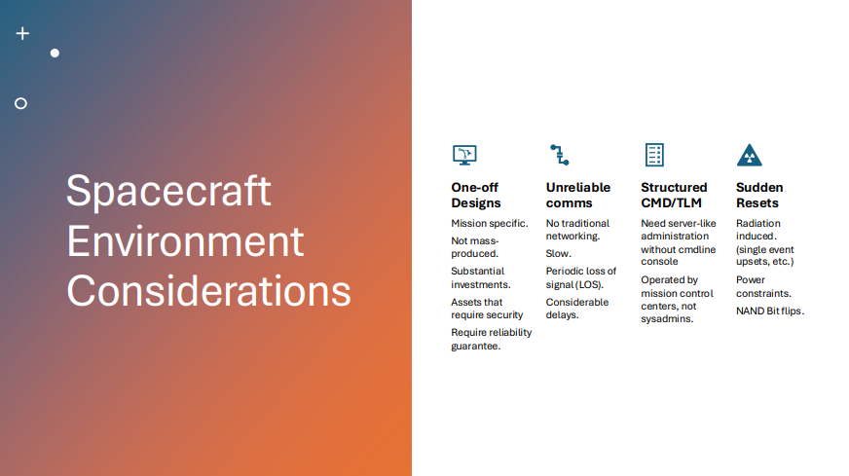

Slide 12
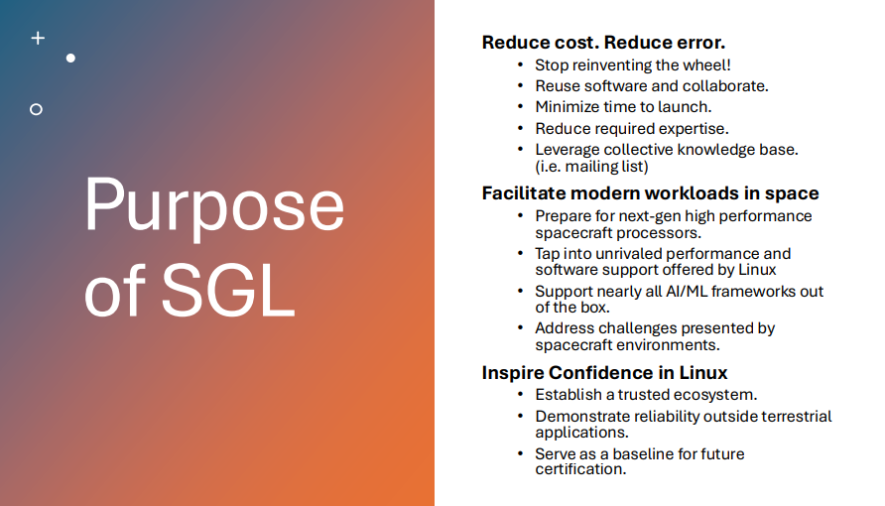

Slide 13
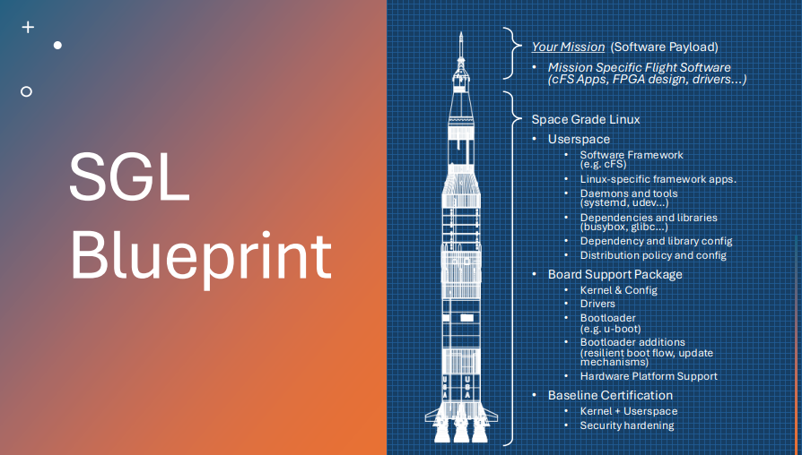

Slide 14
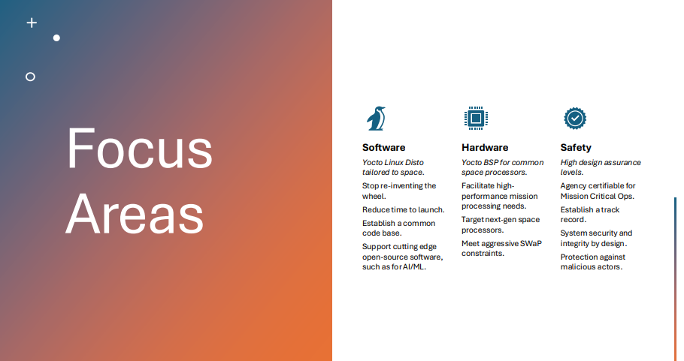

Slide 15
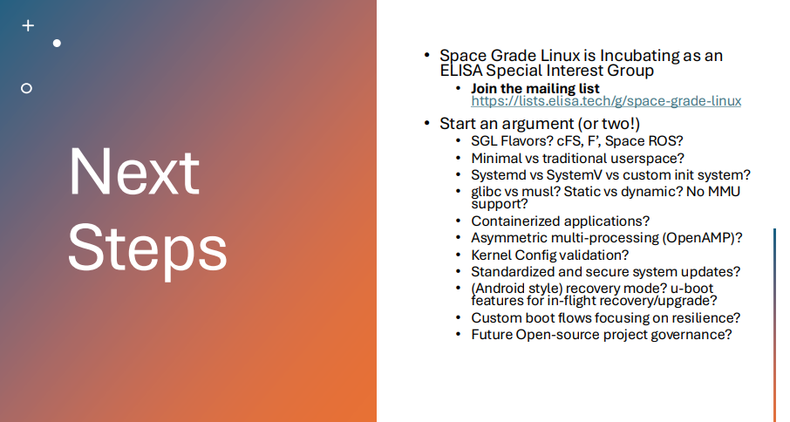

Slide 16

Resources
Community Repository: Meeting Minutes, and Schedule
meta-sgl: Linux Distro repository
Website: Landing Page with all the info on the SIG including the mailing list
SGL Workshop Videos: YouTube Playlist with all the videos from the first Workshop at Goddard Space Flight Center
Aerospace WG website (mailing list / meetings)

Slide 17
Thank you for attending!

