Slide 1
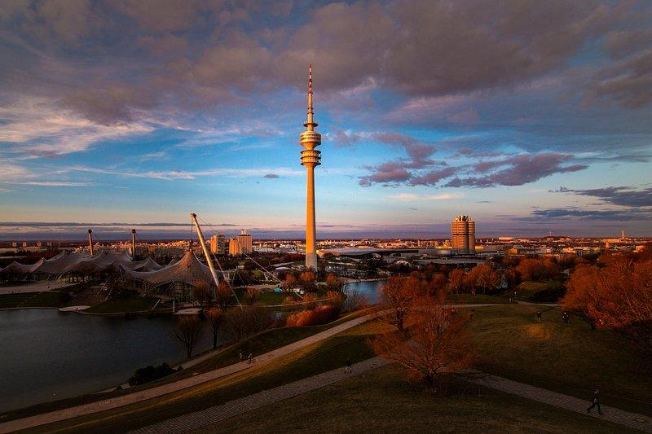
ELISA Workshop
Munich, Germany
November 18-20, 2025
Co-hosted with Red Hat

Slide 2
Industry Safety Level(s) vs.
Aerospace Use Cases
Work in Progress - License: CC-BY-4.0

Slide 3

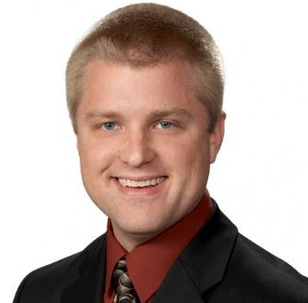
Matthew Weber
Associate Technical Fellow @
The Boeing Company
Work in Progress - License: CC-BY-4.0

Slide 4

Aerospace Working Group
Charter:
“… shall develop use cases to inform and influence Linux architecture and related tools, work to derive technical requirements for avionics operating systems, and seek to enhance and expand avionics software lifecycle processes, practices, and tools to enable use of Linux in avionics systems that are certified to high design assurance levels.”
Work in Progress - License: CC-BY-4.0

Slide 5
Agenda
Aircraft Development Cycle
DO-178C Safety Levels
Safety Levels vs. Certification Artifacts
A Comparison with Other Hazard Level Standards
Use cases
Demo
Work in Progress - License: CC-BY-4.0

Slide 6
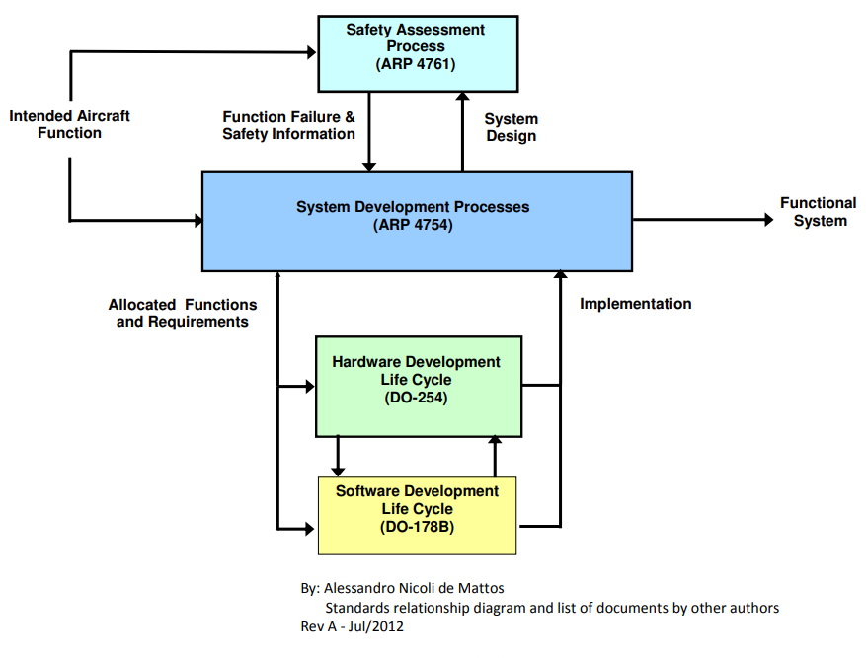

Aircraft Development Cycle
https://upload.wikimedia.org/wikipedia/commons/4/4f/DO-178B_Process_Visual_Summary_Rev_A.pdf
ELISA: Debating Linux in Aerospace: Objectives and Paths Forward
Aerospace Recommended Practice (ARP) - Guidelines for Development of Civil Aircraft and Systems
Functional Safety
Design assurance processes
Assigns DAL to mitigate failure conditions and hazard severity
Design Assurance Level (DAL)
(DO-178C Sec. 2.3) “only partitioned (time&space) software components can be assigned individual SWL by the system safety assessment process.“
(DO-178C Sec. 2.4) “if partitioning and independence between software components cannot be demonstrated, all components are assigned the SWL associated with the most severe failure condition to which the software can contribute”.
Software Level (SWL)
Notes:
partitioning - “technique for providing isolation between software components to contain and/or isolate faults and potentially reduce the effort of the software verification process” == freedom of interference
partitioned software component
- space - “should not be allowed to contaminate another partitioned software component(s) code, input/output, or data storage areas”
- time - “should be allowed to consume shared processor resources only during its scheduled period of execution”.

Slide 7
DO-178C Safety Levels
“Software Considerations in Airborne Systems and Equipment Certification.” is published by RTCA (Radio Technical Commission for Aeronautics) - DO-178C provides guidance for ensuring the safety, reliability, and airworthiness of software used in commercial and military aircraft.
Level | Severity | Example Impact | Example system
A | Catastrophic Failure | Multiple fatalities, loss of aircraft, irrecoverable | Flight control system, Terrain Awareness Warning System (TAWS)
B | Hazardous/Severe Failure | Large impact, severe injuries, a fatality | Legacy Flight Management System(FMS), Engine-Indicating and Crew-Alerting System
C | Major Failure | Discomfort, minor injuries, increased crew workload | Datalinks, Fuel monitoring
D | Minor Failure | Inconvenience | Maintenance, Cabin Lighting, WiFI
E | No Safety Effect | No impact to airplane operation or comfort | Cargo, Entertainment
https://real-time-consulting.com/wp-content/uploads/2025/03/Understanding-DO178C.pdf
https://thecloudstrap.com/design-assurance-level-dal-in-do-178c/

Slide 8

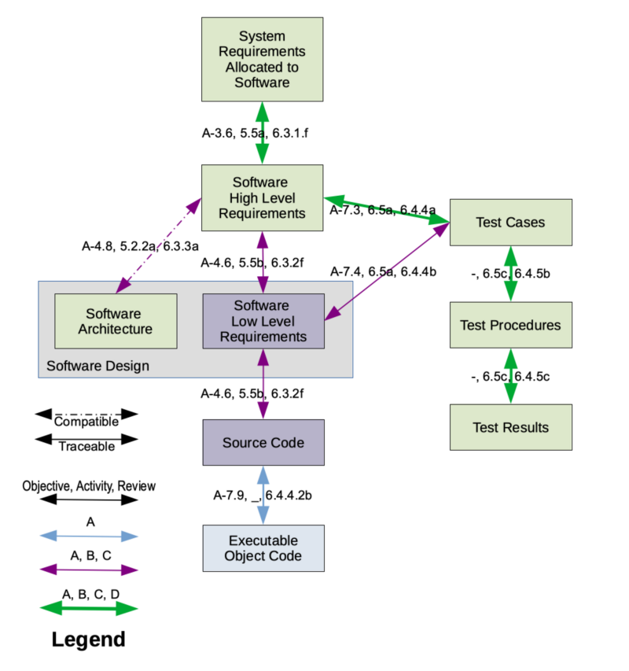
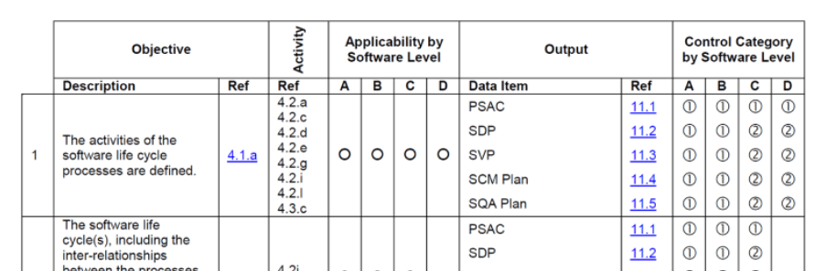

Safety Levels vs. Certification Artifact
ELISA Seminar talk with more detail
Example: DO-178C Annex A
The Annex outlines process objectives, activities and outputs by software level
Example: Artifact Trace
By Steven H. VanderLeest - Own work, CC BY-SA 3.0,
Table example - https://www.parasoft.com/learning-center/do-178c/what-is/
By Steven H. VanderLeest - Own work, CC BY-SA 3.0, https://commons.wikimedia.org/w/index.php?curid=27610716
Notes:
QRCode – It’s another ELISA seminar reference that talks through the demonstration of “safe”, objectives and artifacts. https://youtu.be/XGuYNjr7fJo?t=215 (stop at 6:25 before the coverage topic)

Slide 9
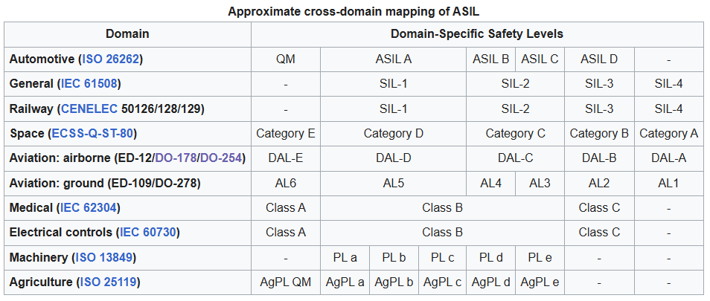

A Comparison with Other Hazard Level Standards
Failure Rates [3,4]
1E-5
[1]
<= 1E-6
<= 1E-7
<= 1E-8
1E-5
<= 1E-9
1E-5
<= 1E-5
<= 1E-7
<= 1E-9
[2]
Military (MIL-STD-882E), “Level of Rigor”
NASA (NPR 7150.2), “Class”
[1] https://www.rapitasystems.com/blog/whats-difference-between-sil-and-dal-how-does-it-affect-my-code-coverage
[2] https://en.wikipedia.org/wiki/Automotive_Safety_Integrity_Level#Comparison_with_Other_Hazard_Level_Standards
[3] https://www.rapitasystems.com/do178c-testing (DO-178C Failure Rate)
[4] https://en.wikipedia.org/wiki/IEC_61508#Probabilistic_analysis (SIL Failure Rate)

Slide 10

Use Cases
Our Process:
1) Propose, 2) Capture, 3) Establish concept, 4) Demo in environment, and 5) Publish results
Level | Severity | Case | Goals
A/B/C | Catastrophic Failure | Fault Tolerant (1) High Integrity Compute (1) Cabin Lights (1) | Mixed criticality architecture w/ partitioning Minimal Codebase / configuration defined Fault tree / recovery / injection Voting schemes IO and protocol approach appropriate for level
D | Minor Failure | Cabin Lights (5) Cabin Lights w/ cFS (2) | First use case - Established outline to capture use cases Runtime Verification w/ Copilot Basic build/emulation/test workflow (patches welcome!) Environment/Tool container
E | No Safety Effect | Attested Boot (1) | Boot chain integrity/authenticity
Please suggest new Use Cases or upvote/add notes on existing!

Slide 11
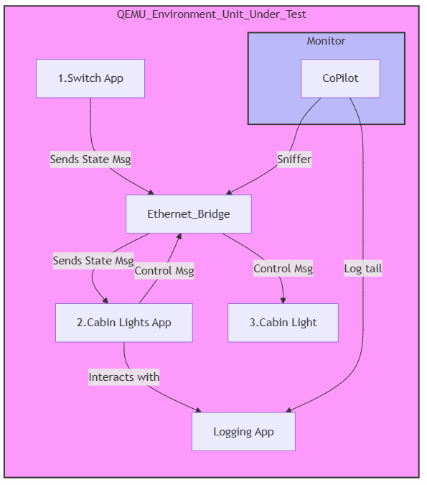
Demo: Cabin Lights
Requirements
  The Cabin Lights system shall turn lights on in less than 500 ms of the light switch turning on.
  The Cabin Lights system shall turn lights off in less than 500 ms of the light switch turning off.
Design
  Switch, Server and Actuator(Light)
  Ethernet and system logging are used
Test / Demo approach
  Applications are paired with CoPilot monitoring of logs / package

Slide 12
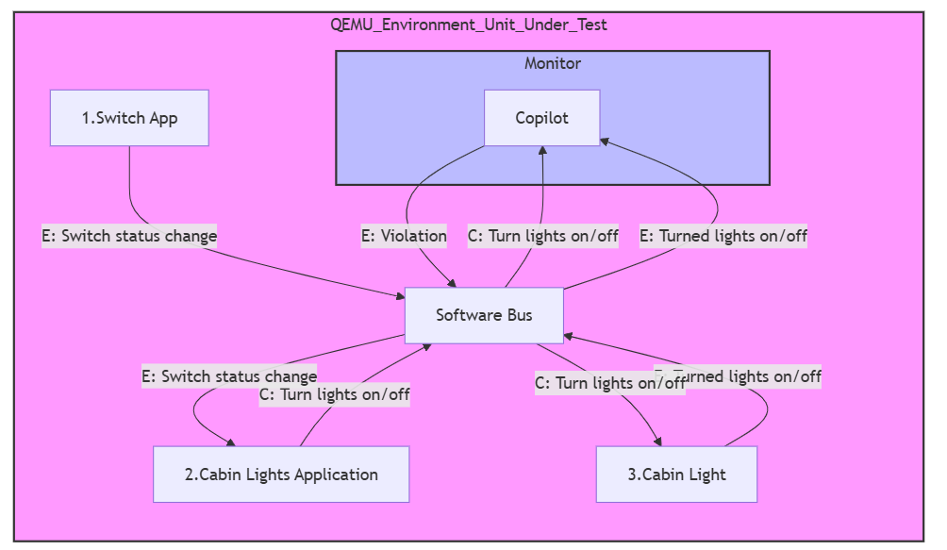

Demo: NASA Core Flight System (cFS)
Maturing Steps*
Demo cFS Sample app
Demo monitor event from sample app
Create Lights demo w/ framework**
Create Switch + Lights demo
* Assumes cFS running in embedded minimal Linux
** Ogma – generator of runtime monitors

Slide 13


How to engage with us?
Join our monthly call(s)
2nd Thursday – “General Topics”
3rd Thursday – Space Grade Linux SIG
4th Thursday – “Industry Papers” working session
Weekly (Friday) – “Use Case” testing call
Mailing list / repos / resources
https://lists.elisa.tech/g/aerospace
Register here to receive a calendar invite
https://elisa.tech/community/meetings/

Slide 14
Licensing of Workshop Results
All work created during the workshop is licensed under Creative Commons Attribution 4.0 International (CC-BY-4.0) [https://creativecommons.org/licenses/by/4.0/] by default, or under another suitable open-source license, e.g., GPL-2.0 for kernel code contributions.
You are free to:
Share — copy and redistribute the material in any medium or format
Adapt — remix, transform, and build upon the material for any purpose, even commercially.
The licensor cannot revoke these freedoms as long as you follow the license terms.
Under the following terms:
Attribution — You must give appropriate credit, provide a link to the license, and indicate if changes were made. You may do so in any reasonable manner, but not in any way that suggests the licensor endorses you or your use.
No additional restrictions — You may not apply legal terms or technological measures that legally restrict others from doing anything the license permits.
Work in Progress - License: CC-BY-4.0

Slide 15
Thank you for attending!

