Slide 1

Aerospace Working Group
FIX to point at new slides
2026 Annual Update
Matthew Weber & Dr. Martin Halle
Aerospace · Automotive · Linux Features
OS Engineering Process · Safety Architecture · Systems · Tools
Lighthouse · Space Grade Linux
License: CC-BY-4.0

Slide 2

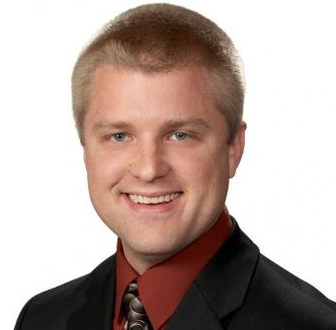
Matthew Weber
Associate Technical Fellow @
The Boeing Company
Aerospace · Automotive · Linux Features · OS Engineering Process · Safety Architecture · Systems · Tools · Lighthouse · Space Grade Linux

Slide 3

Aerospace Working Group
Charter:
“… shall develop use cases to inform and influence Linux architecture and related tools, work to derive technical requirements for avionics operating systems, and seek to enhance and expand avionics software lifecycle processes, practices, and tools to enable use of Linux in avionics systems that are certified to high design assurance levels.”
Aerospace · Automotive · Linux Features · OS Engineering Process · Safety Architecture · Systems · Tools · Lighthouse · Space Grade Linux

Slide 4
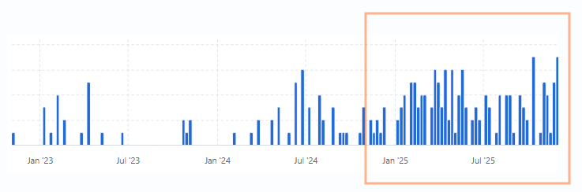
2025 Contributions
Active participation: (2024 vs. 2025)
  46 → 48 unique members attended meetings
    23 → 26 meetings (Combined Aerospace + SGL)
    Aerospace average meeting attendance is 8.91 → 8.7
  Added a weekly use case demo development call – Average attendance of 4.5
  Overall 295 commits from 9 contributors
Thank you for your contributions of time and knowledge this year!
  Aerospace Corporation, Astro Mechanica, Barcelona Supercomputing Center, Boeing, Collins Aerospace, Coros Space, Czech Aerospace Research Centre, Devstringx Technologies, DLR (German Aerospace Center), ESA (European Space Agency), ETAS GmbH, Hamburg University of Technology, KBR @ NASA Ames Research Center, L3Harris, Timesys/Lynx Software, Microchip Technology Inc., NASA (various centers including Ames, Goddard, Langley), NXP Semiconductors, OpenEmbedded, Rapita Systems, Red Hat, Sony, Space Cubics, Stoke Space, TII (Technology Innovation Institute), Voyager, Vorago Technologies, Wind River
Special thanks to those contributing to paper and demo development!
  Barcelona Supercomputing Center, Boeing, Collins Aerospace, Coros Space, Devstringx Technologies, DLR (German Aerospace Center), Hamburg University of Technology, KBR @ NASA Ames Research Center, Timesys/Lynx Software, Wind River
Aerospace · Automotive · Linux Features · OS Engineering Process · Safety Architecture · Systems · Tools · Lighthouse · Space Grade Linux

Slide 5
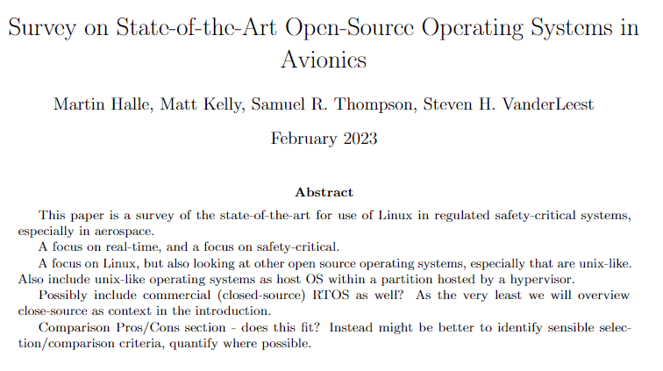
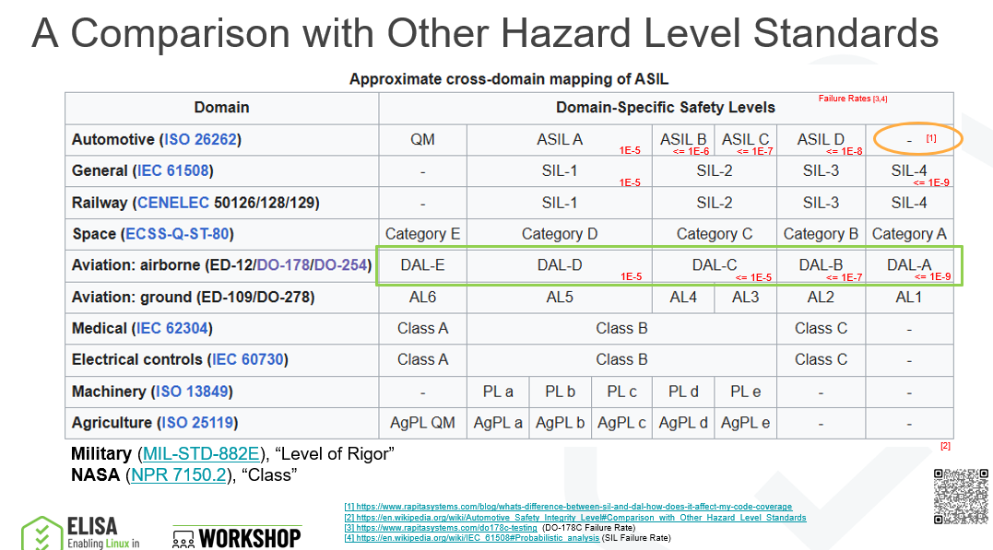
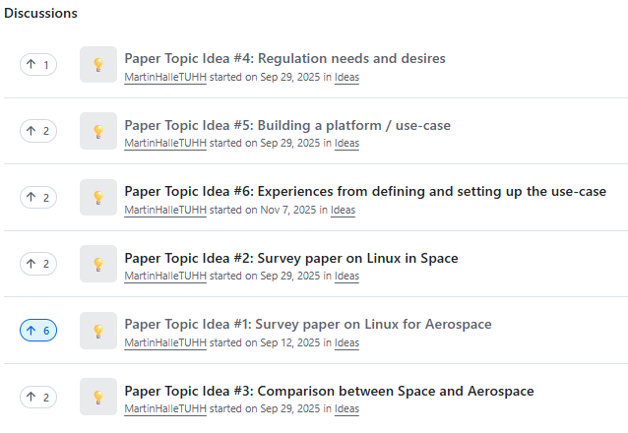
2025 Achievements
  Presented at the Munich workshop
      “Industry Safety Levels vs Use Cases”
      “Research questions and publication directions of Aerospace WG”
    Restarted a monthly “Industry Paper” call
    Iain Galloway(NXP) presented on ASIL-D activities with robotics
    ELISA SystemWG presented on reference systems work and SoDev
Aerospace · Automotive · Linux Features · OS Engineering Process · Safety Architecture · Systems · Tools · Lighthouse · Space Grade Linux

Slide 6
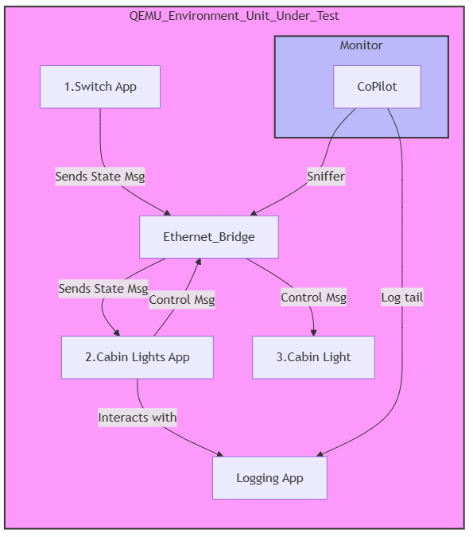
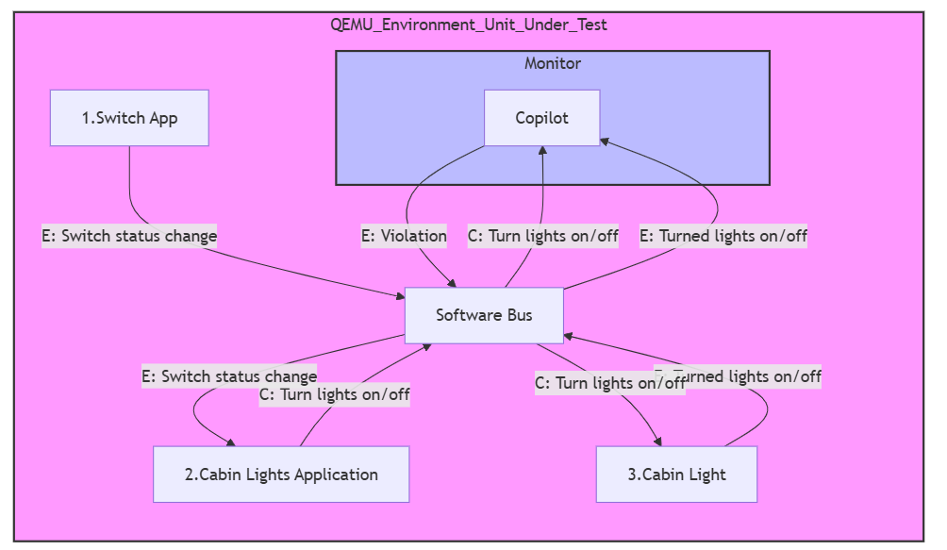
2025 Achievements
    Completed Cabin Lights demo!
      Requirements
        The Cabin Lights system shall turn lights on in less than 500 ms of the light switch turning on.
        The Cabin Lights system shall turn lights off in less than 500 ms of the light switch turning off.
      Design
        Switch, Server and Actuator(Light)
        Ethernet and system logging are used
        QEMU ARM64 and minimal Linux Kernel + Busybox
      Test / Demo approach
        Applications are paired with NASA CoPilot monitoring of logs / package
    Extended the Cabin Lights demo with NASA Core Flight System (cFS)
Aerospace · Automotive · Linux Features · OS Engineering Process · Safety Architecture · Systems · Tools · Lighthouse · Space Grade Linux

Slide 7
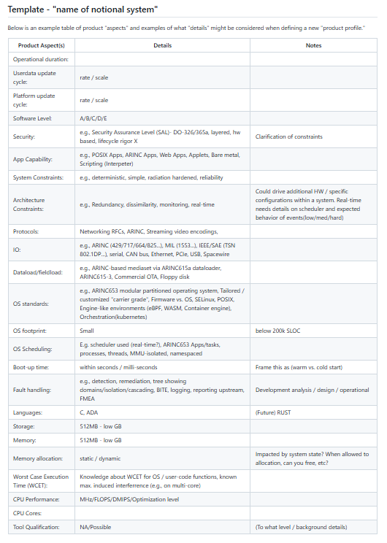
2025 Achievements
  Evaluated how to capture distinguishing system requirements,
  i.e.," What makes a product aerospace vs. just embedded?”
    Discussed Carrier Grade Linux as an example
    Created a template for capturing “aspects”
    of a product’s profile
    Organizing by safety standard and level
    Capturing examples at each level
Aerospace · Automotive · Linux Features · OS Engineering Process · Safety Architecture · Systems · Tools · Lighthouse · Space Grade Linux

Slide 8
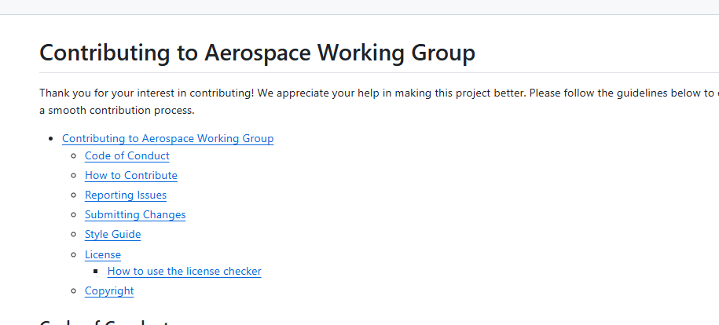
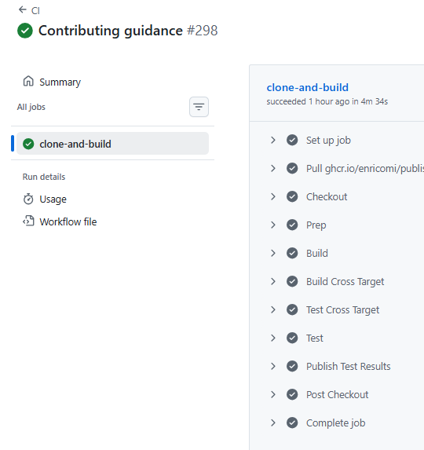
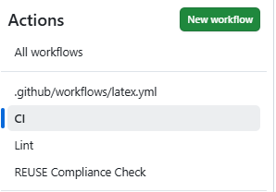
2025 Achievements
  Established our Contributions guidance and Licensing
  Matured CI workflows on push
    Stages to Build, Test, and Report (Block merge)
    Instrumented emulated testing
    Sandboxed tools for reproducibility
    Linting of review material
    License check
Aerospace · Automotive · Linux Features · OS Engineering Process · Safety Architecture · Systems · Tools · Lighthouse · Space Grade Linux

Slide 9


2026 Activities
Expand on capturing products with profile template
  Create NASA profiles → Aids Space Grade Linux
  Tie product profiles to use cases → Drive future reference system
  Elaborate on fault tolerance and availability aspects
A reference system (QEMU & HW) for benchmarking (a subset of current demos)
Find common topics with Space Grade Linux
  E.g. reference system definition, footprint, reliability
  Industry Survey paper
Submit abstract to a conference for at least one Industry paper
Aerospace · Automotive · Linux Features · OS Engineering Process · Safety Architecture · Systems · Tools · Lighthouse · Space Grade Linux

Slide 10


How to Get Involved
Join our monthly call(s)
2nd Thursday – “General Topics”
3rd Thursday – Space Grade Linux SIG
4th Thursday – “Industry Papers” session
Weekly (Friday) – “Use Case” testing call
Register for calendar invite
https://elisa.tech/community/meetings/
Mailing List - https://lists.elisa.tech/g/aerospace
Discord - https://chat.elisa.tech/
GitHub - https://github.com/elisa-tech/wg-aerospace
View meeting minutes
Use case and whitepaper documents
Use case Demos
Aerospace · Automotive · Linux Features · OS Engineering Process · Safety Architecture · Systems · Tools · Lighthouse · Space Grade Linux

