Slide 1
Tools WG 2025 Update
Matt Kelly, The Boeing Company
Aerospace · Automotive · Linux Features
Medical Devices · OS Engineering Process Safety Architecture · Space Grade Linux · Systems · Tools

Slide 2
Tools WG
WG Mission Statement
“The Tool Investigation and Code Improvement WG focuses on creation, analysis, and application of tools and techniques to contribute to the improvement of the kernel for use in safety cases.”
Focus on tooling around the kernel, ELISA CI setups, and addressing static analysis issues against the kernel

Slide 3
2024 Recap
22 unique attendees across 17 meetings
Broadened the WG’s mission statement
Pulled 4 different tool efforts under this umbrella
Ks-nav, BASIL, DeltaKernel, llvm-cov
First cross-company contribution (ks-nav)
First known outside users of a WG tool (BASIL)
Engaged with several outside groups on possible collaboration
Cregit, stress-ng
Still welcome discussion on kernel static analysis results and patching
1 upstream kernel contribution on this last year

Slide 4
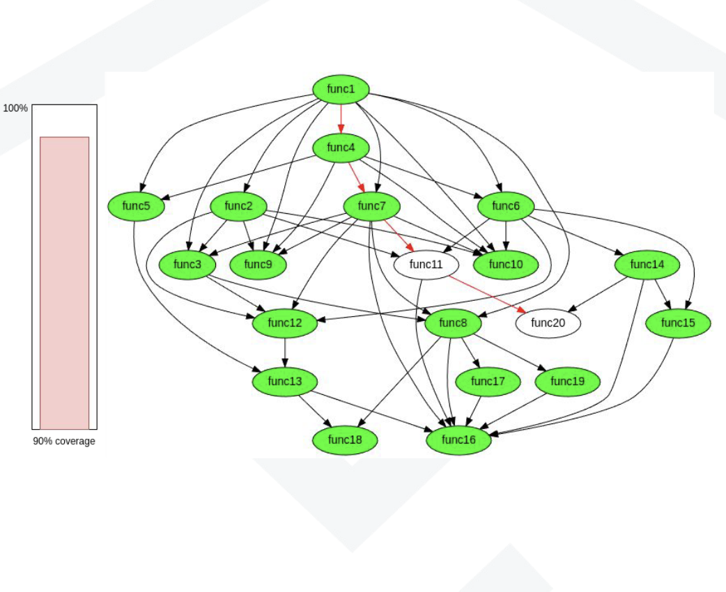
ks-nav
What is it?
Kernel binary analysis tool to assist with IS26262 FFI analysis
Get it: https://github.com/elisa-tech/ks-nav
2024 Updates
Improvements to the web interface
Improvements to the way global variables are tracked and presented
Integrated ftrace-based coverage analysis (https://youtu.be/ghUBAndh_uA)
2025 Plan
Resolve the “indirect function calls” problem

Slide 5
BASIL
What is it?
Lifecycle artifact traceability tooling with many excellent features!
Get it: https://github.com/elisa-tech/BASIL
Try it: http://elisa-builder-00.iol.unh.edu:9056/
2024 Updates
Established a public instance for people to experiment
Various new features linking test cases to requirements specs, etc.
Triggering test in external CI systems and linking to results
2025 Plan
SDPX3.0 and SBOM Integration

Slide 6
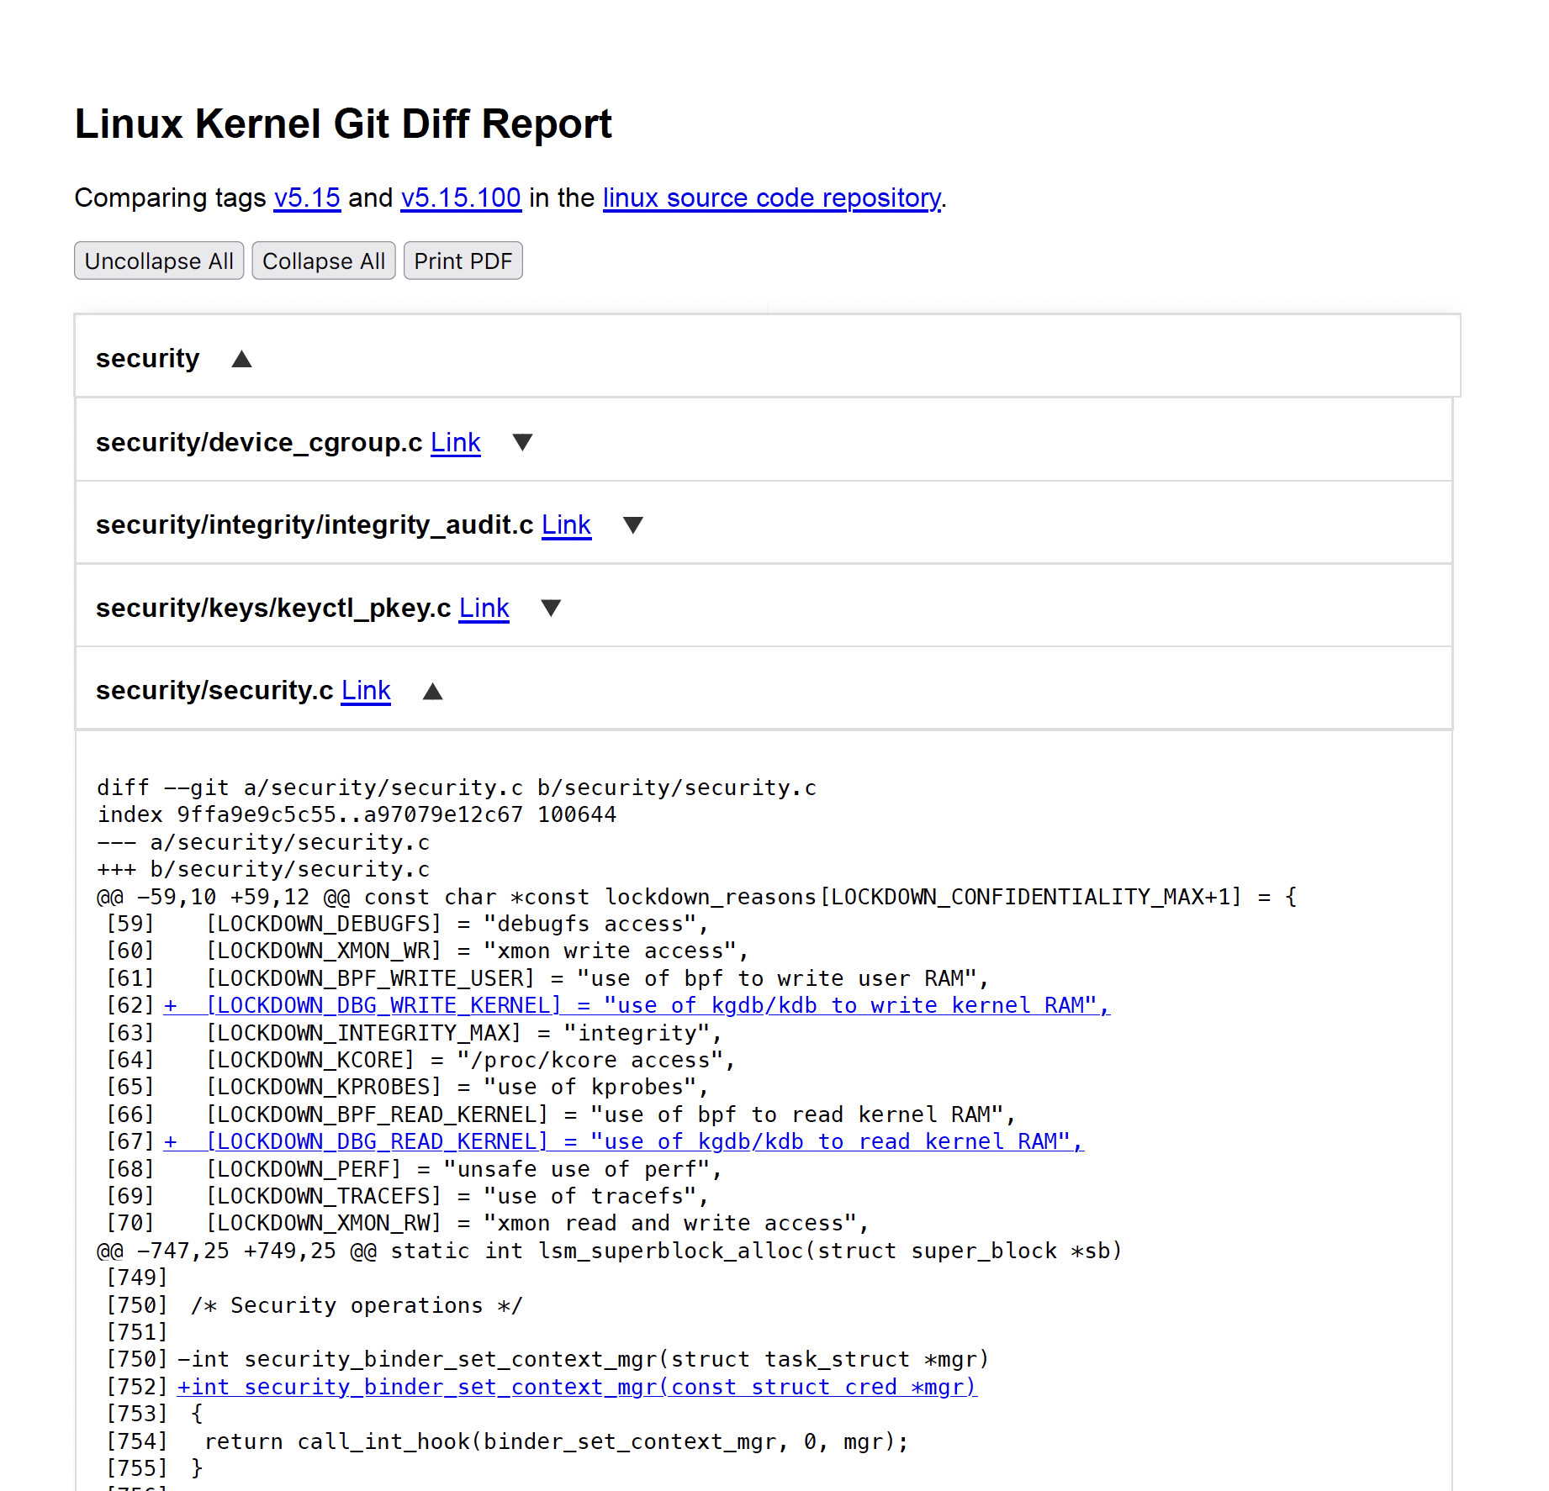
DeltaKernel
What is it?
Provides a visual report of change impact between two kernel versions
Get it: https://github.com/elisa-tech/delta-kernel/
2024 Updates
Initial release of the tooling
2025 Plan
No active plan for 2025 at this moment
Extend analysis to the kernel configuration

Slide 7
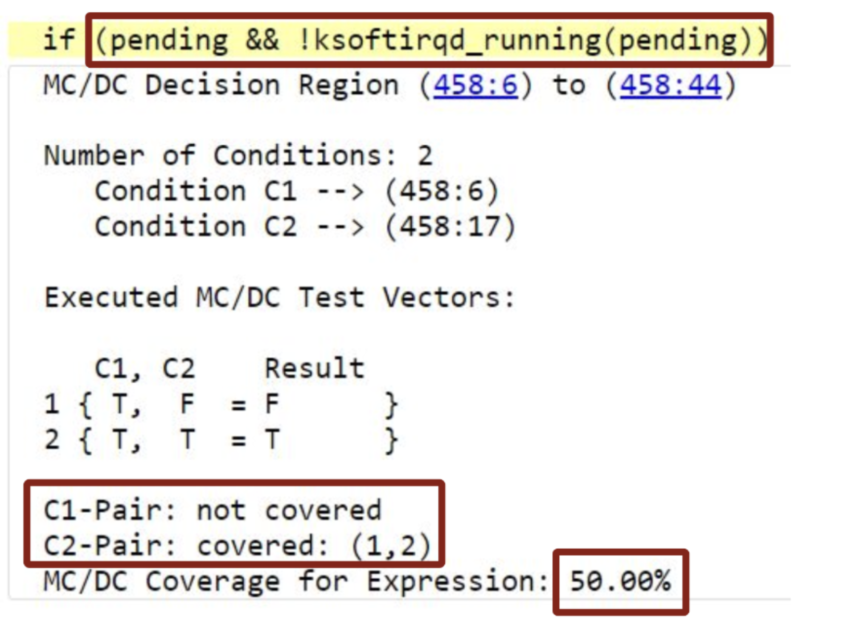
llvm-cov
What is it?
Joint effort between Boeing/UIUC to enhance llvm-cov to achieve MC/DC and object code coverage of the kernel
Get it: LLVM 19.1 and later!
2024 Updates
Demo of MC/DC coverage of the kernel at Linux Plumbers
Started DO-330 qualification effort
2025 Plan
Initial implementation of object code coverage tooling
Notes:
Leveraged work from Alan Phipps from Texas Instruments
Extended this work to include operating on the kernel itself
Resulted in several upstream contributions
After some design deliberation object code coverage tool will actually be a separate tool

Slide 8
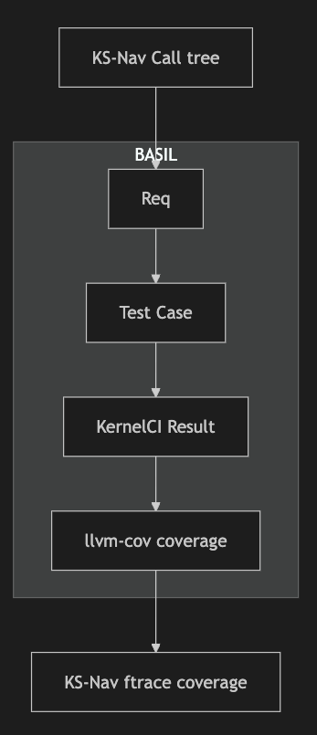
2025 Vision
Present a use case which connects several existing tools/efforts
Leverage ks-nav call trees to inform requirements understanding
Kernel requirements / documentation effort: Create a req in the ftrace area against an existing test case
(NEW) Create CI which loads kernel data into a live instance of ELISA
(NEW) Work to get llvm-cov coverage data capture in KernelCI testing
Demonstrate linkage of Req → Test Case → Test Result → Coverage
Demonstrate ftrace-based coverage on the same test
Big Stretch: Demonstrate how this data can be used for change impact analysis

Slide 9
Get Involved
Join our meetings!
^{2nd} Tuesday of the month @ 9:30 AM EST / 2:30 PM UTC
4th Thursday of the month @ 11:00 AM EST / 4:00 PM UTC
Hit the Mailing List!
https://lists.elisa.tech/g/tool-investigation
Participate in our GitHub
Tools WG: https://github.com/elisa-tech/wg-tools
BASIL: https://github.com/elisa-tech/BASIL
ks-nav: https://github.com/elisa-tech/ks-nav
DeltaKernel: https://github.com/elisa-tech/delta-kernel/

Slide 10
Thank you!

