Slide 1
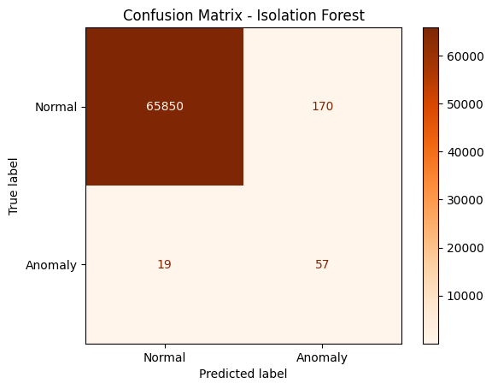
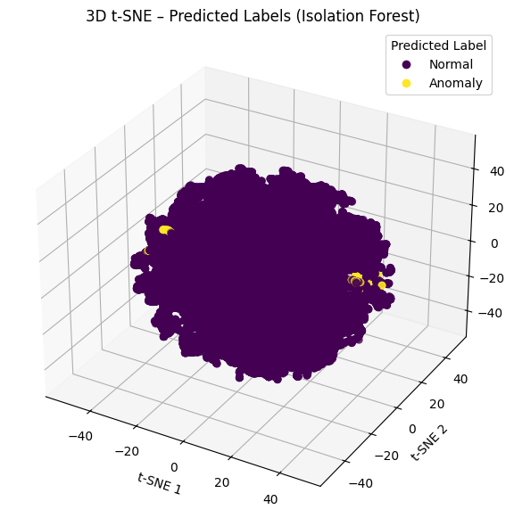
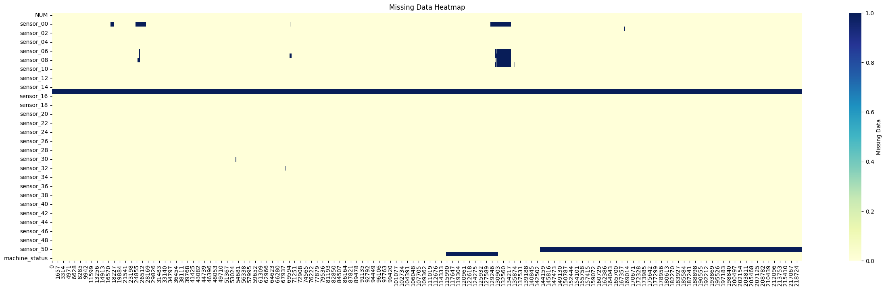

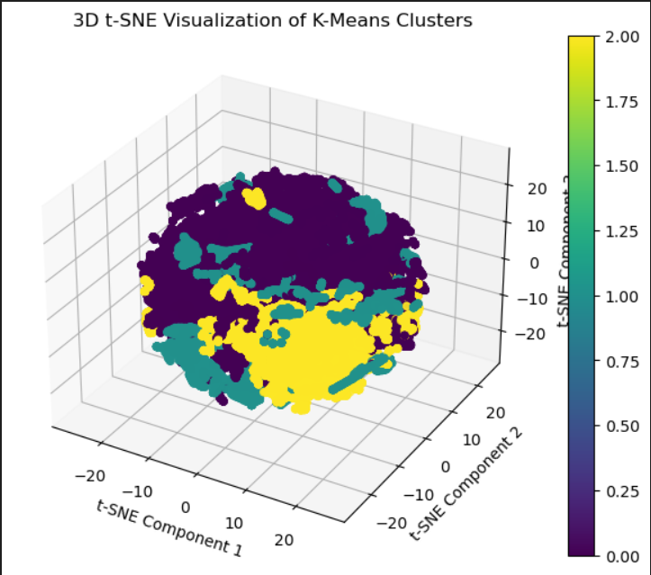

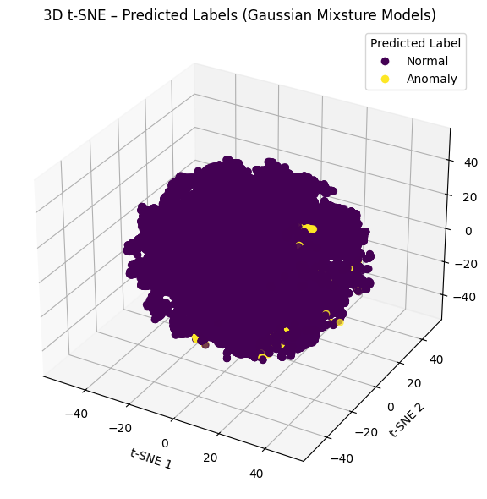
Anomaly Detection in Water Pump Sensor Data
By group 8
Assignment 2, TMM4128 Machine learning for engineers
Business Objective
Industrial facilities rely on the continuous operation of water pumps. Unexpected failures can lead to costly downtime and equipment damage. Our goal is to build a model that detects abnormal behavior in sensor data — enabling predictive maintenance and reducing manual inspection needs.
1. Dataset
Time-series data from industrial water pumps
52 numeric sensor features (e.g., pressure, vibration, temperature)
Machine status labels: NORMAL, RECOVERING, BROKEN
~220,000 total records
5. Evaluation
Metrics used: Precision, Recall, F1-score
Visualized results using Confusion Matrix and t-SNE
2. Data Preprocessing
Dropped sensors with excessive missing values.
Filled gaps using forward-fill, suitable for time series.
Applied StandardScaler for normalization.
Removed highly correlated sensors (correlation > 0.99).
70 / 30 train-test split.
3. Problem Framing
Treated as an unsupervised anomaly detection problem
The model is trained on unlabeled data
Ground truth labels (machine_status) are used only for evaluation
We assume most data points are normal, with rare anomalies
5. Tested and best Model
Isolation Forest: estimators=80, contamination=0.12
Bayesian GMM: n_components=3, weight_concentration_prior =0.1
K-Means: n_clusters =3, init = “k-means++”
Model | Accuracy | Precision | Recall | F1-Score
Isolation Forest | 1.00 | 0.25 | 0.75 | 0.38
Bayesian GMM | 0.99 | 0.06 | 0.55 | 0.11
K-Means | 0.99 | 0.08 | 0.72 | 0.15
Conclusion We built an unsupervised anomaly detection pipeline for sensor data, but all models struggled to detect rare failures.
The main issue was the extremely imbalanced dataset — very few BROKEN cases and many tightly clustered NORMAL samples. This made it hard to form meaningful clusters and caused models to show high accuracy while missing actual anomalies.
Key takeaways:
Isolation Forest performed best but still missed most anomalies.
PCA helped reduce noise.
Accuracy was misleading — recall and precision for anomalies were low.
Recommendations:
Try semi-supervised methods or anomaly-aware models like autoencoders.
Address class imbalance and explore time-based features or domain knowledge.

