Slide 1
High School Involvement Program
Stacy
Rhane Napier
January 2016
Mentor: Eli Baca
Sumeet Ranu

Slide 2
Agenda
Design Process
Brainstorming and Research
Building Process
Final Design
Obstacles
Skills Learned
Time Management

Slide 3
Design Process
Problem Statement:
Build a ‘hive’ of robots with a ‘Queen’ acting as the hub for an information collection system with ‘workers’ with sensors for agricultural and data analysis uses

Slide 4
Brainstorming and Research
Concepts considered while designing:
Communication : Wi-Fi, Rf, Bluetooth
Sensors : soil moisture, water sensor, LCD screen, temp sensor, light sensor, humidity, sound sensor, accelerometer, ultrasonic
Research topics:
Robot communication
Arduino sensors

Slide 5
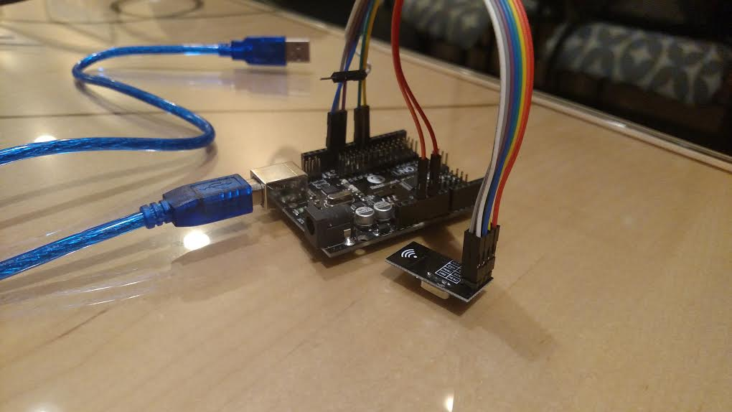
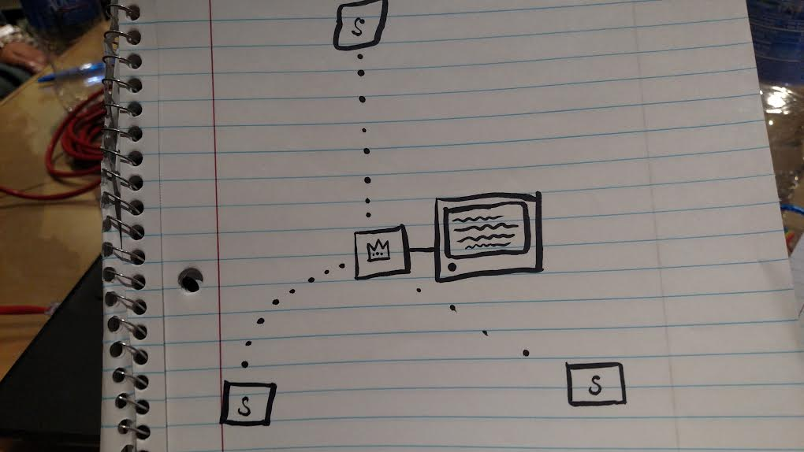
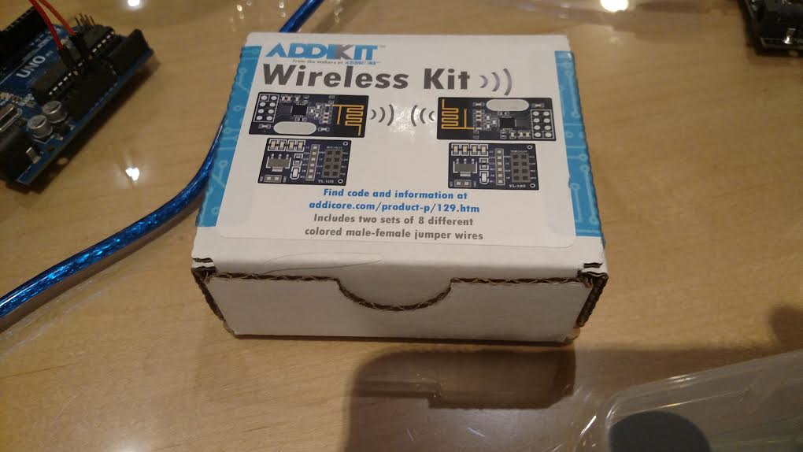
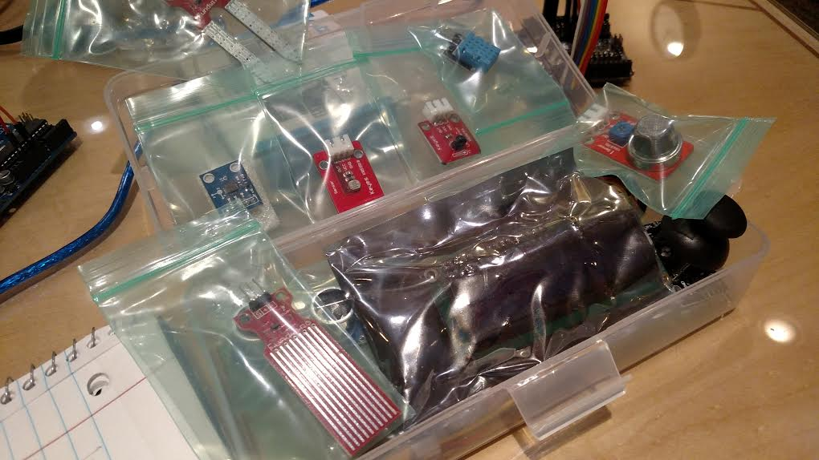
Building Process

Slide 6
Final Design
‘Queen’ bot that can receive information from the ‘worker’ bots and then give that information to the user for further analysis.

Slide 7
Obstacles
Transceivers are crazy
Getting all the different sensor codes to work at the same time with each other
i.e. take a picture based on temperature received

Slide 8
Skills Learned
Coding and transceivers
How to get everything to fit on the same board
Arduino libraries
Electronics safety

Slide 9
Time Management
Sep – Ordered Parts
Oct – Wired up the Camera and took first photo
Nov – Wired up sensors and got the code for each sensor developed
Dec – Work on transceivers working
Jan – Midpoint Update Presentations
Feb –
Mar –
Apr –
May –
Jun – Final Presentations

