Slide 1
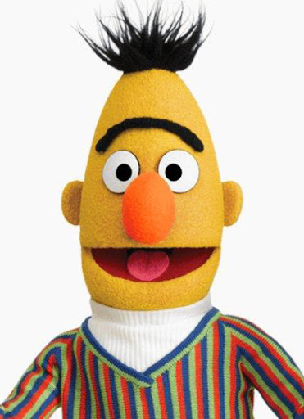
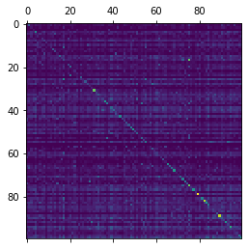
Raw data
Data preprocessing
Q: Where in England was Dame Judi Dench born?
P: Dench was born in Heworth, York. Her mother…
E(Q)
E(P)
Performance

