Slide 1
The Heterogeneous Fleet Vehicle Routing Problem with Draft Limits
Mathematical Optimization - A.A. 2024-2025
Elma Huseinovic, Elisabetta Chisso

Slide 2
Problem Description
Context: In modern maritime transport, naval gigantism has led to increasingly large vessels with greater drafts
Operational issue: Ports have draft limits-ships that are too heavily loaded cannot enter them, which affects the sequence of port visits.
Objective: Minimize the total network cost (port access + sailing) by deciding how many and which ships (of different sizes) to use, and in what sequence to visit the ports.
Novelty:
Incorporates load-dependent draft limits into routing decisions.
Considers a heterogeneous fleet (ships with different capacities, costs, and drafts).
Integrates fleet sizing and routing under draft constraints.
PROBLEM DESCRIPTION

Slide 3

Formulation
SETS
$I=\left[1, I_{max}\right]$ → set of ports
$I0=\left[0, I_{max}\right]$ → set of ports including the depot
$S=\left[1, S_{max}\right]$ → set of ships
FORMULATION

Slide 4
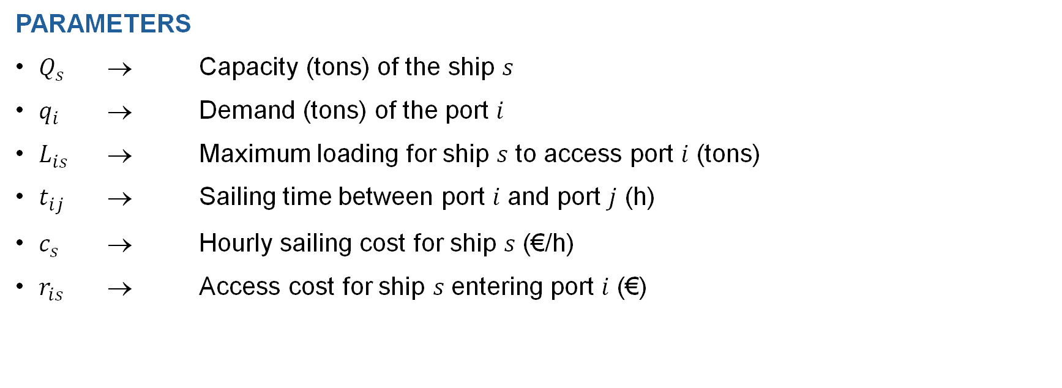
PARAMETERS
$Q_{s}$ → Capacity (tons) of the ship 𝑠
$q_{i}$ → Demand (tons) of the port 𝑖
$L_{is}$ → Maximum loading for ship 𝑠 to access port 𝑖 (tons)
$t_{ij}$ → Sailing time between port 𝑖 and port 𝑗 (h)
$c_{s}$ → Hourly sailing cost for ship 𝑠 (€/h)
$r_{is}$ → Access cost for ship 𝑠 entering port 𝑖 (€)
FORMULATION

Slide 5
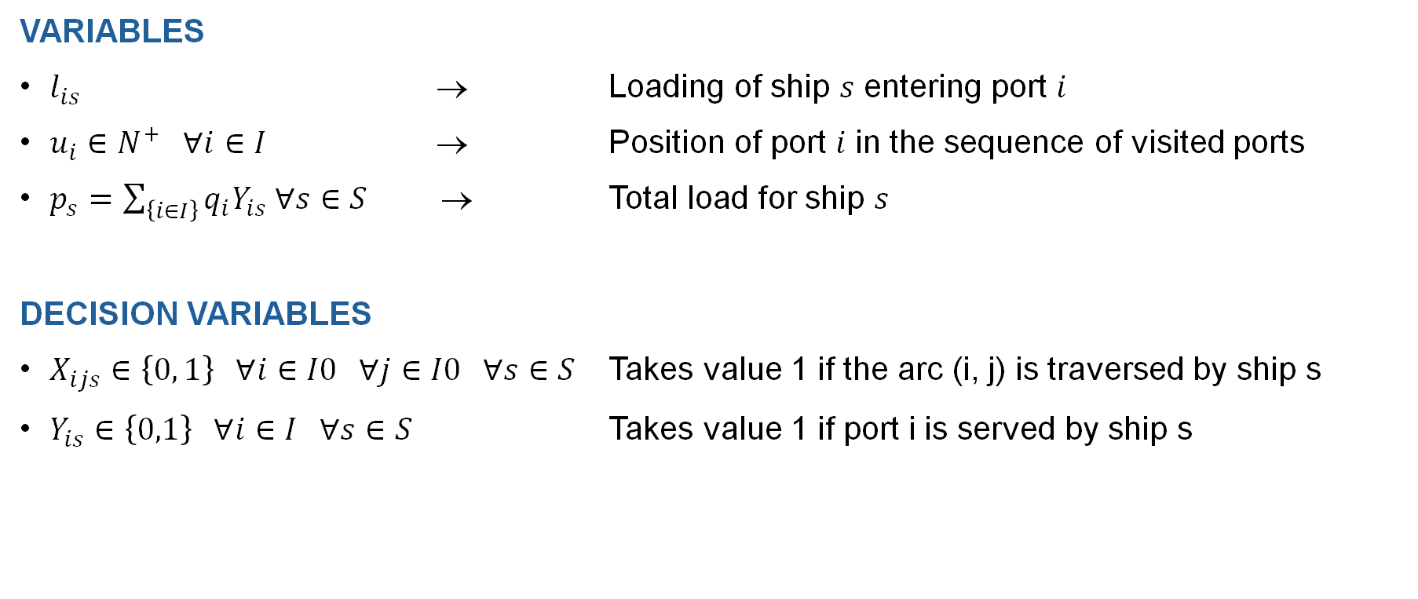
VARIABLES
$l_{is}$ → Loading of ship 𝑠 entering port 𝑖
$u_{i}∈N^{+} ∀i∈I$ → Position of port 𝑖 in the sequence of visited ports
$p_{s}=\sum_{\left\{i∈I\right\}}{q_{i}Y_{is} ∀s∈S}$ → Total load for ship 𝑠
DECISION VARIABLES
$X_{ijs}∈\left\{0, 1\right\} ∀i∈I0 ∀j∈I0 ∀s∈S$ Takes value 1 if the arc (i, j) is traversed by ship s
$Y_{is}∈\left\{0,1\right\} ∀i∈I ∀s∈S$ Takes value 1 if port i is served by ship s
FORMULATION

Slide 6
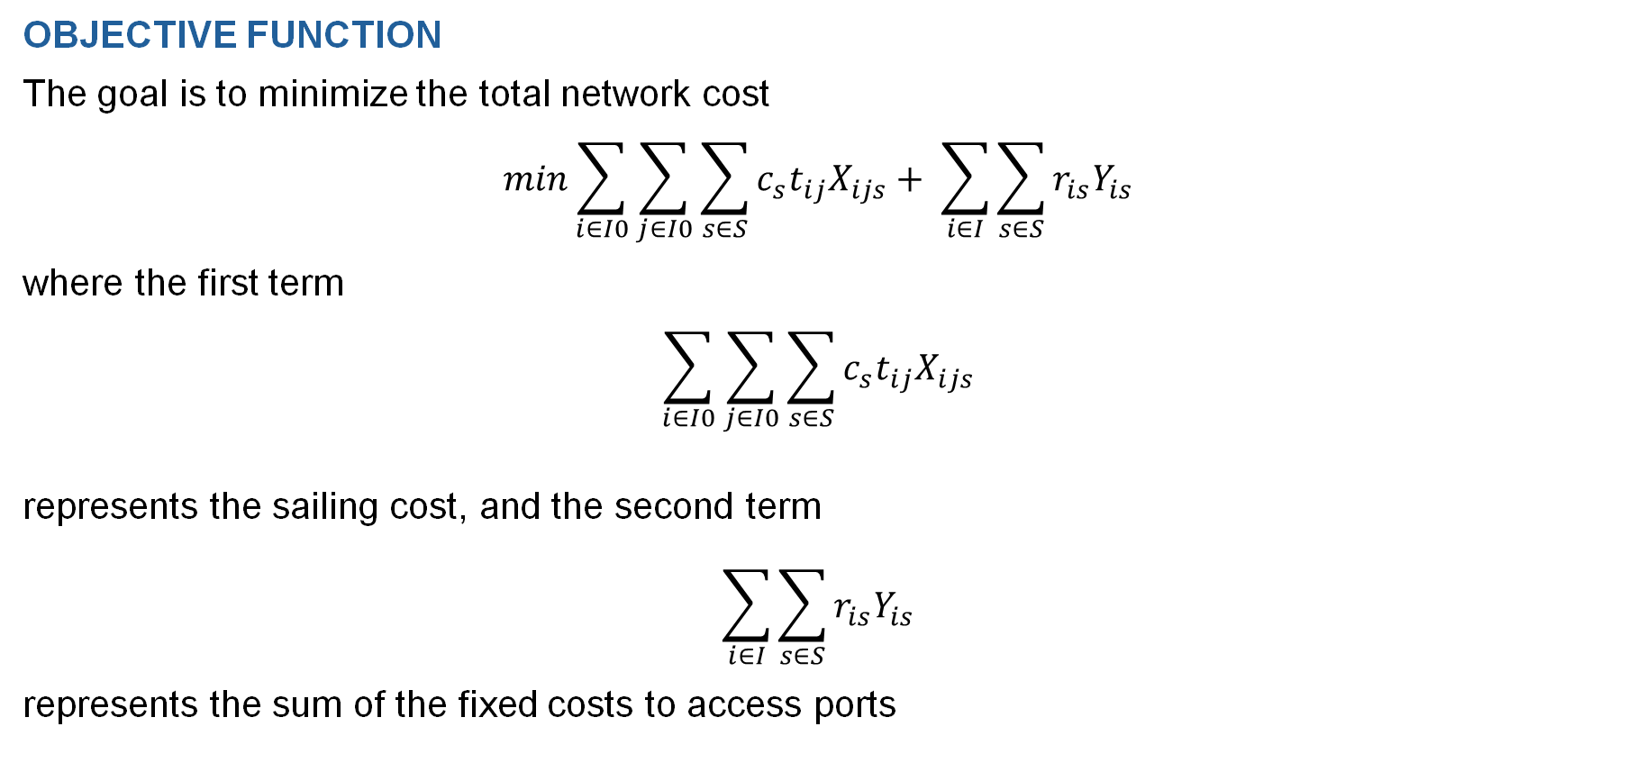
OBJECTIVE FUNCTION
The goal is to minimize the total network cost
$$min\sum_{i∈I0}{\sum_{j∈I0}{\sum_{s∈S}{c_{s}t_{ij}X_{ijs}+ \sum_{i∈I}{\sum_{s∈S}{r_{is}Y_{is}}}}}}$$
where the first term
$$\sum_{i∈I0}{\sum_{j∈I0}{\sum_{s∈S}{c_{s}t_{ij}X_{ijs}}}}$$
represents the sailing cost, and the second term
$$\sum_{i∈I}{\sum_{s∈S}{r_{is}Y_{is}}}$$
represents the sum of the fixed costs to access ports
FORMULATION

Slide 7
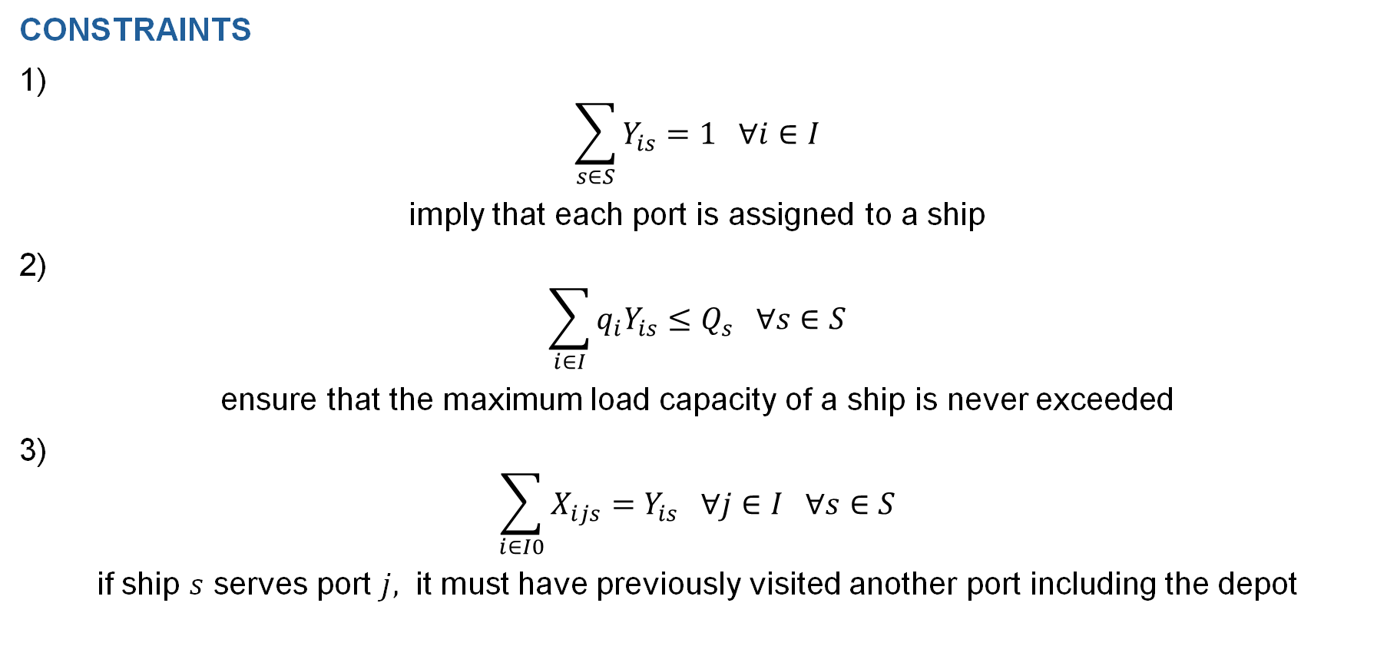
CONSTRAINTS
1)
$$\sum_{s∈S}{Y_{is}=1 ∀i∈I}$$
imply that each port is assigned to a ship
2)
$$\sum_{i∈I}{q_{i}Y_{is}≤Q_{s} ∀s∈S}$$
ensure that the maximum load capacity of a ship is never exceeded
3)
$$\sum_{i∈I0}{{X_{ijs}=Y}_{is} ∀j∈I ∀s∈S}$$
if ship $s$ serves port $j,$ it must have previously visited another port including the depot
CONSTRAINTS

Slide 8
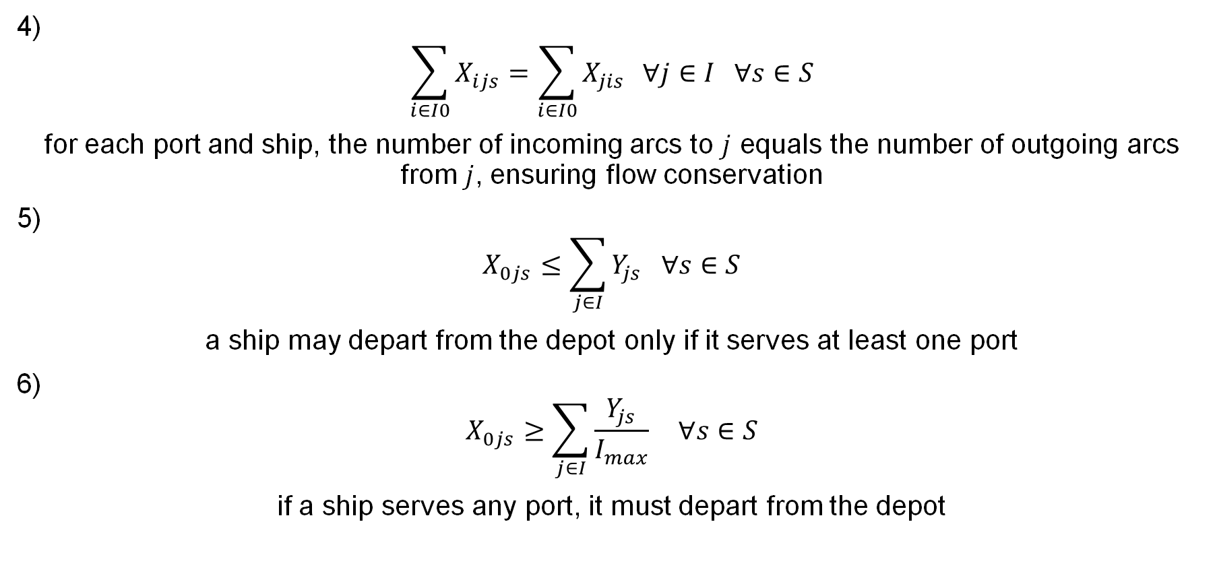
4)
$$\sum_{i∈I0}{X_{ijs}=\sum_{i∈I0}{X_{jis}} ∀j∈I ∀s∈S}$$
for each port and ship, the number of incoming arcs to $j$ equals the number of outgoing arcs from $j$, ensuring flow conservation
5)
$$X_{0js}≤\sum_{j∈I}{Y_{js} ∀s∈S}$$
a ship may depart from the depot only if it serves at least one port
6)
$$X_{0js}≥\sum_{j∈I}{\frac{Y_{js}}{I_{max}} ∀s∈S}$$
if a ship serves any port, it must depart from the depot
CONSTRAINTS

Slide 9
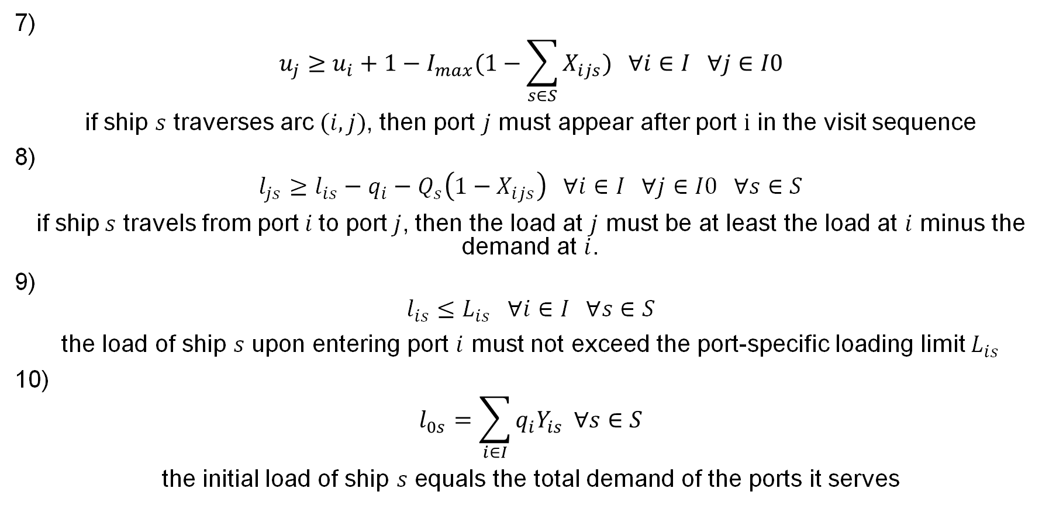
7)
$$u_{j}≥u_{i}+1−I_{max}(1−\sum_{s∈S}{X_{ijs}) ∀i∈I ∀j∈I0}$$
if ship $s$ traverses arc$(i, j)$, then port $j$ must appear after port $i$ in the visit sequence
8)
$$l_{js}≥l_{is}−q_{i}−Q_{s}\left(1−X_{ijs}\right) ∀i∈I ∀j∈I0 ∀s∈S$$
if ship$s$ travels from port$i$to port$j$, then the load at $j$ must be at least the load at $i$ minus the demand at $i$.
9)
$$l_{is}≤L_{is} ∀i∈I ∀s∈S$$
the load of ship $s$ upon entering port $i$ must not exceed the port-specific loading limit $L_{is}$
10)
$$l_{0s}=\sum_{i∈I}{q_{i}Y_{is} ∀s∈S}$$
the initial load of ship $s$ equals the total demand of the ports it serves
CONSTRAINTS

Slide 10
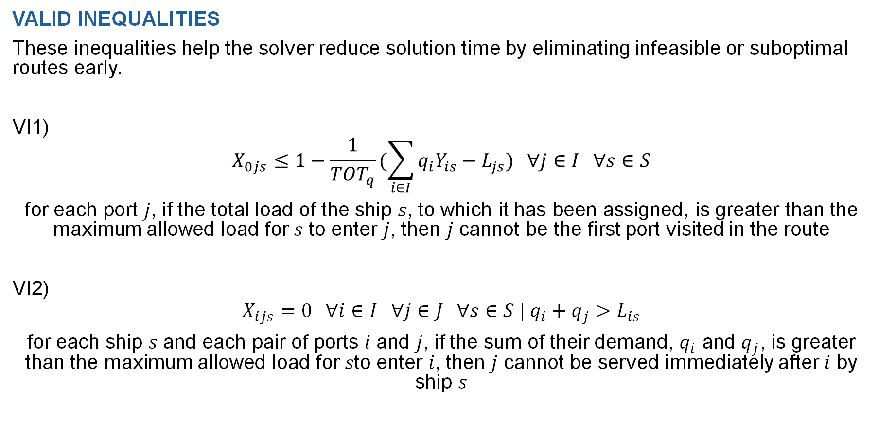
VALID INEQUALITIES
These inequalities help the solver reduce solution time by eliminating infeasible or suboptimal routes early.
VI1)
$$X_{0js}≤1−\frac{1}{TOT_{q}}(\sum_{i∈I}{q_{i}Y_{is}−L_{js}) ∀j∈I ∀s∈S}$$
for each port 𝑗, if the total load of the ship 𝑠, to which it has been assigned, is greater than the maximum allowed load for 𝑠 to enter 𝑗, then 𝑗 cannot be the first port visited in the route
VI2)
$$X_{ijs}=0 ∀i∈I ∀j∈J ∀s∈S | q_{i}+q_{j}>L_{is}$$
for each ship 𝑠 and each pair of ports 𝑖 and 𝑗, if the sum of their demand, $q_{i}$ and $q_{j}$, is greater than the maximum allowed load for 𝑠to enter 𝑖, then 𝑗 cannot be served immediately after 𝑖 by ship 𝑠
VALID INEQUALITIES

Slide 11
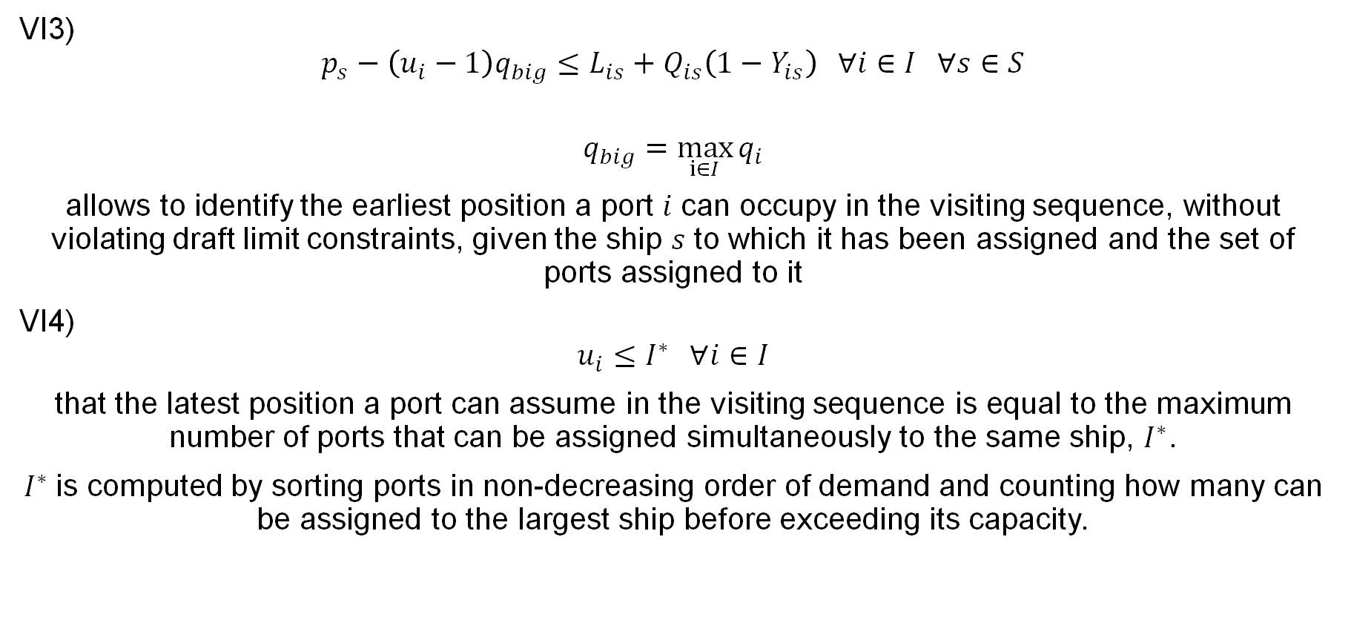
VI3)
$$p_{s}−\left(u_{i}−1\right)q_{big}≤L_{is}+Q_{is}\left(1−Y_{is}\right) ∀i∈I ∀s∈S$$
$$q_{big}=\max_{i∈I}{q_{i}}$$
allows to identify the earliest position a port 𝑖 can occupy in the visiting sequence, without violating draft limit constraints, given the ship 𝑠 to which it has been assigned and the set of ports assigned to it
VI4)
$$u_{i}≤I^{∗} ∀i∈I$$
that the latest position a port can assume in the visiting sequence is equal to the maximum number of ports that can be assigned simultaneously to the same ship, $I^{∗}$.
$I^{∗}$is computed by sorting ports in non-decreasing order of demand and counting how many can be assigned to the largest ship before exceeding its capacity.
VALID INEQUALITIES

Slide 12
Matheuristic
OVERVIEW
The MIP model efficiently solves only small instances (≤15 ports)
For larger networks, the computational time grows exponentially
To handle larger instances, two matheuristics are proposed:
Large Neighborhood Search (LNS)
Iterated Local Search (ILS)
Both methods combine mathematical programming with local search principles
MATHEURISTICS

Slide 13
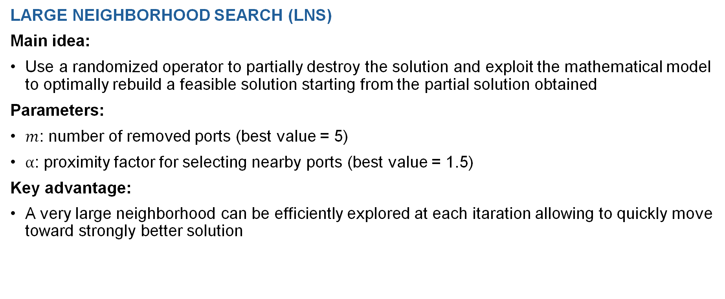
LARGE NEIGHBORHOOD SEARCH (LNS)
Main idea:
Use a randomized operator to partially destroy the solution and exploit the mathematical model to optimally rebuild a feasible solution starting from the partial solution obtained
Parameters:
$m$: number of removed ports (best value = 5)
$α$: proximity factor for selecting nearby ports (best value = 1.5)
Key advantage:
A very large neighborhood can be efficiently explored at each itaration allowing to quickly move toward strongly better solution
LARGE SEARCH NEIGHBORHOOD

Slide 14
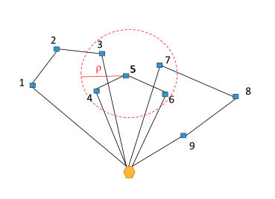
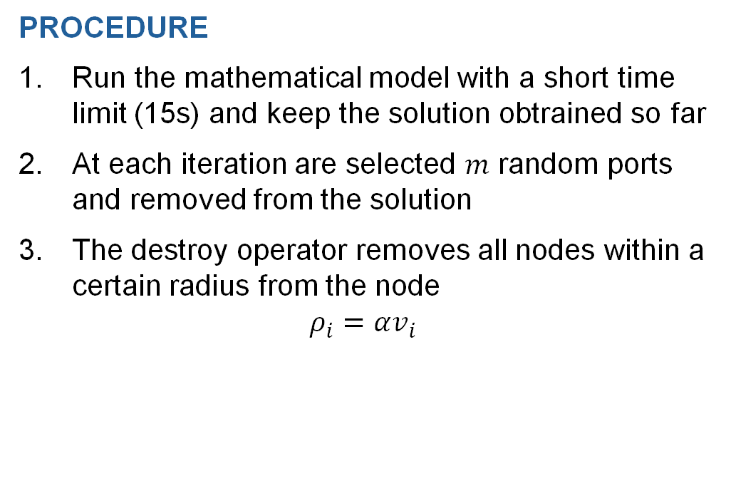
PROCEDURE
Run the mathematical model with a short time limit (15s) and keep the solution obtrained so far
At each iteration are selected $m$ random ports and removed from the solution
The destroy operator removes all nodes within a certain radius from the node
$$ρ_{i}=αv_{i}$$
LARGE SEARCH NEIGHBORHOOD

Slide 15
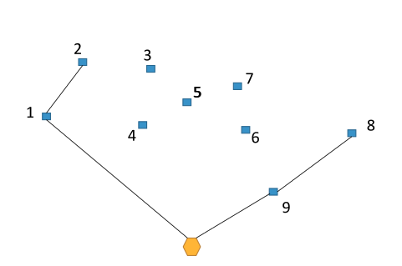
PROCEDURE
The over-constrained mathematical model is run fixing to 1 the variables corresponding to the arcs selected
LARGE SEARCH NEIGHBORHOOD

Slide 16
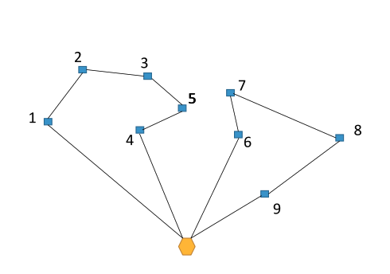
PROCEDURE
If the obained solution is bettere than the actual best solution, it is kept as current best, otherwise is discarded
LARGE SEARCH NEIGHBORHOOD

Slide 17
ITERATED LOCAL SEARCH (ILS)
Main idea:
Combine a deterministic Local Search (LS) phase with a randomized Diversification (DIV) phase.
Algorithm outline:
Start from an initial feasible solution (MIP-based)
Local Search
Diversification
Repeat LS and DIV until the stopping condition is reached
Key advantage: More robust than LNS — better solution quality with similar computational time
ITERATED LOCAL SEARCH

Slide 18
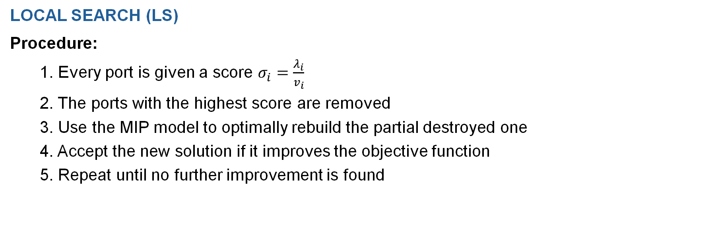
LOCAL SEARCH (LS)
Procedure:
1. Every port is given a score $σ_{i}=\frac{λ_{i}}{v_{i}}$
2. The ports with the highest score are removed
3. Use the MIP model to optimally rebuild the partial destroyed one
4. Accept the new solution if it improves the objective function
5. Repeat until no further improvement is found
ITERATED LOCAL SEARCH

Slide 19
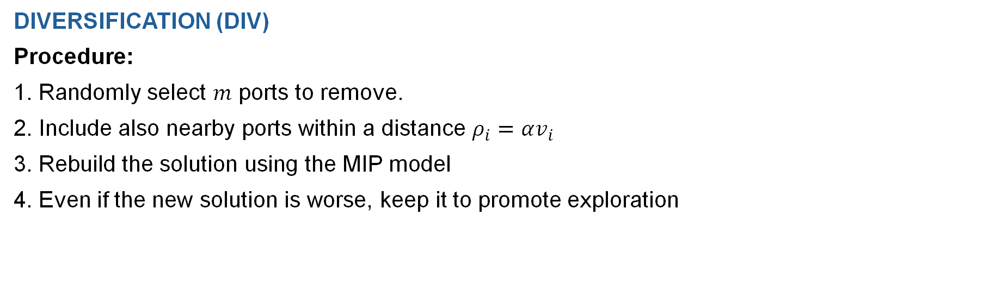
DIVERSIFICATION (DIV)
Procedure:
1. Randomly select $m$ ports to remove.
2. Include also nearby ports within a distance $ρ_{i}=αv_{i}$
3. Rebuild the solution using the MIP model
4. Even if the new solution is worse, keep it to promote exploration
ITERATED LOCAL SEARCH

Slide 20
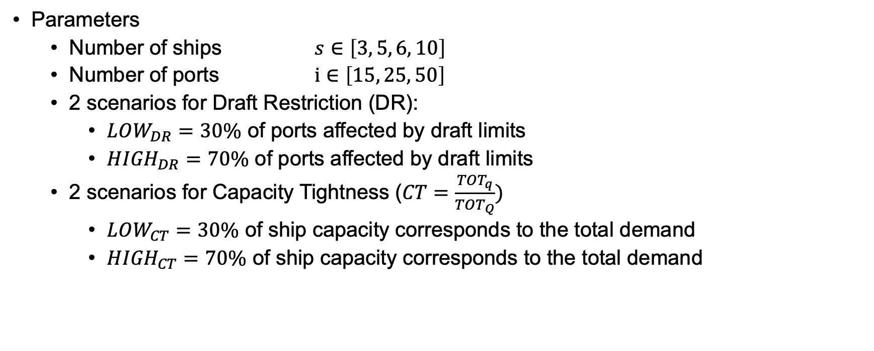
Dataset
Parameters
Number of ships $s∈\left[3, 5, 6, 10\right]$
Number of ports $i∈\left[15, 25, 50\right]$
2 scenarios for Draft Restriction (DR):
$LOW_{DR}=30\%$ of ports affected by draft limits
${HIGH}_{DR}=70\%$ of ports affected by draft limits
2 scenarios for Capacity Tightness (${CT=\frac{TOT_{q}}{TOT_{Q}})}_{ }$
$LOW_{CT}=30\%$ of ship capacity corresponds to the total demand
${HIGH}_{CT}=70\% \text{of} \text{ship} \text{capacity} \text{corresponds} \text{to} \text{the} \text{total} \text{demand}$
DATASET

Slide 21


SMALL INSTANCES
40 small instaces divided in 4 sets of 10 instances each
Set 1:
15 ports
3 ships
$(LOW_{DR}−LOW_{CT})$
Set 2:
15 ports
3 ships
$({HIGH}_{DR}−LOW_{CT})$
Set 3:
15 ports
3 ships
$(LOW_{DR}−{HIGH}_{CT})$
Set 4:
15 ports
3 ships
$({HIGH}_{DR}−{HIGH}_{CT})$
ITERATED LOCAL SEARCH

Slide 22



MEDIUM & LARGE INSTANCES
22 medium instances divided in 2 sets of 11 instances each
10 large instances in 1 set
Set 5:
25 ports
5 ships
$({HIGH}_{DR}−{HIGH}_{CT})$
Set 6:
25 ports
6 ships
$({HIGH}_{DR}−{HIGH}_{CT})$
Set 7:
50 ports
10 ships
$({HIGH}_{DR}−{HIGH}_{CT})$
ITERATED LOCAL SEARCH

Slide 23
Mathematical model – Small instances
 |  |  | AVG COMPUTATIONAL TIME (s)
SET | OF | MIP GAP | NO VI | VI1 | VI2 | VI3 | VI4 | VI1+VI4 | VI2+VI4 | VI3+VI4 | ALL VI
1 | 306,995 | 0,004 | 26,639 | 23,212 | 26,605 | 46,984 | 18,354 | 63,357 | 20,229 | 41,095 | 48,738
2 | 306,995 | 0,004 | 29,152 | 52,730 | 36,653 | 28,255 | 20,592 | 20,056 | 19,376 | 96,213 | 53,668
3 | 442,242 | 379,151 | 352,766 | 379,151 | 347,327 | 352,058 | 352,184 | 280,978 | 338,016 | 403,024 | 351,720
4 | 289,879 | 0,005 | 4,24 | 2,916 | 4,202 | 3,23 | 1,701 | 1,746 | 1,67 | 2,949 | 1,78
RESULTS

Slide 24
Mathematical model – Medium instances
 |  |  | AVG COMPUTATIONAL TIME (s)
SET | OF | MIP GAP | NO VI | 1 | 2 | 3 | 4 | 1+4 | 2+4 | 3+4 | ALL VI
5 | 323,21 | 0,01 | 27,356 | 23,303 | 26,467 | 25,437 | 17,769 | 14,885 | 17,810 | 41,249 | 48,854
6 | 307,063 | 0,01 | 15,288 | 29,916 | 15,79 | 19,023 | 17,912 | 15,741 | 17,909 | 22,854 | 27,141
RESULTS

Slide 25
Mathematical model – Large instances
 |  |  | AVG COMPUTATIONAL TIME (s)
SET | OF | MIP GAP | NO VI | 1 | 2 | 3 | 4 | 1+4 | 2+4 | 3+4 | ALL VI
7 | 323,21 | 0,01 | 27,356 | 23,303 | 26,467 | 25,437 | 17,769 | 14,885 | 17,810 | 41,249 | 48,854
RESULTS

Slide 26
Matheuristic
 | LNS |  | ILS
SET | MIP GAP | AVG TIME | MIP GAP | AVG TIME
SMALL | 323,21 | 0,01 | 27,356 | 23,303
MEDIUM | 307,063 | 0,01 | 15,288 | 29,916
LARGE | 300,292 | 0.004 | 3.243 | 4.904
RESULTS

Slide 27
Matheuristic VS Mathematical Model
 | MATHEURISTIC |  | MATHEMATICAL MODEL
SET | MIP GAP | AVG TIME | MIP GAP | AVG TIME
SMALL | 323,21 | 0,01 | 27,356 | 23,303
MEDIUM | 307,063 | 0,01 | 15,288 | 29,916
LARGE | 300,292 | 0.004 | 3.243 | 4.904
RESULTS

