Slide 1

Recysis
Sentiment Analysis
Data Mining and Machine Learning Project a.a. 2021-2022
Irene Cantini
Elisa De Filomeno

Slide 2
Contents overviews
Introduction
Sentiment Analysis
Streaming Analysis
Application
Conclusions

Slide 3
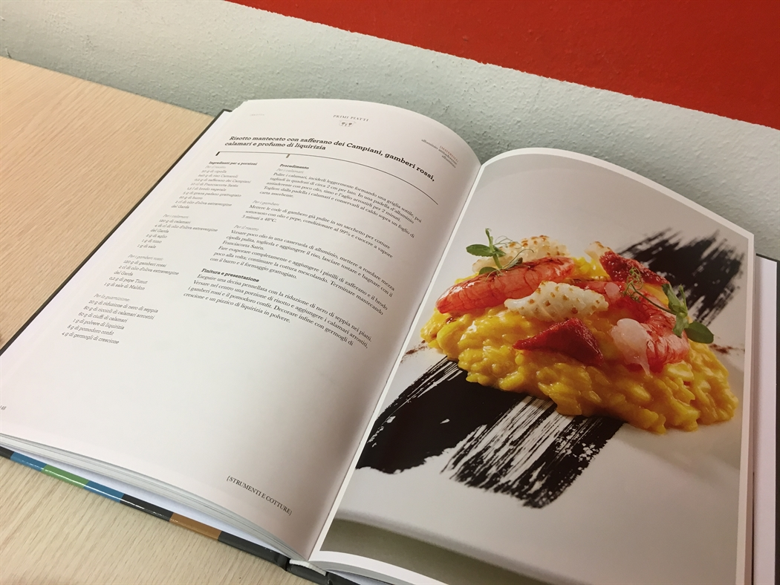
Introduction

Slide 4
Introduction
Recysis is a cooking application offering users over 500,000 recipes,
It allows users to add reviews to each recipe.
These reviews contain users’ opinion and emotion about recipes.
Each recipe contains lots of positive or negative comments.

Slide 5
Goal
Help users in the choice of what recipes to make by looking at the number of positive, neutral and negative comments that has been left on each recipe.
Automatically classify comments by the polarity of the sentiment as positive, negative or neutral (Sentiment Analysis) .

Slide 6
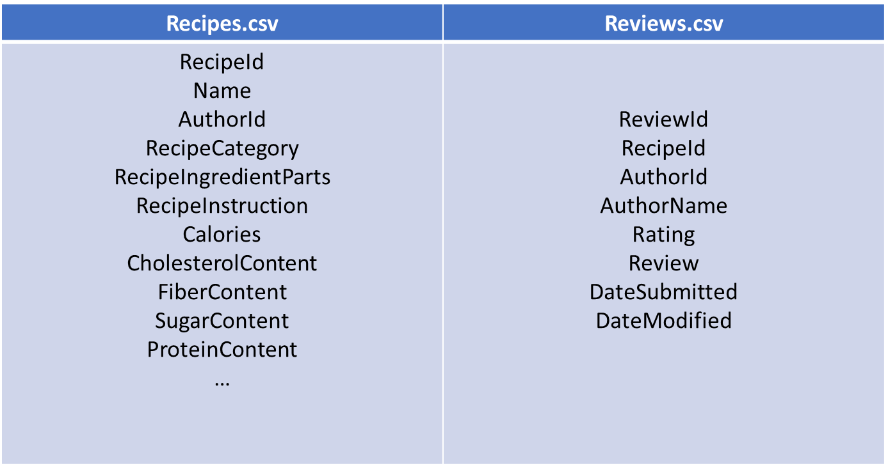
Datasets
Source: https://www.kaggle.com/irkaal/foodcom-recipes-and-reviews
First dataset (recipes.csv): is composed by 522.517 recipes and 28 attributes
Second dataset (reviews.csv): is composed by 1.401.754 comments and 8 attributes

Slide 7

Sentiment analysis

Slide 8
STEPS
Dataset Preparation and Training Set
Text preprocessing, Building Vocabulary and Feature Extraction
Classifiers Evaluations
Model Selection

Slide 9
Dataset cleaning
Dataset: reviews.csv
Removed empty comments
Removed from comments:
- characters which represent the end of the line
- multiple spaces

Slide 10
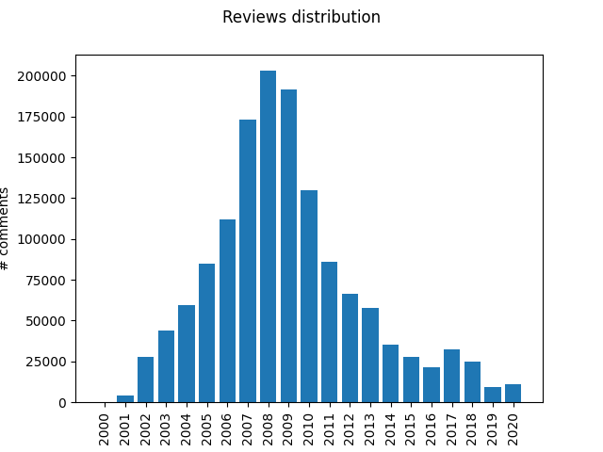
Data reduction
- From1.401.752 comments to 202.979 comments in 2008
- Attribute selected:
Review -> containing the text of the comments
Rating -> score from 1 to 5, establishing a ground truth

Slide 11
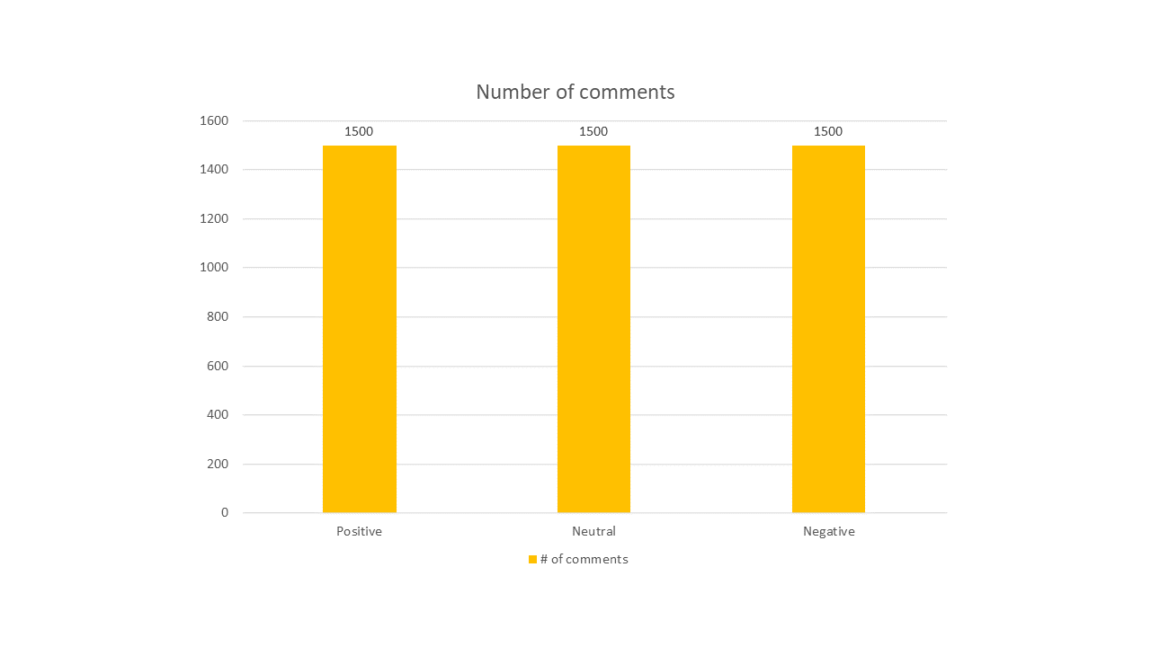
Training Set
Timeline for training set: 01/01/2008 to 31/12/2008
4.500 comments labelled:
- Rating = 1 negative comment
- Rating = 3 neutral comment
- Rating = 5 positive comment
Balanced training set, 1500 instances for each class

Slide 12
Text Elaboration
“This taste great!!!!!! Even my 3yr. old loved it”
Tokenization
<this><taste> <great> <even><my><old><loved><it>
8 tokens
Stop-words filtering
<taste><great><loved>
3 relevant tokens
Stemming
<tast><great><lov>
3 stems
Stem filtering

Slide 13
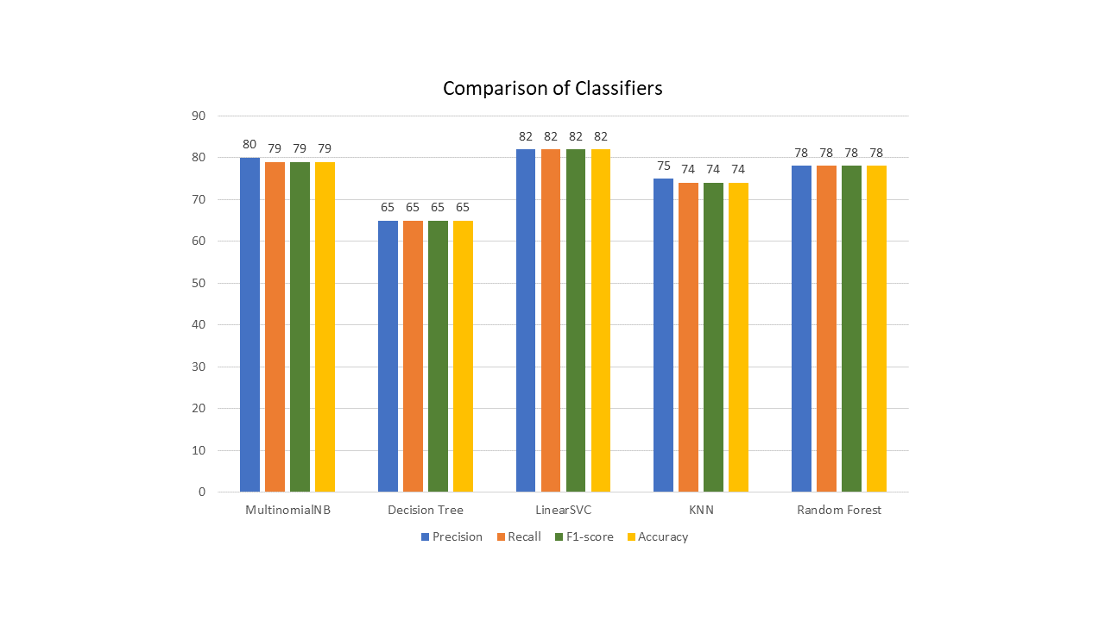
Classification
5-fold cross validation for each classifier
Paired T-test between the two best classifiers

Slide 14
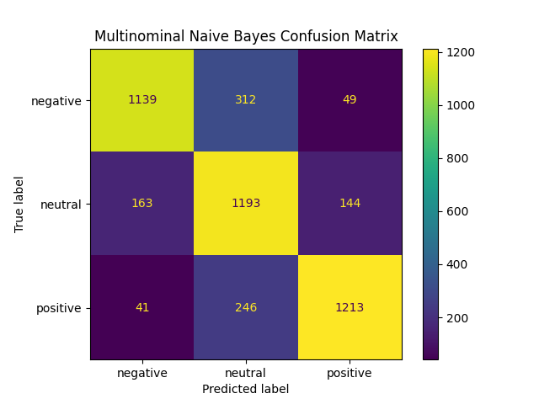
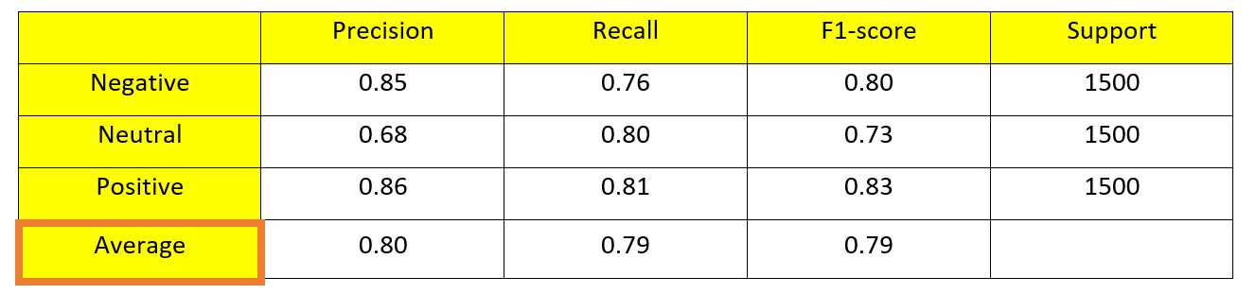
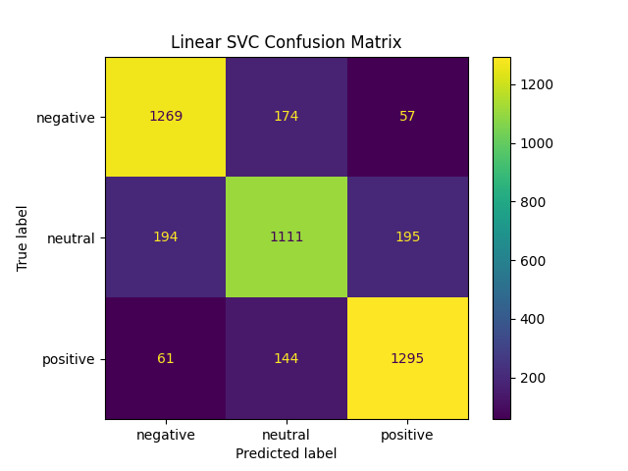
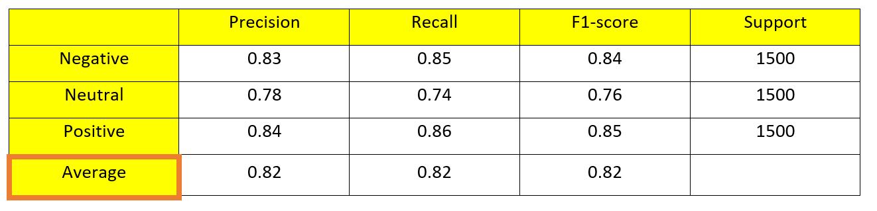
Comparison of two best classifiers
- MultinominalNB()
- LinearSVC(C=0.1)

Slide 15
Results
t-test: α=0.05, p-value=0.003 p < α
General high accuracies in classifying positive, negative and neutral comments
LinearSVC is the most performing classifier
 | ACCURACY | ERROR RATE
multinominalNB | 78.777% | 21.222%
linearSVC | 81.666 % | 18.333%

Slide 16

Streaming Analysis

Slide 17
STEPS
Select a subsequent time window
Select a certan number of events
Find comments about these events
Build three different models
Select most suitable model

Slide 18
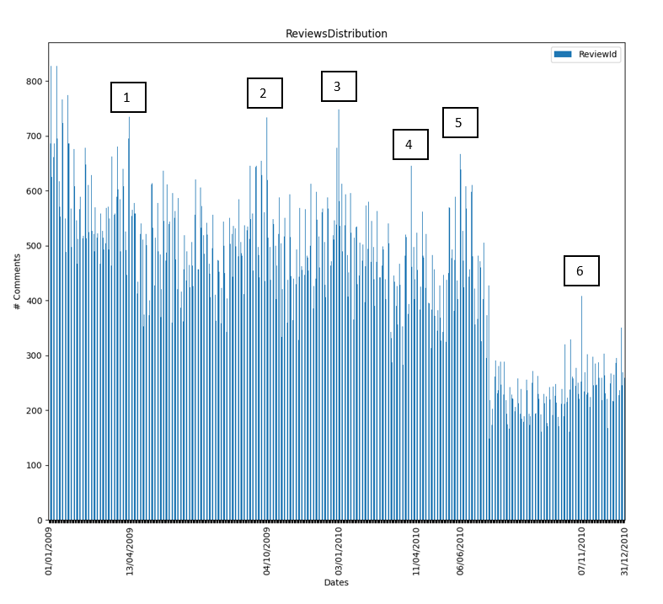
Events
Subsequent time window (2009-2010)
Events: Peaks of comments
Found 6 key events on the timeline

Slide 19
Models
We implemented a comparative study based on different models
For each event selected we labelled 60 comments using the Rating attribute as ground truth
We use those comments as test set for 3 different learning settings:
Static model: the initial training set composed by 4500 comments
Sliding model: retrained each time with the most recent 4500 comments, removing the oldest 60 and adding the newest 60
Incremental model: trained with the initial training set plus all the labelled data of all the previous events before testing on a new event

Slide 20
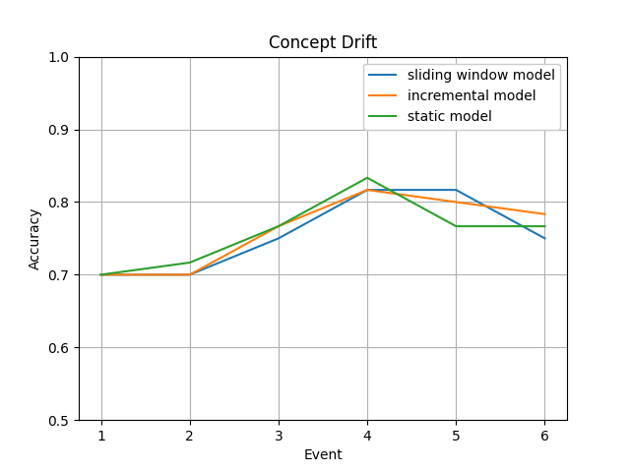
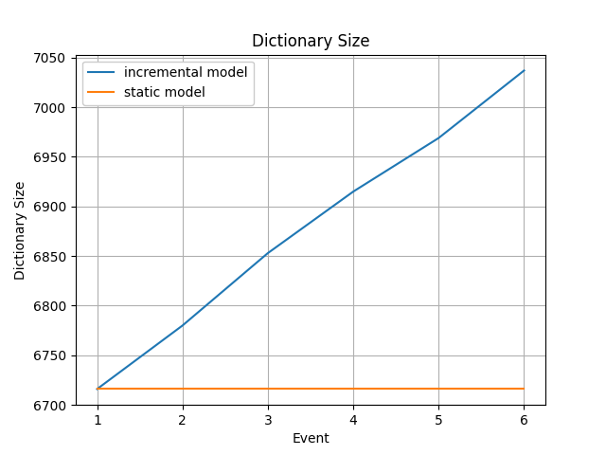
Results

Slide 21

Application

Slide 22
Application
Command line application developed using Python
Use the static model
We embedded in our application all the comments from the original dataset labelled as positive, neutral and negative
There is also the possibility for the users to add new comments and see immediately the associated sentiment

Slide 23
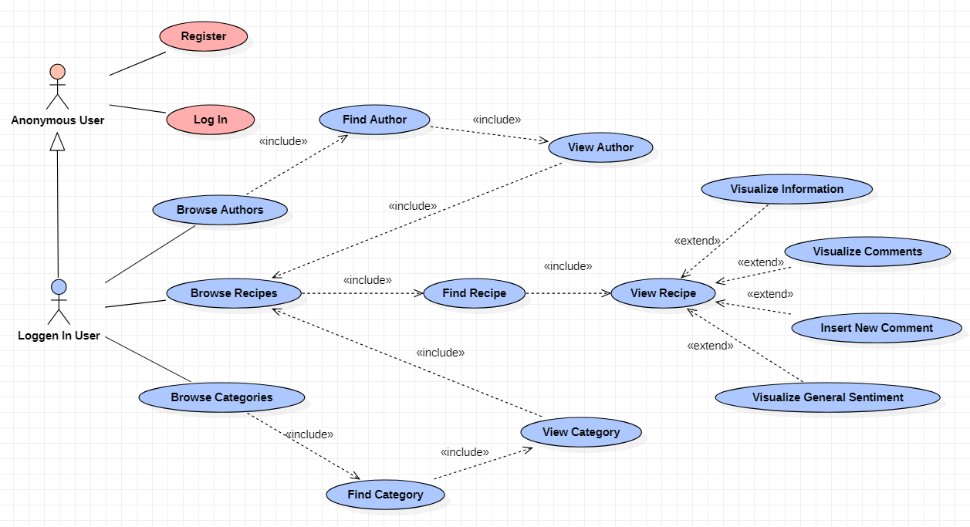
Use case diagram

Slide 24
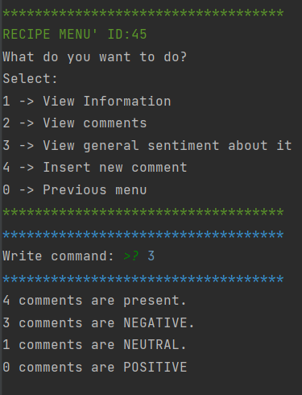
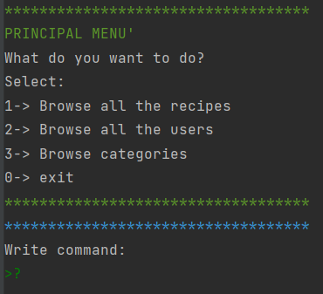
Application

Slide 25

Conclusions

Slide 26
Conclusions
The service we provide offers an additional functionalities to explore all the recipes’ impressions
The application gives an immediate snapshot on the goodness of a recipe useful for both final users and the recipe’s owner

Slide 27
THANKS FOR YOUR ATTENTION!
Data Mining and Machine Learning Project a.a. 2021-2022
Irene Cantini
Elisa De Filomeno

