Slide 1
Preliminary analyze of CFFEPS output
Based on UNIX_20160624.zip (ftp://ftp.nofc.cfs.nrcan.gc.ca/pub/fire/Anderson/CFFEPS/)
Jack compiled and ran on CMC computer: arqjjac@joule4:~/DATA/FireWork/CFFEPS/UNIX_20160624/
Control file input:
/fs/cetus/fs1/aqd/pxarqdr6/arqj/jac/FireWork/CFFEPS/UNIX_20160624/input/cmc20150721.ini
csvfilename /cnfs/dev/aq/aq03/afsurom/FireWork/CFFEPS/UNIX/inputs/cmc20150721.csv [120524 lines, 31M]
emissions /cnfs/dev/aq/aq03/afsurom/FireWork/CFFEPS/UNIX/inputs/emissions.csv
method cmc
shape persistence
Run output::
/fs/cetus/fs1/aqd/pxarqdr6/arqj/jac/FireWork/CFFEPS/UNIX_20160624/output/20160624_CFFEPS_output_for_cmc20150721.csv [120524 lines, 78M]
Jack Chen – 2016-07-05
Notes:
New chemical can be added: there is a file called emissions.csv. If you now the emissions rate of a chemical per fuel consumed (g/kg), then you should be able to add it.
The program is now using persistence. So if a hotspot is something like 0.4 ha so it will continue to burn 0.4 ha per day. I will definitely revisit this when I catch my breath but for now, it produces the most realistic values.

Slide 2
New version note (Kerry’s email from 2016/05/13)
Separation of smoldering from residual smoke (I was adding them together)
Inclusion of fields for area growth per time step (ha) and cumulative total smoke emissions (tons)
Inclusion of Qo (latest time step’s cumulative energy in joules) and Qplume (the energy injected per time step in joules)
Calculations are now based on the correct units (dam are converted to m, knots are converted to kmh, precip in mm/hour - did you really send me precipitation in m/s?)
Correction to the r_smoke calculation (using the correct units)
Fields (following the UTC field) and units are as follows
Temp [oC] : GEM hourly temperature
Rh [%]: GEM hourly humidity
Ws [km/hr] : GEM hourly wind speed
Precip [mm/hr] : GEM hourly precipitation rate
TS [oC] : GEM surface and soil temperature (superficial)
T850 [oC] : GEM 850 hpa temperature
T700 [oC] : GEM 700 hpa temperature
T500 [oC] : GEM 500 hpa temperature
ZS [m]: GEM surface height
Z850 [m] : GEM 850 hpa height
Z700 [m] : GEM 700 hpa height
Z500 [m] : GEM 500 hpa height
Area(t) [ha]: cumulative fire size
Growth(t) [ha]: fire growth in last time step
TotalEmissions [metric tonnes]: total cumulative some emissions from the fire
r_smoke [g/kg]: mixing ratio of smoke to dry air
Zplume [m]: plume height according to my thermodynamic model
Zbriggs [m]: plume height according to Briggs (unvalidated against other calculations so it may be incorrect)
Qo [joules]: this is the cumulative energy injected into the atmosphere prior to the current time step (note black body cooling has also been removed)
Qplume [joules]: this is the energy injected into the atmosphere this time step
PM F – xx flaming emission [metric tonnes per hour]
PM S – xx smouldering emission [metric tonnes per hour]
PM R – xx residual emission [metric tonnes per hour]
Regarding smoke density at a specific altitude, take the density of the air at that altitude and multiply it by the r_smoke to get grams of smoke per cubic metre.
Regarding specific pollutants, I am currently calculating rates [metric tonnes per hour]

Slide 3
lat | Latitude [deg]
lon | Longitude [deg]
rep_date | Hotspot detection date/time [YYYY-MM-DD HH:MM]
source | NASA/NOAA/USFS
sensor | AVHRR/MODIS/VIIRS
ffmc | The Fine Fuel Moisture Code (FFMC) is a numeric rating of the moisture content of litter and other cured fine fuels. This code is an indicator of the relative ease of ignition and the flammability of fine fuel.
dmc | The Duff Moisture Code (DMC) is a numeric rating of the average moisture content of loosely compacted organic layers of moderate depth. This code gives an indication of fuel consumption in moderate duff layers and medium-size woody material.
dc | The Drought Code (DC) is a numeric rating of the average moisture content of deep, compact organic layers. This code is a useful indicator of seasonal drought effects on forest fuels and the amount of smoldering in deep duff layers and large logs.
ws | wind speed [km/hr]
fwi | Fire Weather Index (FWI) is a numeric rating of fire intensity. It combines the Initial Spread Index and the Buildup Index. It is suitable as a general index of fire danger throughout the forested areas of Canada
fuel | Fuel type (C1, C2, etc) from the Canadian Forest Fire Bahviour Prediction (FBP) System
ros | Rate of Spread (ROS) - [meters/min] is the predicted speed of the fire at the front or head of the fire (where the fire moves fastest) and takes into account both crowning and spotting.
sfc | Surface fuel consumption
tfc | Total Fuel Consumption (TFC) [kg/m2] is the predicted weight of fuel consumed by the fire both on the forest floor and in the crowns of the trees. It is based on Foliar Moisture Content, Surface Fuel Consumption, and Rate of Spread.
bfc | Borfire fuel consumption (kg/m2)
hfi | Head Fire Intensity (HFI) [kw/meter of fire front] is the predicted intensity, or energy output, of the fire at the front or head of the fire. It is based on the Rate of Spread and the Total Fuel Consumption.
estarea | Estimated fire area based on hotspot - static per hotspot per day [m2]
UTC | Forecast timestep [YYYYMMDD_HH:MM]

Slide 4
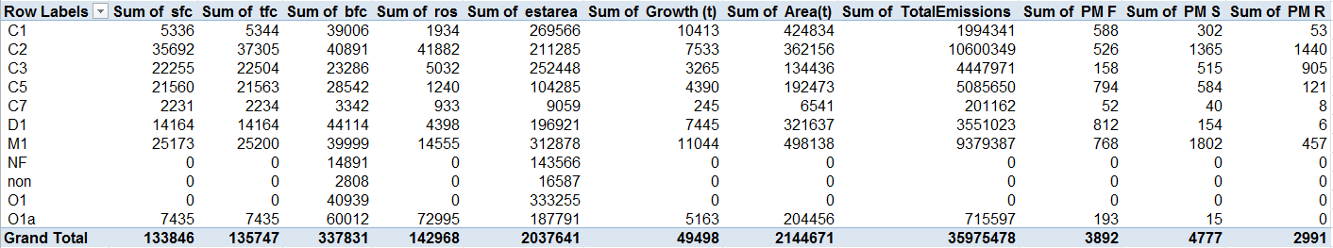
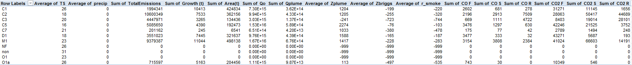
Variable by fuel type
Available Fuel type in the CFFEPS output file: C1,C2,C3,C5,C7,D1,M1,NF,non,O1,O1a
For fuel type= “NF”, “non”, “O1” all with zero “ros”, “sfc”, “tfc”, but non-zero “bfc”, “Estarea”; and zero “area”, “TotalEmissions” and all species emissions.
Table show accumulated species by fuel type for the output test case:

Slide 5
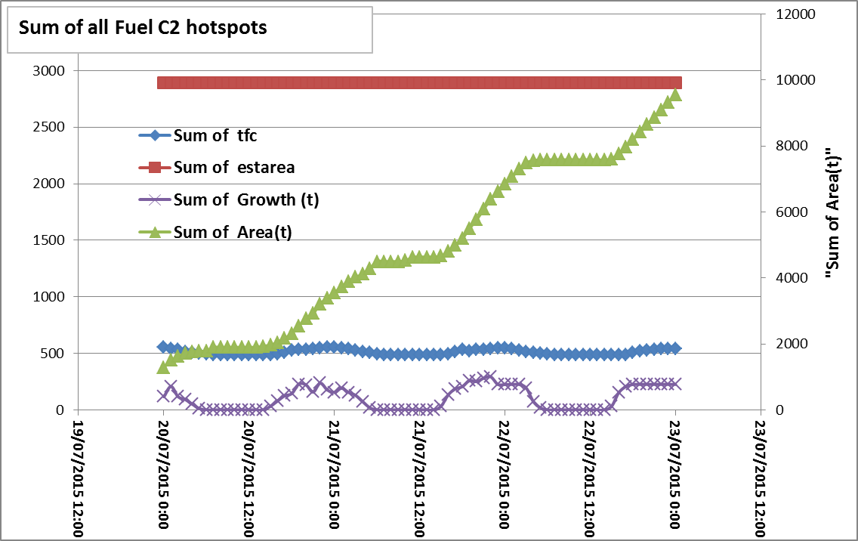
C2 fuel hotspots only
“TotalEmissions” and “Area(t)” are cumulative total over the period, and increase with forecast hour.
There’s a clear diurnal profile for “Growth”, “tfc”, and emissions species, the magnitude for residual and smoldering are larger than flaming...
Emissions for different species are tied to ‘user input’ emission factors. For current run, the emission factors are in (/cnfs/dev/aq/aq03/afsurom/FireWork/CFFEPS/UNIX/inputs/emissions.csv) – table below:
Why is PM2.5_residual > PM10_residual when PM10 includes PM2.5?
Species | Flaming | Smouldering | Residual
PM | 23 | 34 | 34
PM10 | 15 | 24 | 24
PM2.5 | 12.83 | 11.12 | 25.64
CO | 77.72 | 64.66 | 177.33
CO2 | 1239.11 | 1261.7 | 1055.34
CH4 | 2.69 | 2.69 | 7.03
NMHC | 2.29 | 3.73 | 3.73
NO | 1.6 | 1.6 | 0.38
NH3 | 0.92 | 0.92 | 1.67
SO2 | 0.82 | 0.82 | 1.51

Slide 6
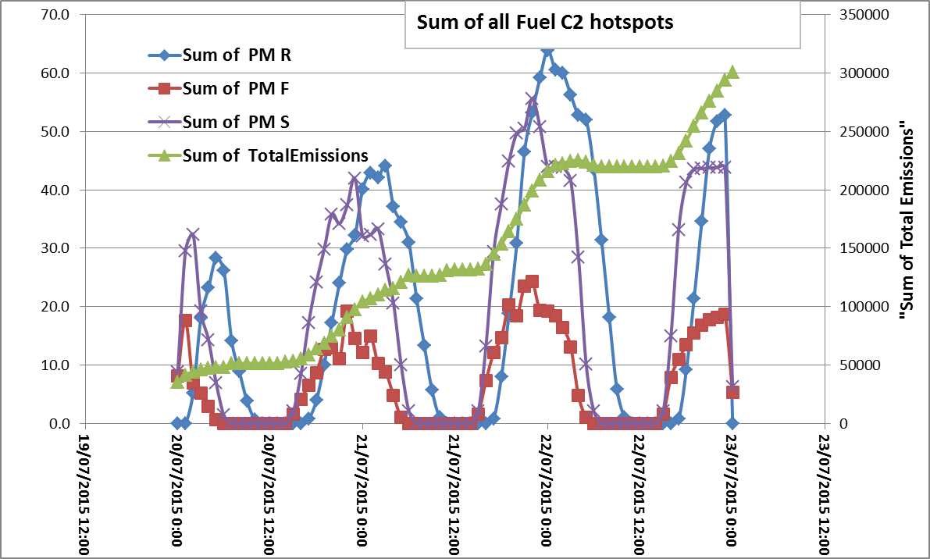
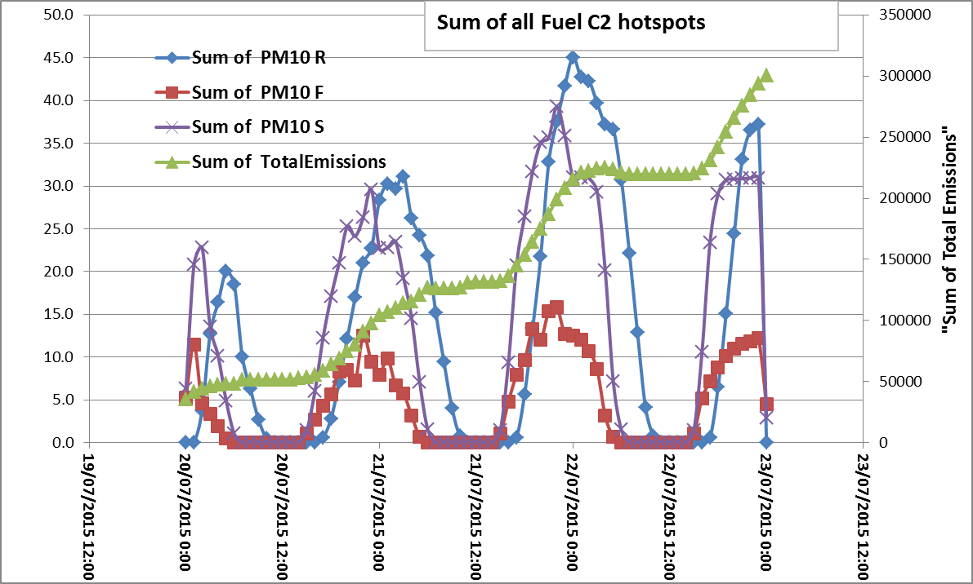
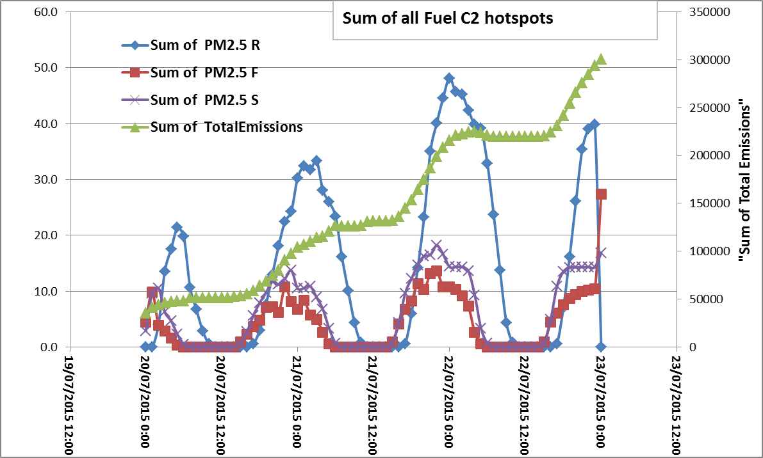
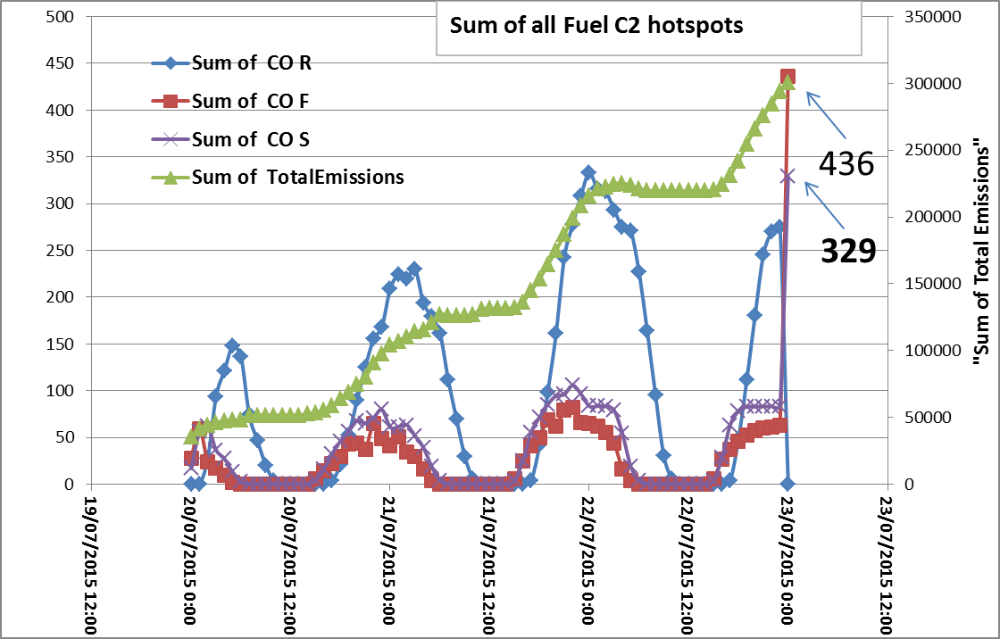
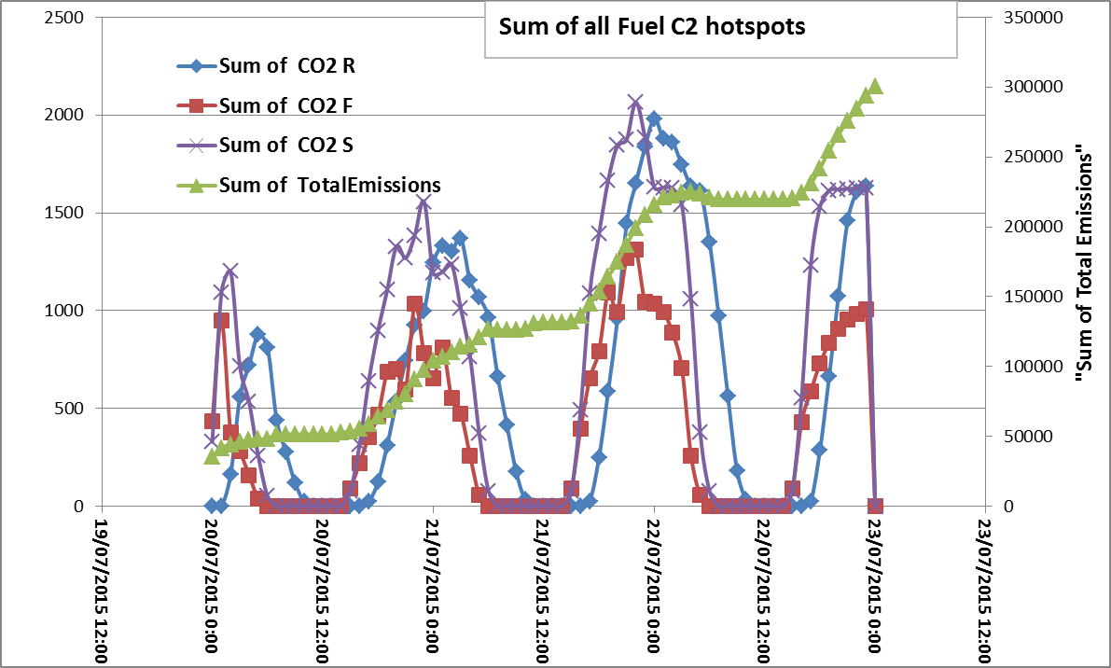
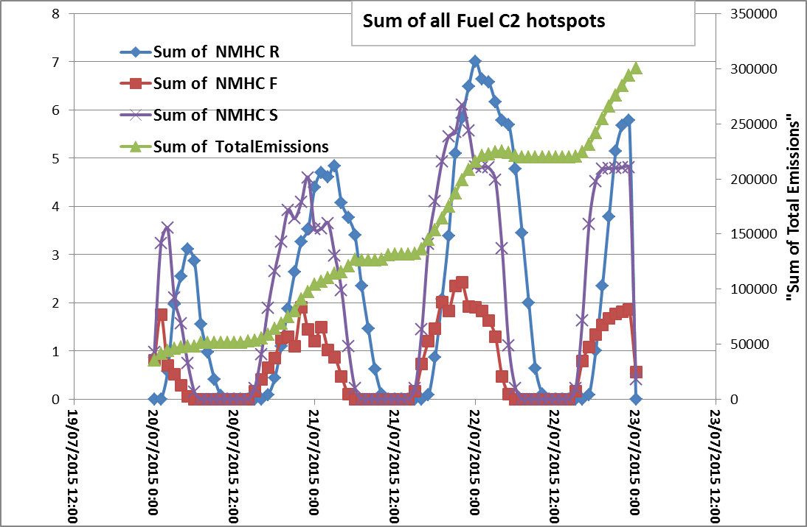
C2 fuel hotspots only

Slide 7
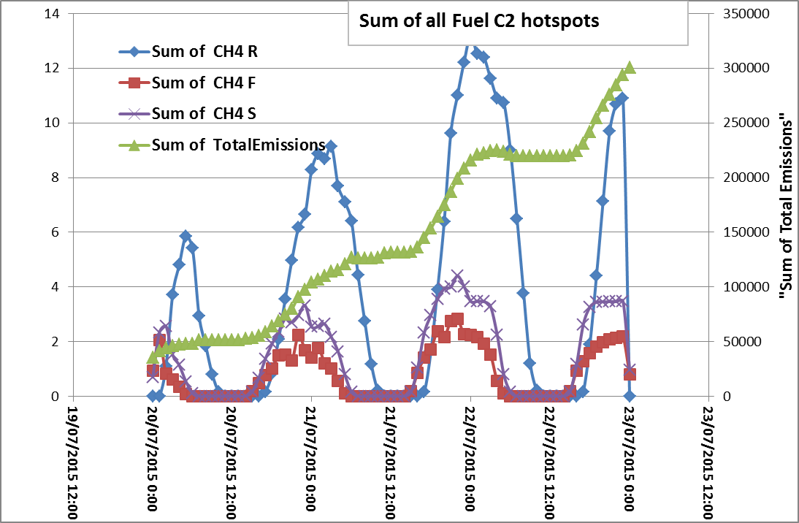
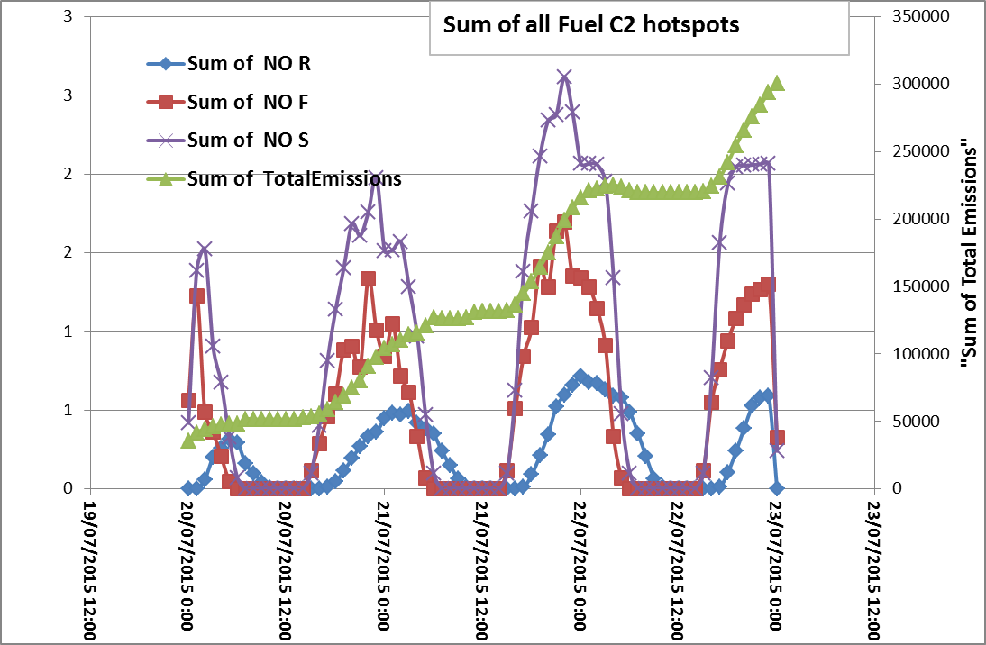
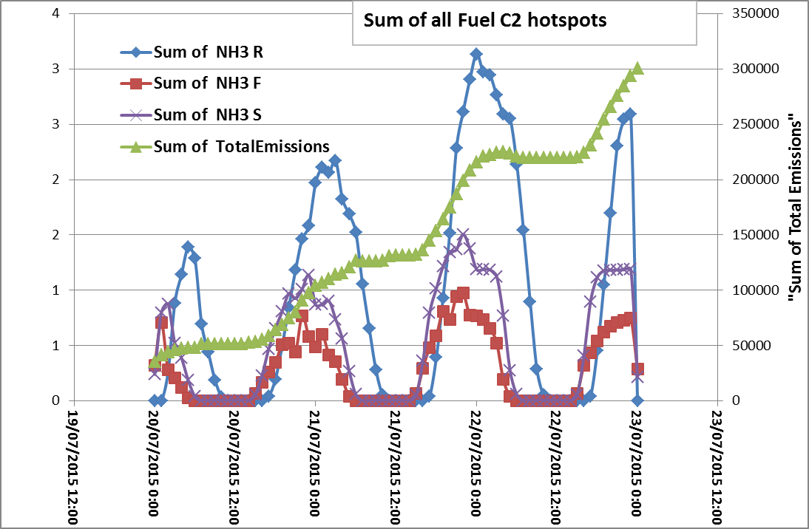
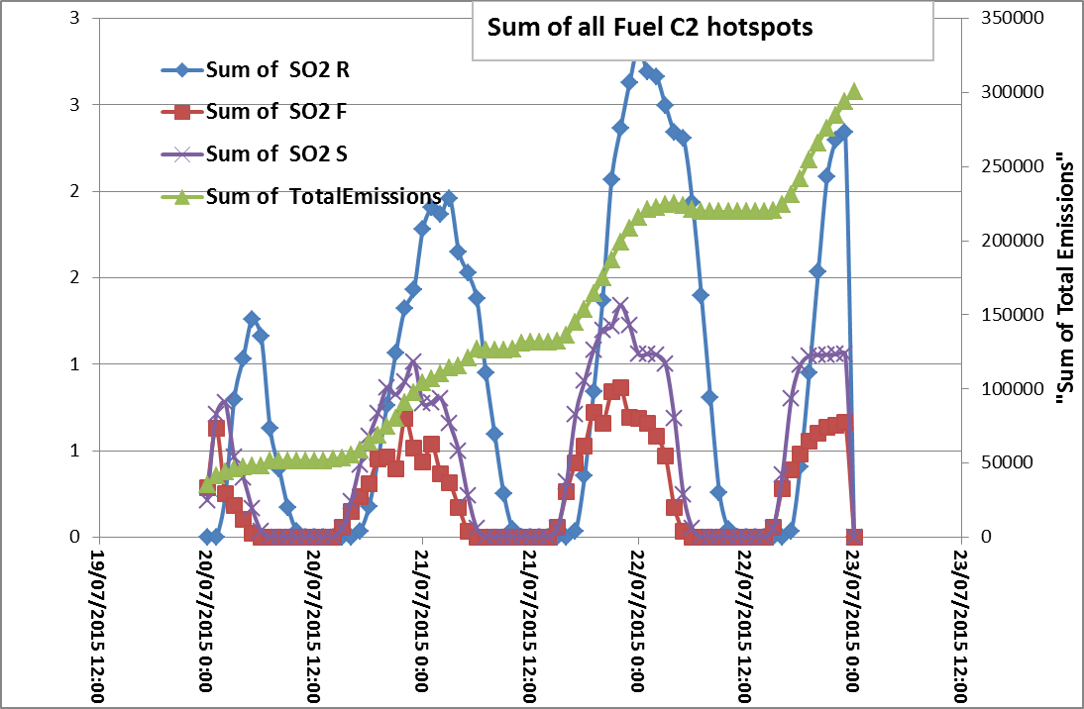
C2 fuel hotspots only

Slide 8

C2 fuel hotspots only -- CO
Same time series but for CO, here we see a sudden spike in emissions for the very last ‘forecast hour’ of the run.
This is behavior is different from other emission species where the last hour exhibits a much lower rate (see table below for ‘first/last’ hour of the day).
The sudden spike in CO_F and CO_S is present in all fuel types except “fuel=C7”. This fuel type has overall very low emissions.

Slide 9
C2 vs. C7 fuel for CO
First and last hour of simulation day:
Something is strange with large CO for C2 fuel in last hour of last day

Slide 10
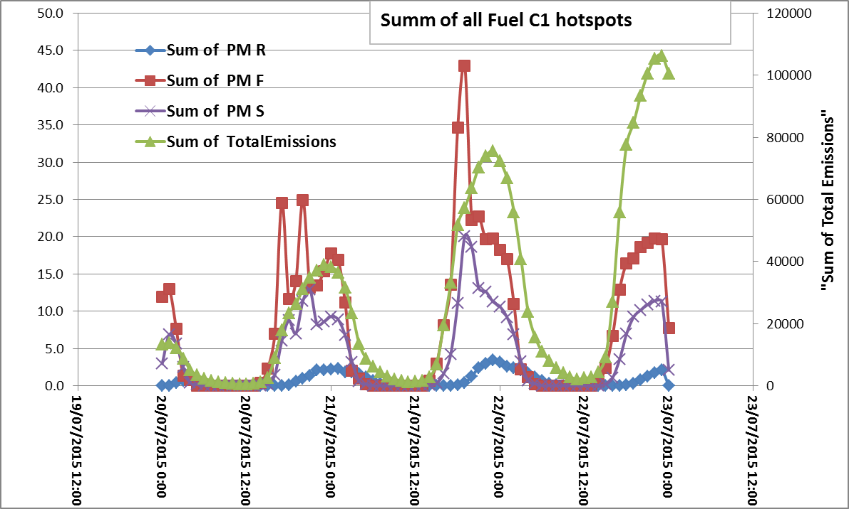
PM emissions by fuel type:
- The diurnal variations are ‘generally’ similar for different fuel types are similar albeit with lower magnitude.
- Something is strange with “TotalEmissions” for fuel=C1 and fuel=C7.. It showed diurnal profile instead of cumulative total as compared to other fuels
- there’s less significant diurnal pattern for fuel=C7, possibly due to sporadic hotspot location during this testing period (only 8 hotspots with very similar lat/lon values lon=-119.5 and lon=-119.45)
- there’s no significant “residual emissions” for fuel=D1and fuel=O1a

Slide 11
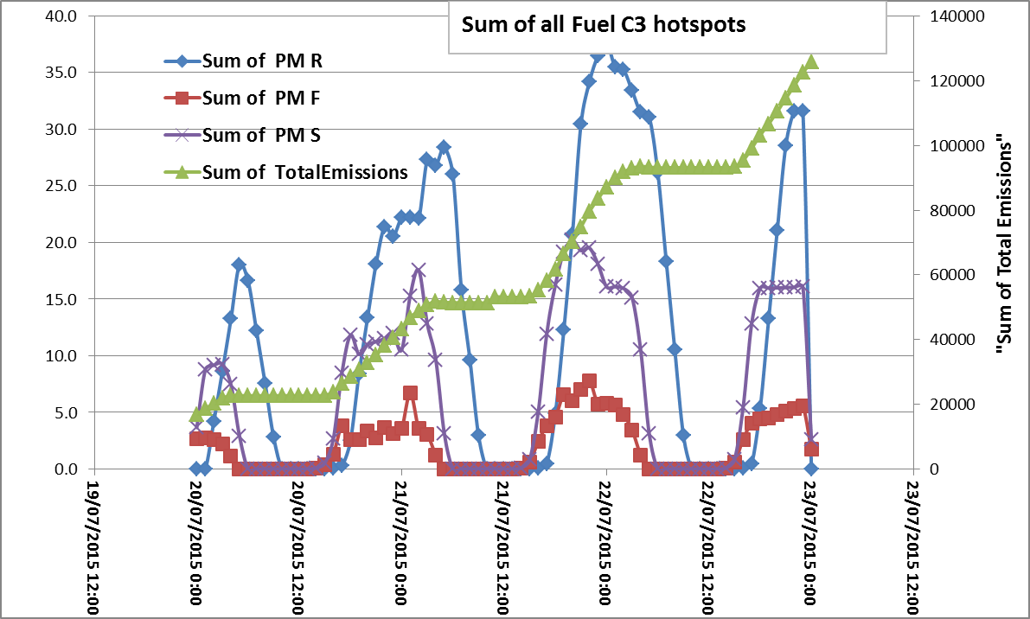
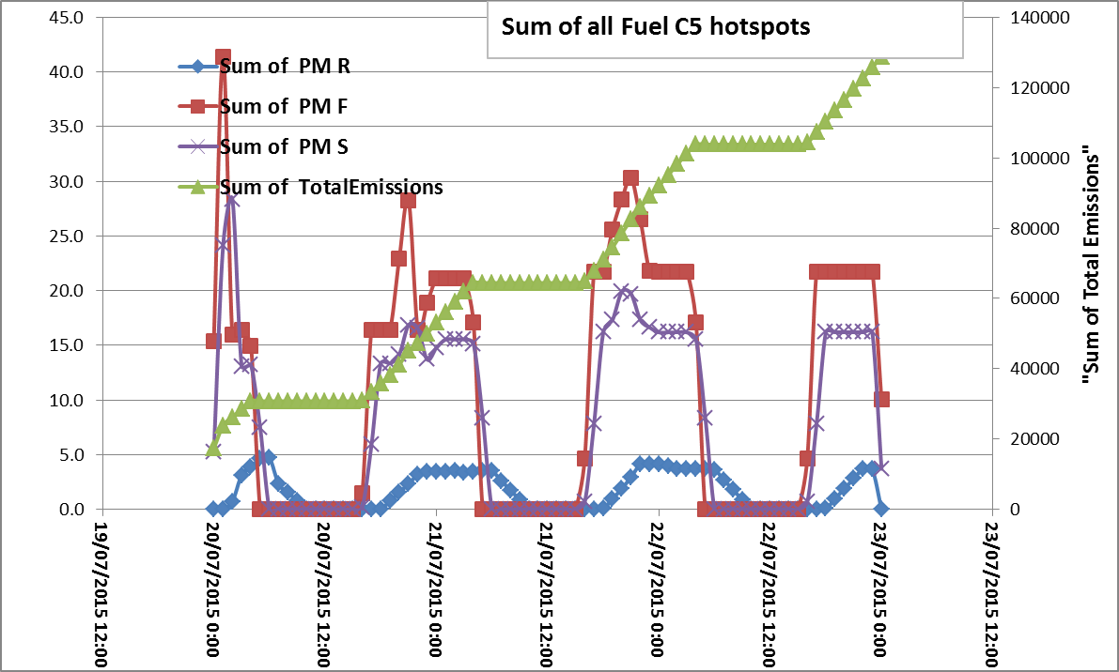
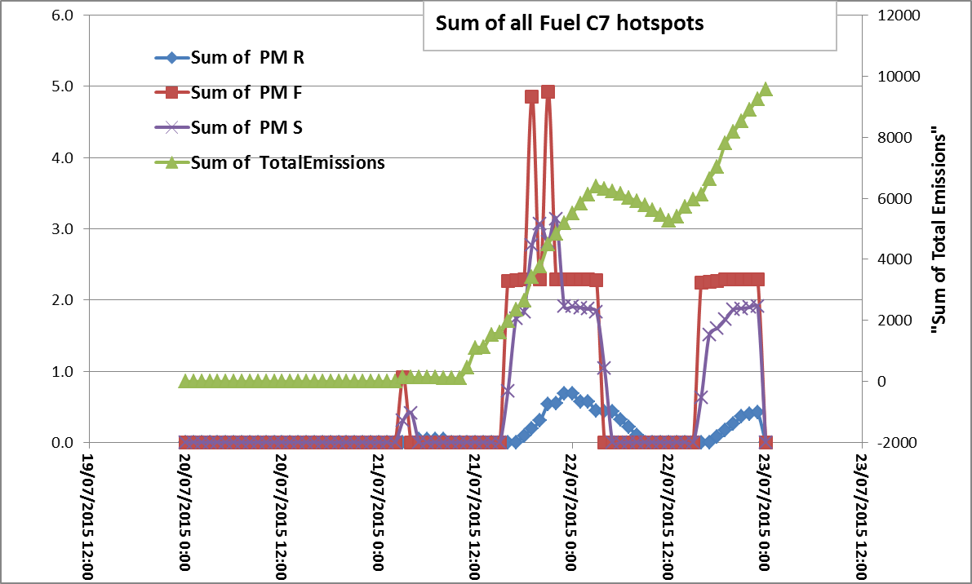
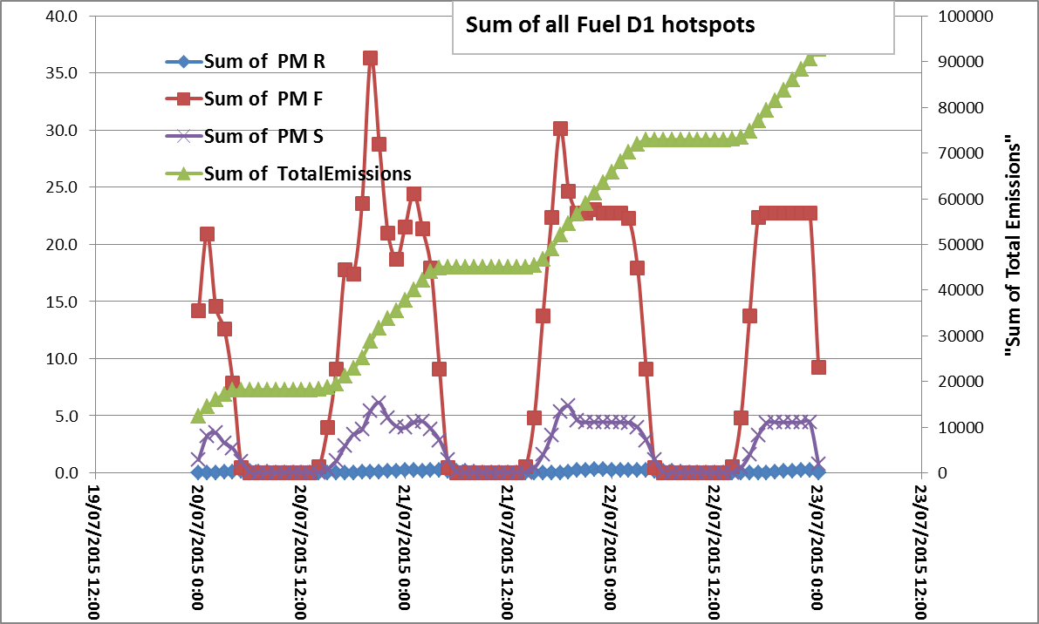
PM emissions by fuel type:

Slide 12
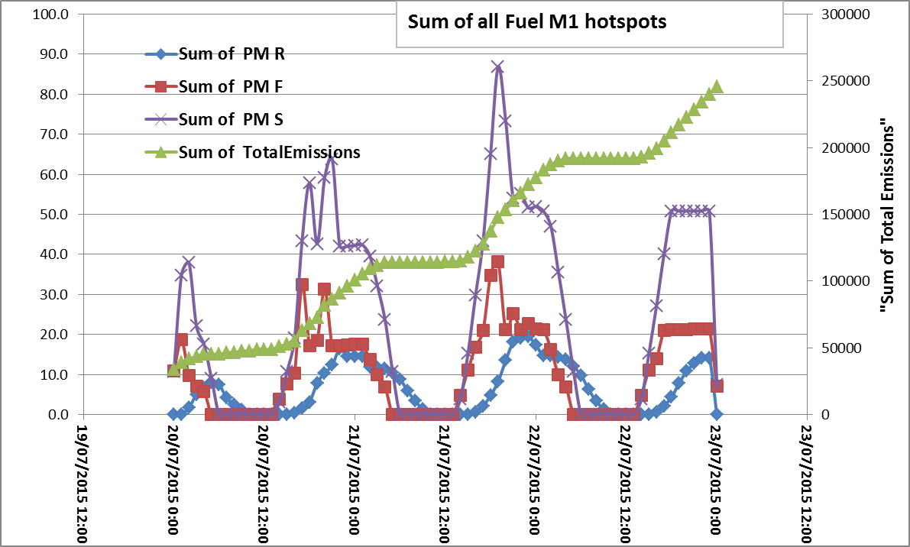
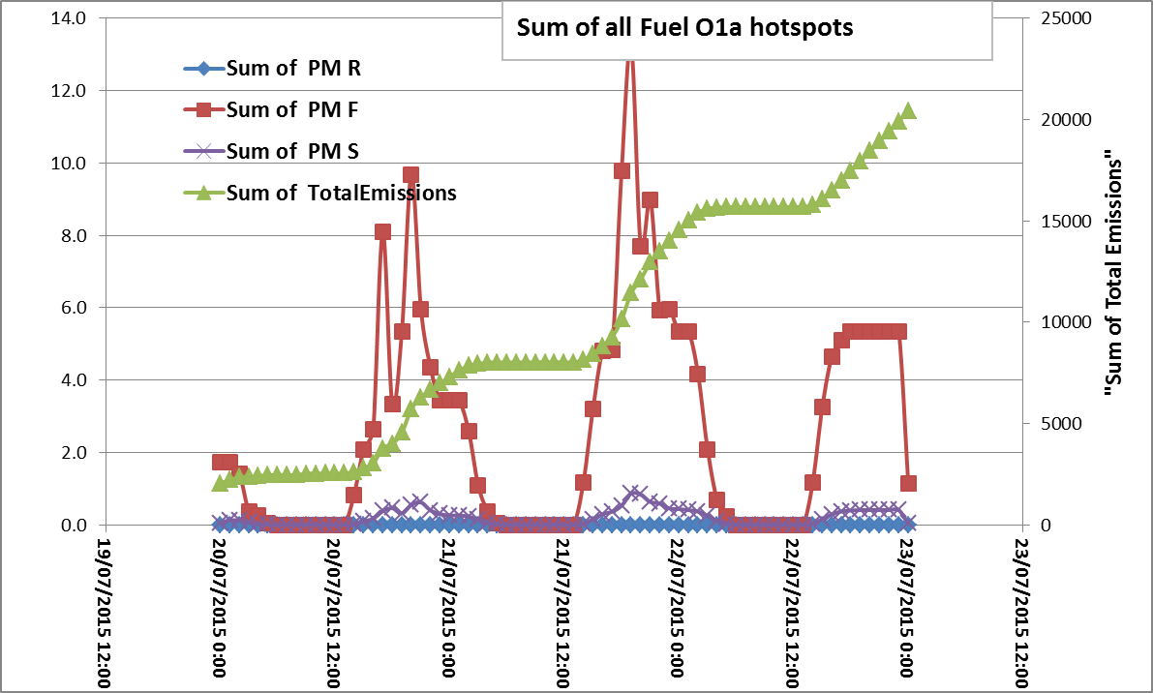
PM emissions by fuel type:

Slide 13
Analyze of Plume rise parameters
Variable | Type | unit | default | Desc
Qo | double | joules | 0 | cumulative amount of energy injected into the plume prior to current time step
QPLume | Double | joules | -999 | energy injected into the plume
R_smoke | Double |  |  | calculated as the mixing ratio of smoke to clean (dry) air in g/kg. You must know the density of air at a given height. Using this value, you can calculate the density of smoke in the air at that height.
Zplume | Double | metres AGL. |  | CFFEPS Injection height (top)
Zbriggs | Double | metres AGL. |  | Briggs’ injection height (top)
When r_smoke > 0 (or not -999), Zplume all >0 (not -999)
When Z_plume > 0 (or not -999), r_smoke all >0 (not -999)
But there are cases when emissions >0, and Zplume/r_smoke are 0 or -999
For records not -999, the values of R_smoke and Zplume for this case are:
 | R_smoke | Zplume
avg | 0.227373 | 2030
maxval | 3.749694 | 3845
minval | 0.001727 | 38
median | 0.177182 | 2084

Slide 14
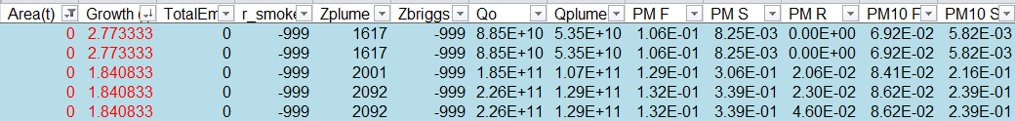
Analyze of Plume rise parameters
R_smoke, Zplume, Zbriggs, Qo, QPlume are zero, -999 [null] when ‘Area(t)’, ‘Growth(t)’ are zero, this also result in all emissions being zero
In sample output, there are cases when area=0, and Growth(t)>0 [small numbers ~0.6-2.8]. In these cases, Zbriggs=-999, Zplume > 0, Qo, Qplume and emisisons are small are positive values.

Slide 15
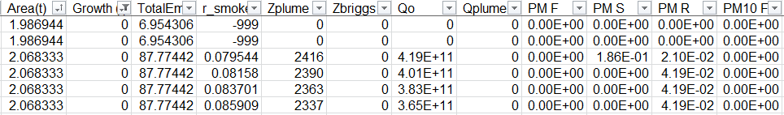
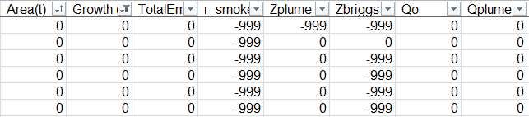
Analyze of Plume rise parameters
Similarly there are many cases where ‘Growth(t)=0’ and ‘Area(t)>0’ with small but non-zero emissions. In these cases, Zbriggs=0, Qplume=0 while Qo, Zplume and r_smoke are positive, non-zero.
Cases when Zplume=0 or Zbriggs=0 vs. -999?? Will treat 0 as -999;

Slide 16
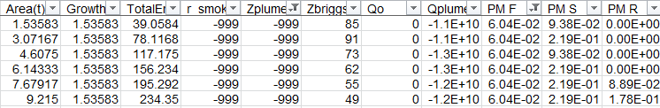
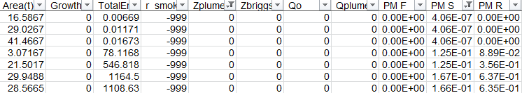
Analyze of Plume rise parameters
Cases when Zplume=-999 and emissions are non-zero?!
There are 3 hotspots with this condition, all with C3 fuel, with non-zero “Area(t)” and “Growth(t)”.
‘r_smoke’=-999, Zplume=-999, Qo=0 and Qplume= negative
‘Zbriggs’ are non zero
Hotspot with non zero emission when Zplume=-999
lat | lon
48.81 | -116.77
48.794 | -118.45
48.8 | -118.45
Cases when Zplume=0 and emissions are non-zero?!
There are 4 hotspots with this condition, 1 with C5 fuel, and 3 with C3 fuel
‘Area(t)’ is positive, non-zero, but ‘Groth(t)’ is zero
All plume parameters are zero Zplume, Zbriggs, Qo, Qplume, and r_smoke=-999
Emission for smoldering and residual are non-zero
Hotspot with non zero emission when Zplume=0
lat | lon
49.603 | -117.22
48.81 | -116.77
48.794 | -118.45
48.8 | -118.45

Slide 17
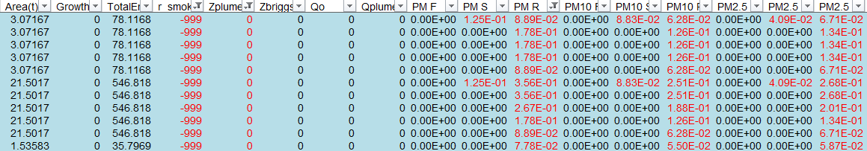
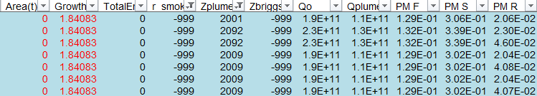
Analyze of Plume rise parameters
Cases when Zplume=0, r_smoke=-999 and emissions are non-zero
For lat/lon (32.008/-93.21, 48.794/-118.45, 48.8/-118.45, 48.31/-116.77)
Area(t) is nonzero, while growth(t) is zero
Only residual and smoldering emissions are non-zero:
Cases when Zplume > 0 and r_smoke=-999 and emissions are non-zero
How to distribute emission in this case?
Several hotspots has this condition
lat | lon
31.685 | -93.13
32.967 | -88.36
32.967 | -88.36
32.811 | -89.82
32.813 | -89.79
32.969 | -88.37
52.268 | -124.06
52.268 | -124.07
52.271 | -124.06
50.582 | -121.21
56.999 | -100.06
50.053 | -119.5
33.02 | -79.88

Slide 18
Reference Slides

Slide 19

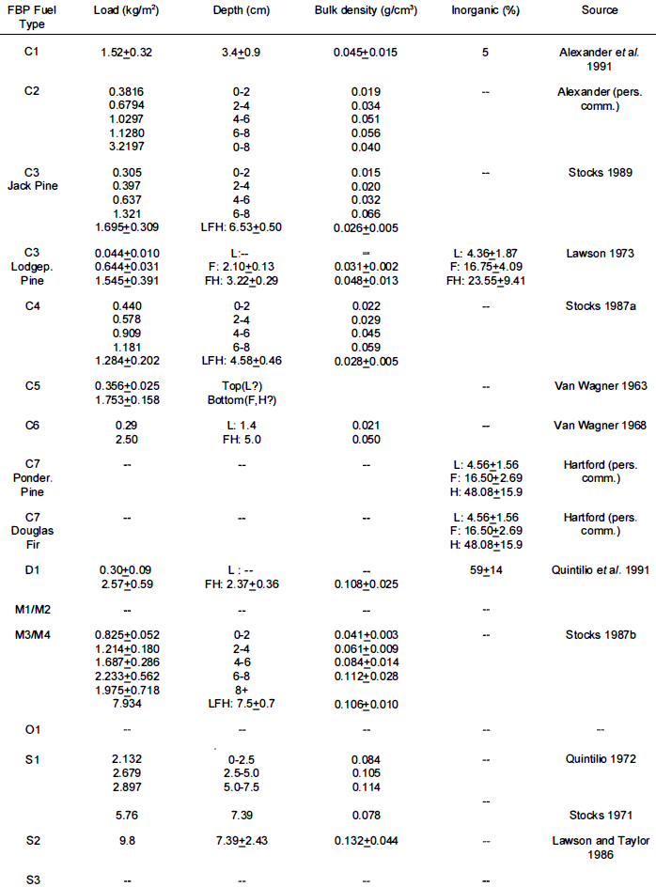
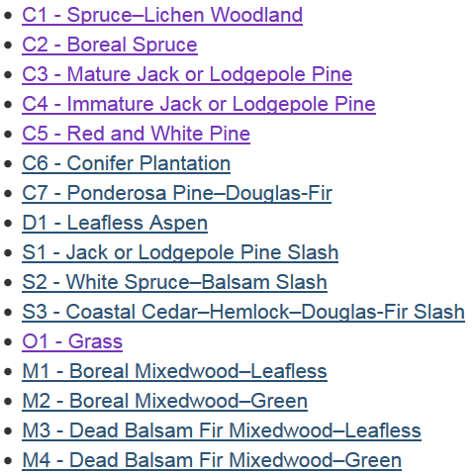
FBP Fuel type Ref
http://cwfis.cfs.nrcan.gc.ca/background/fueltypes/c1

Slide 20
Emission factors from Rodrigo
From CONSUME:
Fuel Type | Combustion | PM | PM10 | PM25 | CO | CO2 | CH4 | NMHC
Weighed-Average | Flaming | 23.00 | 15.00 | 13.00 | 90.00 | 2522.00 | 3.00 | 5.00
(based on measured carbon flux) | Smoldering | 34.00 | 24.00 | 19.00 | 209.00 | 2285.00 | 11.00 | 10.00
 | Residual | 34.00 | 24.00 | 19.00 | 209.00 | 2285.00 | 11.00 | 10.00
Average | Flaming | 26.71 | 16.77 | 15.17 | 104.71 | 3365.29 | 4.24 | 6.53
 | Smoldering | 39.37 | 27.94 | 25.59 | 292.29 | 2994.43 | 15.56 | 15.11
 | Residual | 39.37 | 27.94 | 25.59 | 292.29 | 2994.43 | 15.56 | 15.11
New Updates values for CONSUME:
Fuel Type | Combustion | PM | PM10 | PM25 | CO | CO2 | CH4 | NMHC
Average | Flaming |  |  | 11.40 | 74.37 | 1678.57 | 2.45 | 2.99
 | Smoldering |  |  | 12.63 | 126.37 | 1576.39 | 6.72 | 5.64
 | Residual |  |  | 12.63 | 126.37 | 1576.39 | 6.72 | 5.64
From Urbanski:
NMOc_u= NMOC fraction of unidentified mass
Fuel Type | Combustion | PM | PM10 | PM25 | CO | CO2 | CH4 | NMHC | NMOC | NMOC_u | NOx | NH3 | SO2
Average | Flaming |  |  | 14.97 | 90.43 | 1653.43 | 3.81 |  | 21.85 | 13.78 | 1.86 | 1.07 | 0.95
 | Smoldering |  |  | 14.97 | 90.43 | 1653.43 | 3.81 |  | 21.85 | 13.78 | 1.86 | 1.07 | 0.95
 | Residual |  |  | 34.53 | 248.00 | 1383.00 | 9.94 |  | 56.08 | 115.98 | 0.45 | 1.94 | 1.76
Factors defined by Kerry:
 | Combustion | PM | PM10 | PM25 | CO | CO2 | CH4 | NMHC
Default | Flaming | 11.50 | 7.50 | 6.50 | 45.00 | 1261.00 | 1.50 | 2.50
 | Smoldering | 17.00 | 12.00 | 9.50 | 104.50 | 1142.50 | 5.50 | 5.00
 | Residual | 17.00 | 12.00 | 9.50 | 104.50 | 1142.50 | 5.50 | 5.00

