Slide 1
MISR / Model Plume Heights update

Slide 2
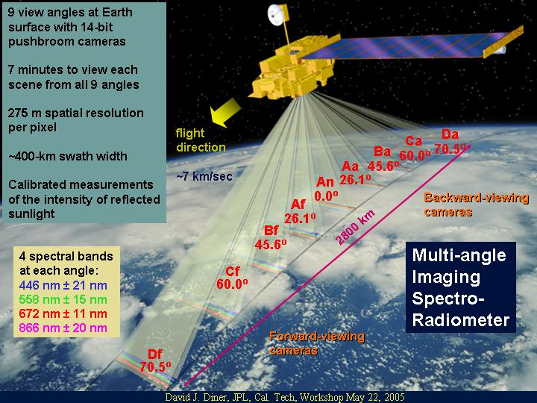
MISR / MINX
Orbiting aboard the NASA Terra satellite, in a sun-synchronous polar orbit, with a local overpass time of 10:30am.
Smoke Plume Heights ~500 m vertical accuracy at a 1.1 km horizontal resolution
We utilize the nine imagery files from the MISR cameras, as well as camera geometry and aerosol data, and some ancillary data, to calculate smoke plume heights through the NASA MINX software.
Notes:
MISR, short for The Multi-angle Imaging SpectroRadiometer, flies aboard the NASA EOS satellite, Terra. The Terra satellite orbits the earth in a near-polar, sun-synchronous orbit, with a local overpass time of about 10:30am. The MISR instrument contains nine different cameras which, as can be seen in the figure, image earth at nine different angles, ranging from 70.5 degrees above nadir, to 70.5 degrees below. The cameras photograph the same position on earth, in the blue, green, red and near-infrared bands, with about a 7 minute difference from the forward-most camera (Df) to the rear-most (Da). The camera’s capture about at 400-km wide swath with a spatial resolution of 275 metres per pixel.
This multi-angle imaging allows for the stereoscopic retrieval of smoke plumes, by observing the changes in the plume between each image. To facilitate this, we utilize the nine camera images, as well as camera geometry and aerosol files, to calculate plume heights.

Slide 3
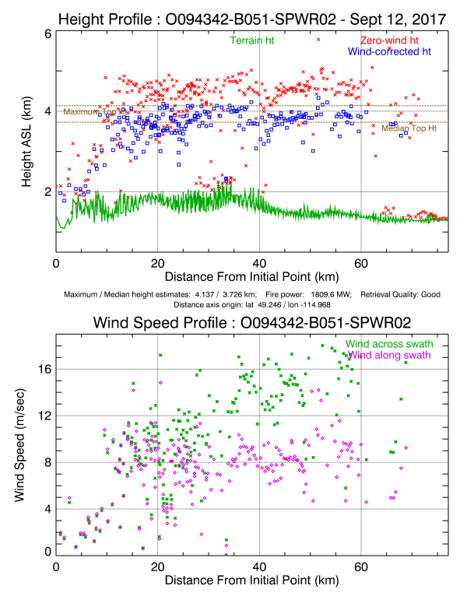
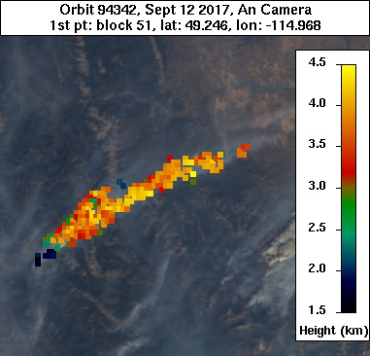
Southern BC (Sept. 2017) Example
MINX outputs plume height and wind speed results
Notes:
In red we have the “zero-wind” heights, which are fictitious heights that assume no wind disparity. The actual calculated heights we see in blue.
Wind direction is inputted by users, wind speed is calculated using disparity between MISR cameras.

Slide 4
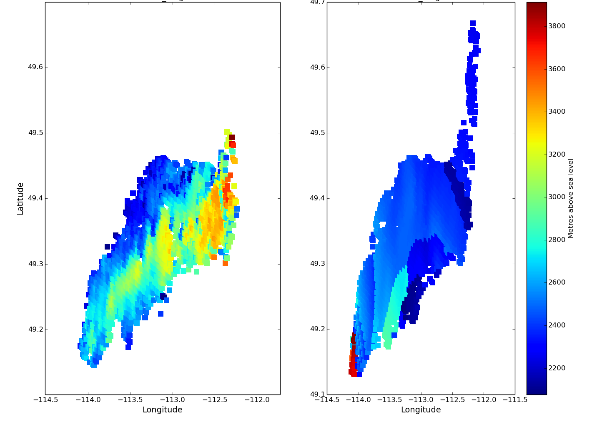
postMINX
Python Module now exists for use in the visualization and comparison of MISR/MINX and model smoke plumes.
Given a MINX digitized plume, it extracts plume heights from same geographic location in model using simple algorithm
Contains many technical, statistical and graphical methods for comparing plume heights, along with other attributes
MISR Plume heights
CFFEPS Plume heights

Slide 5
Rationale for model plume height
Ideally, we would take GEM-MACH top-of-atmosphere radiances like those measured by MISR, and run them through MINX to determine plume heights
In practice, we are simply finding the height where the model PM_{2.5} is a global maximum above the boundary layer.
A plume is identified only when PM_{2.5} at this maximum exceeds 1.6 μg/m³
Based on several cases, we found essentially no difference between this definition of plume height and a more sophisticated determination of plume height using radiative transfer simulations for MISR geometry (based on Kahn et al., JGR, ’07)
Plume height

Slide 6
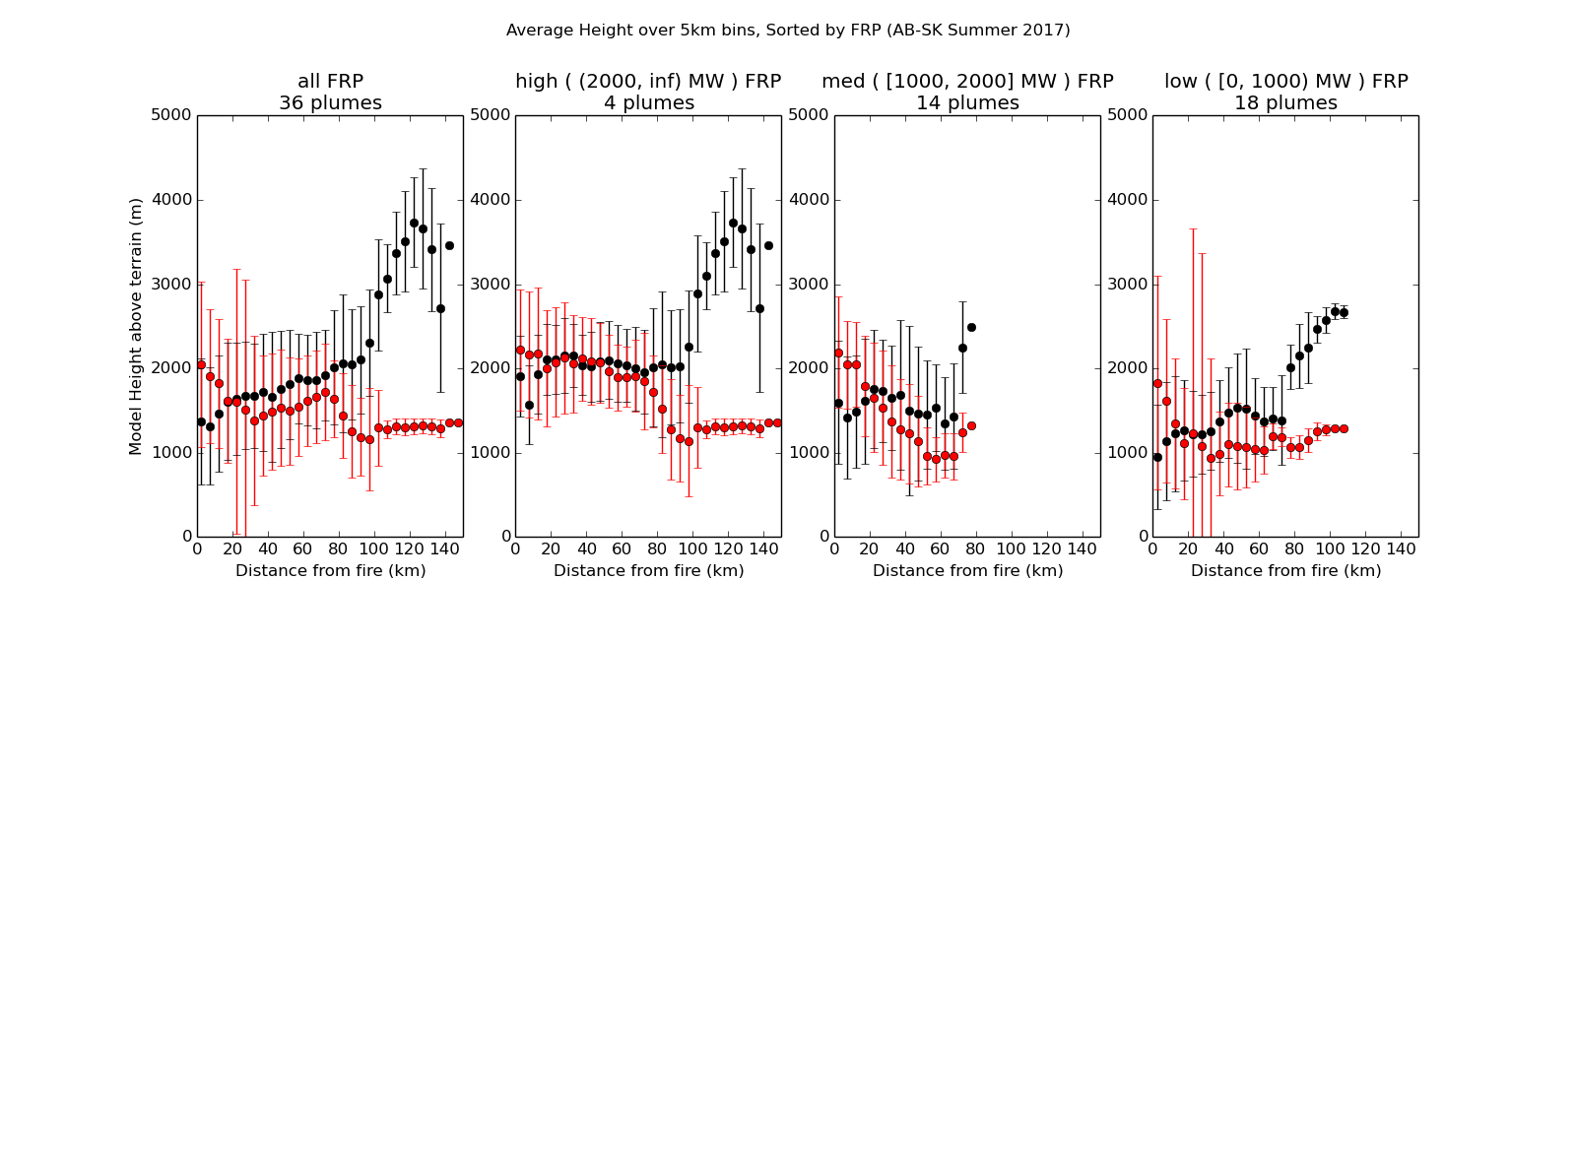
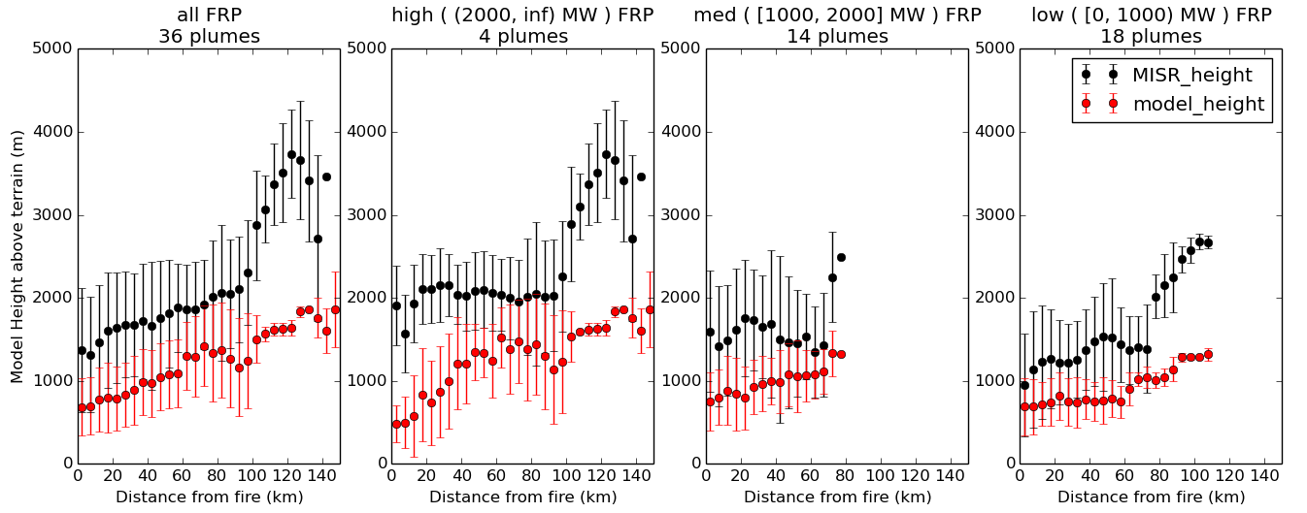
Average height of all Aug.-Sept. plumes over 5 km bins. Grouped based on total FRP (MW)
Bias: 0.78
Corr. Coeff.: -0.66
Bias: 0.73
Corr. Coeff.: -0.69
Bias: 0.23
Corr. Coeff.: -0.00
Bias: 0.47
Corr. Coeff.: -0.09
CFFEPS
Bias: 1.01
Corr. Coeff.: 0.90
Bias: 1.13
Corr. Coeff.: 0.69
Bias: 0.65
Corr. Coeff.: 0.57
FireWork
Bias: 0.75
Corr. Coeff.: 0.95

Slide 7
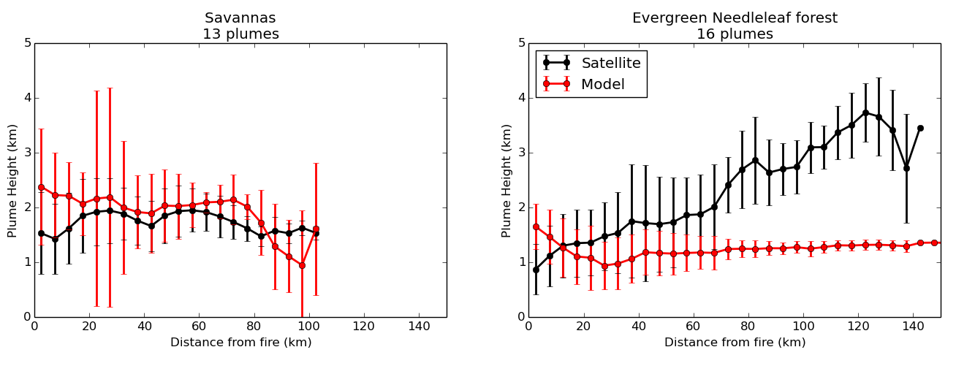
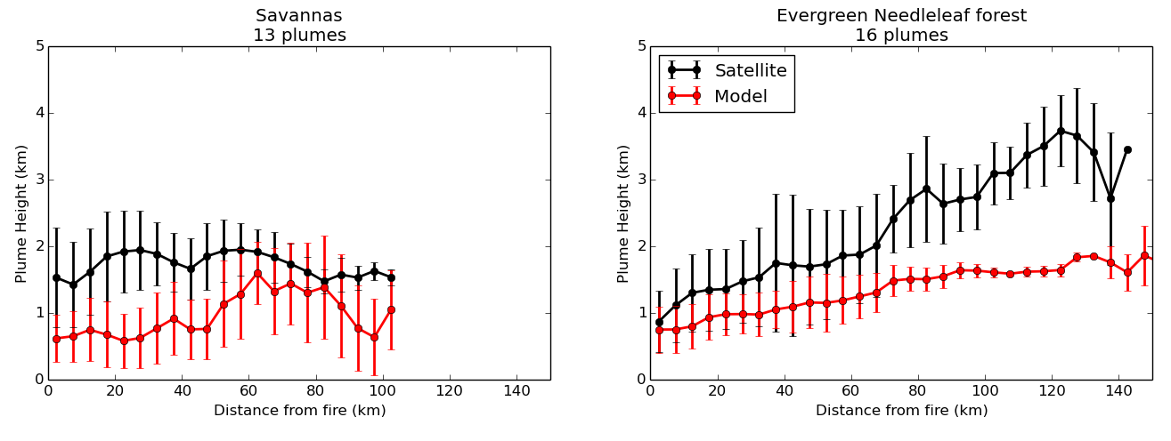
Average height of all Aug.-Sept. plumes over 5 km bins. Grouped based on biome
Bias: -0.19
Corr. Coeff.: 0.37
CFFEPS
Bias: 1.10
Corr. Coeff.: 0.37
Bias: 0.76
Corr. Coeff.: 0.10
FireWork
Bias: 1.00
Corr. Coeff.: 0.95

Slide 8
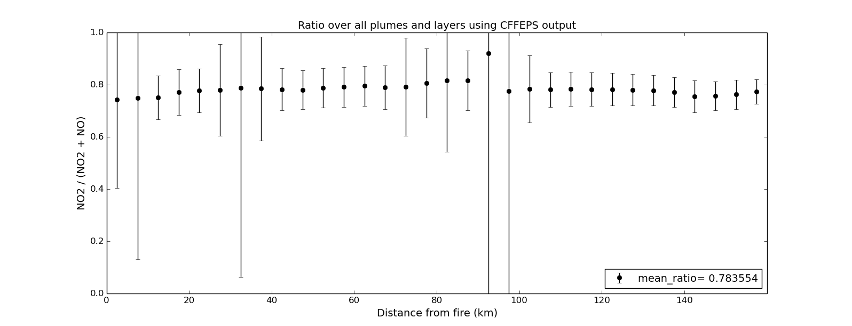
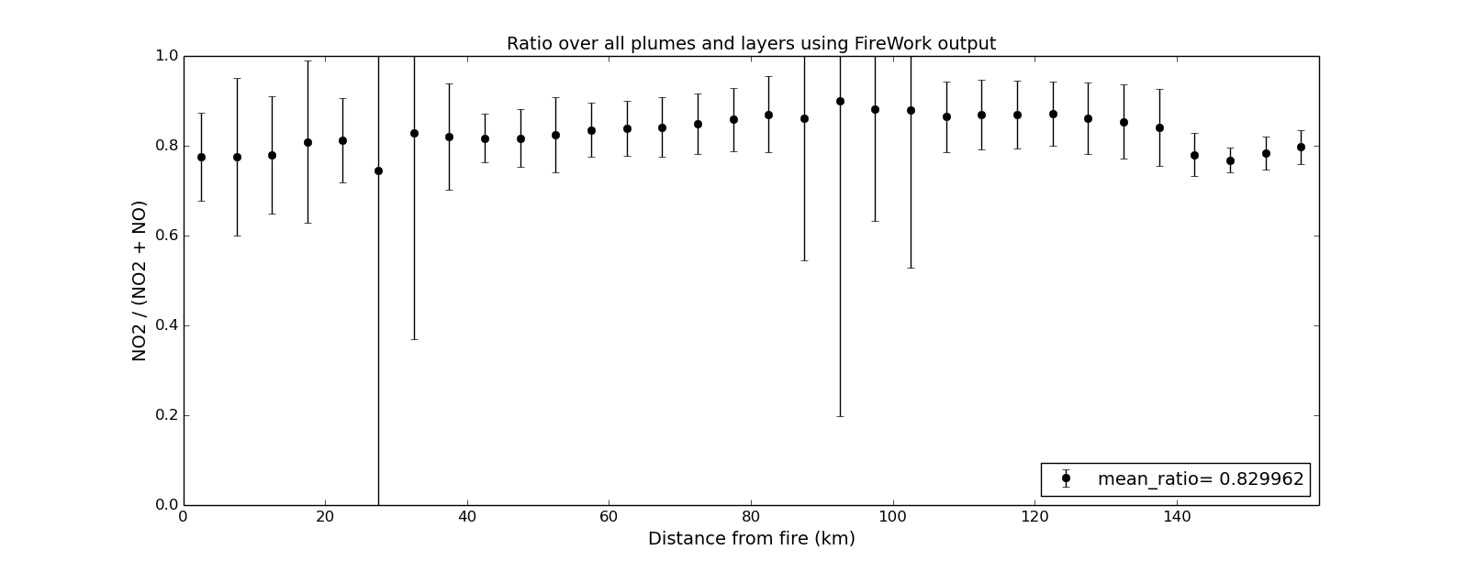
Average NO₂ / NO_{x} ratio of all Aug.-Sept. plumes over 5 km bins.
CFFEPS
FireWork

Slide 9
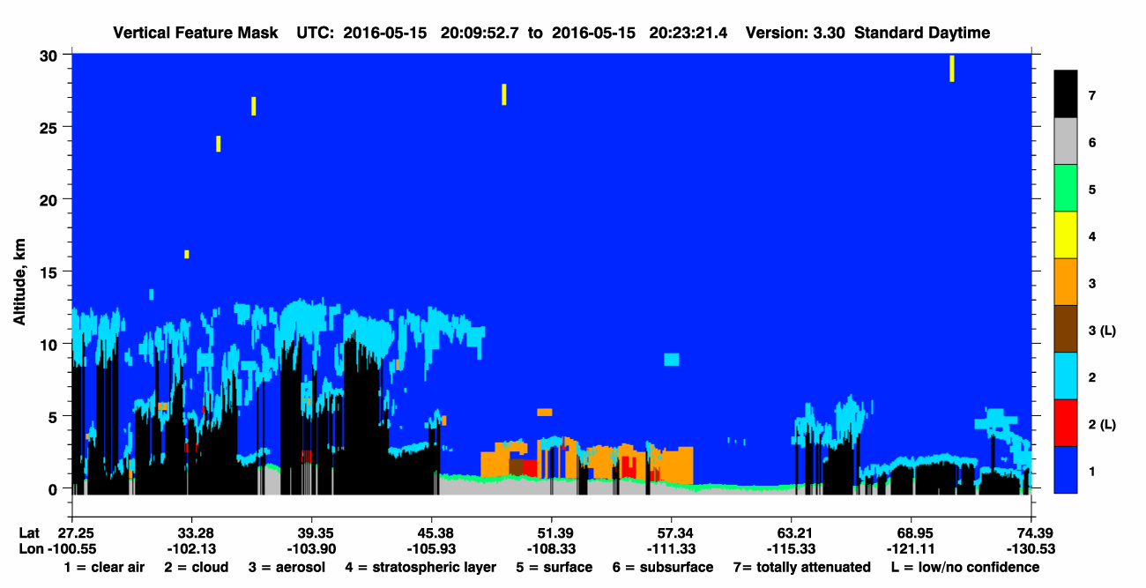
Future CALIOP LIDAR evaluation
Currently working towards utilizing the CALIOP lidar instrument, flying aboard the CALIPSO satellite, to evaluate the plume heights given by MINX.
Pencil beam makes it difficult to find intersecting plumes, but active sensor gives good results when intersects do occur.
Potential third component for comparison with model/MISR plumes.
Smoke Aerosol

