Slide 1
Predicting Low Performing Job Postings with ML
Elise Chang, Mischa Mikami, Sean Tai
Notes:
elise start

Slide 2
TABLE OF CONTENTS
01
02
03
04
Introduction
EDA
Modeling
Impact

Slide 3
01
Introduction

Slide 4
Motivation
many postings get high views but few applications → inefficient hiring
hard to diagnose low-conversion causes
  unclear text, no salary, strict requirements, weak employer brand
low-quality postings hurt candidate experience + reduce qualified applicants
understanding conversion patterns improves posting clarity and transparency
predictive model can flag at-risk postings early and guide improvements
Notes:
Many job postings online get a lot of views but very few applications. This is inefficient for hiring teams, and it’s also frustrating for job seekers.
There are a lot of reasons a posting might underperform — the text could be unclear, the salary might be missing, the requirements could be too strict, or the employer brand may not be strong.
Low-quality postings end up hurting candidate experience and reduce the number of qualified applicants companies receive.
So, understanding these conversion patterns can help make postings clearer, more transparent, and ultimately more effective. If we can predict low-conversion ahead of time, platforms can flag these postings early and help employers improve them before they lose applicants.

Slide 5
Stakeholders
early alerts for underperforming postings
revise titles, descriptions, or requirements
insights into factors driving applicant engagement
Recruiters/Hiring Team
better recommendation ranking using conversion
automated feedback to employers on posting quality
improve overall posting effectiveness site-wide
Job Platforms (LinkedIn)
clearer, more transparent job postings
more roles with salary info + realistic requirements
more relevant + efficient job search experience
Job Seekers
Notes:
There are several groups who benefit from this kind of analysis.
And for recruiters or hiring teams, early alerts about underperforming postings let them revise titles, descriptions, or requirements, and better understand what drives applicant engagement.
For job platforms like LinkedIn, improving conversion prediction helps them recommend higher-quality postings and even give automated feedback to employers as they write job descriptions.
For job seekers, clearer postings with salary information and realistic requirements create a better search experience and more relevant matches.
Overall, improving conversion prediction enhances posting effectiveness across the whole platform.

Slide 6
Research Question & Goals
Primary Question:
  can we reliably predict whether a job posting will be low-conversion (i.e., few applicants per view) or normal conversion?
Broader Goals:
  identify which features most strongly influence applicant behavior
  understand what characteristics tend to correlate with poor conversion
  provide actionable insights to improve posting quality
Notes:
Our main research question was:
Can we reliably predict whether a job posting will be low-conversion — meaning it receives few applicants per view — or normal conversion?
Along with that, we had a few broader goals:
Identify which features most strongly influence applicant behavior
Understand what characteristics correlate with poor conversion
And ultimately, provide actionable insights that help improve posting quality
So our project isn’t just about predictive accuracy — we also want to understand why certain posts perform differently

Slide 7
02
Exploratory Data Analysis

Slide 8

Data Collection
Recent
2023-2024
Robust
124,000+ job postings
LinkedIn Jobs Dataset
Diverse
Thousands of jobs, companies, careers
Real
Real data scraped from Linkedin, not synthetic data
Notes:
For our analysis, we used a large dataset of over 124,000 job postings from LinkedIn from 2023 to 2024.
The dataset is real and diverse — covering thousands of companies, industries, and job types — which helps the model generalize better than synthetic data would

Slide 9
Data Description
row/datapoint: job ID
columns/features: company, job description, skills, salary, experience level, remote
Postings File
row/datapoint: company ID
columns/features: company name, company size, location (city, state, country)
Companies File
row/datapoint: company ID
columns/features: employee count, LinkedIn follower count, time recorded
Employee Counts File
Notes:
The dataset comes from three connected files.
The Postings file contains job-level data like the title, full description, skills, salary info, experience level, and remote status.
The Companies file gives us company-level information such as company name, company size, or location
And the Employee Counts file includes employee count and number of linkedin followers
Together, these give us both textual and structured features describing each posting.

Slide 10
Data Cleaning
filled missing values with the median
robust to outliers so extreme values don’t distort anything
preserves shape of skewed distributions
maintains variability closer to the true distribution
Numeric Features
filling missing values with “missing”
missing features like pay period can indicate meaningful pattern rather than random noise
avoids introducing false categories
preserves original category distribution
Categorical Features
Notes:
For numeric features, we filled missing values using the median.
We chose median because it’s robust to outliers — salaries and follower counts can vary by orders of magnitude — so using the mean would distort skewed distributions.
Using the median preserves the shape of the original data and keeps the variability close to the true underlying distribution
For categorical features, we filled missing values with an explicit 'missing' label.
For some categories, missingness is itself meaningful — for example, not specifying a pay period can actually signal something about the posting.
Labeling it explicitly avoids creating false categories and keeps the original category distribution intact.

Slide 11
Target Label Definition
conversion rate = applies / views
computed 25% of conversion rates
Thresholds
low conversion: bottom 25% (Q1)
high conversion: top 75%
Application-to-View Ratio
Notes:
To define our target, we computed a conversion rate for each posting using applies divided by views.
We then used quantiles to set thresholds:
Low conversion is defined as the bottom 25% of postings
High or normal conversion is the top 75%
This gives us a balanced and data-driven way to identify underperforming postings.

Slide 12
Data Filtering
Removing Invalid Targets to Ensure a Clean Dataset
removed rows w/ invalid target metrics
  dropped postings w/ missing applies or views
  dropped postings with view <= 0
removed noisy conversion outliers
  dropped the top 1% of postings with extreme conversion rates
avoided target leakage
  dropped columns like applies, views, and conversion_rate
preserved dataset diversity
  didn’t restrict by industry, region, role type, or language
Notes:
elise end
Before modeling, we filtered out invalid or noisy rows.
We removed postings with missing applies or views, or cases where views were zero or negative.
We also dropped the top 1% of extreme conversion outliers
To avoid target leakage, we removed columns like applies, views, and conversion rate — because those wouldn’t be available at posting time.
Importantly, we didn’t restrict by industry, region, role type, or language, because preserving diversity helps the model generalize better.

Slide 13
Feature Engineering
TF-IDF Text Features
Missing Features
One Hot Encoding
Converted text inputs into numerical features by applying TF-IDF vectorization to a new column combining text, description, and skills
Created binary indicators for data that is missing, allowing the model to learn from the absence of certain values
Categorical variables are transformed into binary columns, so they can be interpreted by our models
Adding Important Features
Feature 1: Job listings from large cities
Feature 2: Average sentence length of the description
Feature 3: Word count of the description

Slide 14
Feature Selection
Salary: min_salary, med_salary, max_salary
Company: company_size, employee_count, follower_count, in_large_city, sponsored
Text: description_word_count, avg_sentence_length
Numeric Features
Categorical and Text Features
Role: formatted_work_type, formatted_experience_level, application_type, remote_allowed
Compensation: pay_period, currency, compensation_type
Text: (title, description, and skills)
Postings: salary_missing, remote_missing, posting_domain_missing, skills_missing
Companies: company_size_missing, employee_count_missing, follower_count_missing
Dropped Features

Slide 15
03
Modeling

Slide 16
Evaluation Metrics
F1-Score
Harmonic Mean of Recall and Precision
AUC-ROC Score
Class Classification Correctness
Accuracy
Prediction Correctness
Pro: reduces bias between recall and precision for imbalanced classes
Con: focuses on a single class and therefore doesn’t capture the entire model’s performance
Pro: measures model performance with varying classification thresholds
Con: doesn’t offer any information about the actual classifier’s performance
Pro: measures how accurately the model is classifying predictions
Con: misleading in imbalanced classes and doesn’t account for classification nuances

Slide 17
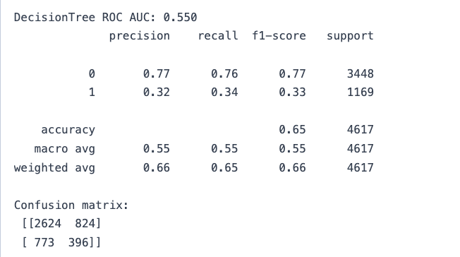
Decision Trees
Maps out varying choices and their possible outcomes to create a prediction
Decision Trees split on each feature, making it difficult to combine all the numeric and one-hot encoded features. Thus, the positive class is often missed.
Highly Sparse Features
Decision Trees prefer strong split points, but sparse feature patterns are spread across smaller weights.
Distributed Patterns

Slide 18
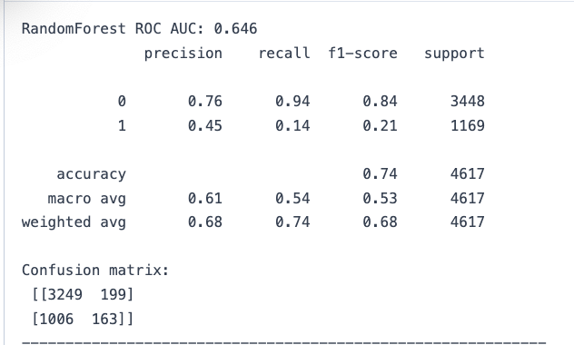
Random Forest
Ensemble of decision trees that independently average all decisions into a prediction
Random Forest averages away weak distributed patterns from features within each individual decision tree.
Combining Distributed Patterns
Each tree overfits features with many unique values. Thus, when averaged out, it predicts positive when decision trees agree and negative when inconclusive.
Averaged Independent Trees

Slide 19
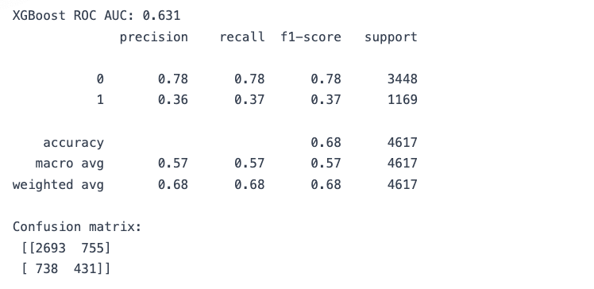
XGBoost
Ensemble of decision trees that sequentially processes trees to make a prediction
Each tree targets the misclassifications made by previous trees. However, if one tree overfits on a feature, all the subsequent trees will also overfit.
Averaged Sequential Trees
XGBoost can fixate on minimizing the error of minor splits and overfitting features with many unique values.
Misclassification Focus

Slide 20
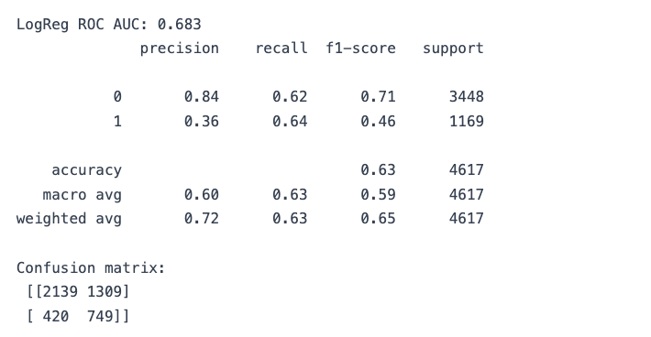
Logistic Regression
Predicts the probability of a binary outcome for classification
Logistic Regression can model linear relationships, making it well-suited for utilizing TF-IDF vectorization of text inputs to create a new feature.
TF-IDF Text Features
The logistic regression model takes 2 minutes on average to run, compared to the ~10 seconds of all decision trees.
Decreased Efficiency

Slide 21
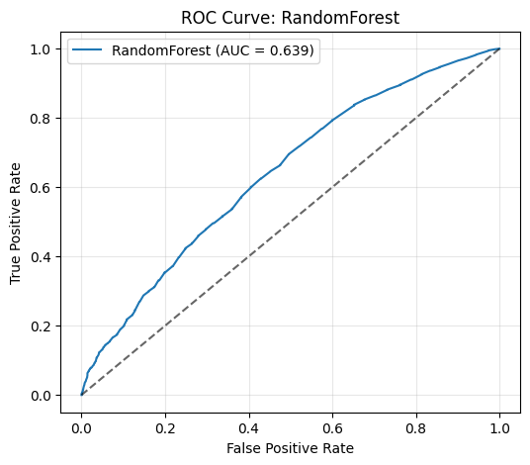
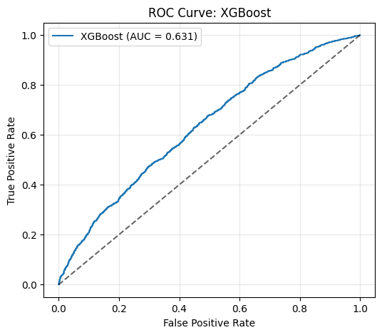
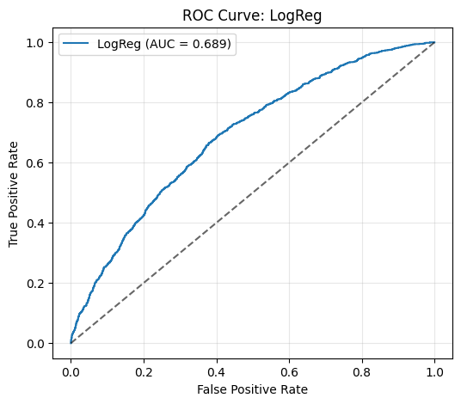
Which model performed best?
Predicts the probability of a binary outcome for classification
Notes:
Many linear features, all weak, trees struggle to split, logistic regression excel, text is dense, efficiency tradeoff
Because Logistic Regression is the only model that uses the full text information (via TF-IDF embeddings), while the tree-based models drop text entirely, LR has access to far more predictive signal.
Drop text because matrix because super sparse and big, which tree models struggle with.
Job posting text contains the strongest indicators of conversion (job title wording, skills mentioned, industry, role type, tone).
Since tree models only use structured features—which are weaker and more subtle signals—they naturally underperform.
Additionally:
The relationship between structured features and conversion is mostly linear and additive, which LR captures well.
Tree models seek nonlinear interactions that don’t strongly exist here.
LR handles high-dimensional sparse text data extremely well; tree models do not.

Slide 22
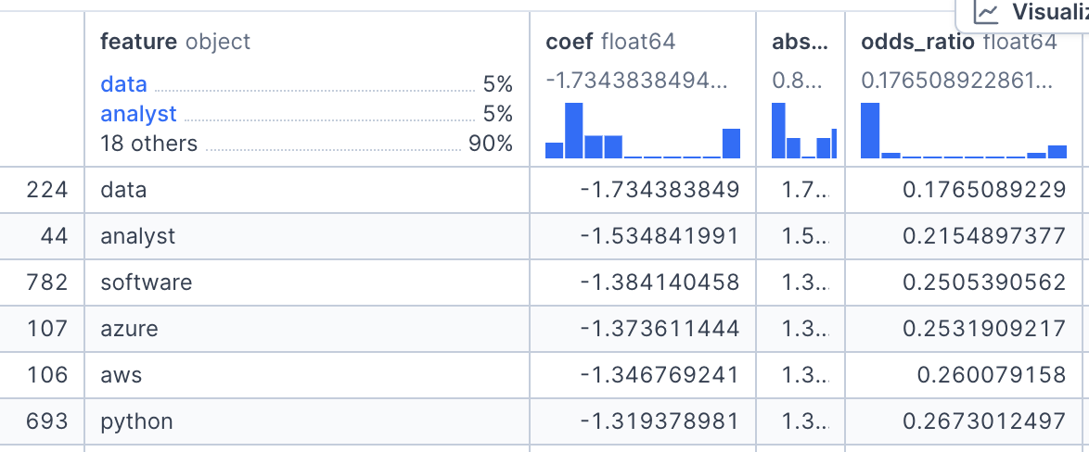
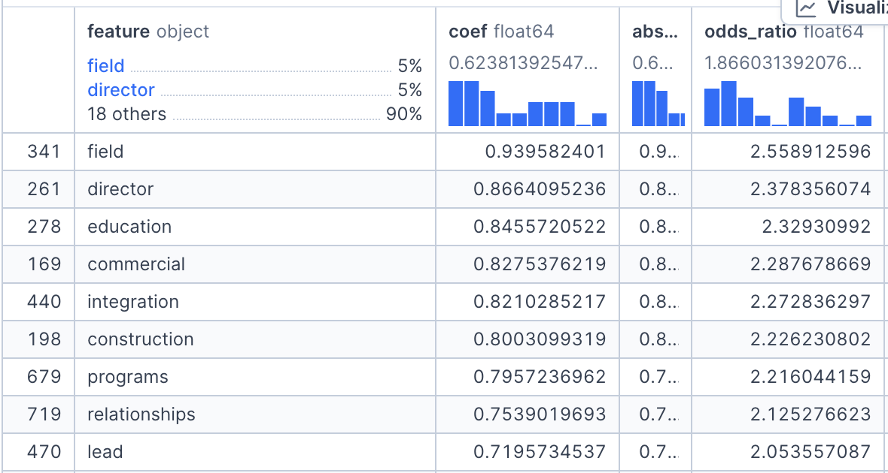
Coefficient Interpretation
Logistic Regression Coefficients
(Text included)
Coefficients show the log-odds impact on low conversion
Negative coefficient: reduces risk
Positive coefficient: increases risk
Findings:
Data jobs are 0.17x likely to be low conversion
Senior jobs (director, staff) and field work is 2.4x more likely to be low conversion.

Slide 23
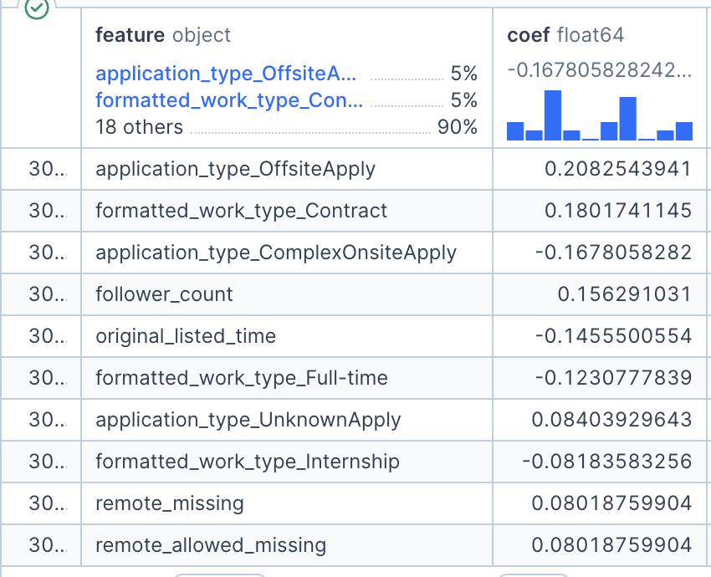
Coefficient Interpretation
Logistic Regression Coefficients
(Text excluded)
Structured features that increase risk of low conversion:
Application type (offsite/unknown)
Contract work
Remote missing
Structures features that decrease risk of low conversion:
Application type (onsite)
Full-time, Internship Work

Slide 24
04
Impact

Slide 25
Who Would This Model Impact?
Job Platforms
Recruiters
Candidates

Slide 26
Job Platforms
Optimize recommendation algorithms
Increase brand reliability with candidates
Flag low converting posts
Push high converting posts to feeds
Suggest edits to recruiting teams
  “Senior roles in your industry convert poorly without remote flexibility”
Model becomes feedback engine

Slide 27
Recruiters
Identify underperforming job postings early
Intervene before a job fails to attract talent
Produce actionable insights
  “Adding salary ranges will help conversion odds!”
  “This description is lengthy, consider shortening for a higher application rate”
  “You might want to relax overly strict requirements!”
Improve jobs postings through transparency
  Always list salary, location, clear responsibilities

Slide 28
Candidates
Job Seekers gain when there is transparency
More transparent compensation
Clearer expectations
Better-quality postings
Less time wasted on unclear/incomplete ads
Fairer job market

Slide 29
Is our model ready to be used in the real world?
almost..

Slide 30
Limitations & Improvements
Dataset Limitations
Fine-tune & more
Text features dominate unless filtered. Views vs applications also may vary by industry norms.
Try tuning hyperparameters more to maximize our metrics. Try other methods like other ensembling models (LightGBM, etc.)
Temporal Context
Modern Embeddings
Our model doesn’t consider the time in the hiring cycle, if it’s a holiday, or the labor market conditions
Currently using TF-IDF, which treats each word independently. Cannot capture context, tone, structure. Use embedding models to capture these relationships.

Slide 31
Questions?

