Slide 1
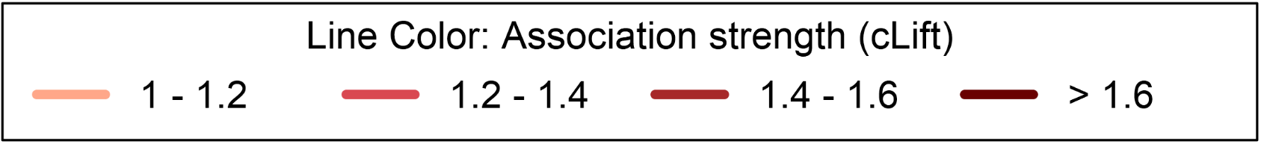
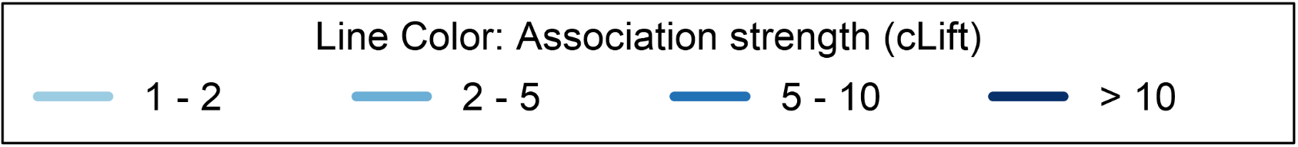
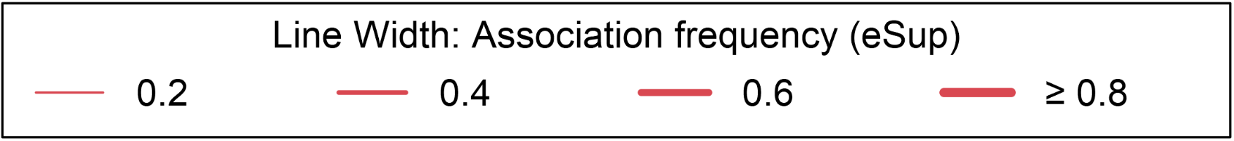
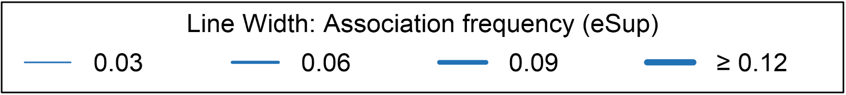
Penicillins
Penicillins
TEM
MEC
TIC
AMX
TEM
MEC
TIC
AMX
AMC
AMP
AMC
AMP
TZP
FOS
TZP
FOS
CXM
TOB
CXM
FOX
FOX
TOB
CAZ
GEN
GEN
AKN
CAZ
Third-generation
cephalosporins
AKN
CFM
CFM
TSU
Third-generation
cephalosporins
TSU
CRO
NAL
CRO
CTX
CTX
NAL
FEP
OFL
FEP
OFL
ERT
NOR
ERT
NOR
IMP
FUR
CIP
LEV
IMP
LEV
Fluoroquinolones
FUR
CIP
Fluoroquinolones
Node Pie chart:
% Not tested
% Susceptible
% Resistant
Node color: antibiotic class
Aminoglycoside
Penicillin + beta-lactamase inhibitor
Fourth gen. cephalosporin
Fluoroquinolone
Other
Second gen. cephalosporin
Carbapenem
Other quinolone
Large spectrum penicillin
Third gen. cephalosporin
Nitrofuran derivative
Trimethoprim/ Sulfamethoxazole
Line color: Association strength (cLift)
Line color: Association strength (cLift)
Line width: Association frequency (eSup)
Line width: Association frequency (eSup)

