Slide 1
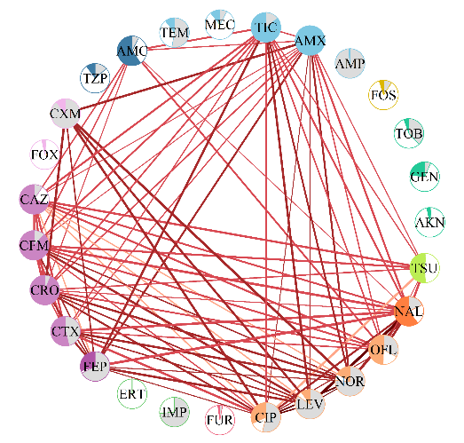
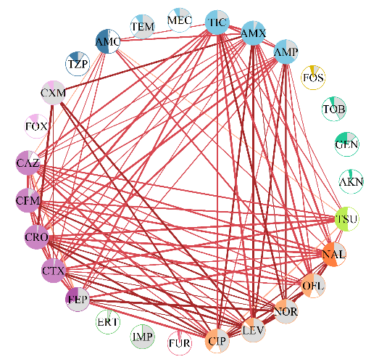
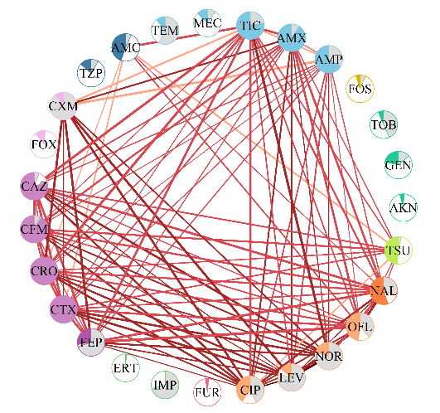
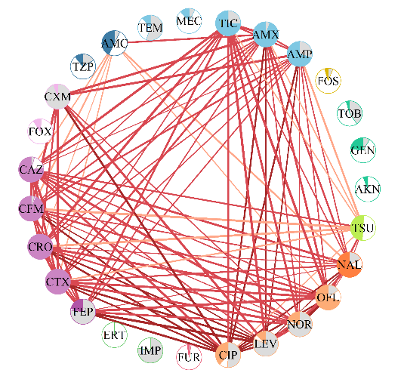
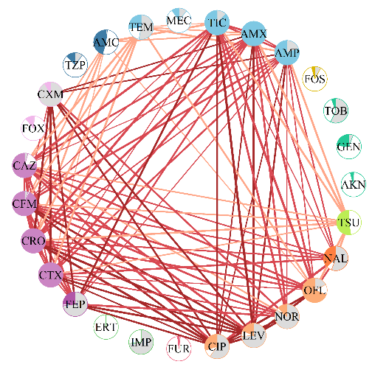
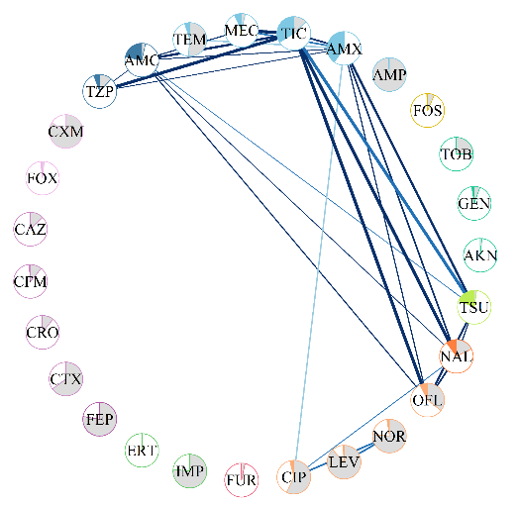
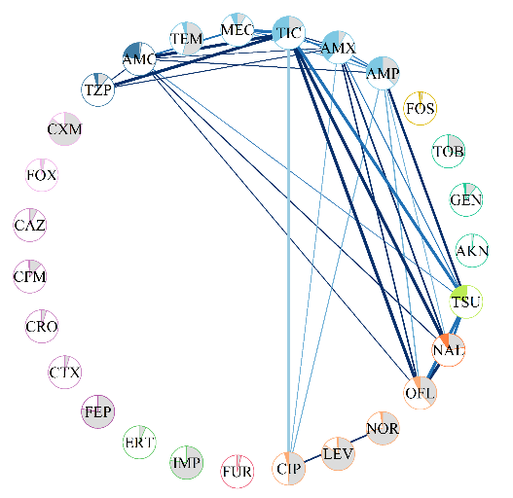
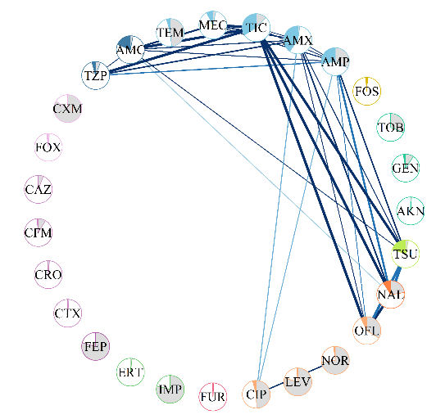
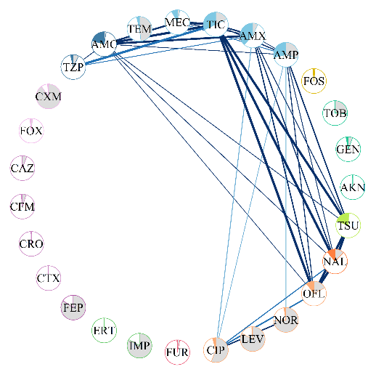
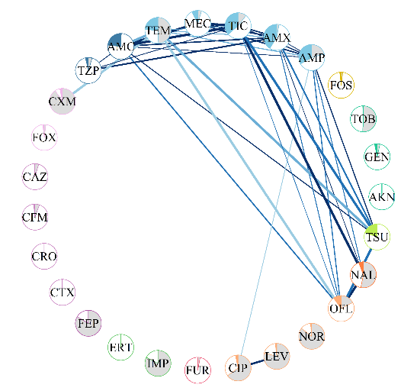
2018
2019
2020
2021
2022
ESBL E. coli
 | 0.238 [0.234; 0.249] | 0.285 [0.283; 0.285] | 0.281 [0.266; 0.290] | 0.292 [0.288; 0.293] | 0.301 [0.294; 0.302]
Density
Non-ESBL E. coli
 | 0.074 [0.074; 0.074] | 0.091 [0.091; 0.091] | 0.088 [0.088; 0.088] | 0.097 [0.097; 0.097] | 0.100 [0.100; 0.103]
Density

