Slide 1
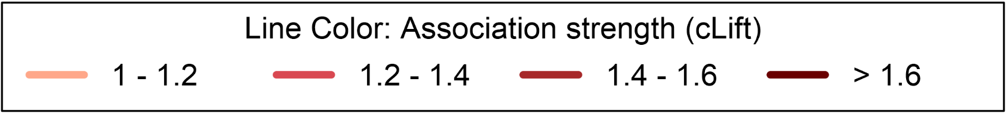
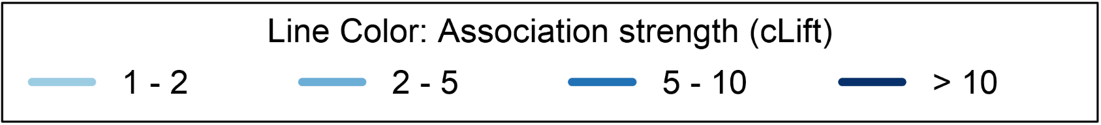
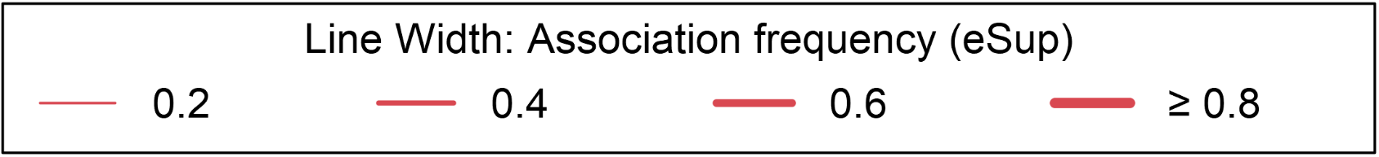
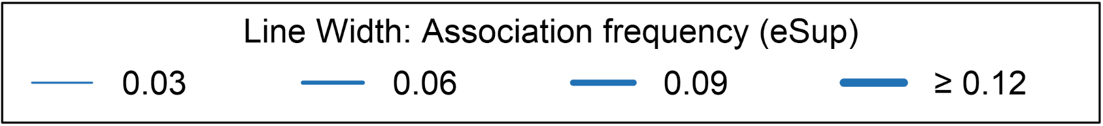
ESBL E. coli
Non-ESBL E. coli
Penicillins
Penicillins
TEM
MEC
TIC
AMX
TEM
MEC
TIC
AMX
AMC
AMP
AMC
AMP
TZP
FOS
TZP
FOS
CXM
TOB
CXM
TOB
FOX
FOX
GEN
CAZ
GEN
CAZ
AKN
CFM
AKN
Third-generation
cephalosporins
Third-generation
cephalosporins
CFM
TSU
TSU
CRO
CRO
NAL
CTX
NAL
CTX
FEP
OFL
FEP
OFL
ERT
NOR
ERT
NOR
IMP
FUR
CIP
LEV
IMP
FUR
CIP
LEV
Fluoroquinolones
Fluoroquinolones
Node Pie chart:
% Not tested
% Susceptible
% Resistant
Node color: antibiotic class
Aminoglycoside
Penicillin + beta-lactamase inhibitor
Fourth gen. cephalosporin
Fluoroquinolone
Other
Second gen. cephalosporin
Carbapenem
Other quinolone
Large spectrum penicillin
Third gen. cephalosporin
Nitrofuran derivative
Trimethoprim/ Sulfamethoxazole
Line color: Association strength (cLift)
Line color: Association strength (cLift)
Line width: Association frequency (eSup)
Line width: Association frequency (eSup)

