Slide 1
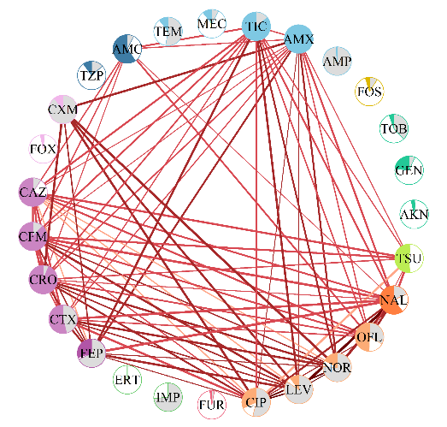
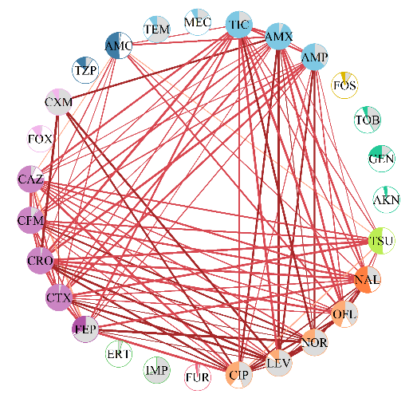
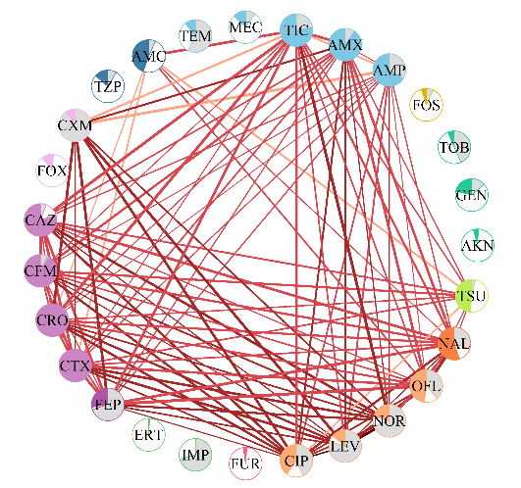
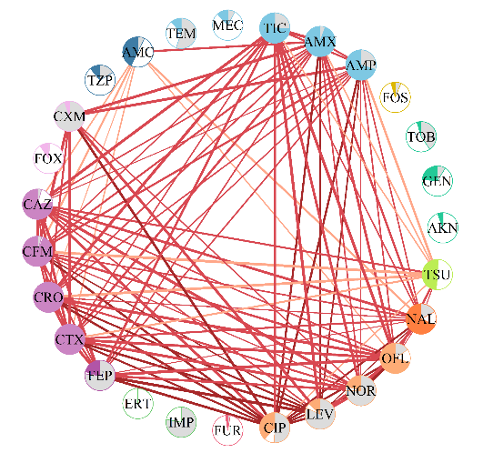
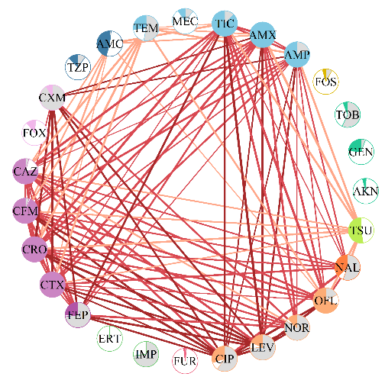
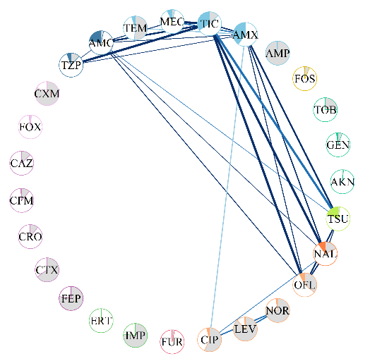
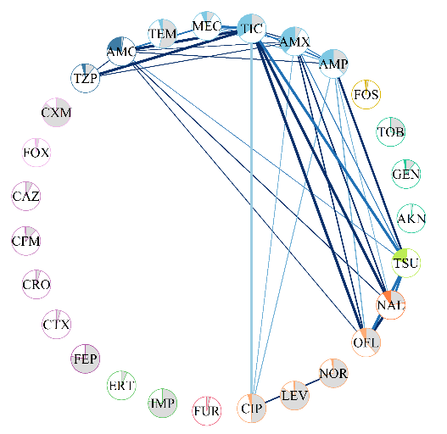
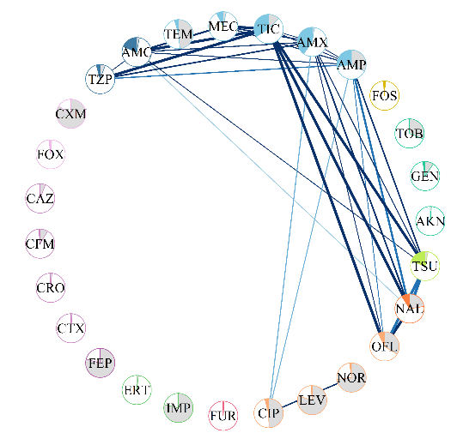
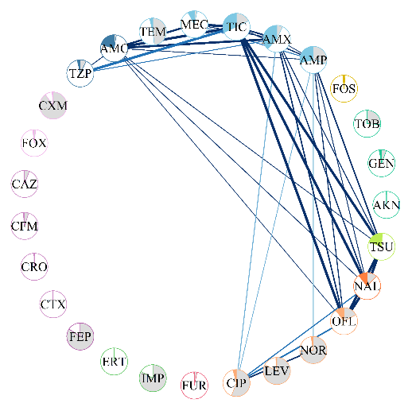
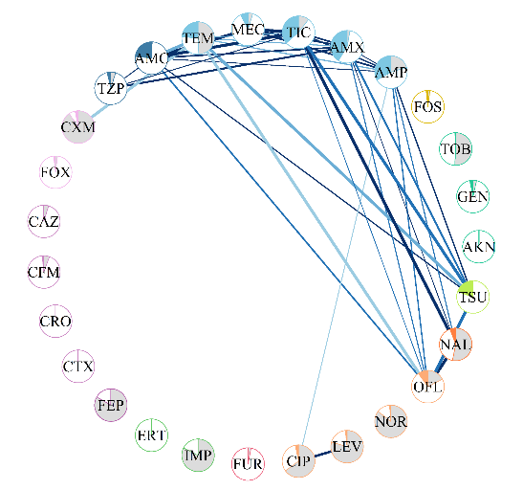
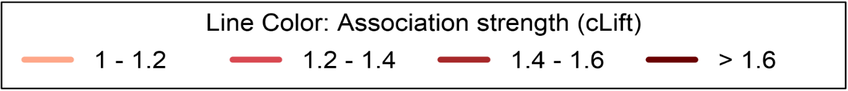
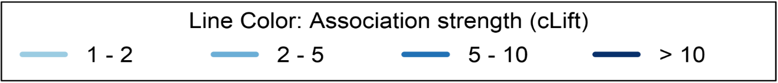
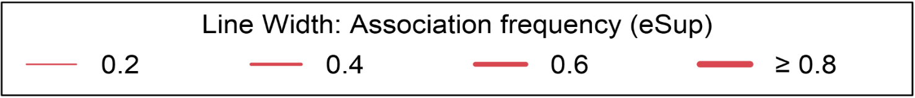
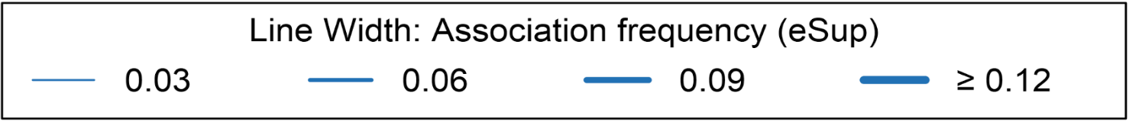
2018
2019
2020
2021
2022
ESBL E. coli
Density
 | 0.238 [0.234; 0.249] | 0.285 [0.283; 0.285] | 0.281 [0.266; 0.290] | 0.292 [0.288; 0.293] | 0.301 [0.294; 0.302]
Non-ESBL E. coli
 | 0.074 [0.074; 0.074] | 0.091 [0.091; 0.091] | 0.088 [0.088; 0.088] | 0.097 [0.097; 0.097] | 0.100 [0.100; 0.103]
Density
Node Pie chart:
% Not tested
% Susceptible
% Resistant
Node color: antibiotic class
Aminoglycoside
Penicillin + beta-lactamase inhibitor
Fourth gen. cephalosporin
Fluoroquinolone
Other
Second gen. cephalosporin
Carbapenem
Other quinolone
Large spectrum penicillin
Third gen. cephalosporin
Nitrofuran derivative
Trimethoprim/ Sulfamethoxazole
Line color: Association strength (cLift)
Line color: Association strength (cLift)
Line width: Association frequency (eSup)
Line width: Association frequency (eSup)

Slide 2
2018
2019
2020
2021
2022
ESBL E. coli
Density
0.238 [0.234; 0.249]
0.285 [0.283; 0.285]
0.281 [0.266; 0.290]
0.292 [0.288; 0.293]
0.301 [0.294; 0.302]
Non-ESBL E. coli
Density
0.074 [0.074; 0.074]
0.091 [0.091; 0.091]
0.088 [0.088; 0.088]
0.097 [0.097; 0.097]
0.100 [0.100; 0.103]
Node Pie chart:
% Not tested
% Susceptible
% Resistant
Node color: antibiotic class
Aminoglycoside
Penicillin + beta-lactamase inhibitor
Fourth gen. cephalosporin
Fluoroquinolone
Other
Second gen. cephalosporin
Carbapenem
Other quinolone
Large spectrum penicillin
Third gen. cephalosporin
Nitrofuran derivative
Trimethoprim/ Sulfamethoxazole
Line color: Association strength (cLift)
Line color: Association strength (cLift)
Line width: Association frequency (eSup)
Line width: Association frequency (eSup)

Slide 3
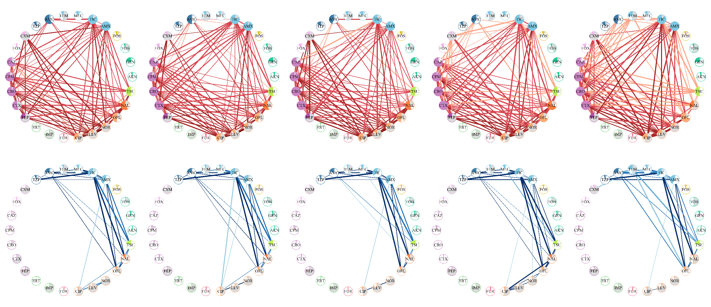
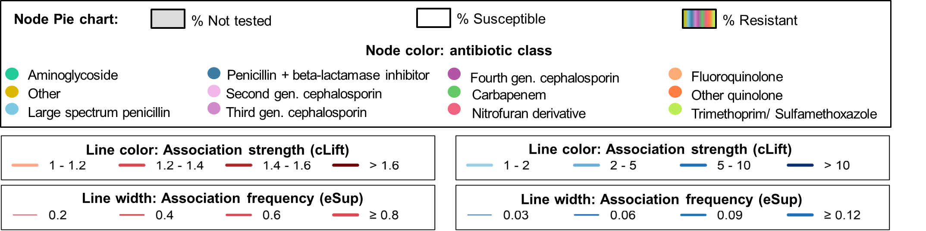
2018
2019
2020
2021
2022
ESBL E. coli
Non-ESBL E. coli

Slide 4
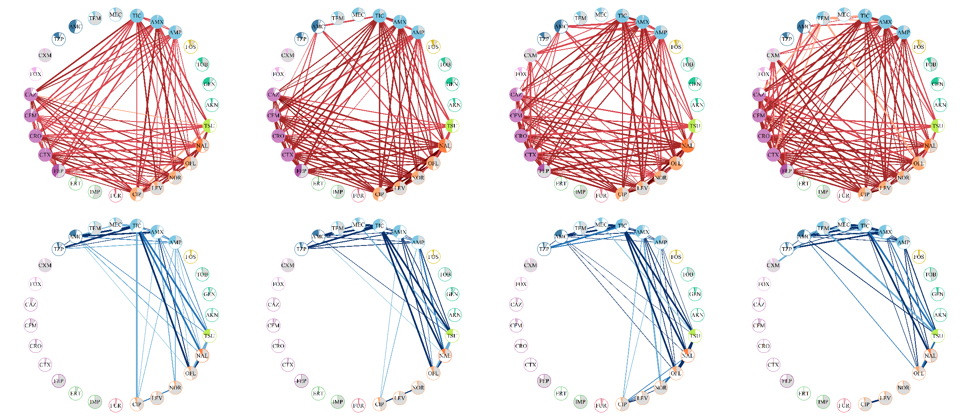
2019
2020
2021
2022
ESBL E. coli
 | 0.240 ± 0.004 | 0.255 ± 0.005 | 0.279 ± 0.011 | 0.300 ± 0.008
Density
Non-ESBL E. coli
 | 0.094 ± 0.004 | 0.091 ± 0.002 | 0.104 ± 0.003 | 0.097 ± 0.001
Density

Slide 5
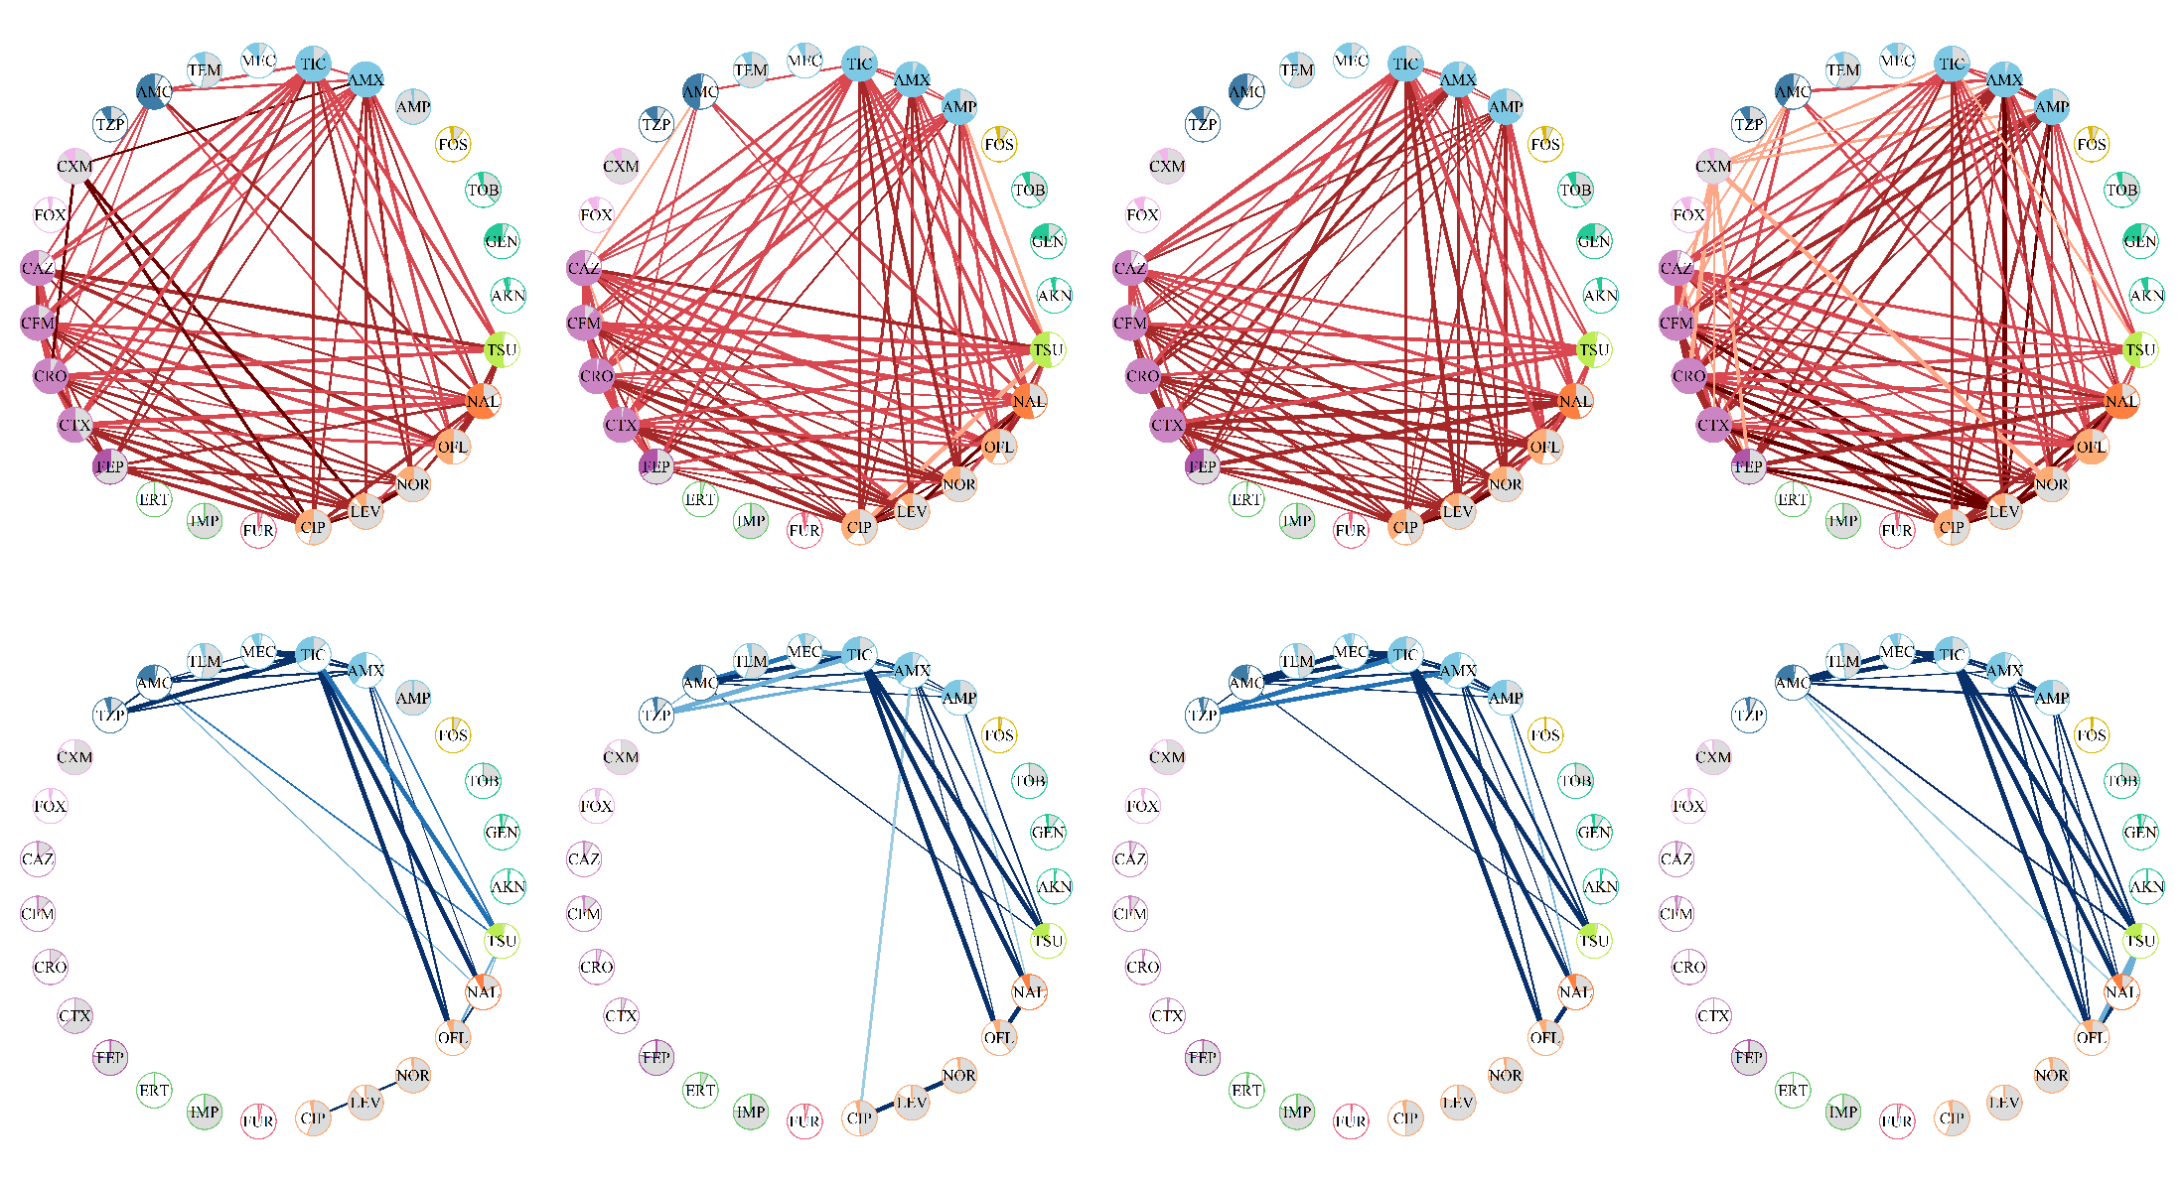
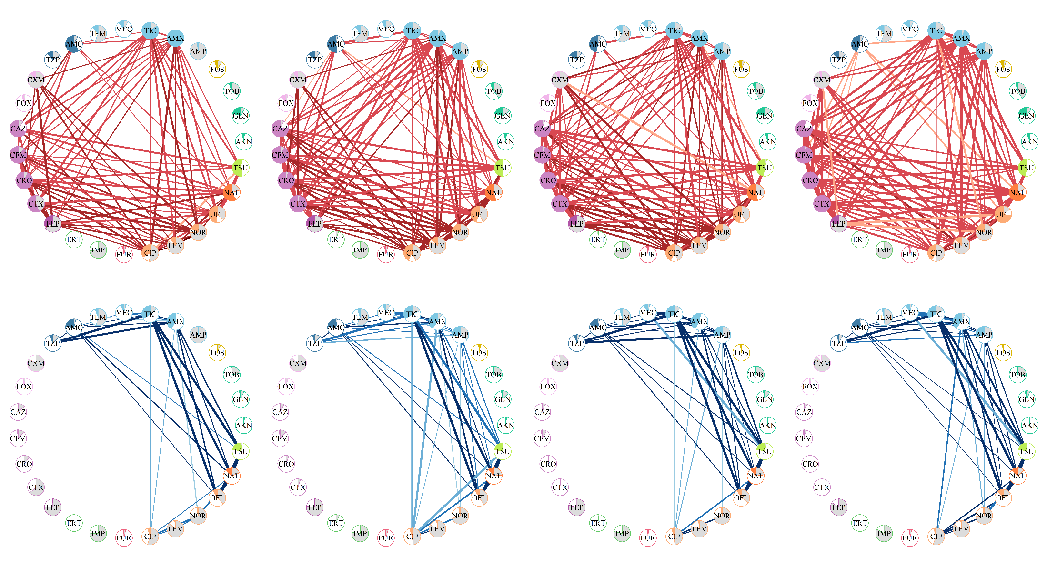
A
2018
2019
2020
2021
ESBL E. coli
Non-ESBL E. coli
B
2018
2019
2020
2021
ESBL E. coli
Non-ESBL E. coli

Slide 6
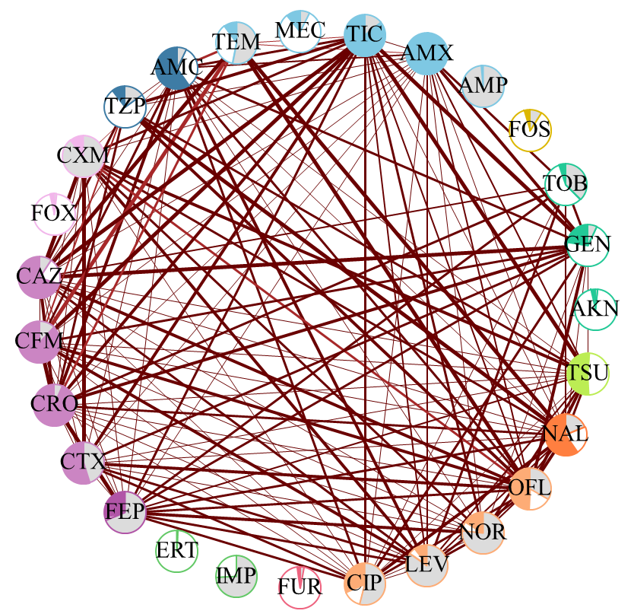
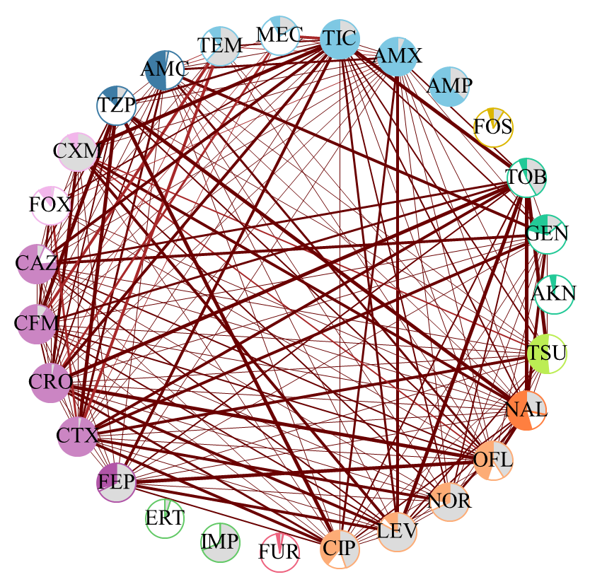
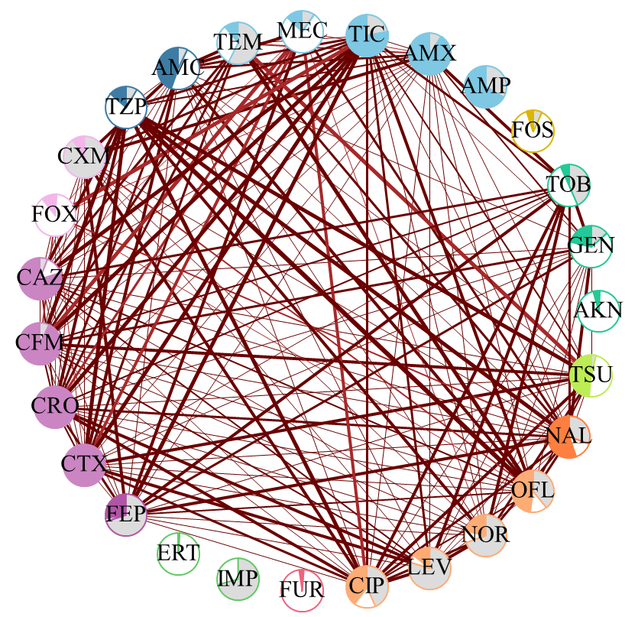
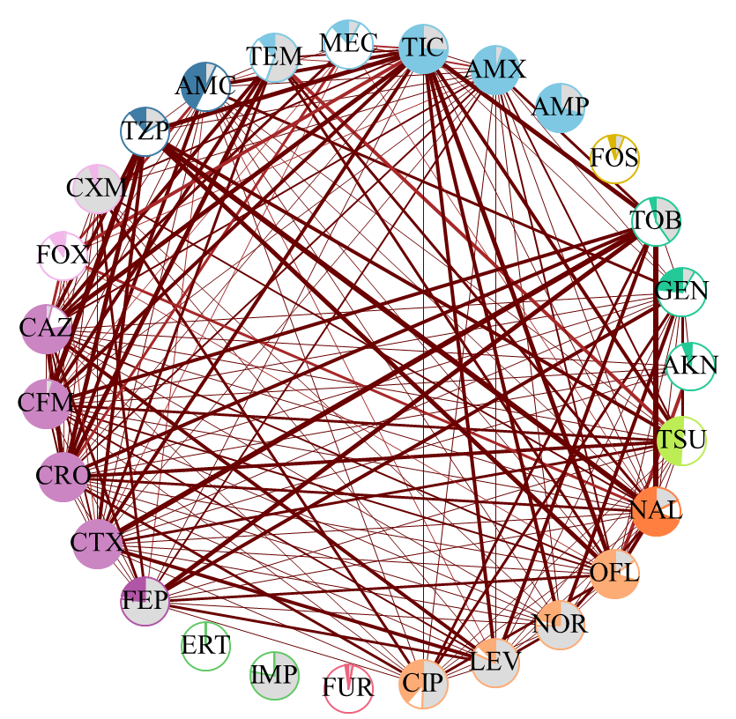
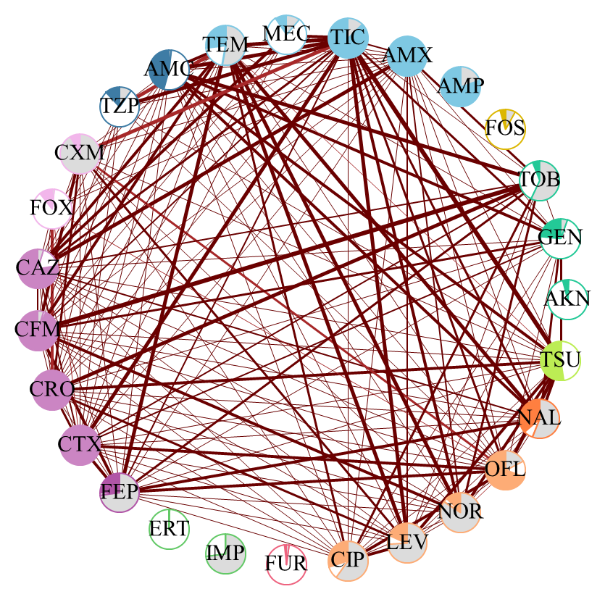
2018
2019
2020
2021
2022
ESBL E. coli
 | 0.424 [0.407; 0.440] | 0.489 [0.467; 0.511] | 0.501 [0,481; 0.520] | 0.496 [0.475; 0.527] | 0.498 [0.476; 0.519]
Density
Node Pie chart:
% Not tested
% Susceptible
% Resistant
Node color: antibiotic class
Aminoglycoside
Penicillin + beta-lactamase inhibitor
Fourth gen. cephalosporin
Fluoroquinolone
Other
Second gen. cephalosporin
Carbapenem
Other quinolone
Large spectrum penicillin
Third gen. cephalosporin
Nitrofuran derivative
Trimethoprim/ Sulfamethoxazole
Line color: Association strength (cLift)
Line color: Association strength (cLift)
Line width: Association frequency (eSup)
Line width: Association frequency (eSup)

