Slide 1
Robot design

Slide 2
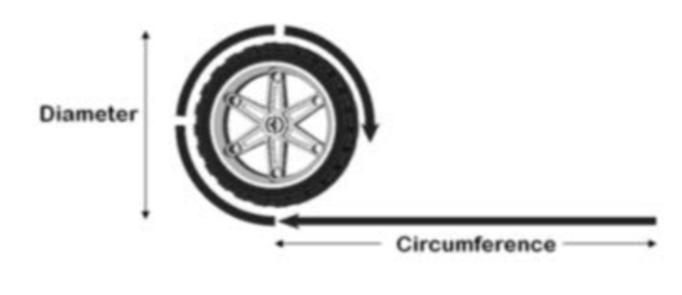
Choosing wheels
Speed
The larger the wheel, the faster it will go.

Slide 3
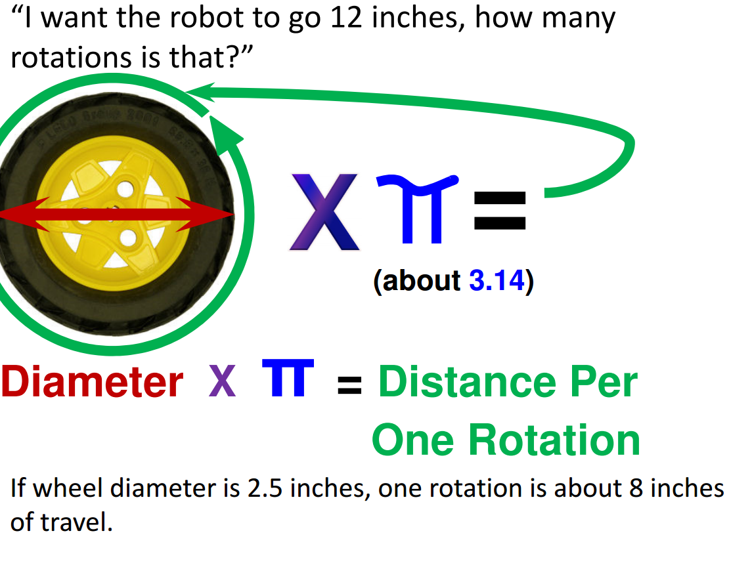
Wheel size

Slide 4
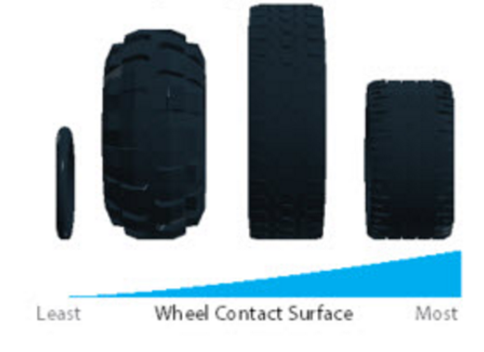
Choosing wheels
Traction
The more wheel contact surface, the more traction for pushing objects.
The heavier your robot, the more traction it will have.

Slide 5
Choosing wheels
Turning
The larger the wheel, the less accurate it will turn.

Slide 6
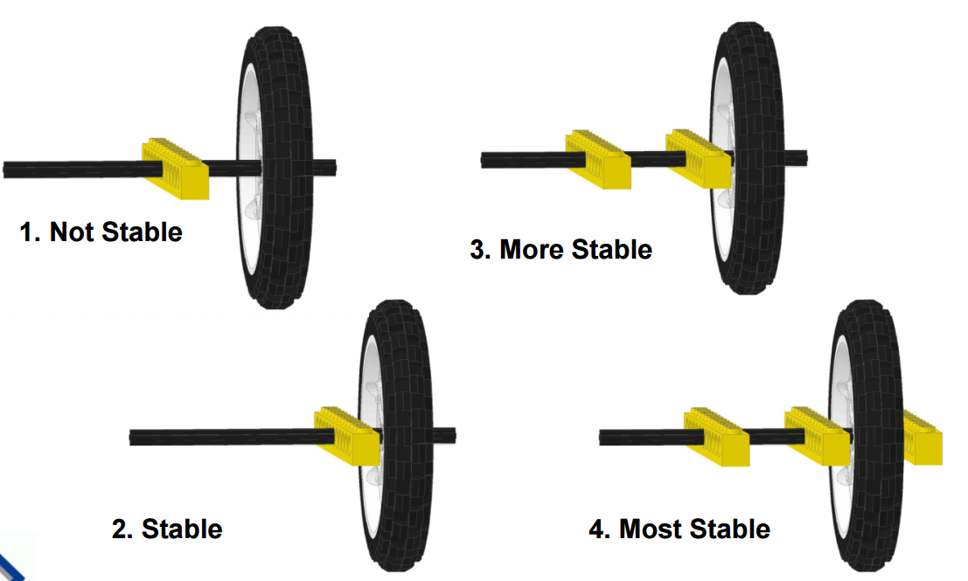
Choosing wheels
Axle Support / Stability

Slide 7
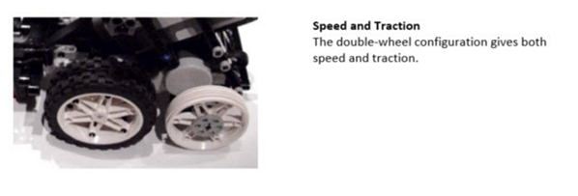
Choosing wheels
Dual Wheel Design

Slide 8
Robot balance
Too much weight on non-drive wheel(s)
Hard to make turns
Turns can be less accurate
Not enough weight on non-drive wheel(s)
- Robot can pop a wheelie when starting or stopping
- Steering can become inaccurate.

Slide 9
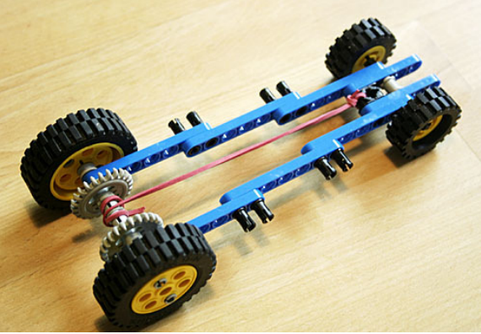
Using lego rubber bands
Keep wires out of the way
Like springs - to hold touch sensor levers in place
To trigger a trap
Make rubber band motors

Slide 10
tips
Make attachments that can handle as much error as possible.
Match motors (better repeatability and easier to program)
Consider EASY TO ATTACH attachments

Slide 11
Motor matching

Slide 12
Straight test

