Slide 1
Ev3 sensors
10.06.2016

Slide 2
Touch Sensor
1
Let’s start with the first set of slides

Slide 3
EV3 Touch Sensor
Detects pressed
Detects released
Detects bumped (pressed and released)

Slide 4
Ultrasonic Sensor
2

Slide 5
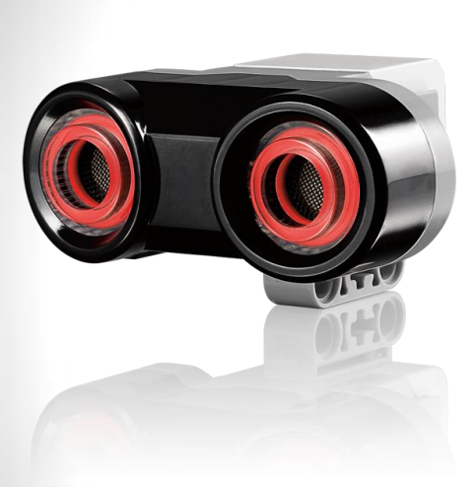
EV3 Ultrasonic Sensor
Detects distance
Accurate to 1 cm or 0.3 inches
Can listen for other ultrasonic sensors
Eyes light up to identify which mode the sensor is operating in

Slide 6
Color Sensor
3

Slide 7
EV3 Color Sensor
Detects eight different colors
Detects ambient light, from dark to sunlight
Detects reflective red light
Build-in cancelling of backlight makes sensor more reliable
Common Uses: move until a dark line is encountered by the robot, align the robot with a black line, follow a line, etc.

Slide 8
Motors
4

Slide 9
EV3 Motors
Two types of motors: the large motor and
the medium motor
The large motor is a strong and powerful full motor
The medium motor is a less powerful motor but runs at a higher revolution rate.
The medium motor is smaller and lighter to allow more construction options.

Slide 10
Tips
For driving the robot, use the B & C motor ports; the A & D ports should be used for the robot’s arm.
Using full motor power (100%) may cause erratic robot movement, use 75% or less.
Conversely, too little power (below 25%) may cause the robot to stall.
Brake at the end of each MOVE block in order to allow the robot to self correct and achieve more precise, accurate moves.
REMEMBER: the tradeoff between speed and accuracy!

Slide 11
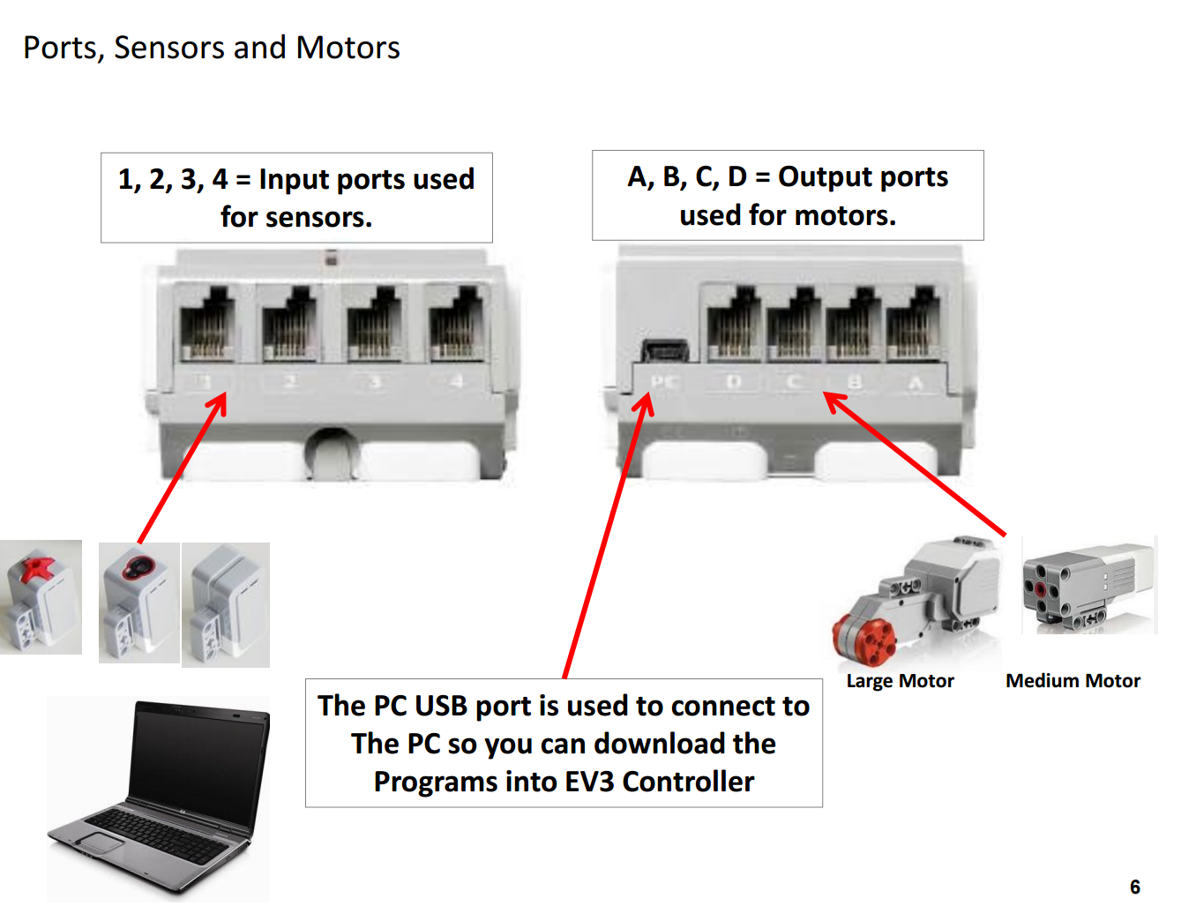

Slide 12
LET’S REVIEW SOME CONCEPTS
Move Tank Block
Use the Move Tank block to steer the Driving Base.
The Loop Block
Sometimes, there are actions that you want to repeat. The LOOP block allows you to repeat those actions until an end condition is met (or becomes TRUE).
Wait Block
Switch Block
The Switch block will check for a condition and will take one action if the condition is true and another action if the condition is false.

