Slide 1
BlockChain: Applications other than Cryptocurrency
FP Team 3
Noah Smith & Elise Timmons | CIS 481-01 | 6 April 2020

Slide 2
What Is BlockChain?
A time-stamped series of data managed by multiple computers.
No single owner or central authority.
Creation of a block starts a transaction.
The block is verified by thousands of computers.
The block is then added to the chain.

Slide 3
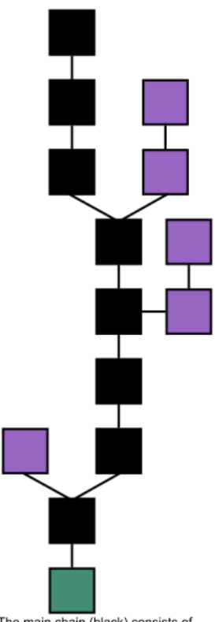
Main Chain (Black)
Genesis Block (Pink)
Orphan Block (Blue)

Slide 4
Quick History of BlockChain
1991: Stuart Haber & W. Scott Stornetta envisioned BlockChain.
1992: They added Merkle trees to the system.
2008: Nakatomo conceptualized the first BlockChain.
2009: Nakatomo released the first white paper.
2013: Etherium was born.
2015: Etherium was launched.
The Future: Further implementation.

Slide 5
Cryptocurrency
Cryptocurrencies are built off BlockChain.
The idea of cryptocurrencies predates the idea of BlockChain.
Cryptocurrencies use cryptographic functions to conduct financial transactions.
The validity is provided by a BlockChain.
2009: Bitcoin was released.

Slide 6
Comparison of BlockChain and Cryptocurrency
Cryptocurrencies are one of the many uses of BlockChain:
BlockChain- Technology
Cryptocurrency- Asset Class

Slide 7
Relevancy
How can we eliminate issues pertaining to exchanging data from one platform to another?
Vast Growth
Proof of Ownership
Personal Informations Security
Large Data Protection
Transparent Data

Slide 8
Relevancy
Issues found in regular exchanges can be fixed through encryption and backups, which are the key goals of BlockChain.
Banking transactions can be saved in a timestamped chain.
Change of ownership can be seen.

Slide 9
Applications of Blockchain

Slide 10
Finance
Primary Uses:
Capital Markets
Payments
Trade
Investment Management

Slide 11
Government
Primary Uses:
Voter Security/Fraud
Public Identity
Elections
Welfare Distribution

Slide 12
Healthcare
Primary Uses:
Securing Patient Data
MedicalChain
Streamline Care
Disease Control
Genetic Breakthroughs

Slide 13
Security Concerns and their Preventions

Slide 14
Social Engineering and Phishing
Concerns
$ 2 Million lost in 2018
Loss of Trust
May lead to Malware or DNS Hijacking
Preventions
Using Private Keys
Clear Policies
Thoroughly Reading any Info
Use Caution

Slide 15
Endpoint Vulnerabilities
Concerns
Connections between Blockchain and Users
Abuse of Functionality
Creates Attack Paths
May Lead to Malware or Exchange Hacks
Preventions
Software
Strategies
Skilled Executives
Public and Private Encryption Keys
Task Managers

Slide 16
51% Vulnerabilities and Attacks
Concerns
$20.8 Million losses in 2018
Hashrate or Power Distributions
May Lead to a Double-Spend or Double Data
Halt in Operations
Preventions
Decentralization
Better Consensus Methods
Leaning on Other Networks
Strong Protocols

Slide 17
Exchange Hacks
Concerns
$907.5 Million lost in 2018
Access to Databases
Difficulty Tracking Real vs Fabricated Exchanges
Public vs Private Networks
Preventions
Cold vs Hot Databases
Multi-Signature Protocols
Peer to Peer Exchange Layers

Slide 18
Conclusion
BlockChain is extremely versatile with uses in
Finance
Government
Healthcare
There are still some security concerns
Endpoint Vulnerabilities
Social Engineering & Hacking
Malware
51% Attacks
Exchange Attacks

Slide 19
Quiz
Question 1:
_____ Blocks are outside of the main chain on a BlockChain.
Child
Orphan
Parent
Secondary
Question 2:
There are a limited number of blocks that can be on a single BlockChain. (True/False)?

Slide 20
Questions?

