Slide 1


C++ Program: Help with Reading German!
Elisha Gretton

Slide 2
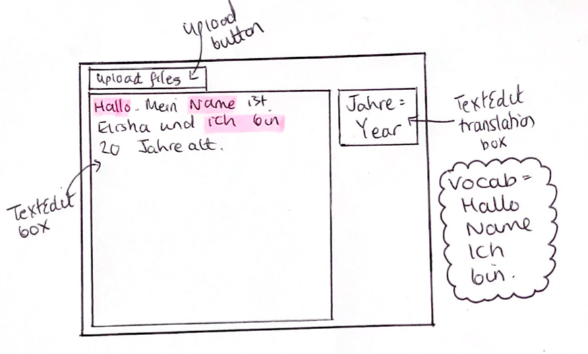
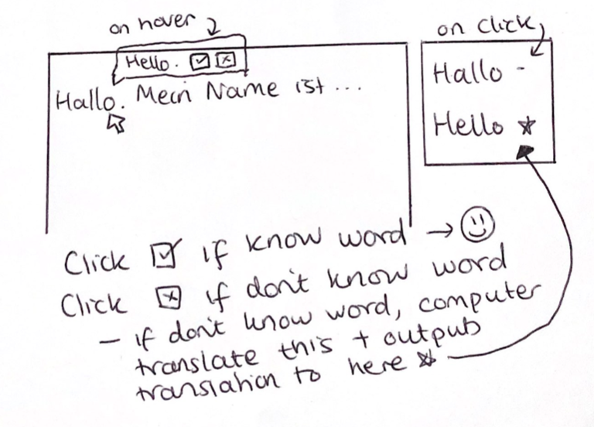
Phase 1+2: Idea, Design
AIM:
Save the user time by looking up all the words they don’t know/have forgotten.
Creating a vocabulary list for the user so they can learn the words.

Slide 3
Phase 1: Initial Idea explained
Input German text
Input German vocabulary
Compare text and vocabulary
Highlight
Provide English translation
Add/keep word to vocabulary
Upload_buttonClick()
Compare_files – function to compare the words in two text files
Compare text to be studied and german vocabulary to see if user knows any of the words
Compare german vocabulary and English translation to give the translation of a word they know
Highlight – function to highlight the words they do know

Slide 4
Potential Problems
How to translate words not in the user’s vocabulary
Highlighting text
Clicking/hovering over text

Slide 5

Problem 1
How to get the computer to translate the words the user doesn’t know?

Slide 6

Problem 2
How to highlight text?
- QSyntaxHighlighter

Slide 7
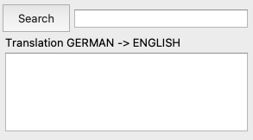
Problem 3
How to click on words? How to do hover feature?

Slide 8
Phase 3: Program

Slide 9


[3.1] Compare files: split_file_into_words(QTextStream &file, QstringList &list)
Vocab
Text
Open textstream
Get each line of textstream
Split each word in line
Store words in a QStringList
QFile, QTextStream QString line QStringList each_line QStringList list

Slide 10
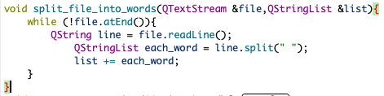
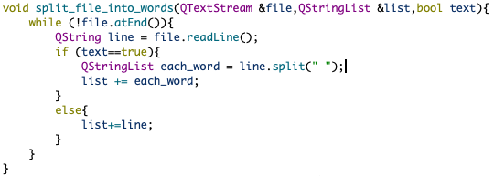

Slide 11
[3.1] Finish comparing files compare_files(QStringList &text, QStringList &dict, QStringList &modifiedString)
Get two textstreams
Split each file into words
Compare each word in text to dictionary
Turn known words into capitals
QTextStream x2 prev function for loop QStringList

Slide 12
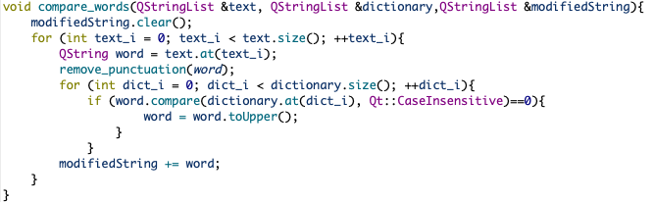

Slide 13
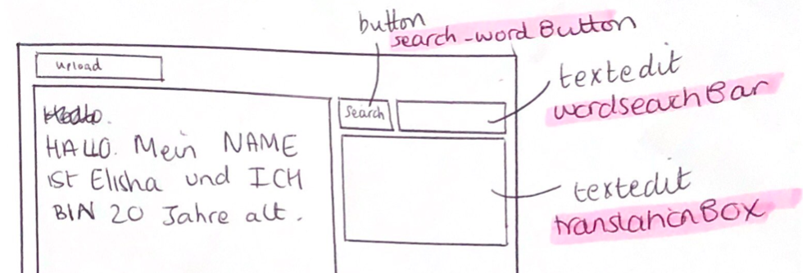
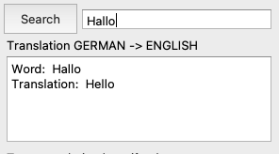
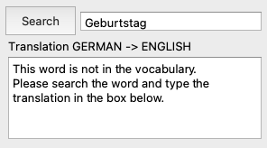
[3.2] Search function
Get word
For every_element in german dictionary
If matches word
Take index and go to English_translation and get translation using index
Output word and translation

Slide 14
Evaluation
It works for simple text and words!!!
Needs some extra features and should be able to take more complicated text

Slide 15


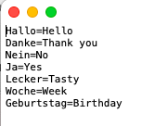
Evaluation
Format of German and English vocabulary sheets

Slide 16
Evaluation
Use more complicated German text
Conjugations (ich spielE, du spielST, er spielT, wir spielEN etc….)
Tenses (problems with the future)
Pronoun +conjugated werden +information+infinitive verb
Ich werde Pizza essen [I will eat Pizza].
Add obvious vocab to vocab (e.g pronouns, articles)
Grammar rules

Slide 17


