Slide 1
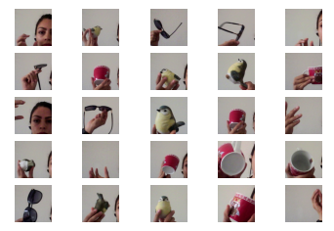
Dataset and Preparation
4 Classes
Empty
Sunglass
Mug
Bird
2155 Images with Shape (224, 224, 3)
For my CNN:
Split Data
1855 Train
300 Test
Normalized Data (division by 255)
One-Hot-Encoded the labels

Slide 2
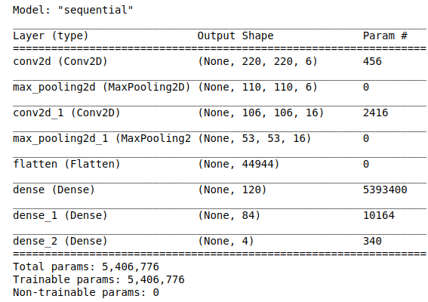
Building a CNN with 8 Layers
8 layers
2 conv
2 maxpooling
1 flatten
3 dense layer
neurons: 120 -> 84 -> 4
Fitting with
batch_size=32,
epochs=10,
validation_split=0.2

Slide 3
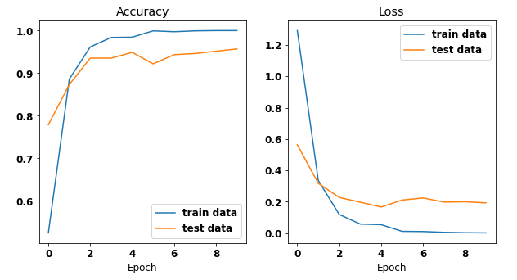
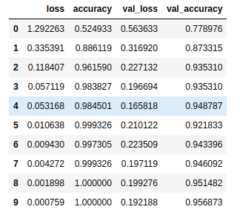
Evaluating the Model
Val-accuracy(TP): 96%
Val_loss(FP): 19%

Slide 4
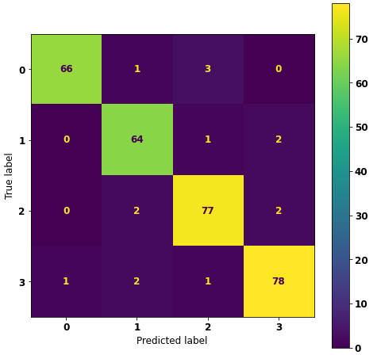
Prediction & Confusion Matrix
300 Test Data
95 % accuracy

Slide 5
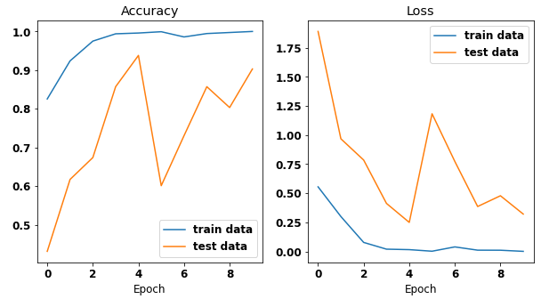
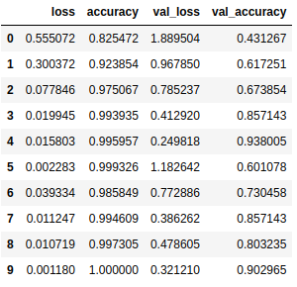
1st Modification Try on CNN
Increasing filters in convolutional layers
6 -> 7
16 -> 17
Increasing neurons in second to last FCL
84 -> 90
Adding Batch Normalization layer before FCL
Worse results:
Val-Accuracy down to 90%
val-loss up to 32%

Slide 6
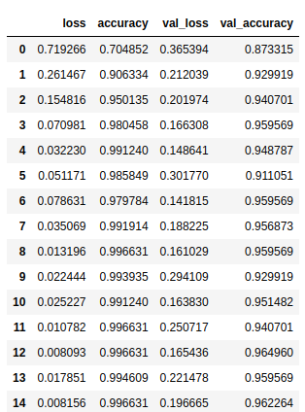
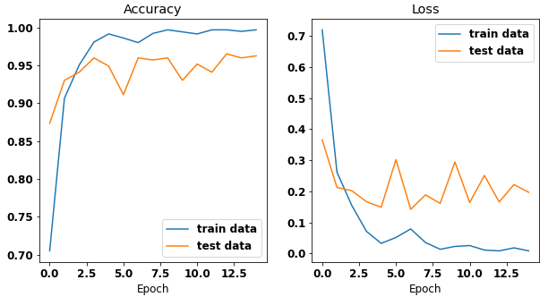
2nd Modification Try on CNN
Increasing epochs
10 -> 15
Adding 2 Dropout(0.2) layers
Same results:
Val - Accuracy: 96%
Val-loss: 20 % (1% increase)
fluctuation

Slide 7
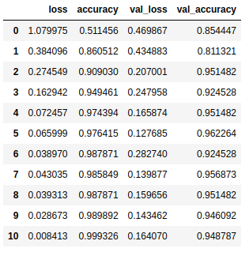
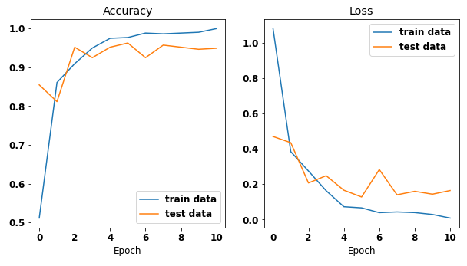
Early stopping for 2nd Modification
monitor = 'val_loss'
patience = 5
restore_best_weights=True
Nice trade off:
Val - Accuracy: 95% (1 % decrease)
Val-loss: 16 % (4% decrease)

Slide 8
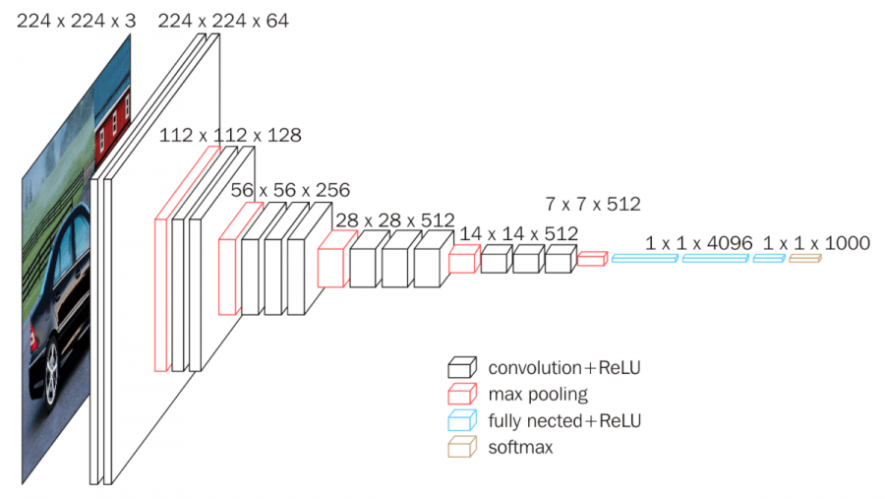
Using Pretrained Model (VGG 16)
23 layers
1 layer input
18 layers feature extraction
13 convolutions
5 maxpooling
4 layers classification
weights -> Image Net: 14 million images

Slide 9
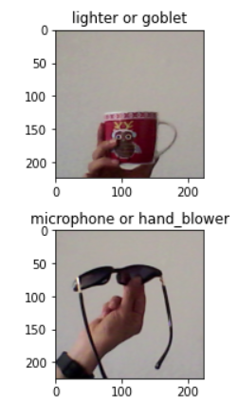
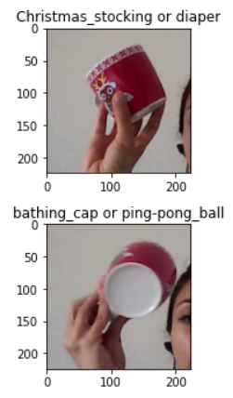
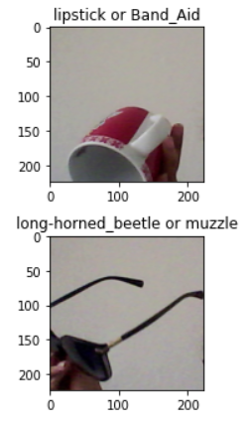

Slide 10
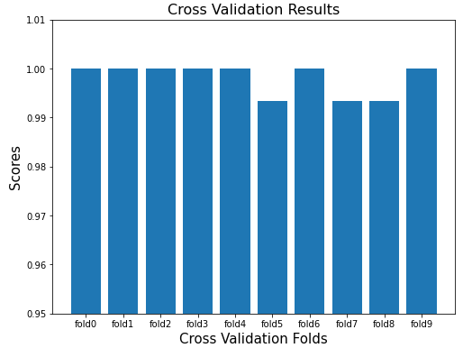
Transfer learning from VGG 16 Model + Logistic Regression
Create a base model with Freezed layers (19 layers = input layer + feature extraction layers )
Predicting features with the base model
Flattening out features vector
Train Test Split (0.3)
Logistic Regression on extracted features
Making predictions
1.0
1.0
1.0
1.0
1.0
1.0
1.0
0.993
0.993
0.993
Accuracy score on train: 1.0
Accuracy score on test: 1.0

Slide 11
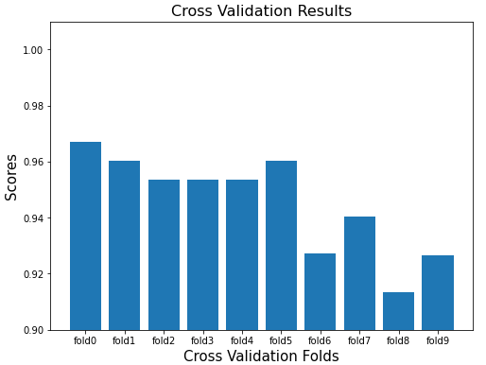
Random Forest
[0.967, 0.960 , 0.954, 0.954, 0.954, 0.960 , 0.927, 0.940, 0.913, 0.927]
Accuracy score on train: 0.958
Accuracy score on test: 0.938

